Slide 1
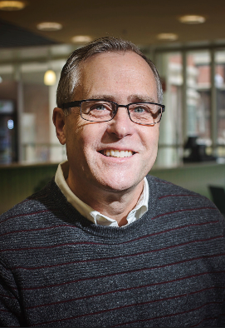
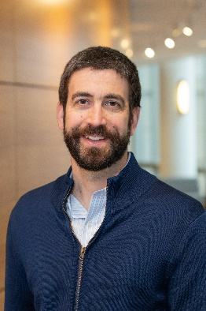
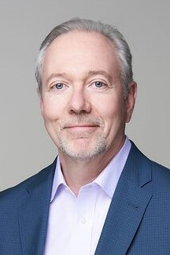
Your Instructors:
I-Corps@NCATS Regional Short Course
**All sessions will be held virtually over zoom.**
Orientation, Expectations & Pre-work (Pick one date)
Mon, 17 Oct (1-1:30pm)
Wed, 19 Oct (10-10:30am)
Week 1: The Approach, Customers & Value
Mon 31 Oct (8:30am to 12:30pm)
Week 2: Workflows & Life Science companies
Wed 02 Nov (8:30am to 12:30pm)
Week 3: Office Hours & Sharing (Pick one date)
Mon 07 Nov (1-3pm)
Wed 09 Nov (1-3pm)
Week 4: Regulatory, Healthcare MVPs & Progress Check
Wed 16 Nov (8:30am to 12:30pm)
Week 5: Office Hours & Sharing (Pick one date)
Mon 28 Nov (1-3pm)
Wed 30 Nov (1-3pm)
Week 6: Final Report-outs & Feedback
Fri 02 Dec (8:30am to 12:30pm)
Mark W. Wilson Simon Business School University of Rochester | Nate Hafer, PhD UMass Chan Medical School | David Eilers Syracuse University Whitman School of Management
What is the business case for your translational science?
Find out via the I-Corps@NCATS Regional Short Course. Based on the National Science Foundation’s Innovation Corps (I-Corps TM) program, the premier federally funded innovation and commercialization training in the U.S. I-Corps@NCATS provides biomedical scientists, clinical scientists and engineers with a new approach to accelerate the translation of discoveries from the lab to clinical practice.
Who should attend?
Teams of faculty, postdocs, and students with biomedical innovations or ideas.
Why should I attend?
The I-Corps@NCATS Regional Short Course hosted by the University of Rochester will help you connect with potential customers for your research projects, protocol, service, or prototype.
Determine the commercial viability of your innovation.
Develop a successful business case for securing funding.
Expand your network of innovation partners, mentors, and potential collaborators.
Develop a new way of thinking about how to value the impact of your research.
Leverage funding to support customer discovery for selected teams.
Please note that attendance is required at ALL sessions. Also, no sessions will be held during Thanksgiving week.
To register, sign up your team by October 3 at https://redcap.link/UR_NCATS_I-Corps_2022 Applicants will be notified of acceptance by October 10th.
For more background information, visit: https://www.uab.edu/ccts/training-academy/trainings/innovation-and-entrepreneurship/i-corps or contact Karen Grabowski at Karen_Grabowski@urmc.Rochester.edu

