Slide 2

Part 1
A dangerous Salmonella infection

Slide 3
Part 1: A dangerous Salmonella infection
1. Each disk contains a different type of antibiotic. Why do six of the antibiotic disks not have a zone of inhibition around them?
2. How many of the antibiotics tested would be effective in treating Ajay’s Salmonella infection?
Support your answer with information from the diagram above.

Slide 4
Part 1: A dangerous Salmonella infection
3. How can you tell that the Salmonella that infected Ajay are antibiotic-resistant Salmonella?
4. Explain why the lab report from Ajay’s tests described the Salmonella that affected him as
“multidrug-resistant” bacteria.

Slide 5
Part 2
The source of the outbreak

Slide 6
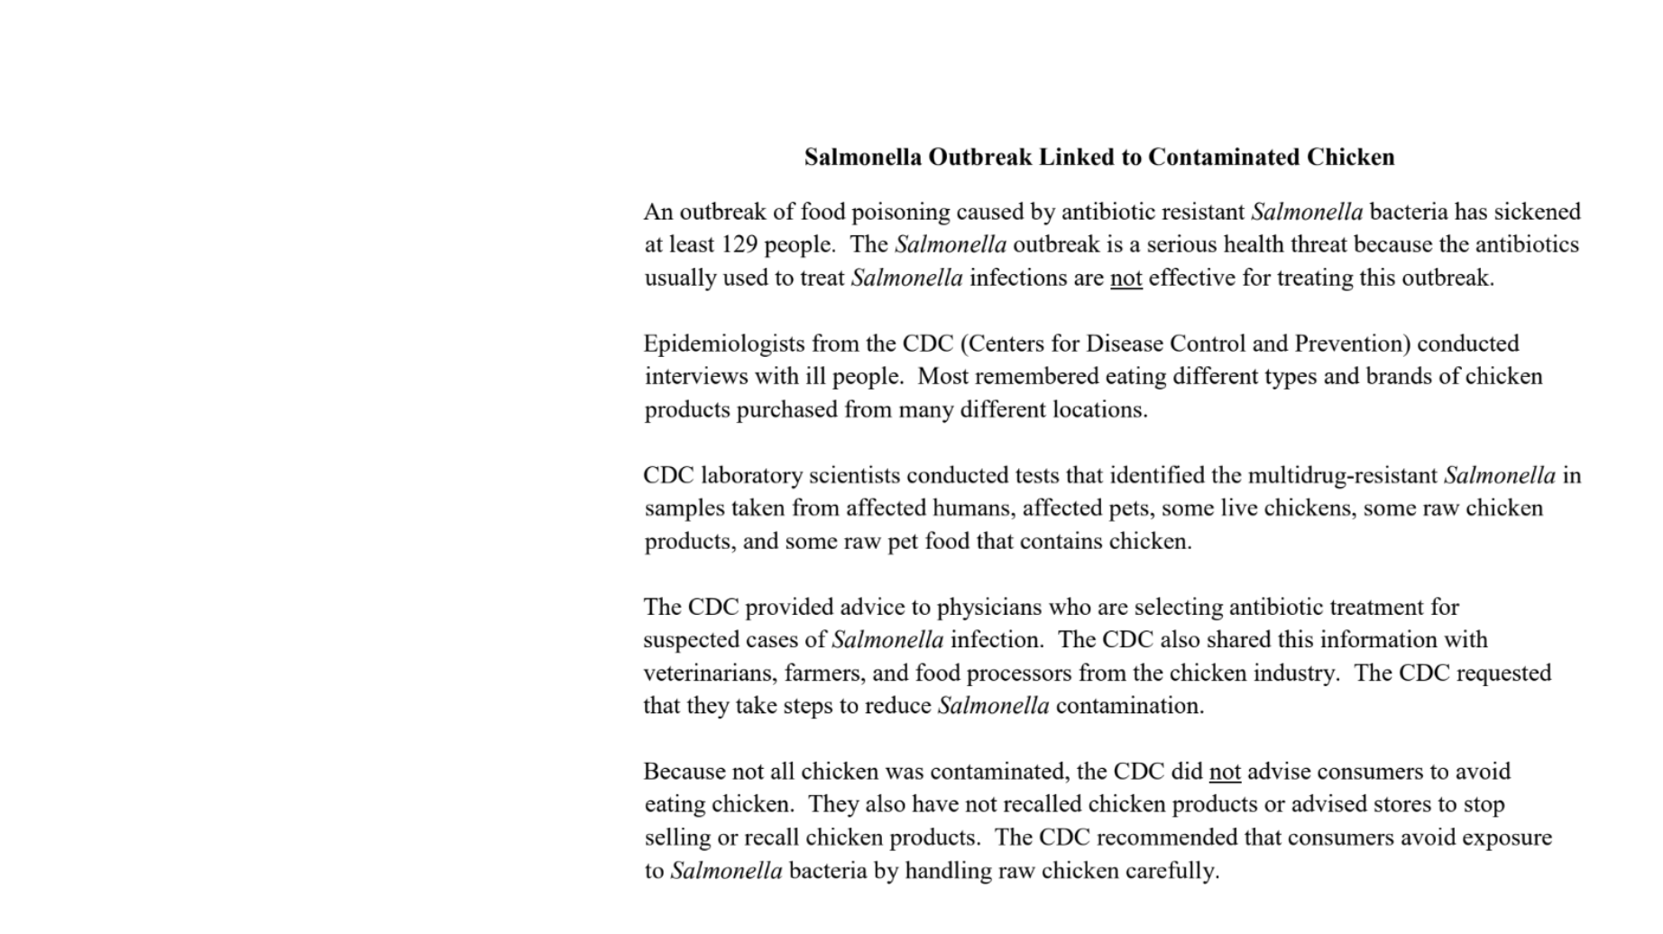
Part 2: The source of the outbreak
Read the news article below. As you read, underline information that would help Ajay understand how he was exposed to the Salmonella that made him sick. Use the circle, box, or line to highlight the important information.

Slide 7
Part 2: The source of the outbreak
5. Explain why “multidrug-resistant” bacteria are dangerous.
6. The news article claims that chickens were the source of Salmonella that caused the outbreak. State two pieces of evidence to support this claim.

Slide 8
Part 2: The source of the outbreak
7. The CDC did not recommend that people stop selling or buying chicken. State two pieces of evidence that support this decision by the CDC.
8. Explain why the CDC provided information about the Salmonella outbreak to veterinarians, farmers, and food processors.

Slide 9
Part 3
How do bacteria become resistant to multiple antibiotics?

Slide 10
Part 3: How do bacteria become resistant to multiple antibiotics
Record color wheel data below. What color did you get on the color wheel?
EXAMPLE: First spin : Black
First spin: | Third spin:
Second spin: | Fourth spin:
Record dice roll data below. What number did you roll? (Write down all attempts if you had multiple attempts.)
EXAMPLE: First roll: 2
First roll: | Third roll:
Second roll: | Fourth roll:

Slide 11
Part 3: How do bacteria become resistant to multiple antibiotics
Record data from steps 1-4 below
Did the Salmonella bacteria get a new antibiotic resistance gene, if so what resistance gene did the Salmonella receive?
What process was used to acquire this resistance gene? Describe the process by which the bacteria obtained the new gene.

Slide 12
Part 3: How do bacteria become resistant to multiple antibiotics
9. How many attempts did it take to become multi-drug resistance? What is it resistant to?
10. If a person becomes infected with Salmonella bacteria like the one that you modelled, what kinds of
antibiotics would be effective for treating the infection? Explain how you can tell.

Slide 13
Part 3: How do bacteria become resistant to multiple antibiotics
9. How many attempts did it take to become multi-drug resistance? What is it resistant to?
10. If a person becomes infected with Salmonella bacteria like the one that you modelled, what kinds of
antibiotics would be effective for treating the infection? Explain how you can tell.

Slide 14
Part 3: How do bacteria become resistant to multiple antibiotics
11. If you are working with other students who have made Salmonella bacteria models, explain how you would identify the Salmonella bacteria model that would be most likely to survive and reproduce in an environment where multiple antibiotics are present.
12. Ajay wanted to know how Salmonella bacteria could become resistant to many different
antibiotics. Explain how it is possible for bacteria to acquire resistance to multiple antibiotics
without relying on the rare and random process of mutations.

Slide 15
Part 4
Natural selection and antibiotic-resistant bacteria

Slide 16
Part 4: Natural selection and antibiotic resistant bacteria
13. What antibiotic resistance genes need to be present in Salmonella bacteria to enable them to survive and reproduce in the chickens that live on this farm?
14. Could the Salmonella bacteria that you modelled survive and reproduce in the intestines of chickens that live on this farm? Look at the cup with beads and the key from Part 3. Explain why or why not.

Slide 17
Part 4: Natural selection and antibiotic resistant bacteria
15. Did the use of antibiotics on the farm cause your Salmonella bacteria to become antibiotic resistant OR was your Salmonella bacteria resistant to antibiotics before the antibiotics were used on the farm? Support your answer with evidence from the model.
16. Natural selection occurs when genes for antibiotic resistance become more common in a population because they increase organisms’ abilities to survive and reproduce. What genes are likely to become more common in the population of Salmonella bacteria that live on the chicken farm?

Slide 18
Part 4: Natural selection and antibiotic resistant bacteria
17. The statements below describe events in the natural selection of bacteria that are resistant to the
antibiotic penicillin. Indicate the order in which the events occurred by writing numbers (2, 3 or 4)
in front of the statements.
___1__ Bacteria in the chickens’ intestines naturally have a variety of antibiotic resistance genes.
______ The bacteria are exposed to erythromycin when chickens drink their water.
______ Erythromycin-resistant bacteria become more common on the chicken farm.
______ Bacteria that are resistant to erythromycin survive and reproduce.

Slide 19
Part 4: Natural selection and antibiotic resistant bacteria
Review Part 4 cartoon or use the summary the summary below to answer questions 20 and 21
on the next slide.
To prevent respiratory diseases in young chickens on his farm, farmers add an antibiotic called erythromycin to the water that the chickens drink. When the antibiotic erythromycin is used, only bacteria that have erythromycin resistance genes will survive.
To prevent intestinal diseases in young chickens on the farm, the farmer uses chicken feed that contains an antibiotic called ciprofloxacin. When ciprofloxacin is used, only bacteria that have ciprofloxacin resistance genes will survive.
Animals in large industrial farms produce large quantities of manure - liquid (urine) and solid (feces) wastes. These wastes contain many different kinds of bacteria and viruses. Animal manure is often stored in open pits called “manure lagoons.”
Manure lagoons are ideal places for bacteria reproduction. As the bacteria reproduce, they are exposed to low levels of antibiotics from the feces of animals that were treated with antibiotics. They are also surrounded by sources of antibiotic resistance genes such as viruses, free-floating antibiotic resistance genes, and other types of bacteria that are antibiotic resistant. This can result in new bacteria that are resistant to many different kinds of antibiotics. Wastes from manure lagoons may be used to fertilize fields or may be accidentally released into nearby water sources.

Slide 20
Part 4: Natural selection and antibiotic resistant bacteria
18. Describe what conditions in a manure lagoon are likely to result in the evolution (natural selection)
of new antibiotic-resistant bacteria.
19. Describe two ways that people might be exposed to antibiotic-resistant bacteria from manure
lagoons.

Slide 21
Part 5
The spread of antibiotic-resistant bacteria

Slide 22
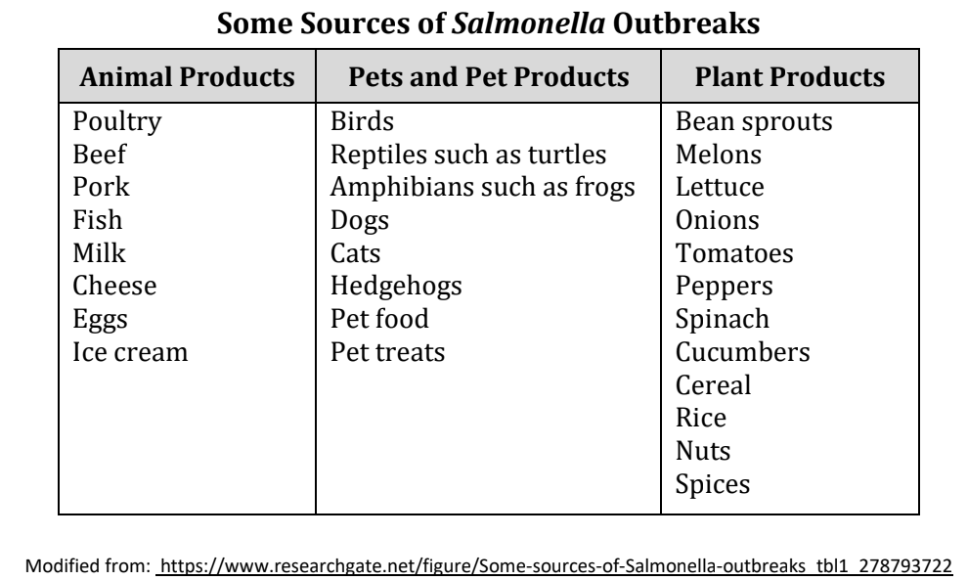
Part 5: The spread of antibiotic-resistant bacteria
20. Does the information on the chart support Ajay’s claim that outbreaks of Salmonella could be prevented by banning the sale of animal products from farms that use antibiotics? Support your answer with information from the chart.

Slide 23
Part 5: Natural selection and antibiotic resistant bacteria
There are many ways that Salmonella can spread between humans, animals, and the environment. The six statements (A-F) listed below describe some of the ways that antibiotic-resistant bacteria such as Salmonella can spread between humans, animals, and the environment.
A. Antibiotic-resistant bacteria from humans can enter waterways if they are not completely removed by waste sanitation systems.
B. Farm animal manure applied to fields spreads antibiotic-resistant bacteria to soil and water.
C. Crops can be contaminated by antibiotic-resistant bacteria in soil and water.
D. Foodborne transmission of antibiotic-resistant bacteria to humans is a common route the spread to humans.
E. Antibiotic-resistant bacteria enter humans when they drink contaminated water.
F. Contact with pets and wildlife can transmit antibiotic-resistant bacteria to humans.
21. On the next slide, Drag arrows from the KEY on to the How Antibiotic-Resistant Bacteria Spread picture to represent each of the six statements (A-F). Then, drag letters B-F on to the picture to label the arrow with the letter of the statement that it represents.
Note: As an example, the first statement has been shown on the picture using a red arrow and red “A”.

Slide 24
B
C
D
E
F

Slide 25
Part 5: The spread of antibiotic-resistant bacteria
22. Look at the arrows you drew on the How Antibiotic-Resistant Bacteria Spread picture. These arrows represent processes/routes that spread antibiotic-resistant bacteria. Suggest one way to block a process/route and present the spread of antibiotic-resistant bacteria to each of the following:
Humans:
Animals (pets or wildlife):
The environment (soil, water, plants, or air):

Slide 26
Part 6
One Health and antibiotic-resistant bacteria

Slide 27
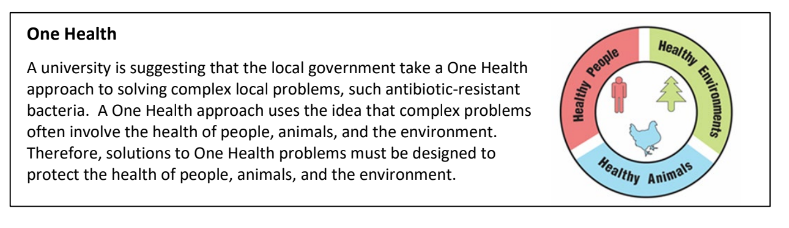
Part 6: One Health and antibiotic resistant bacteria
23. Use the information in the text box above to explain what must be involved in a complex problem for it to be considered a One Health problem.

Slide 28
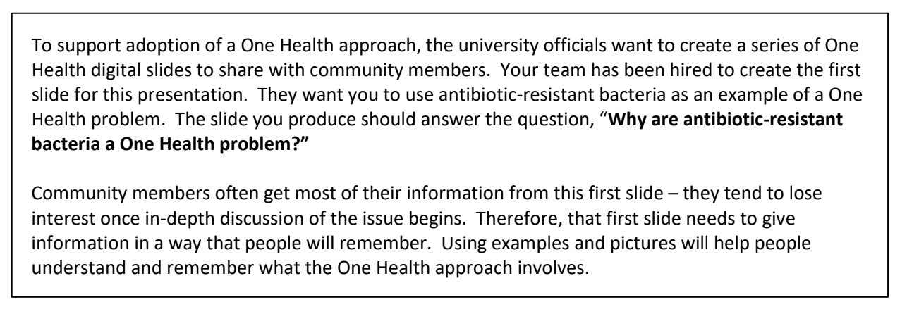
Part 6: One Health and antibiotic resistant bacteria
24. Use the information in the textbox above and what you learned about antibiotic-resistant bacteria to develop your digital slide. The following template (in the next slide) may help you organize your digital slide:

Slide 29
Part 6: One Health and antibiotic resistant bacteria
Use this template link to create your own digital slide
Why are antibiotic-resistant bacteria a One Health problem?
1-2 sentences that answer the question | Picture with brief caption
Picture with brief caption | Picture with brief caption

Slide 30


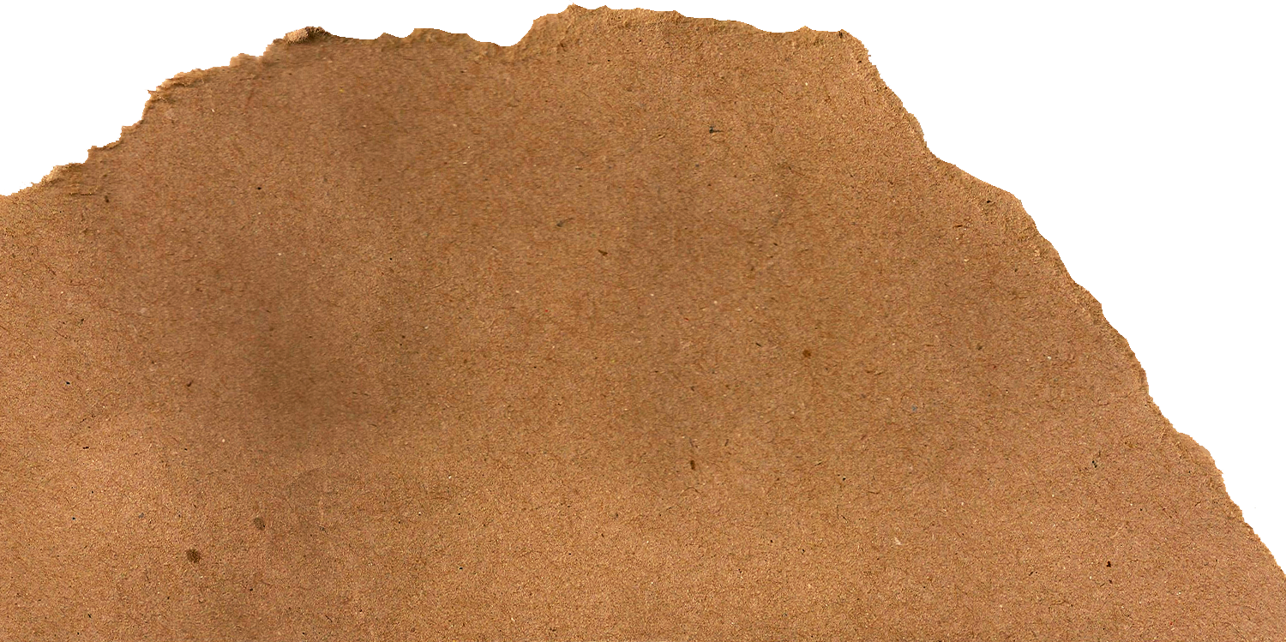
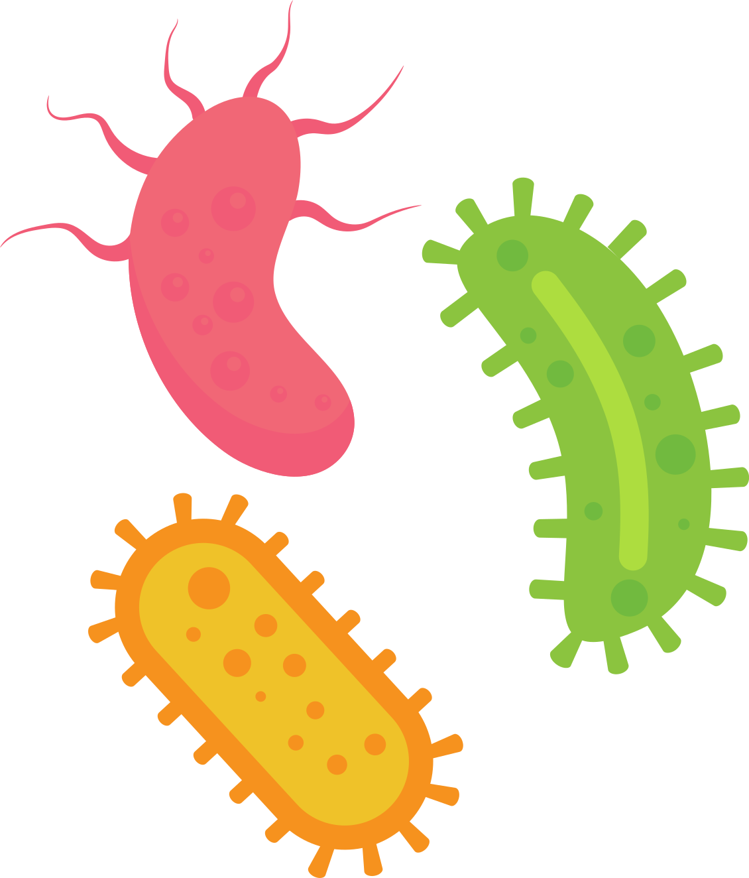



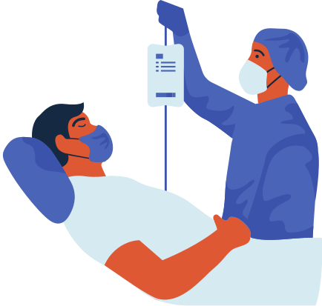




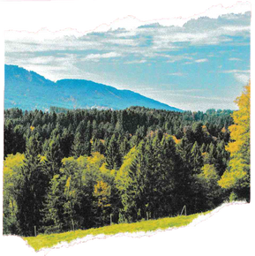

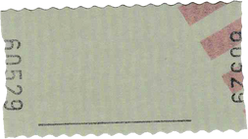


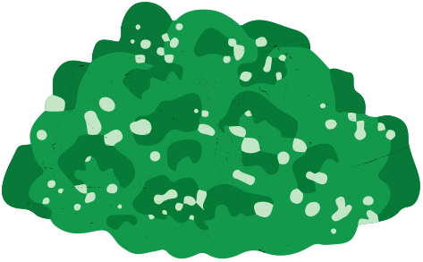






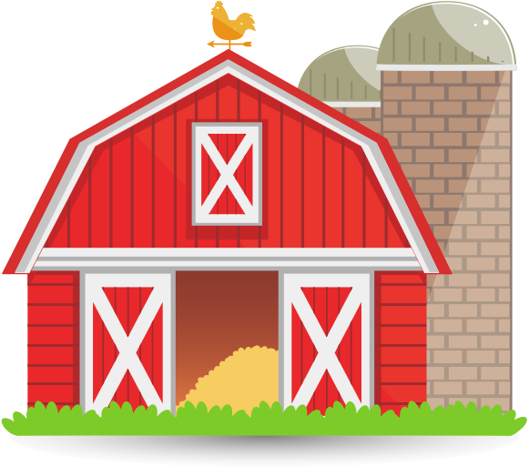

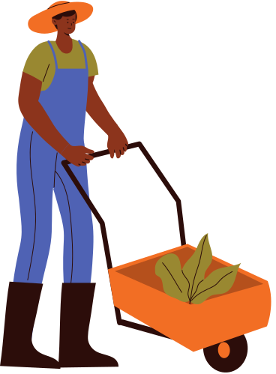

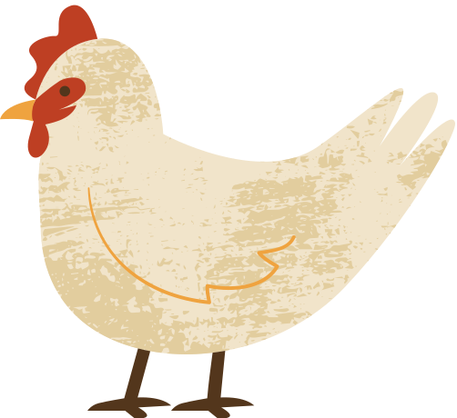
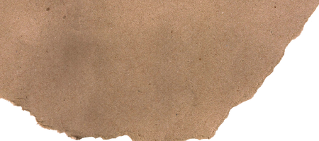


Resource Page
Use the layout in the template on the next slide or use these images to personalize your Digital Slide design.
Delete this slide before sharing with others!

Slide 31




Why are Antibiotic-Resistant Bacteria a One Health problem?
  Type 1 sentence that answers the question here
  Delete text or Type additional sentences that answer the question here
  Delete text or Type additional sentences that answer the question here
Picture 1. Make a title for your figure and type here.
Insert
Picture 1
Here
Type a brief caption for the picture here
Picture 1. Make a title for your figure and type here.
Insert
Picture 1
Here
Type a brief caption for the picture here
Picture 1. Make a title for your figure and type here.
Insert
Picture 1
Here
Type a brief caption for the picture here
Digital Slide created by: Type your name here

Slide 32
Create your own...

Slide 33

Antibiotic-Resistant Bacteria
Digital Lab Student Evaluation Form.
CLICK HERE
To complete and submit your feedback
Notes:
Now that you have finished, discuss your responses to Part 6 with your teacher(s), classmates, and others who may be learning about One Health concepts. Perhaps others have thought of similar ideas to the ones you shared. Alternatively, you could learn new things that you had not thought of before. Continue learning and enjoying investigating your responses more using the resources from this field trip.
Also if you want to help our Virtual Field Trip programs, return to the virtual field trip website (use the CLICK HERE on the slide) and complete the survey questions . We value your feedback.

Slide 34
Additional Notes

Slide 35
Additional Notes

Slide 36
Additional Notes

