Slide 1

Not Vaccinated?
Copyright © 2023 by University of Rochester

Slide 2

In the Monk County School District, only 34% of students aged 5 to 11 and 62% of students aged 12-17 have received two doses of a COVID-19 vaccine. Less than 32% of the older students have received the booster dose recommended for greater protection against COVID-19.

Slide 3
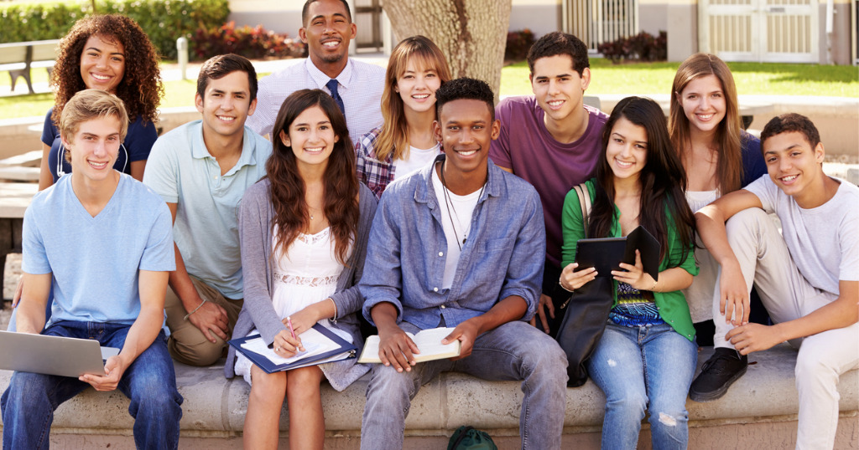
The board of education for the Monk County School District recognizes that students under the age of 18 need parental or guardian approval before they can be vaccinated. A team of high school students has volunteered to develop a program to encourage parents to have their children vaccinated against COVID-19.

Slide 4
Part 1: Listening
To begin the program, the high school students thought it was important to listen to parents explain why they chose to not have their children get vaccinated to protect them from COVID-19.
1. Make a list of reasons why parents might not have their children vaccinated.
2. The team of students wants to create a program to encourage people to have their children vaccinated. Why do you think the team thought it was important to begin the program with parents’ reasons for not having their children vaccinated?

Slide 5
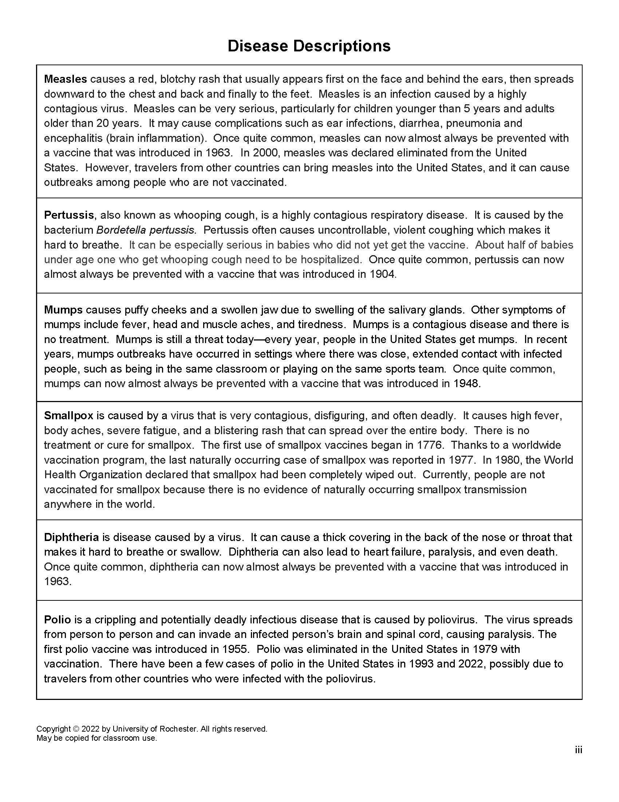
Part 2: Vaccines make a difference
The students on the program planning team decided to first focus on how childhood vaccines had been important in protecting children from dangerous diseases. They found information about diseases that could result if children did not receive the usual recommended childhood vaccines.
Read the Disease Descriptions sheet that describes what it would be like to have the following diseases. As you read the information on each disease:
“X” = disease you had when you were a child
“X” = you know someone who had the disease

Slide 6
Deaths in the United States Due to
Vaccine Preventable Diseases
2. Summarize the main trend or
pattern that you observe in the
data table on the right.
3. Why do you think we no longer see
widespread outbreaks of these
diseases in the United States?
4. What actions could people take to
prevent widespread outbreaks of
COVID-19?
Disease | Before 1900 Average Deaths Per Year | Deaths Reported in 2019
Measles | 530,217 | 1,287
Pertussis | 200,752 | 15,662
Mumps | 162,344 | 3,509
Smallpox | 29,005 | 0
Diphtheria | 21,053 | 2
Polio | 16,316 | 0

Slide 7
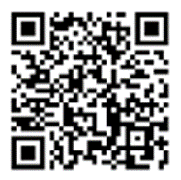
4. What actions could people take to prevent widespread outbreaks of COVID-19?
For more information about diseases that may be prevented by vaccines, see this website:
14 Diseases You Almost Forgot About

Slide 8
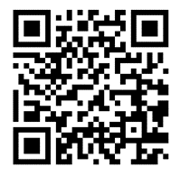
Part 3: Understanding herd immunity
One of the students thought that they should use a video that modeled the spread of COVID-19 in a community.
View the video using your computer, phone, or tablet. Mute the video sound so that you do not disturb your classmates.
Video:
Model How Herd Immunity Works

Slide 9
What color domino represents:
  A person who was sick with COVID-19
  A person who is not immune to COVID-19
  A person who is immune to COVID-19
What does a yellow domino falling over mean?
State two ways that a person could become immune
to COVID-19.

Slide 10
4. Herd immunity (or community immunity) occurs when a high percentage of a community is immune to a disease (through vaccination and/or prior illness).
Explain how the model in the video illustrates how herd immunity can slow or stop the spread of COVID-19.

Slide 11
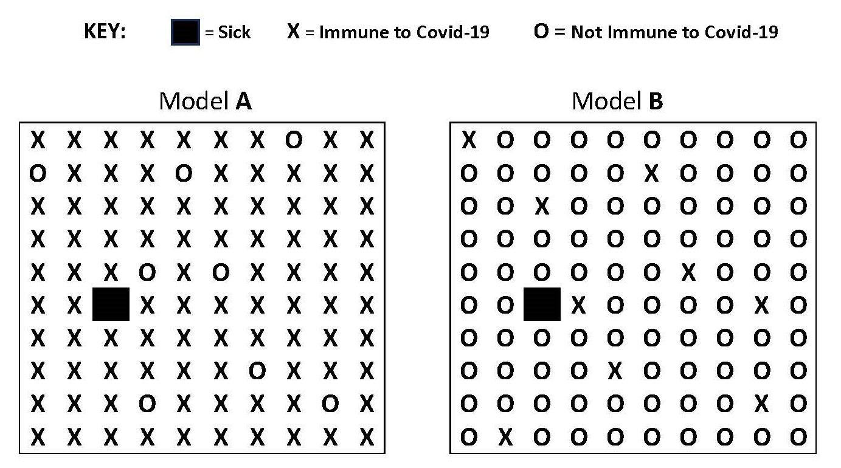
Another student made two diagrams to model how herd immunity could slow or stop the spread of COVID-19. These models are shown below.

Slide 12
5. Which model (A or B) represents a community with herd
immunity? Explain why you chose that answer.
6. Explain why it would be difficult for COVID-19 to spread in the
model that you selected.
7. Based on your experience with the video of the dominoes
and the models of A and B, explain how herd immunity can
slow the spread of COVID-19.
8. Children younger that 6 months should not be given
COVID-19 vaccines. COVID-19 vaccines may not be effective
for people with immune systems that do not work properly.
Explain why herd immunity is important for these people.

Slide 13
4. Based on your experience with the models, explain how herd
immunity can slow the spread of COVID-19.
5. People can become immune to COVID-19 in two ways – by
getting vaccinated or by actually getting the disease. Which
method do you think is safer for members of the community?
Support your answer with an explanation.

Slide 14
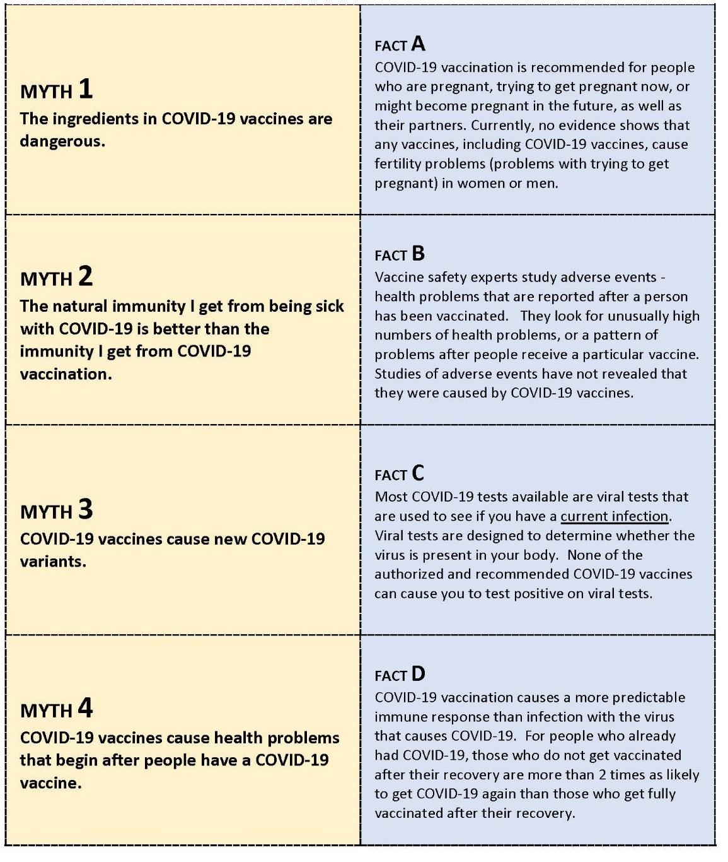
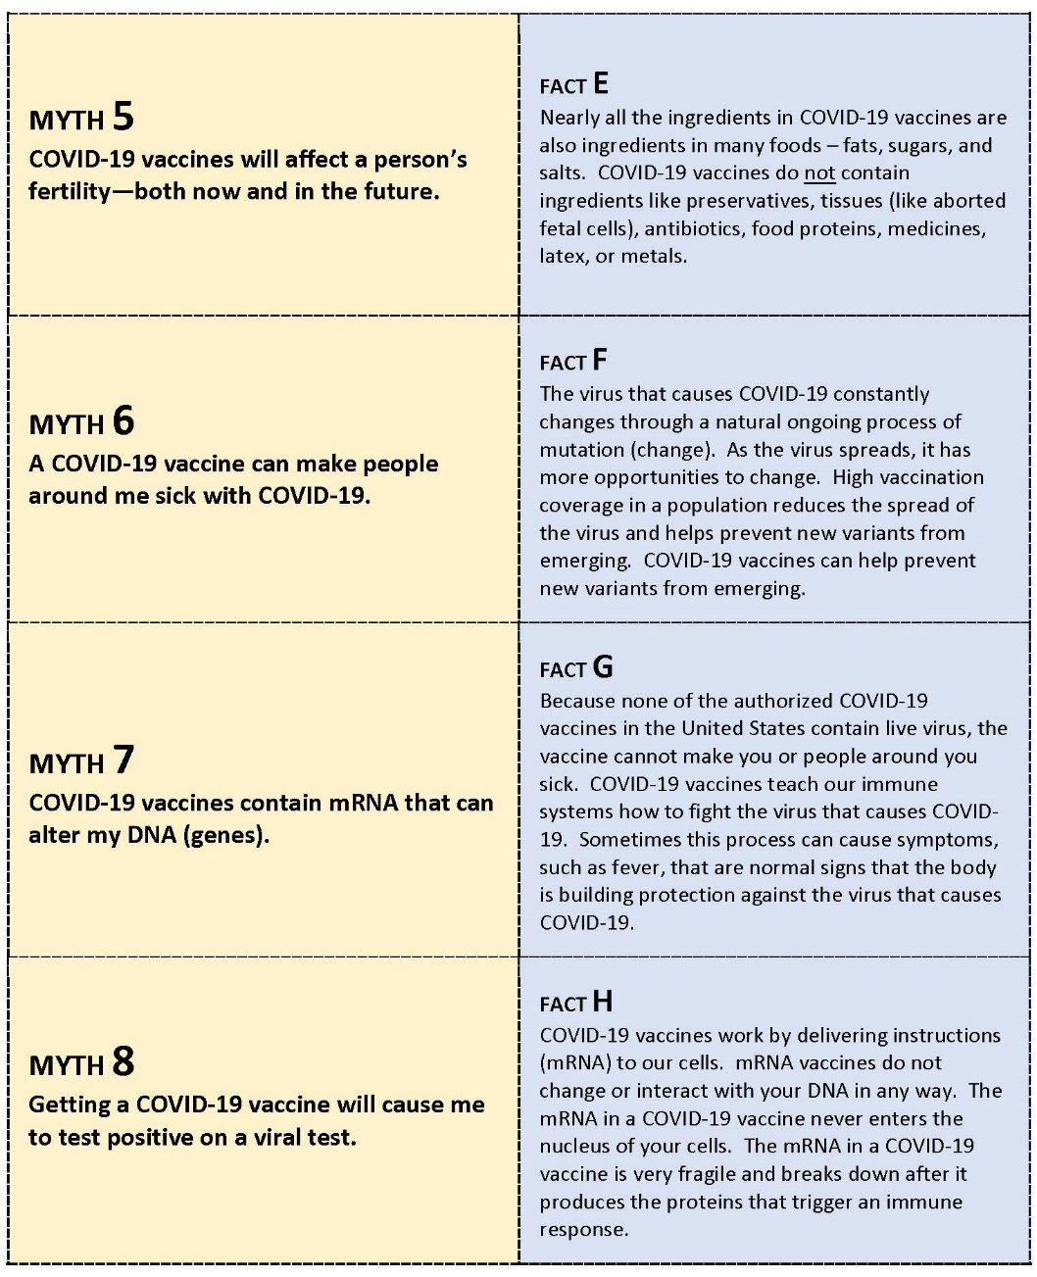
Part 3: COVID-19 Vaccine Myth Busters
Myths and rumors may affect people’s willingness to get vaccines. Students on the program planning team created a card matching activity with accurate COVID-19 vaccine facts to help stop common myths and rumors.
The statements on the yellow Myth cards represent some common myths about COVID-19 vaccines. The blue Fact cards summarize facts that could be used to dispel (“bust”) the myths.

Slide 15
Work with your partner to match the yellow Myth cards with the appropriate blue Fact card.
For each of the yellow Myth card numbers below, write the letter on the matching blue Fact card.
1 ____ 2 _____ 3 _____ 4 _____ 5 _____ 6 _____ 7 ____ 8 _____

Slide 16
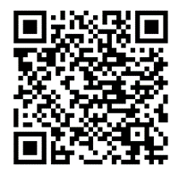
4. Describe another reason why parents might think that the
COVID-19 vaccine is not safe for their children.
5. Do some research to find out if your answer in question 4 is a
myth or a fact. Summarize the results of your research. Cite the
source for the results of your research.
The students used this information from the CDC (Centers for Disease Control) to make their Myth and Fact cards.
Myths and Facts about COVID-19 Vaccines

Slide 17
Part 4: Where are free COVID-19 vaccines available?
The students on the program planning team knew that people are more likely to get their children vaccinated if they can find free COVID-19 vaccines that are offered at convenient places and at convenient times. The program planning team will use internet resources to identify sites appropriate for the participants in their community.
Help the planning team find possible locations where free COVID vaccines are available at convenient locations near your home.

Slide 18
2. Provide information on two locations near your home or
school that give free COVID-19 vaccines. For each location,
include the website, location address, distance from your
home/school, hours that vaccines are available, and whether
an appointment is needed.
3. Some people do not have computer skills/access or language
skills to schedule appointments for vaccinations. What ideas
do you have for ways to help these people get their family
members vaccinated?

Slide 19
4. Some vaccine locations offer only one kind of COVID-19 vaccine. Are all COVID-19 vaccines currently available in the United States safe for children? Do internet research to answer this question. Provide the website for your information source.

