Slide 1
How Do mRNA Vaccines Work?
Copyright © 2023 by University of Rochester

Slide 2
Some people are hesitant to get a COVID-19 vaccine because they do not understand how the new mRNA vaccines work. You and your partner will make models and take photos that could be used to help people understand how mRNA vaccines work. You will use the models and photos to create a slide show that could be used to educate the community about mRNA vaccines.

Slide 3


Slide 4
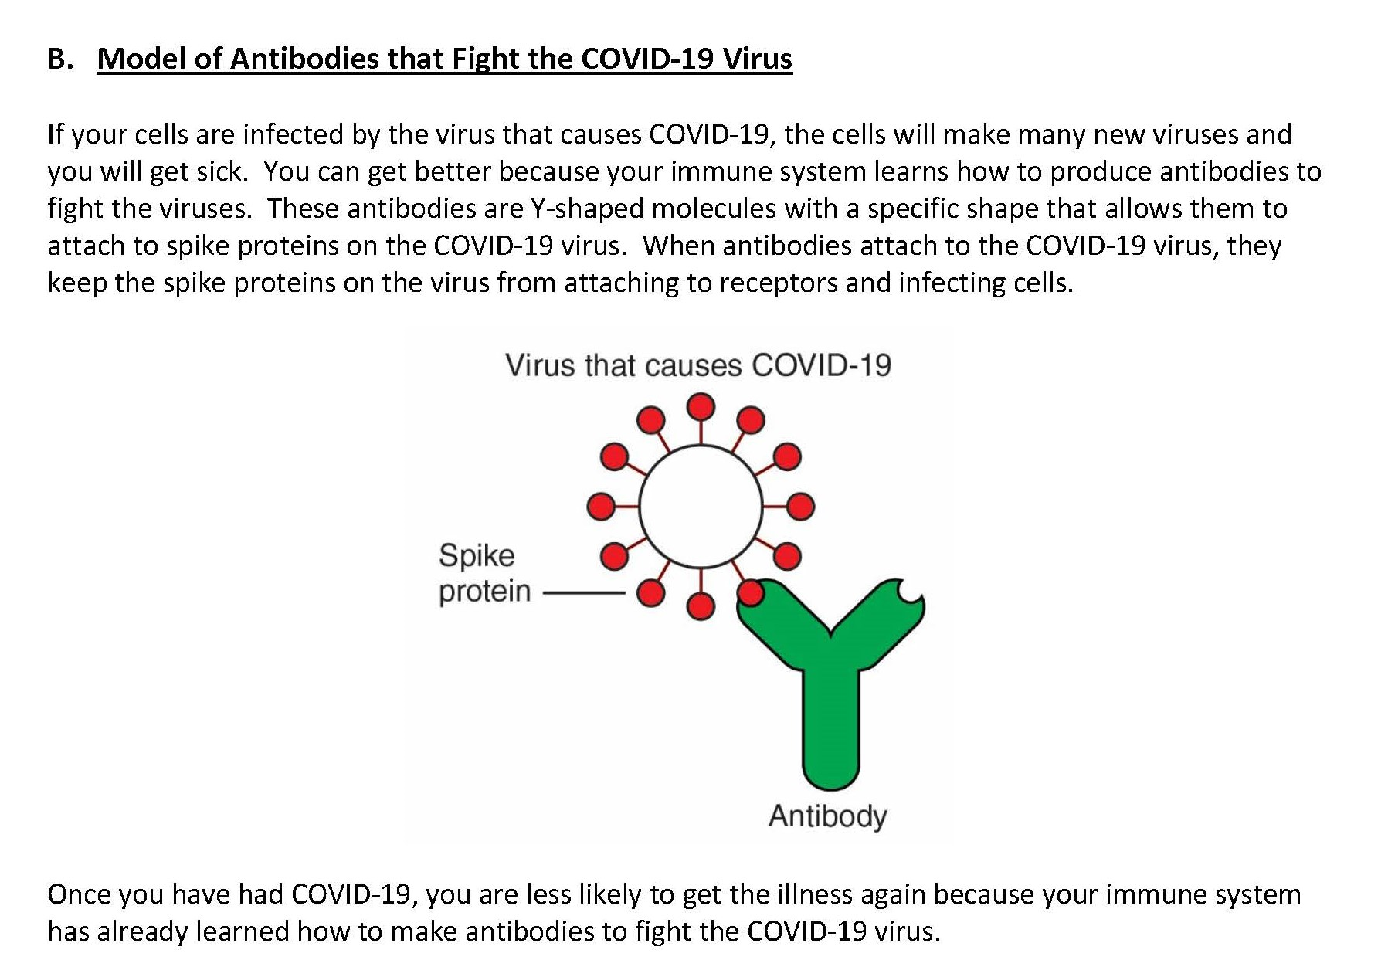

Slide 5
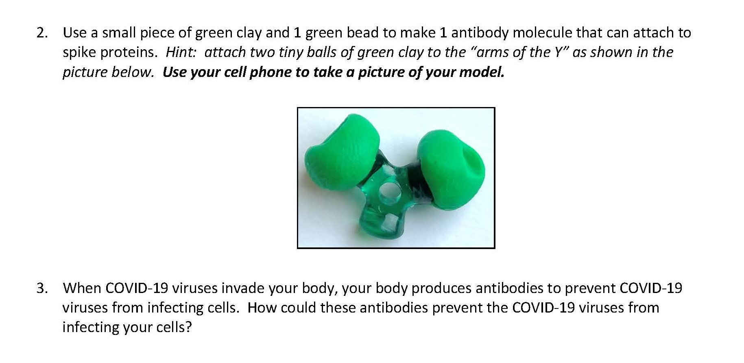

Slide 6
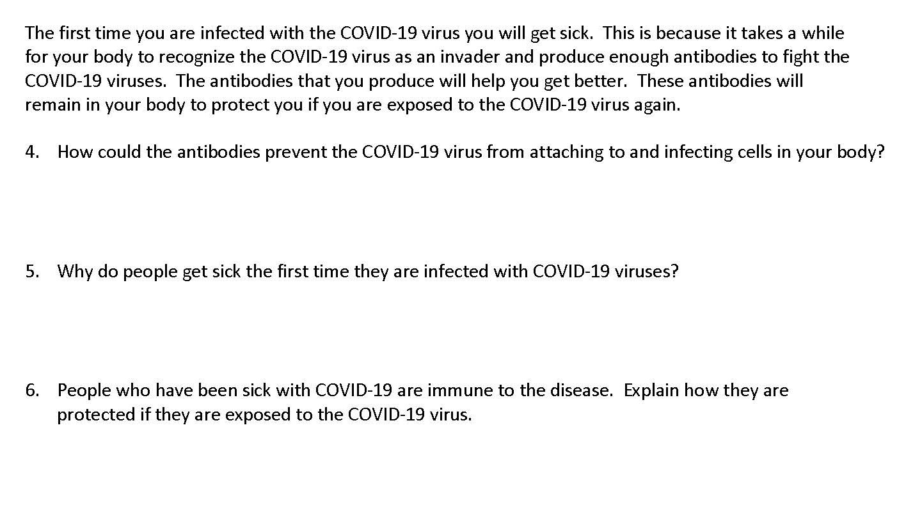

Slide 7


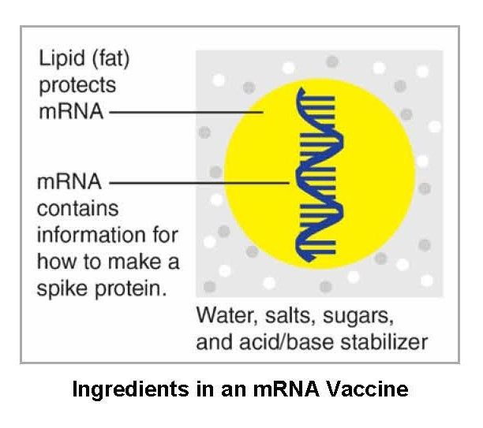

Slide 8
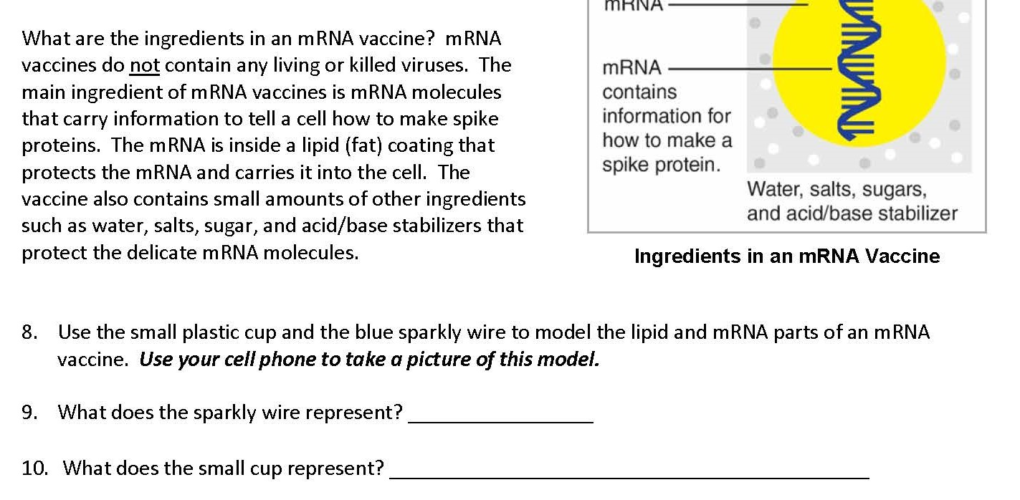

Slide 9


Slide 10
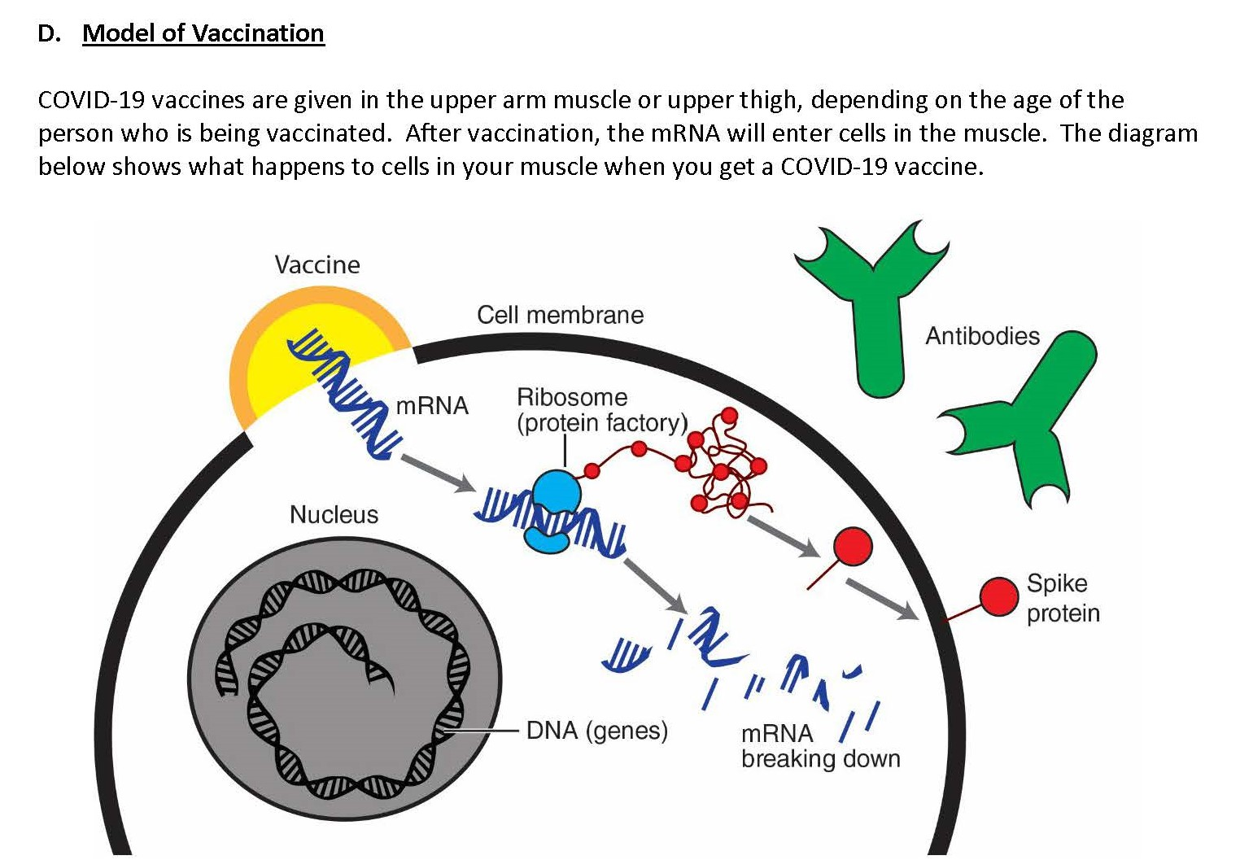

Slide 11

Cell in Muscle

Slide 12
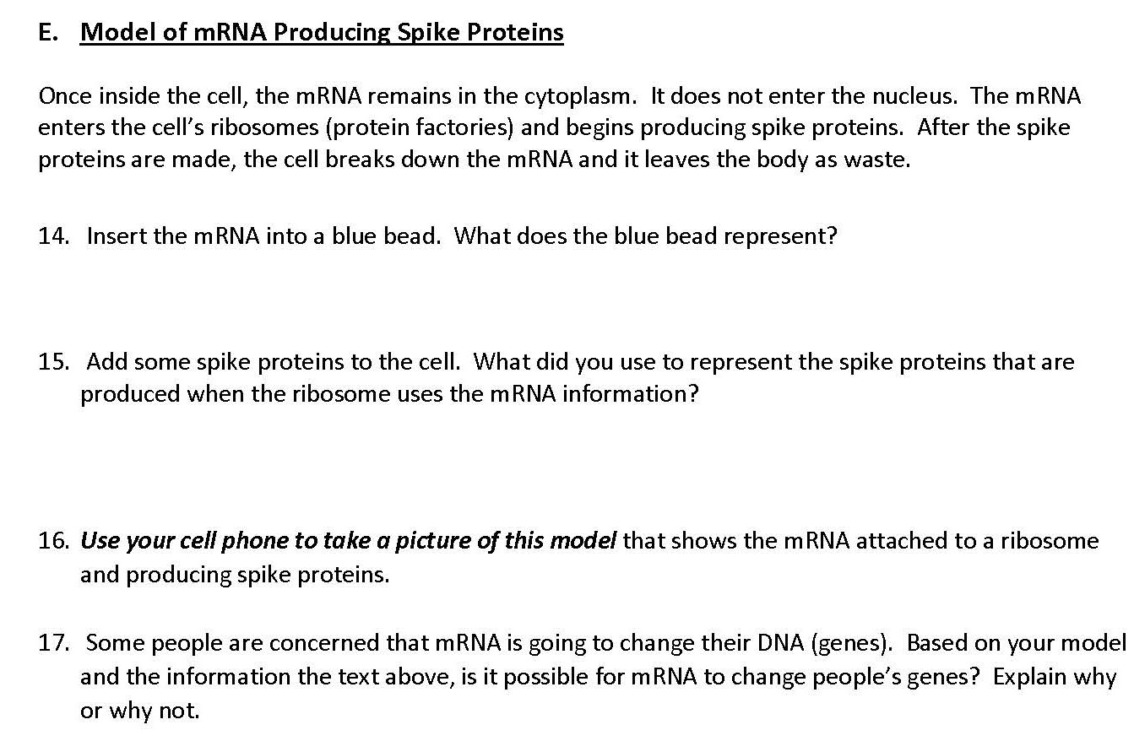

Slide 13
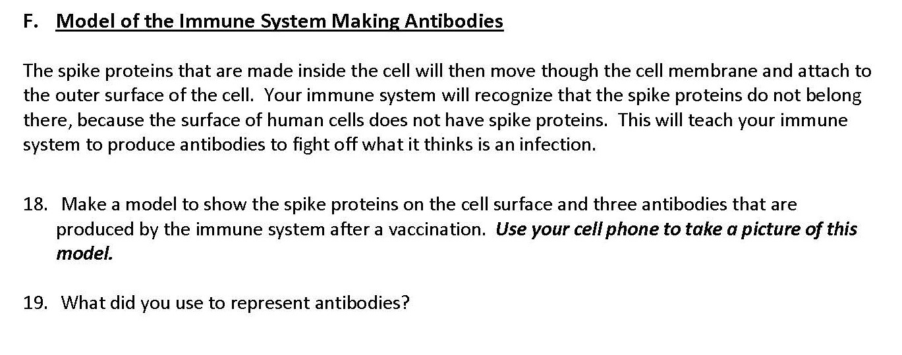

Slide 14
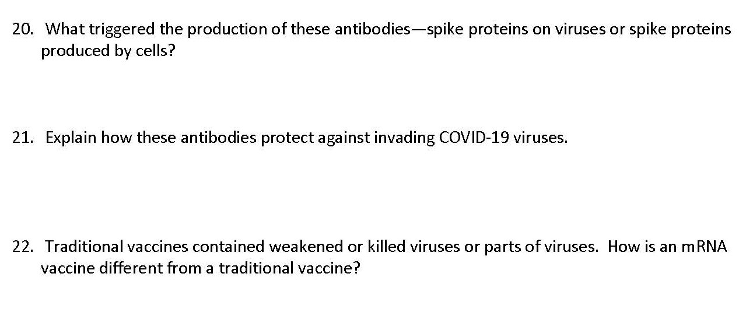

Slide 15
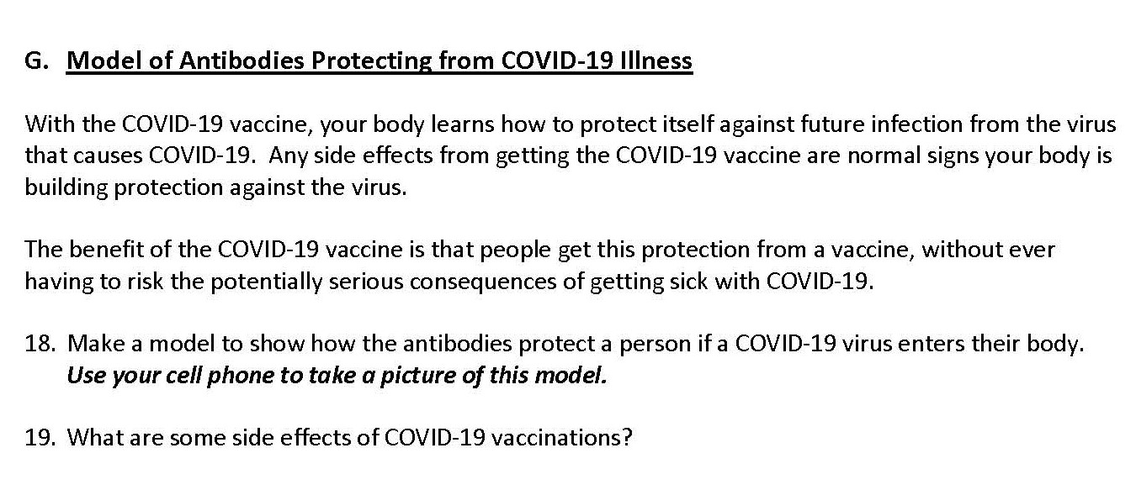


Slide 16
