Slide 1
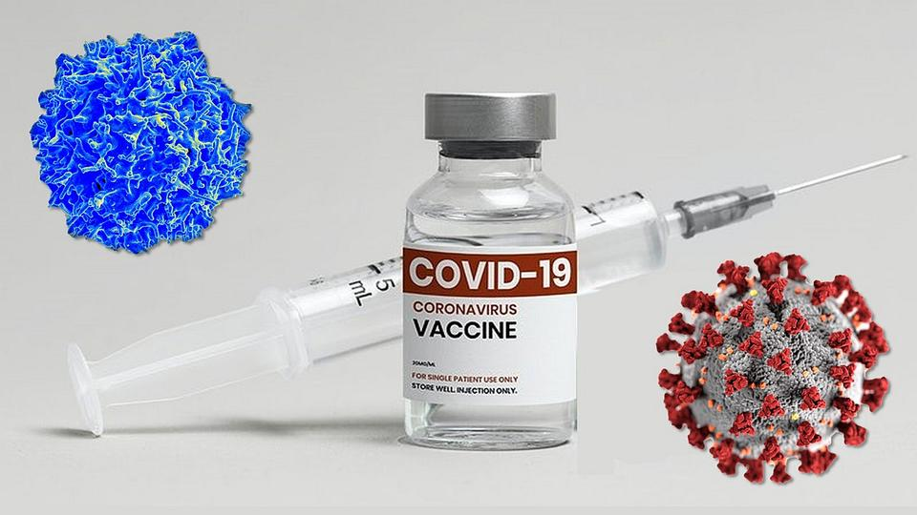
At Risk for COVID-19?
Copyright © 2023 by University of Rochester

Slide 2
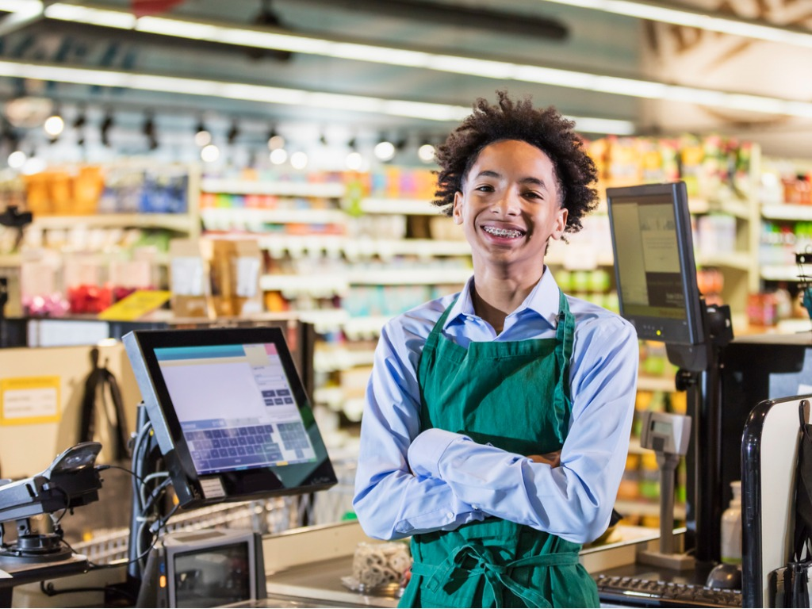
Part 1: Why was Sam not vaccinated?
Sam Robinson, a 16-year-old cashier at the Town Market grocery store, left work early four days ago. He had a bad headache, his arms and neck ached, and he had a fever. Sam’s friends suspect that he has COVID-19. They know that Sam did not get the COVID-19 vaccine. The grocery store manager told Sam that he could not return to work until he had a negative COVID-19 test.
Work with your partner. Make a list of four explanations
that Sam might give for why he did not get the COVID-19 vaccine.

Slide 3
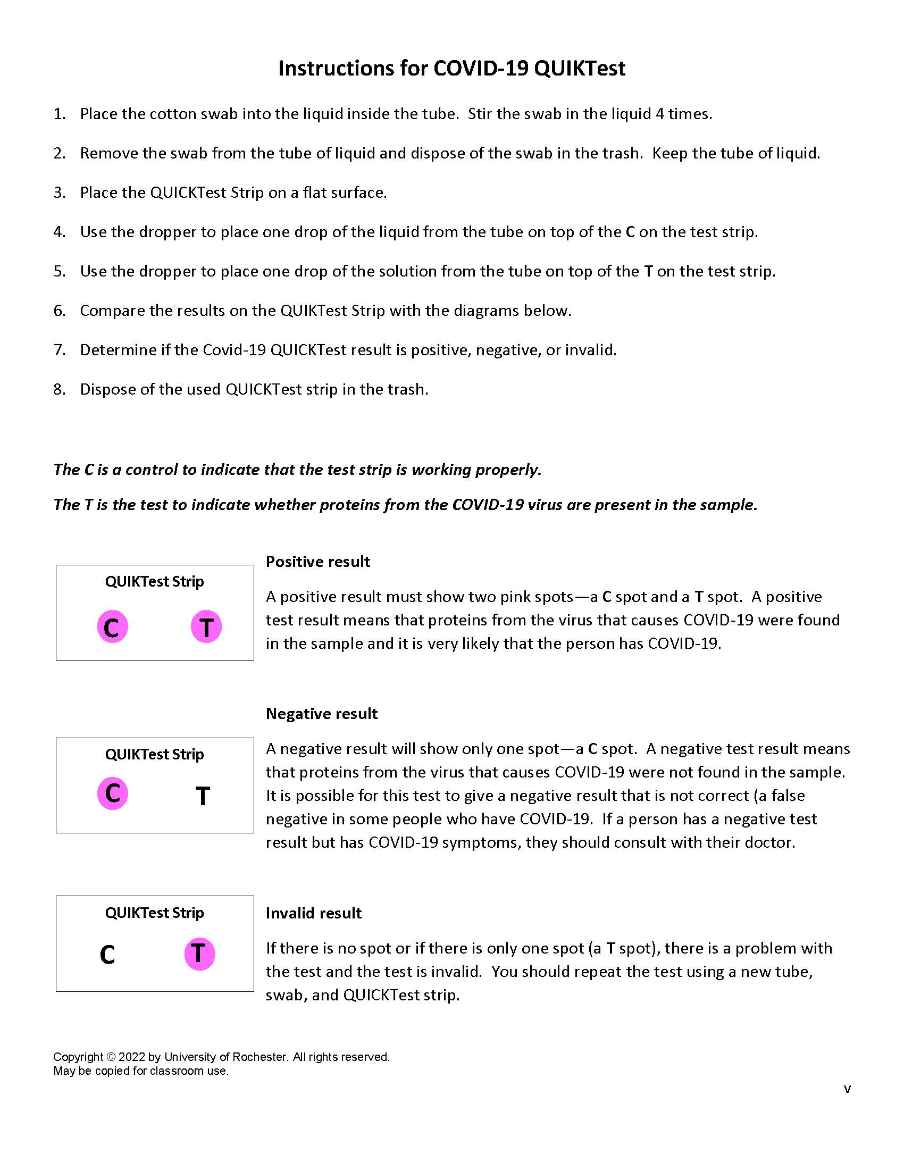
Part 2: Does Sam have COVID-19?
The cotton swab in the bag labeled “Sam Robinson” has a sample of nasal (nose) secretions from Sam.
Follow the COVID-19 QUIKTest
Instructions sheet to test
Sam’s sample.

Slide 4
2. Does Sam have COVID-19? Explain how you could tell.
3. Based on the results of Sam’s COVID-19 test, could
Sam have put other people at risk for getting
COVID-19? Explain why or why not.

Slide 5
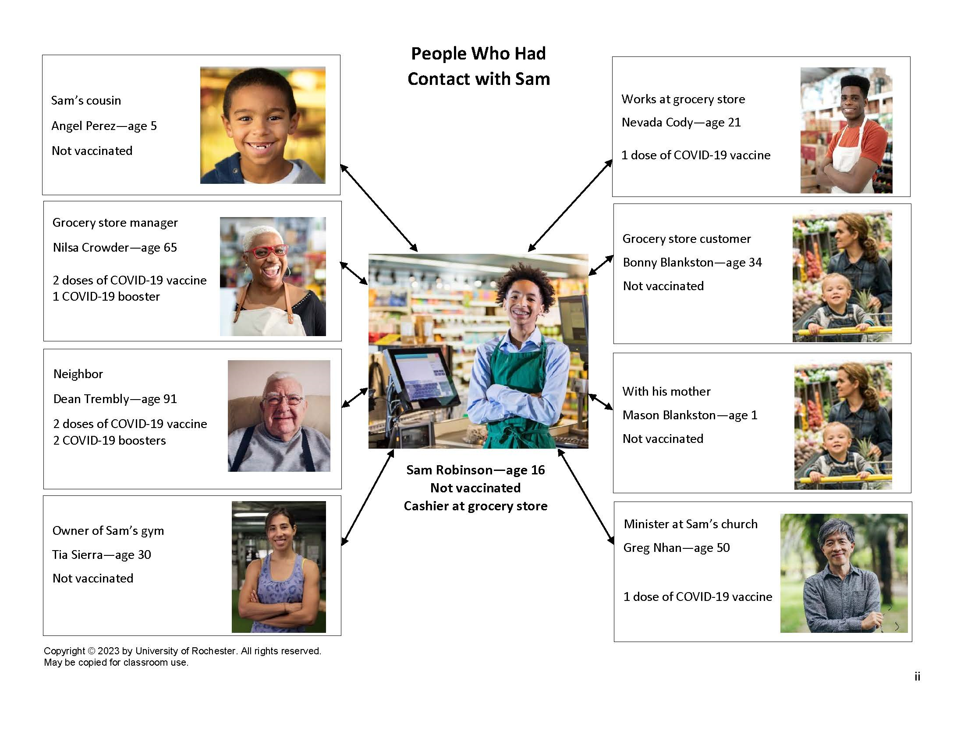
Part 3: Who is likely to be hospitalized for COVID-19?
The People Who Had Contact with Sam sheet shows eight
people who had contact with Sam the day before he started
having symptoms for COVID-19. How at risk are each of these people for becoming very sick and hospitalized if they get COVID-19?

Slide 6
Use the beads to predict each person’s risk for becoming
very sick and hospitalized. Refer to the Key for Beads.
Red = likely Purple = somewhat likely Blue = not likely

Slide 7
2. Explain what things you considered when
predicting the person’s risk for becoming very sick
and hospitalized if they get COVID-19.
3. What kinds of additional information would help you
decide which people are more at risk of being
hospitalized if they get COVID-19?

Slide 8
Part 4: Who is at risk if they get COVID-19?
The Health Information Cards provide information on each person’s health. Match the cards with the people on the People Who Had Contact with Sam sheet. Place each Health Information card next to the appropriate person.
2. Circle the names of the people who are “at risk” being
hospitalized if they get COVID-19.
Angel Perez Nevada Cody
Nilsa Crowder Bonny Blankston
Dean Trembly Mason Blankston
Tia Sierra Greg Nhan

Slide 9
3. Could you tell just by looking at pictures of the
people whether getting COVID-19 will be dangerous
for them? Explain why or why not.
4. What things could “at risk” people do to avoid
getting COVID-19?
5. What things could you do to protect “at risk”
people from getting COVID-19?

Slide 10
Part 5: COVID-19 testing
COVID-19 affects different people in different ways. People infected with COVID-19 have reported a wide range of symptoms – from mild symptoms to severe illness. Symptoms of COVID-19 may appear between 2-14 days after exposure to the virus. People with these symptoms may have COVID-19. However, these symptoms could also be the result of other diseases such as a cold, the flu, or allergies.

Slide 11
It is approximately one week after the eight people were in contact with Sam. All eight of the people have developed several symptoms of COVID-19. Explain two reasons why they should be tested to see if they have COVID-19.
2. The cotton swab in the bag has a sample of nasal (nose) secretions
from one of the eight people who were in contact with Sam. Write
the name of the person who you will be testing on the line below.
___________________________________________
3. Follow the COVID-19 QUIKTest Instructions to test that person’s
sample for COVID-19.
4. Record the results of the COVID test for the person you tested in the appropriate row on the Results of COVID-19 Testing chart on the next page.

Slide 12
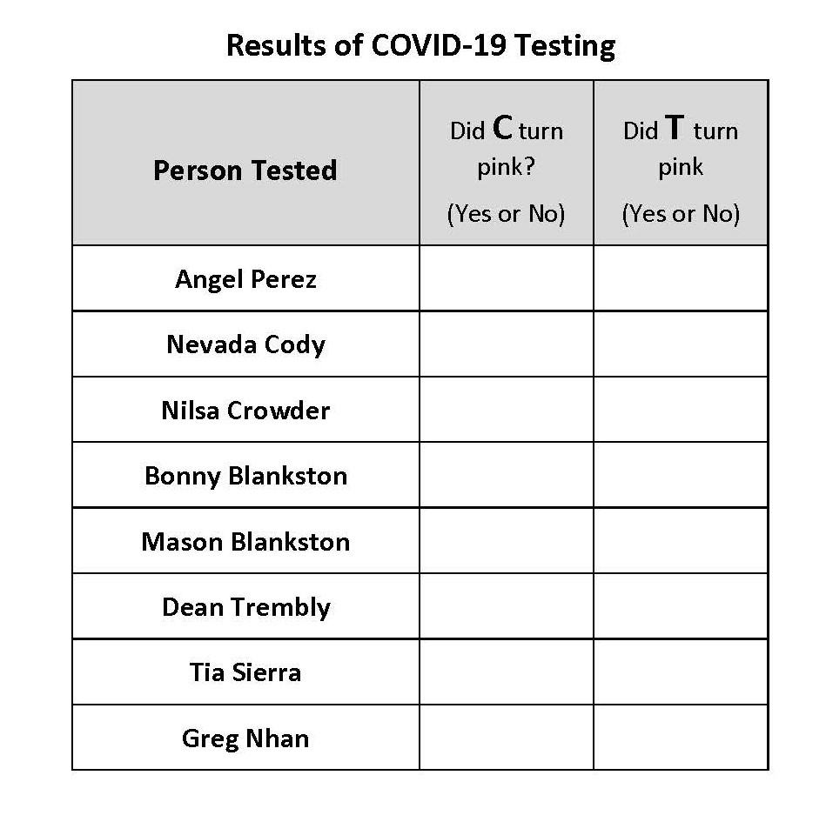

Slide 13
7. Based on the information in the chart, which people tested
positive indicating that they have COVID-19? Explain how you
could tell.
8. Based on the information in the chart, which people should be
retested because the test did not work properly? Explain how you
could tell.
9. Based on the information in the chart, which people tested
negative indicating that they do not have COVID-19? Explain how
you could tell.

Slide 14
10. State two reasons why testing is important for
someone who was exposed to COVID-19.
11. Free COVID-19 testing is available in most
communities. Where could people go to get free
COVID-19 testing in your community.

Slide 15
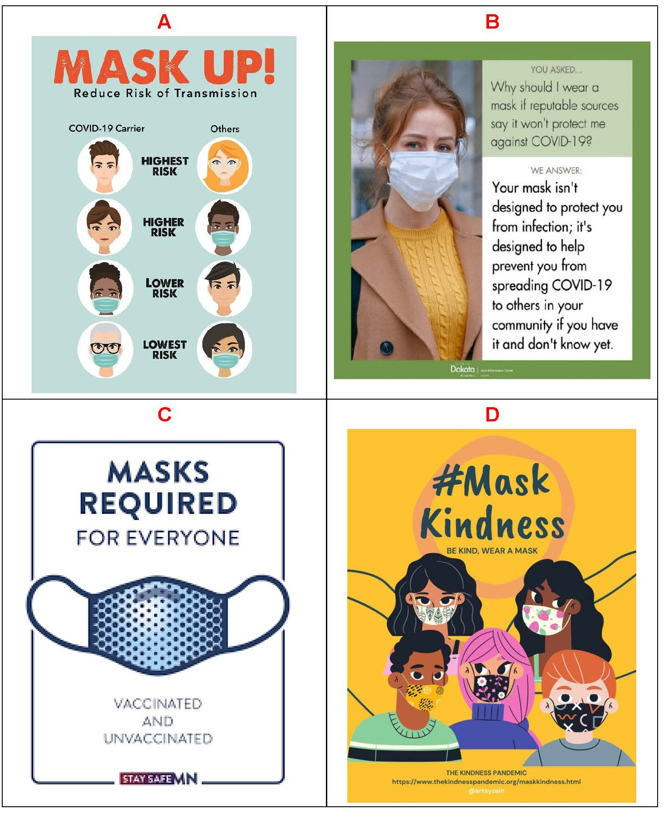
Part 6: Protecting yourself and others
The Four Signs (A, B, C and D) were designed to encourage people to wear masks when they are likely to encounter others. Which of the signs do you think would be most effective in encouraging people to wear masks? Explain your choice.

Slide 16
2. Design a sign, pin, poster, T-shirt, or other item that would encourage people to protect themselves and others by getting vaccinated and staying up to date with COVID-19 vaccines. Draw your idea in the space below or on a separate page.

Slide 17
3. What is the most interesting or important thing that you learned from this lesson?
4. What is one thing you learned that you would want other people to know?

