Slide 1
Is there a GOD?

Slide 2
Is there a GOD? (Generator of Diversity)

Slide 3
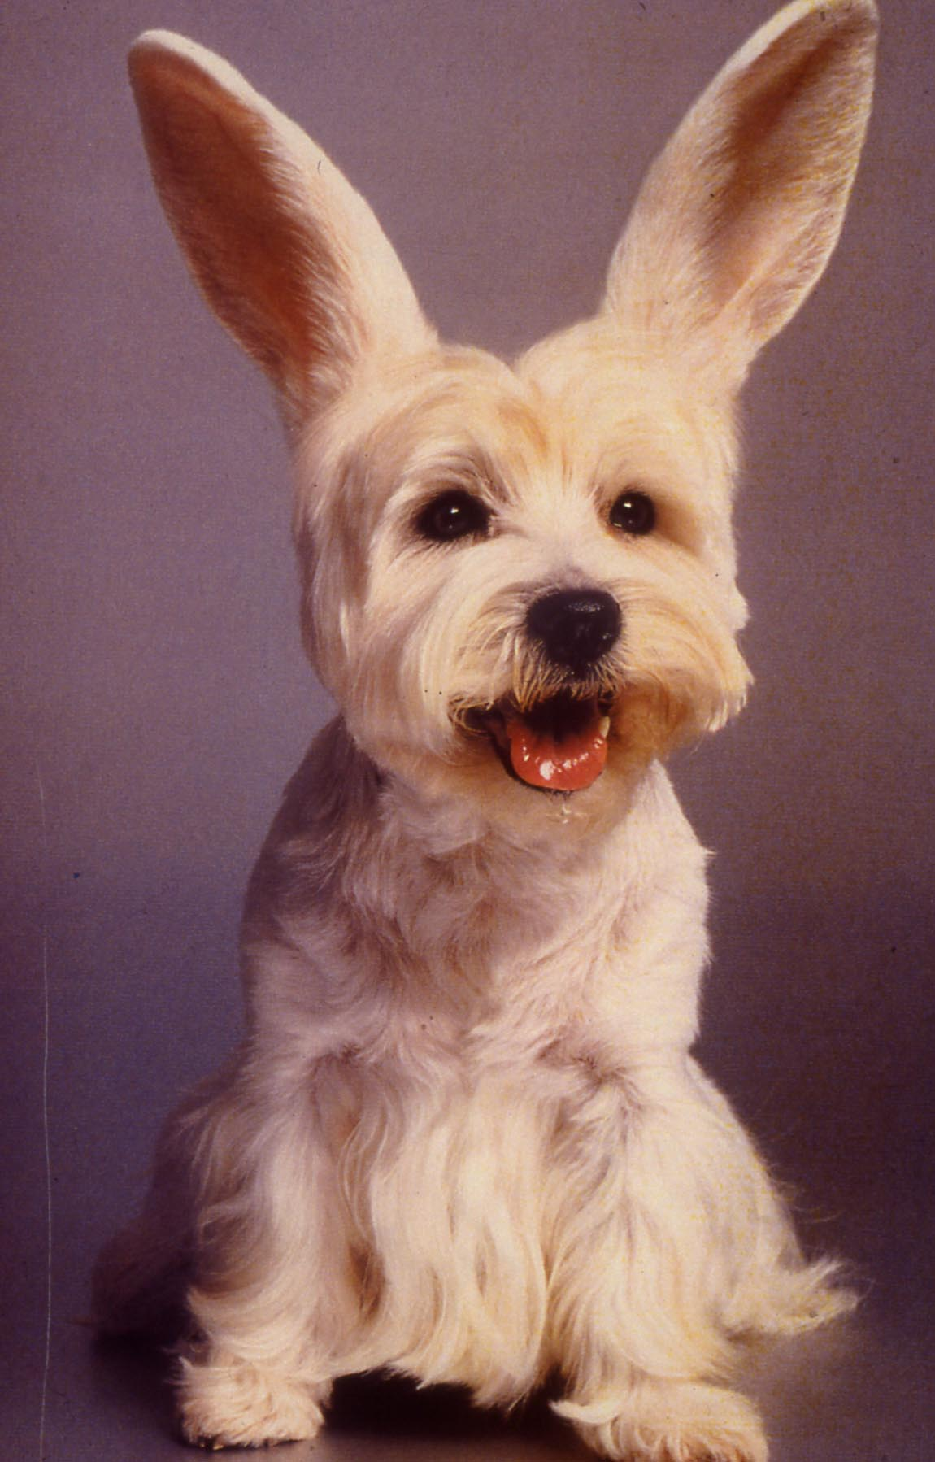
Genetic engineering and molecular biology was the key!

Slide 4
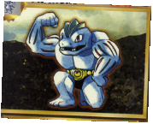
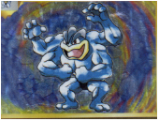
Committed B cell Development

Slide 5
Committed B cell Development

Slide 7
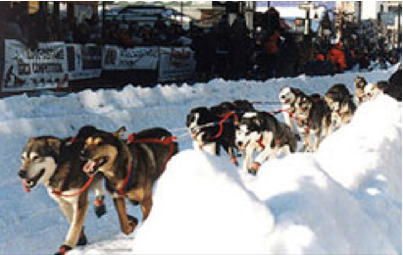
Anti-Toxins used for treatment of disease
Iditaroid Dog race
commemorates life saving
delivery
of anti-toxin for diphtheria
Notes:
Picture of Iditarod Dogs Balto was a Siberian husky born in Nome, Alaska in 1923. He spent much of his early life as part of a sled dog team that transported supplies to miners in the surrounding areas. But Balto is famous for his dog sled race from Nenana, Alaska to Nome, Alaska.
On January 21, 1925, several Inuit children in Nome, Alaska were diagnosed with diphtheria. Without the anti-toxin needed to stop the disease from spreading, almost all of the children in Nome would be attacked by this highly contagious disease. The only serum (antitoxin) for the disease was in a hospital in Anchorage, almost 1000 miles away. A train could only bring the serum part of the distance to Nenana, but after that transportation was hard to come by. Ice prevented transportation by ship, and frequent blizzards prevented transportation by flight. The final decision to transport the serum the remaining 674 miles between Nenana and Nome was by using a relay of dog sled teams. By doing this, it was estimated that it could take up to 13 days.
The package containing the serum left Anchorage by train on Monday, January 26, 1925 and arrived the next day in Nenana where it was turned over to the first dog sled team. More than 20 teams participated in this relay. The last team that would finish the relay was led by a musher named Gunnar Kassen, with Balto leading his sled team.
A blinding blizzard dropped temperatures to -50 degrees and winds gusted at 50 mph. Kassen was unable to navigate his way, and was about to give up all hope. But Balto remembered the trail well and followed his instincts leading Kassen and his team through the cold and snow. On February 2 at 5:30 AM, the team finally arrived in Nome, successfully delivering the serum, only seven days after leaving Anchorage.
Today, in memory of Balto�s hard work there is a statue of Balto in Central Park in New York City. Also the Iditarod Trial Sled Dog race has been run from Anchorage to Nome every year since 1973, and remembers the role of the dog teams in the settlement of Alaska and the heroic serum race that saved many children in 1925. On Balto�s statue there is a plague that reads: �Dedication to the indomitable spirit of the sled dogs that relayed anti toxin 600 miles over treacherous waters, through arctic blizzards, from Nenana to the relief of stricken Nome in the winter of 1925- Endurance, Fidelity, Intelligence.�

Slide 8
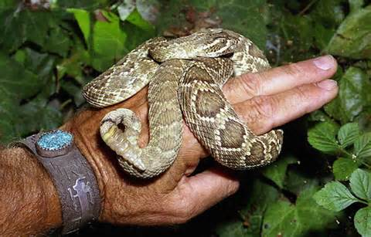
SnakeBite

Slide 9
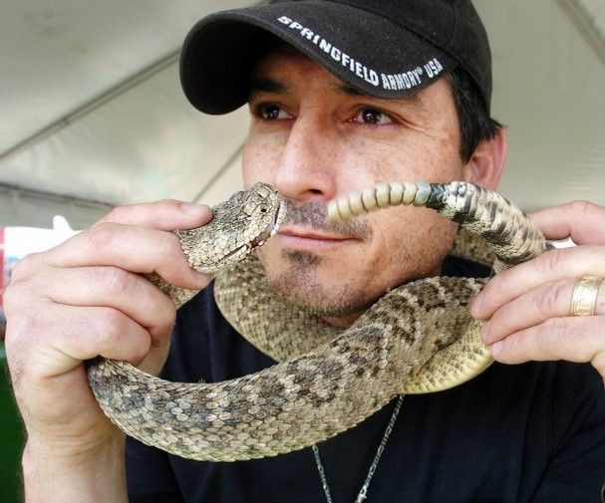
http://media.caller.com/media/img/photos/2013/03/16/422397_t607.JPG

Slide 10
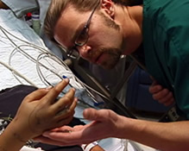
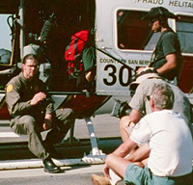
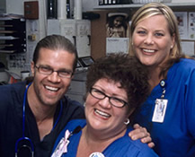
Animal Planet
CroFab
Anti-venin
Notes:
nonpyrogenic, purified, lyophilized preparation of ovine Fab (monovalent) immunoglobulin fragments obtained from the blood of healthy sheep flocks immunized with one of the following North American snake venoms: Crotalus atrox (Western Diamondback rattlesnake), Crotalus adamanteus (Eastern Diamondback rattlesnake), Crotalus scutulatus (Mojave rattlesnake), and Agkistrodon piscivorus (Cottonmouth or Water Moccasin). To obtain the final antivenin product, the four different monospecific antivenins are mixed. Each monospecific antivenin is prepared by fractionating the immunoglobulin from the ovine serum, digesting it with papain, and isolating the venom-specific Fab fragments on ion exchange and affinity chromatography columns.CroFab (crotalidae polyvalent immune fab ovine) is standardized by its ability to neutralize the lethal action of each of the four venom immunogens following intravenous injection in mice. The potency of the product will vary from batch to batch; however, a minimum number of mouse LD₅₀ neutralizing units against each of the four venoms is included in every vial of final product, as shown in Table 1. For comparison, the minimum potency of each monospecific component in the batches demonstrated to be efficacious in clinical trials is also included in Table 1.

Slide 11
Animal Planet Doc
Speed is essential
Passive Immunization
Need to act as quickly as possible before venoms can act
Venoms are complex mixtures of proteins

Slide 12
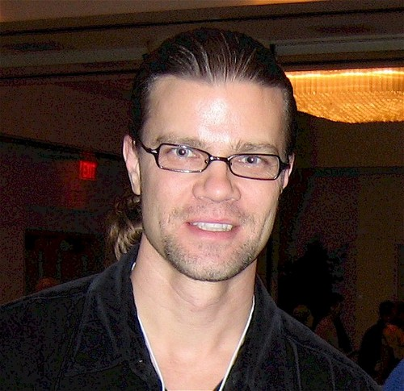
Dr. Bush

Slide 13
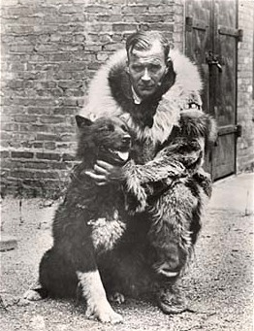
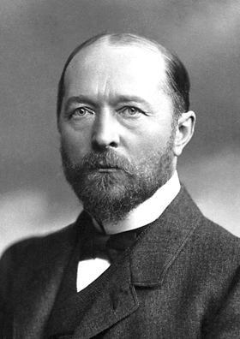
Famous Faces In Passive Immunity
Balto and Gunnar Kaasen.
EMIL VON BEHRING

Slide 14
Habitat for humanity
Not equal to antibody binding!
Y
Why is this distinction important?

Slide 15
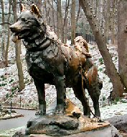

Slide 16
Hypersensitivity related slides

Slide 18
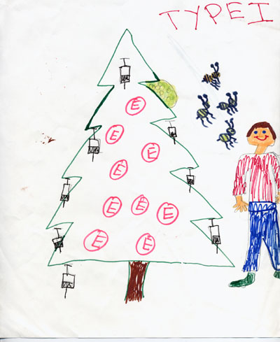
Type I hypersensitivity
Examples-stinging insect
Penicillin, hay fever,
Peanut allergy
Memory peg-Xmas tree-
Number 1

Slide 19
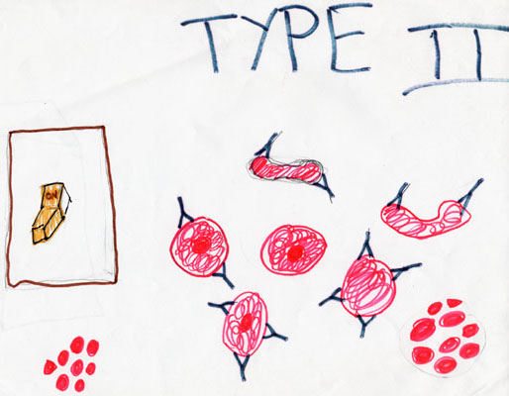
Type II hypersensitivity
Examples- Rh, myasthenia gravis
Memory peg-light switch Number 2-on off

Slide 20
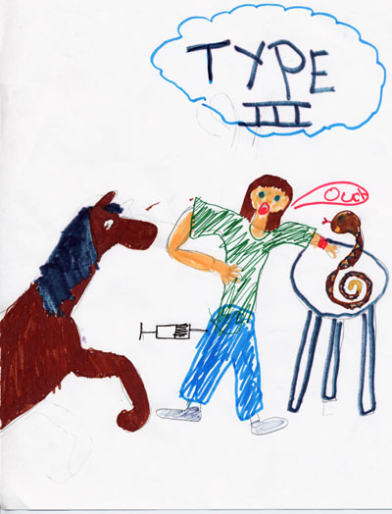
Type III hypersensitivity rxn
Examples-
serum sickness-horse serum
Lupus, Post-streptococcal
glomerulonephritis
Memory Peg-stool with 3 legs

Slide 21
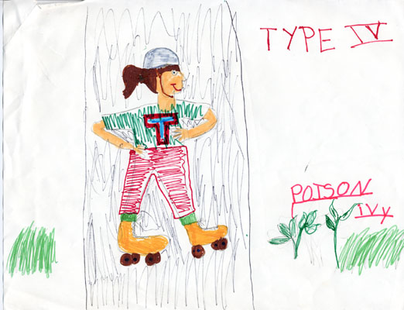
Type IV hypersensitivity reaction
Examples-TB skin test, poison ivy, Ni rxn
Memory Peg-rollerskate-4 wheels-with T shirt

Slide 22
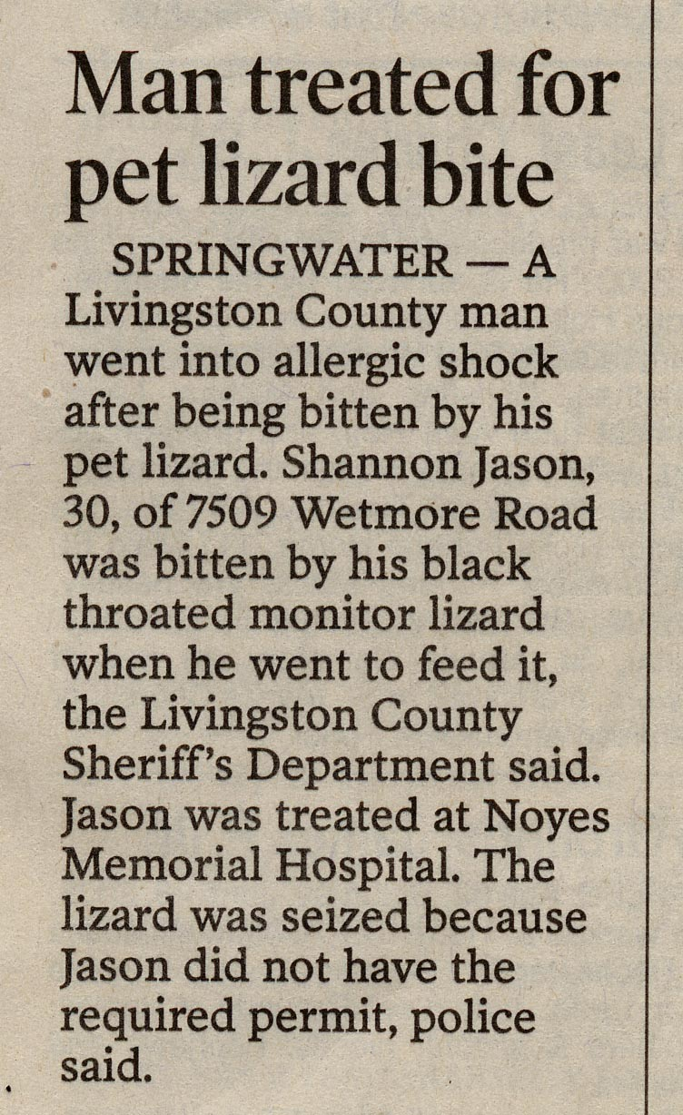

Slide 23
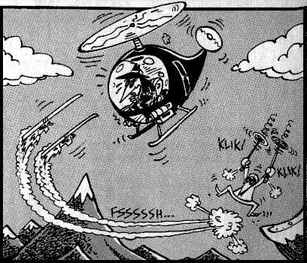

Slide 24
Why use Myelomas to Determine the Structure of Immunogloublins?
Myelomas or Plasmacytomas
Normal
Myeloma
Patient

Slide 25
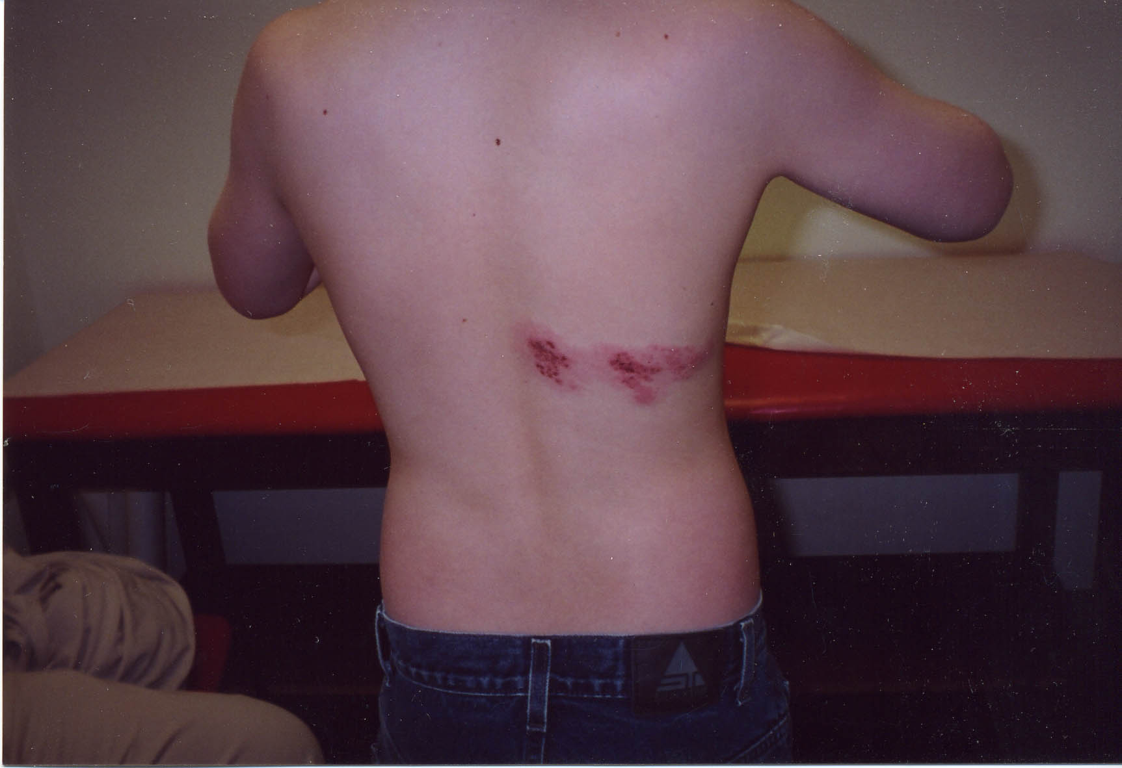

Slide 26
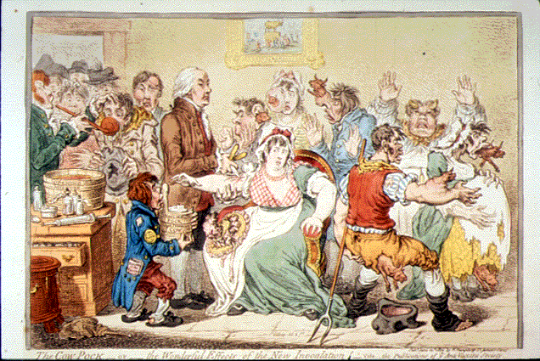
Anti-Vaccine movement is not new

Slide 27
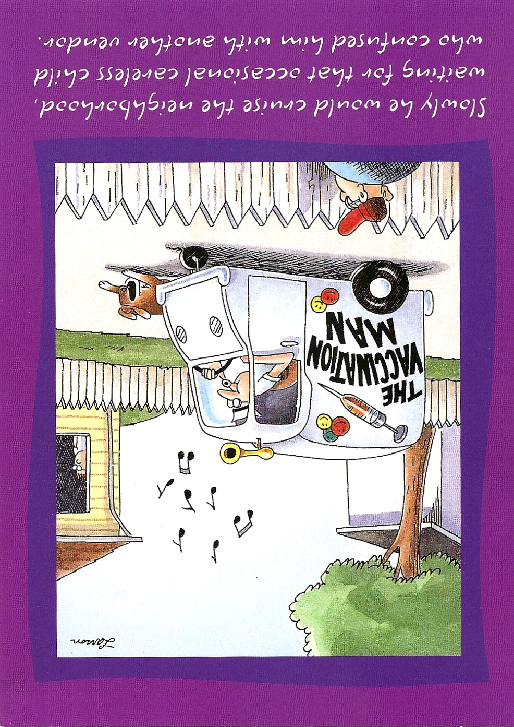
Slowly he would cruse the neighborhood waiting for the occasional careless child who confused him with another vendor

Slide 28
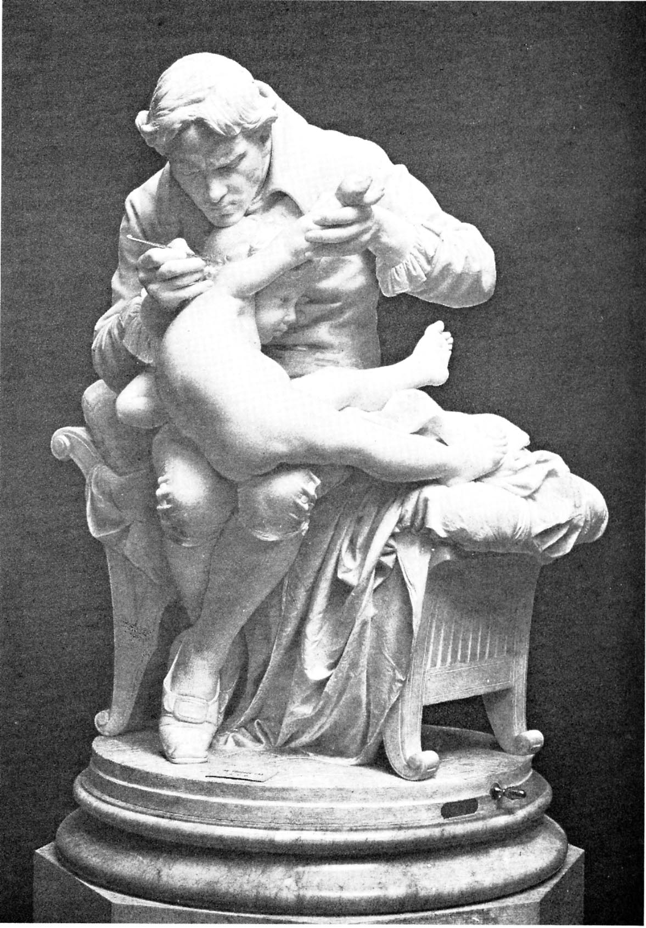
Jenner Immunizing an Infant
Notes:
Nodern immunology-small pox immunzation-
Use danger later

Slide 29
Elected to Royal Academy

Slide 30
Elected to Royal Academy
For nesting habit of cuckoo

Slide 31
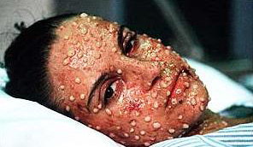
Smallpox

Slide 32
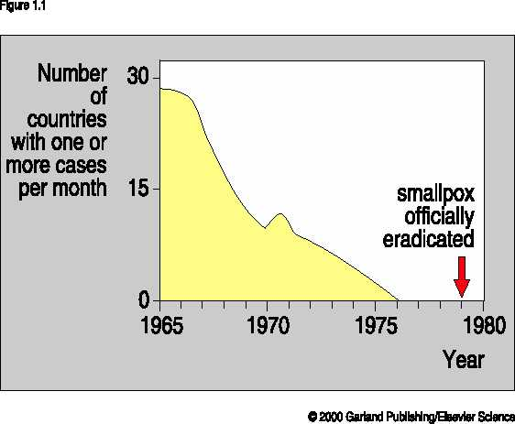
Smallpox eliminated!
Notes:
How many people immunzed
Bioterreorism
How long immunity last

Slide 33
