Slide 1
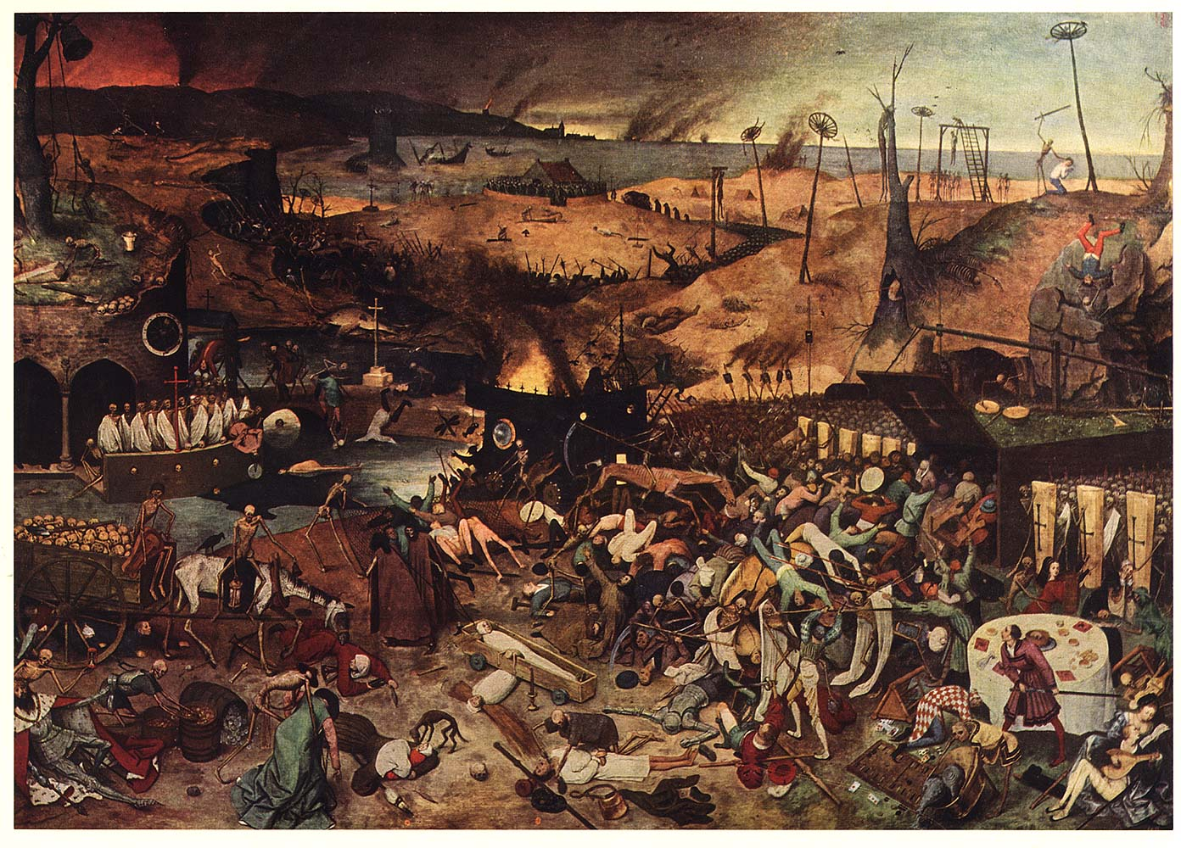

Slide 2
Immune System
Antigen
or
Pathogen
Immune
response

Slide 3
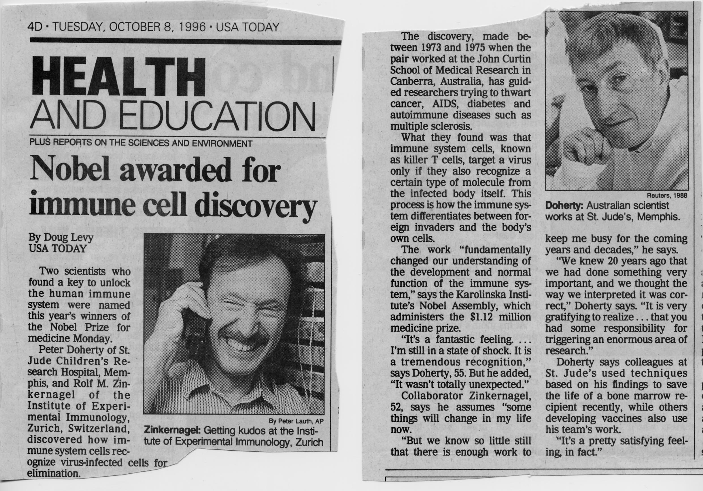
Nobel Prize in Immunology
Very High Affinity For self-MHC complex | Moderate affinity For self-MHC complex | No/low affinity For self-MHC complex
Negatively selected Deleted | Matures- Migrates to periphery | Not positive selected Dies of neglect
Prevents autoimmunity | High affinity for some foreign protein/self MHC | Useless-does not make it to periphery

Slide 4
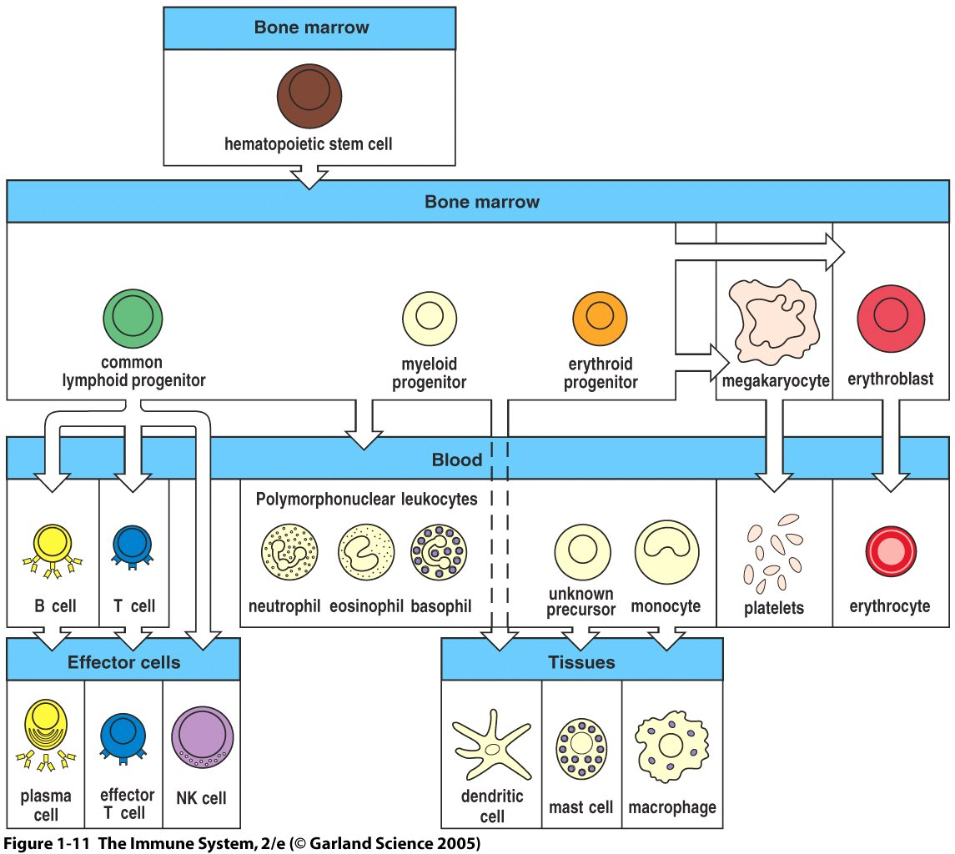
Figure 1-11

Slide 5
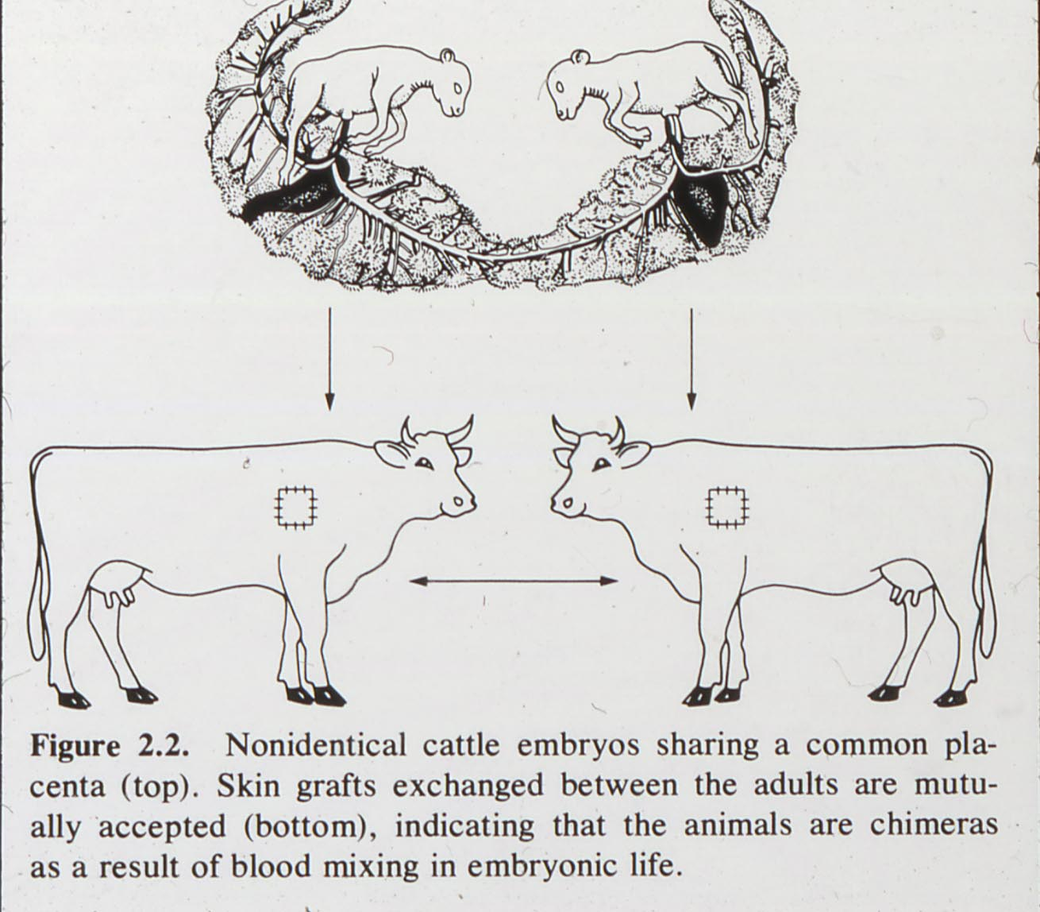

Slide 6

Chimeras

Slide 7

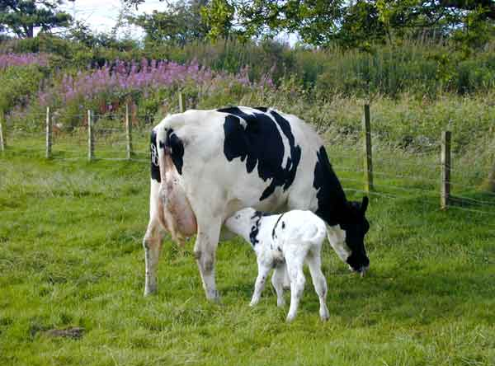
Cow slide
Self Tolerance is learned: lesson from cows

Slide 8

Is there a “logic”to the immune system design?
It is a custom job!

Slide 9
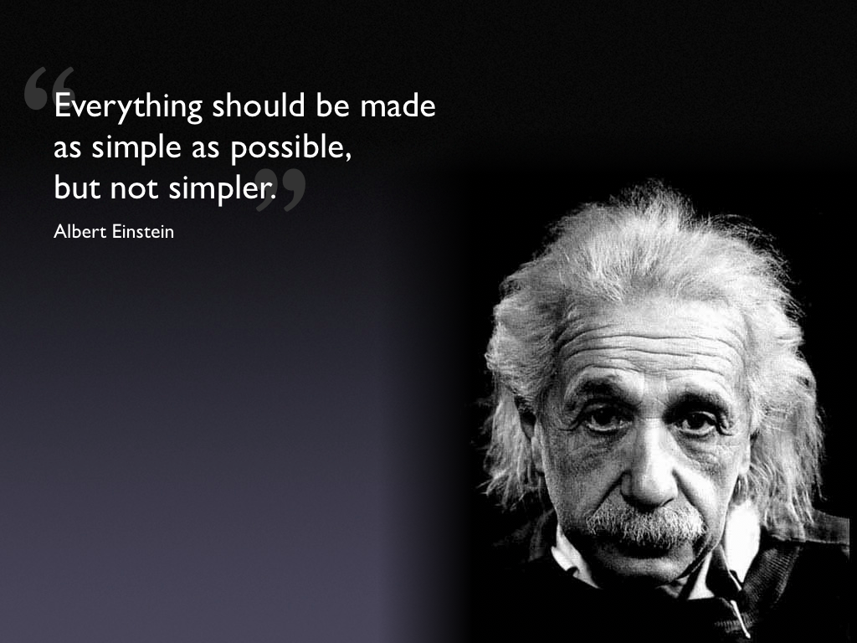
Immunology quote from Einstein

Slide 10
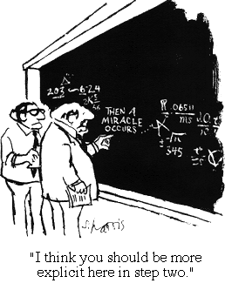
The Immune
Response

Slide 11
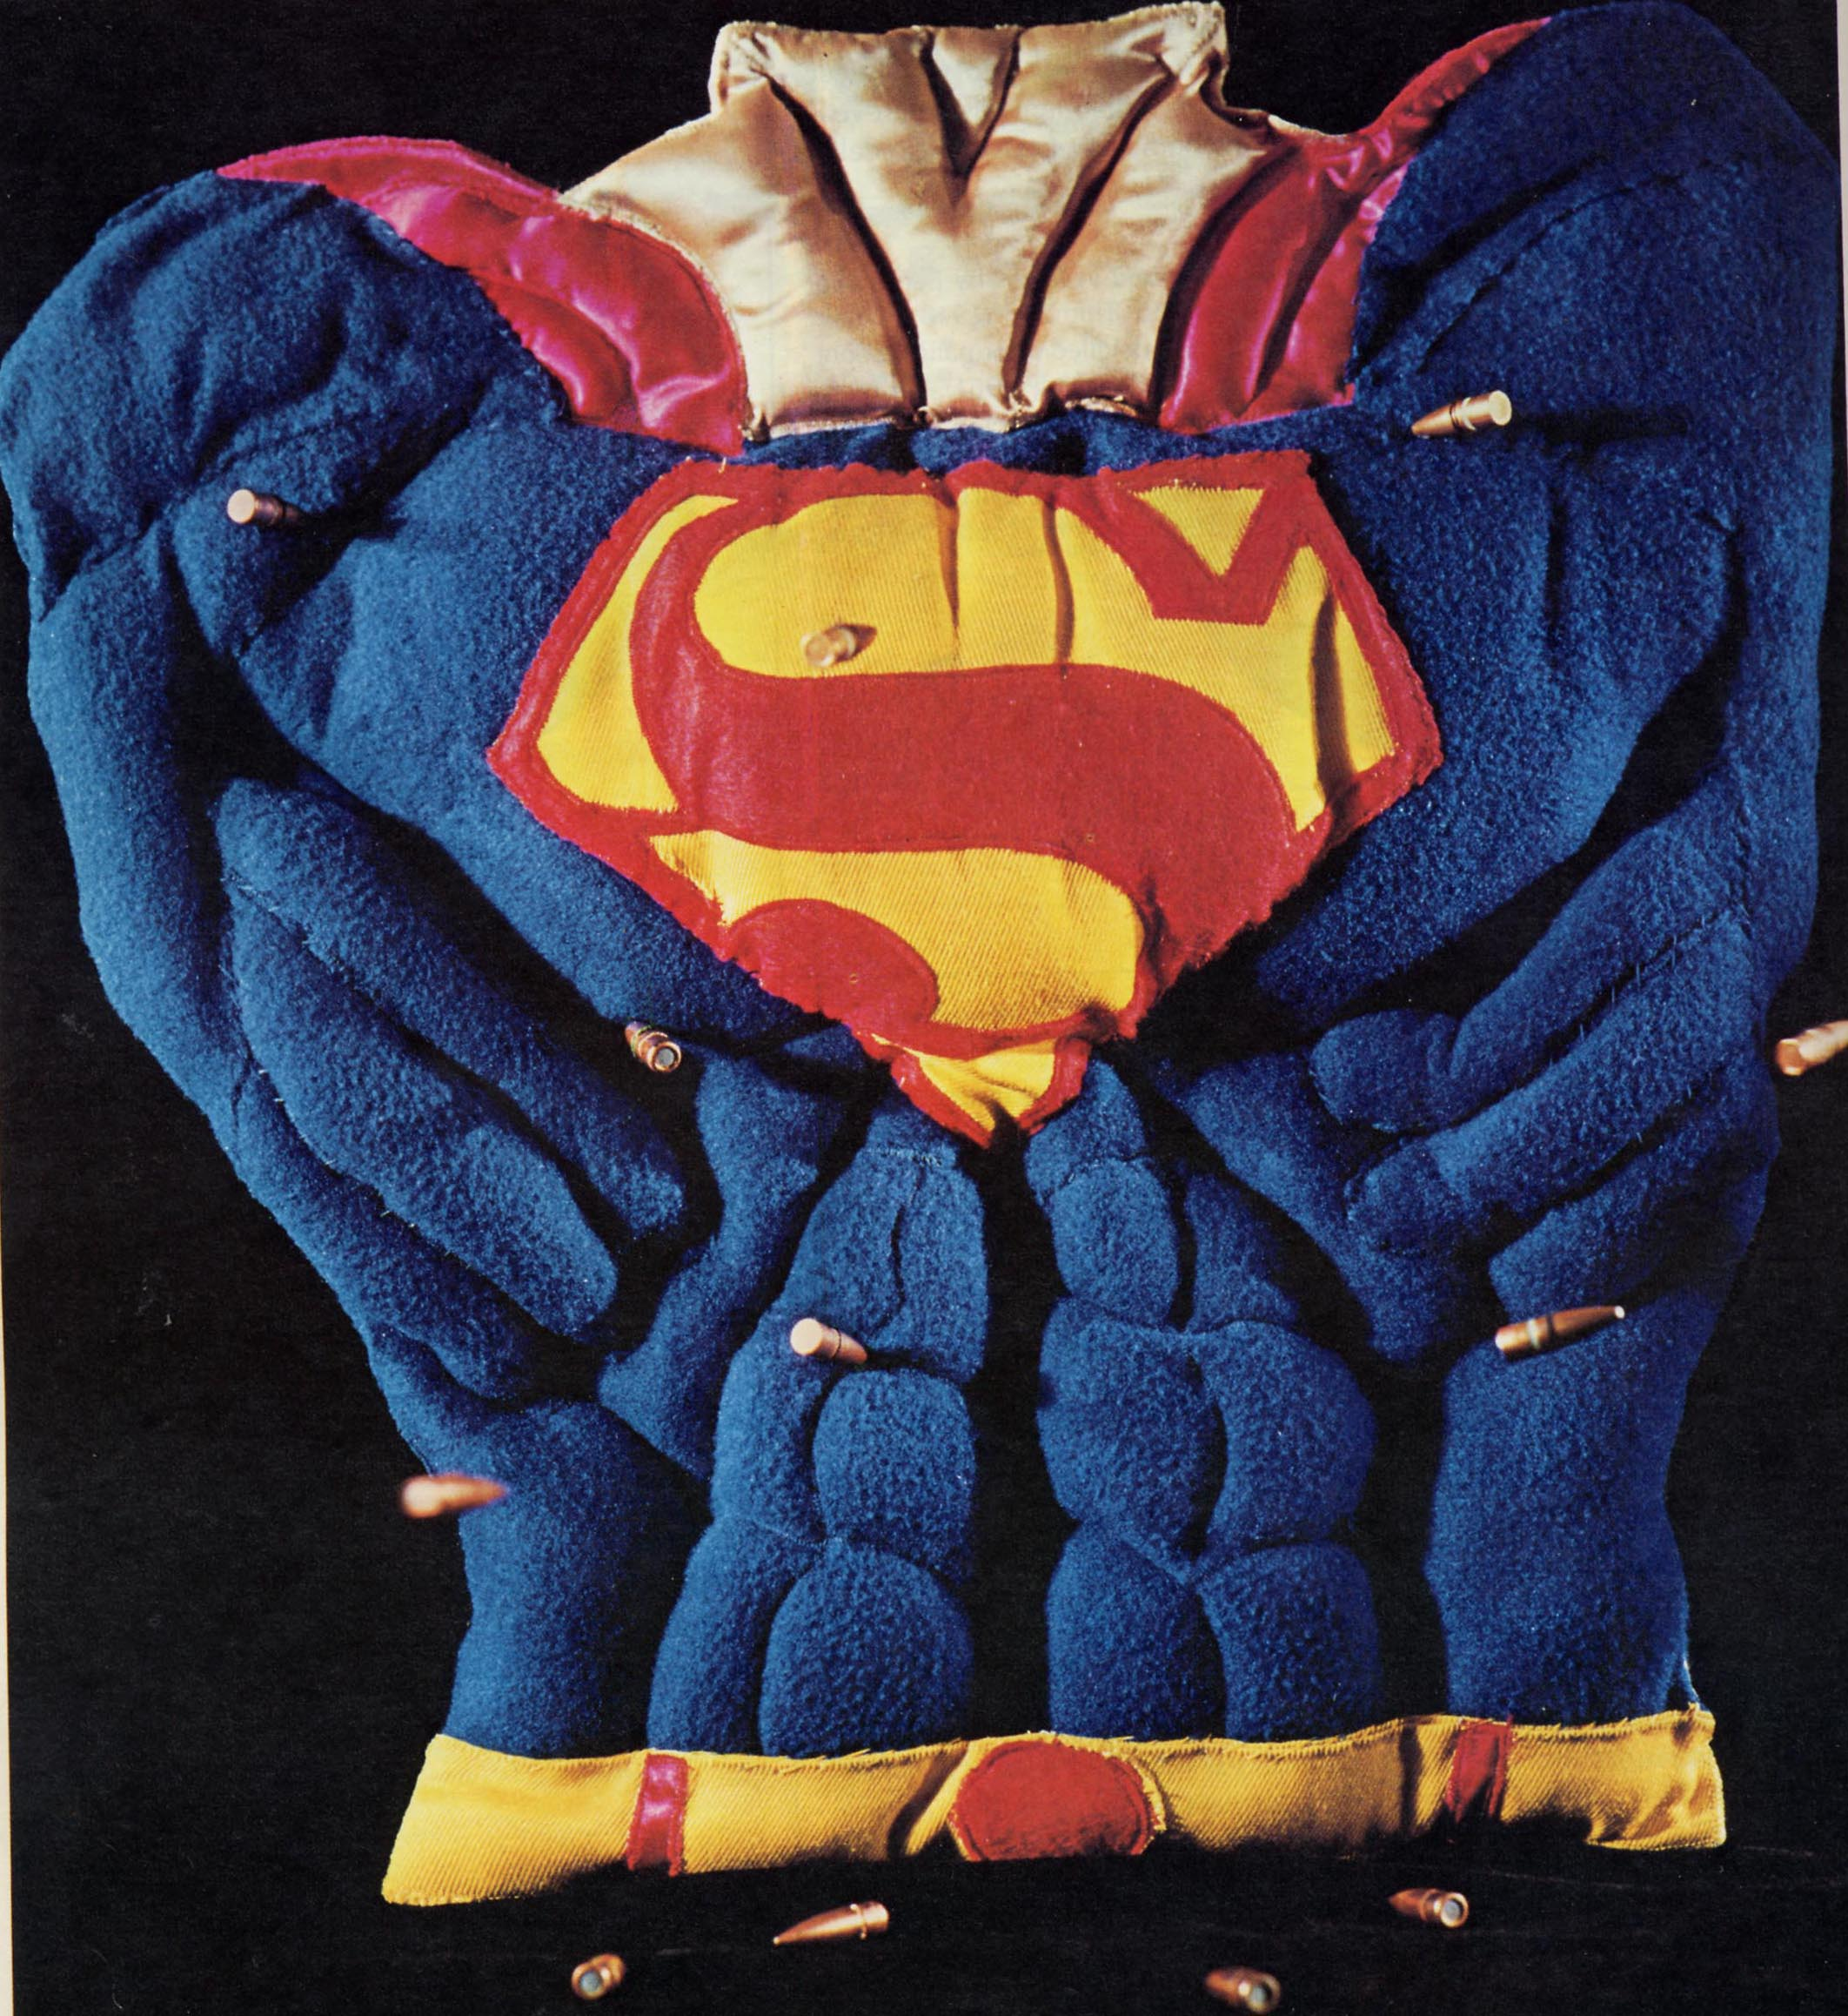

Slide 12
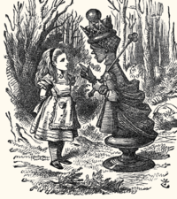
"It takes all the running you can do, to keep in the same place."

Slide 13
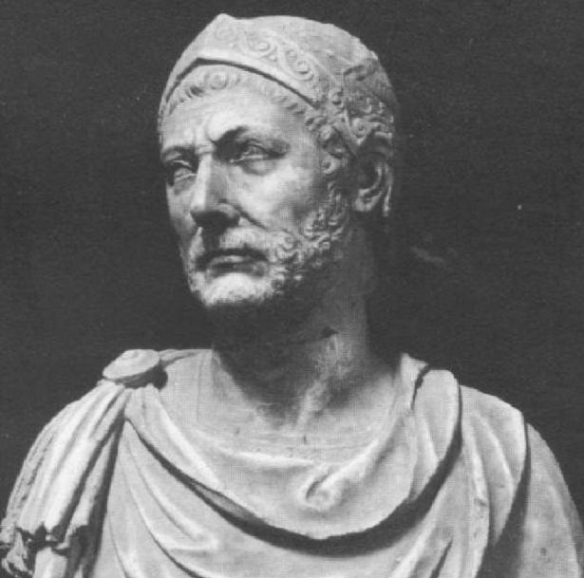
Hannibal

Slide 14
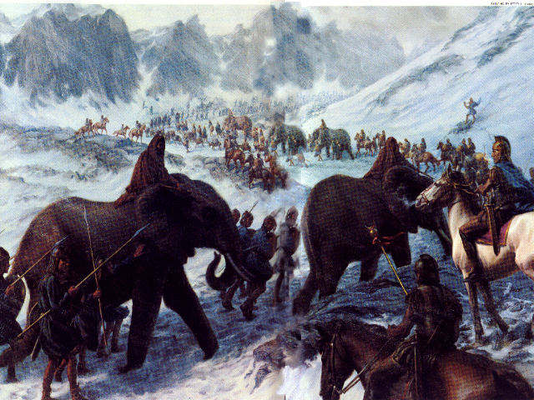

Slide 15
Gene rearrangement-the alteration of DNA-the the blueprint of life- was the solution!
An audacious and dangerous mechanism allows one to make receptors for things that don’t yet exist-but in comes with many costs…

Slide 16
Transplantation related slides

Slide 17
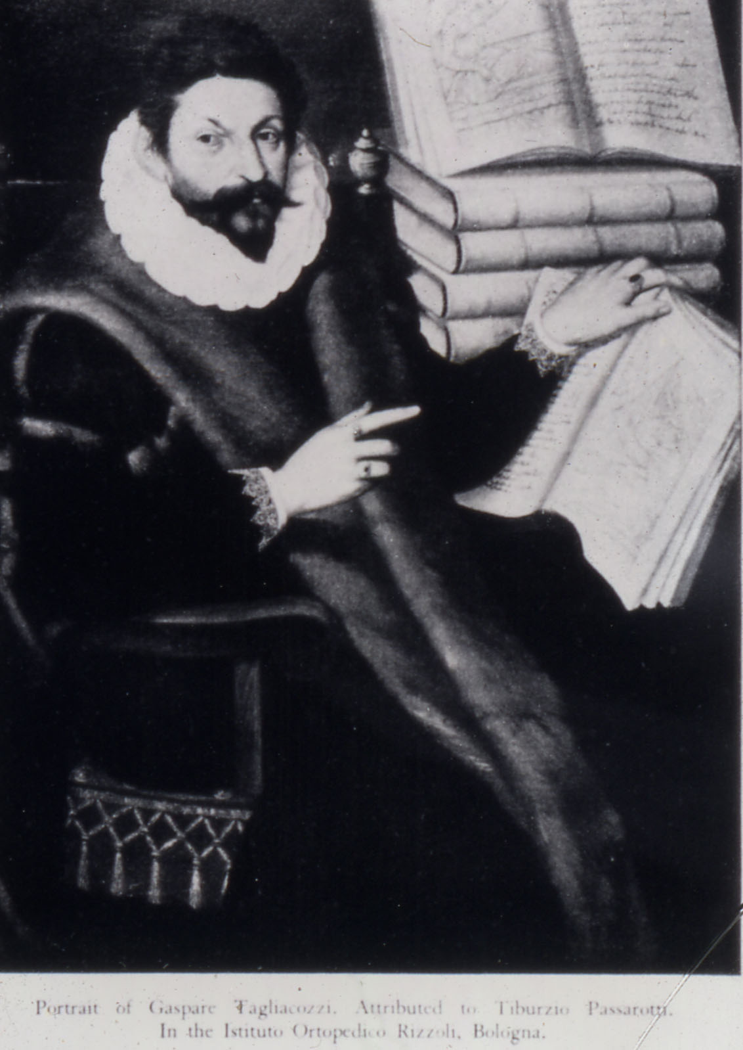

Slide 18
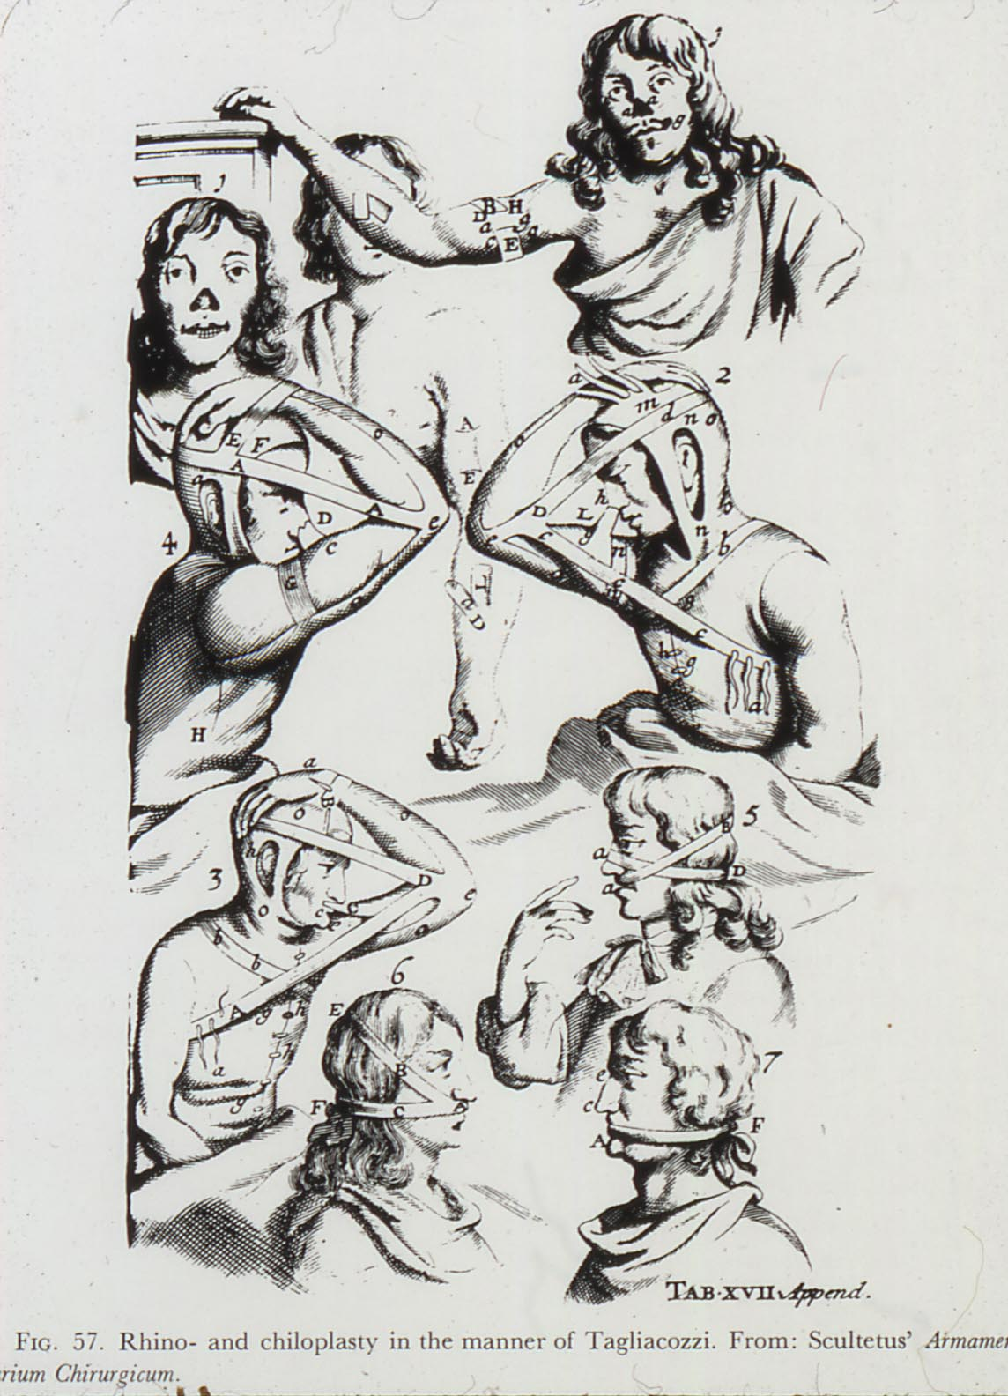

Slide 19
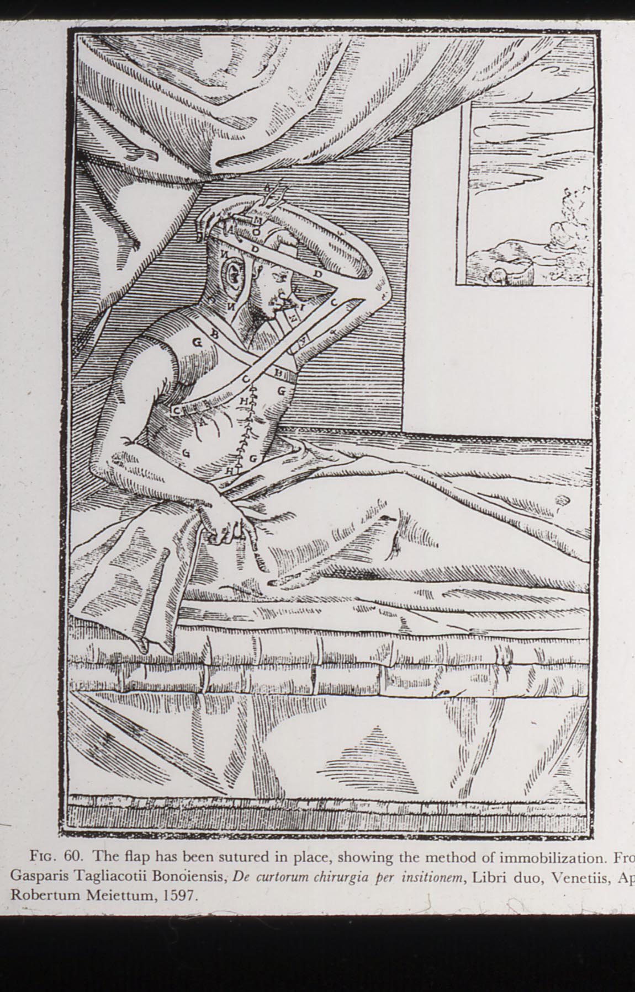

Slide 20
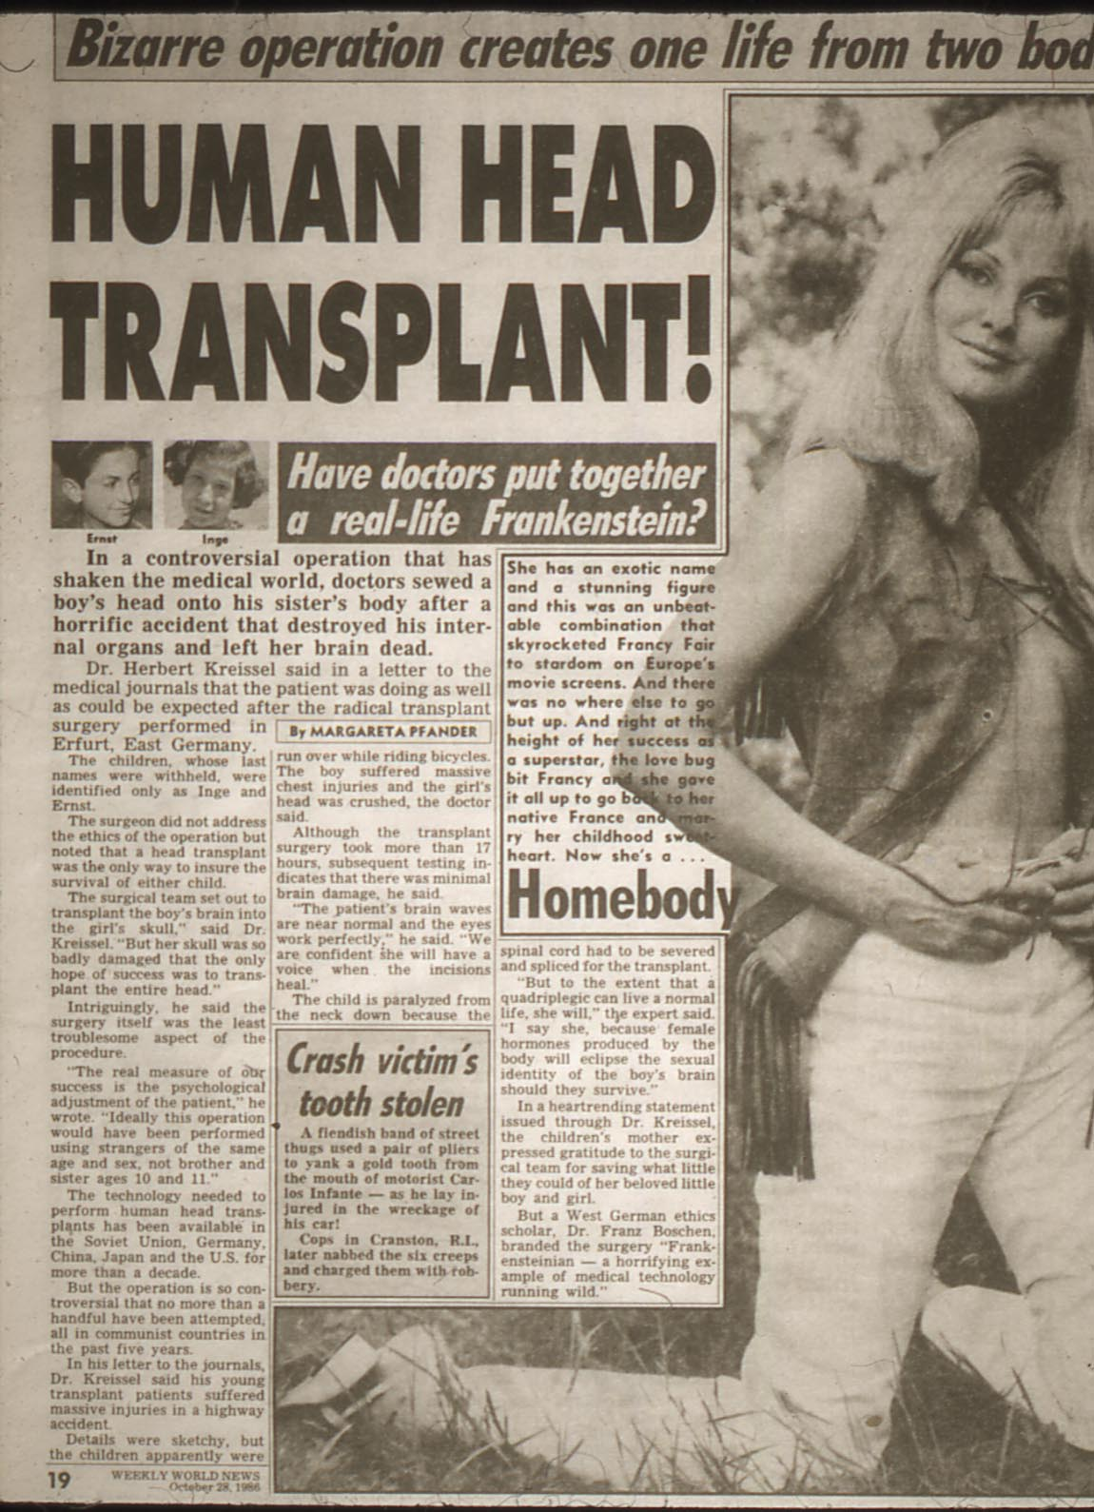

Slide 21
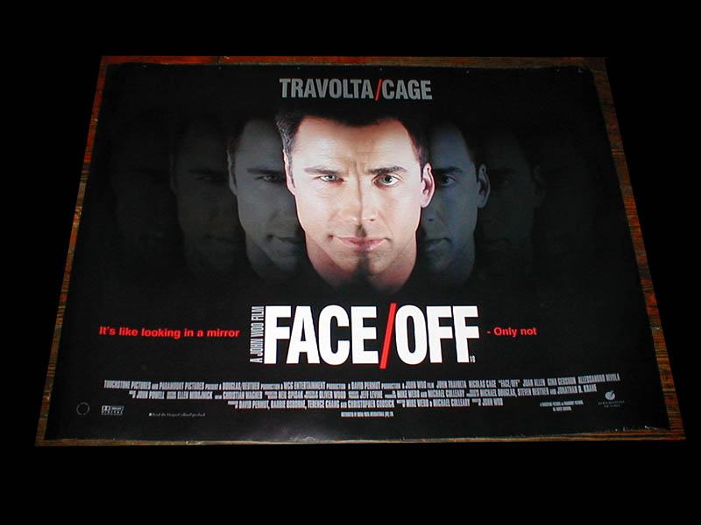

Slide 22
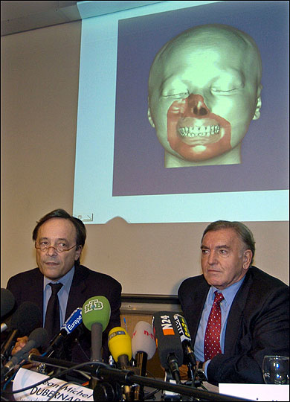
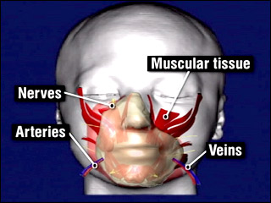
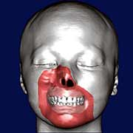

Slide 23
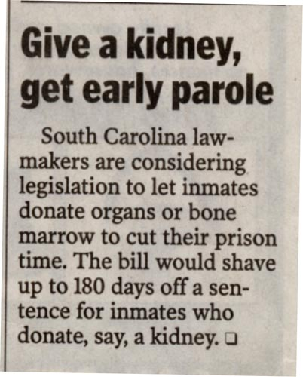
Ethical or Not?
Secondary markets?
Why the need?
Are they good donors?

Slide 24
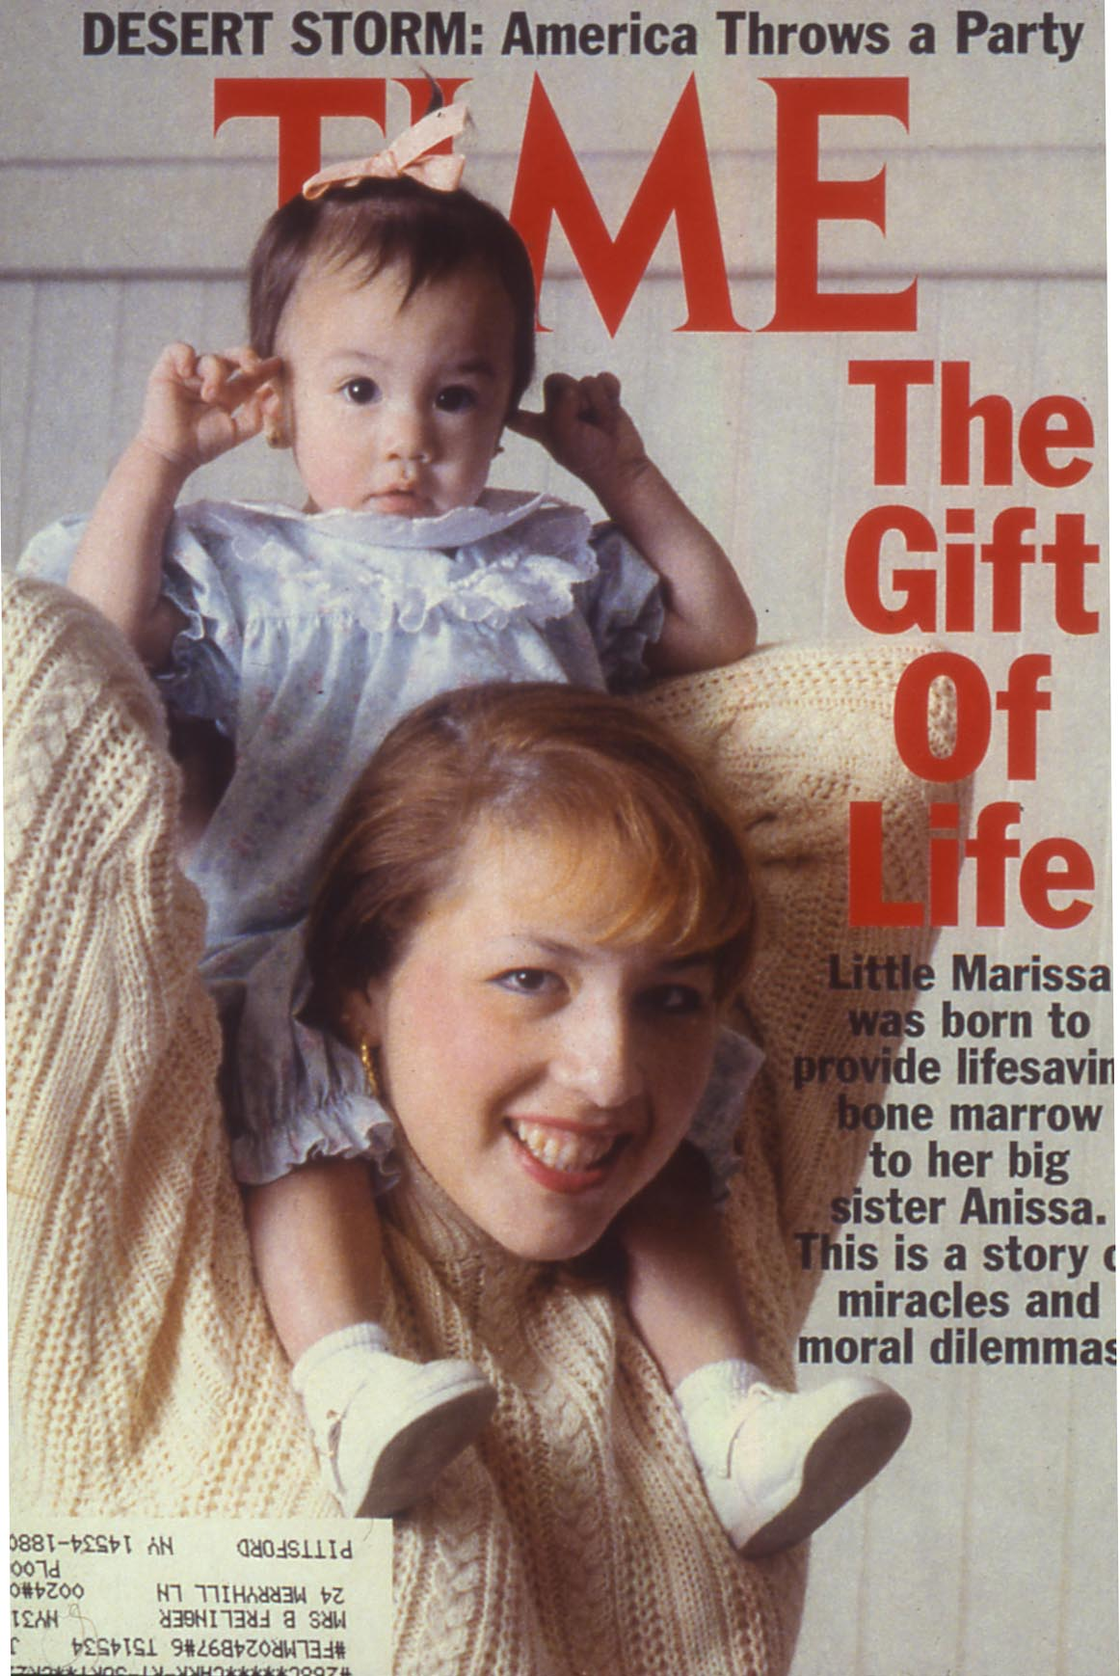

Slide 25
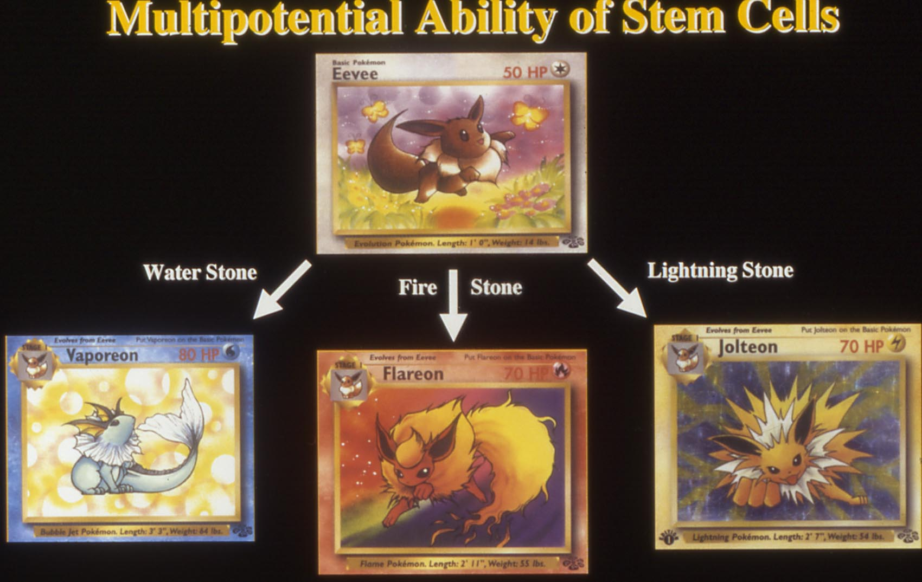

Slide 27
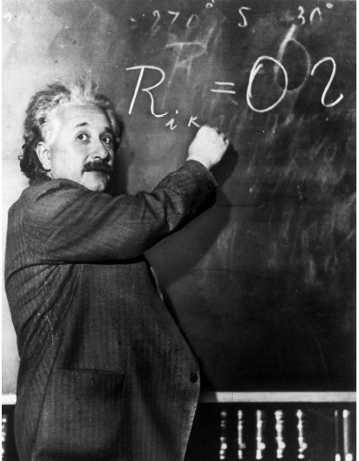
Special Relativity
Frame of the observer
Consider this from the point of view of the T cell

Slide 28
Vaccine related slides

Slide 29
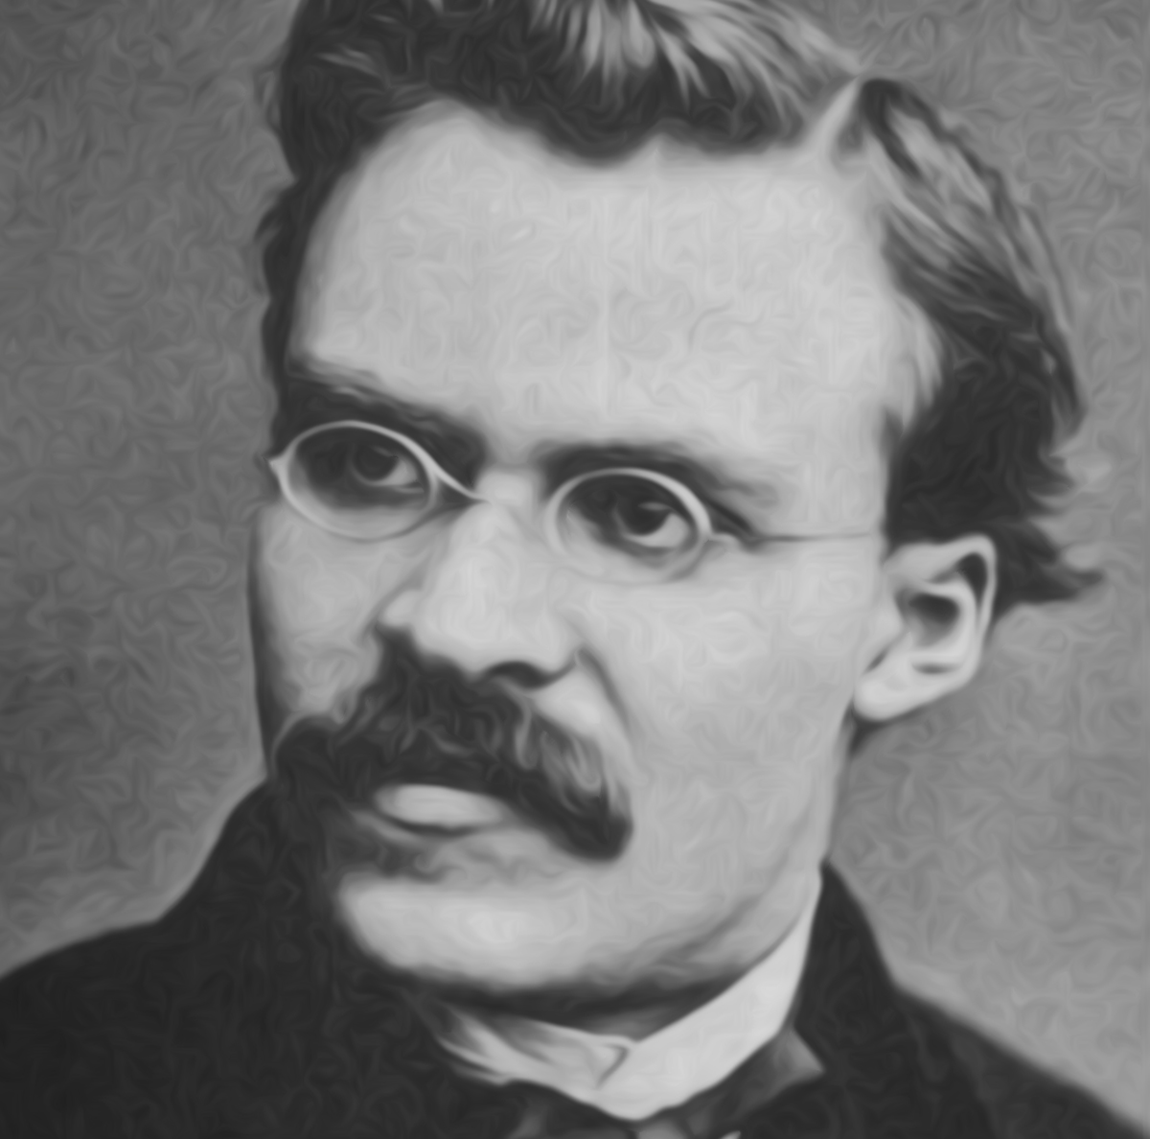
Nietzsche famous philosopher and immunologist

Slide 30
“That which does not kill me makes me stronger “
Friedrich Nietzsche

Slide 31
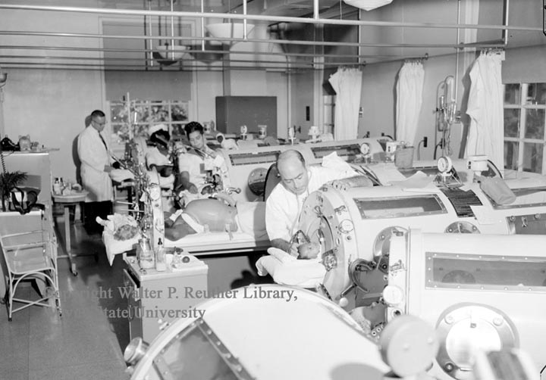

Slide 32
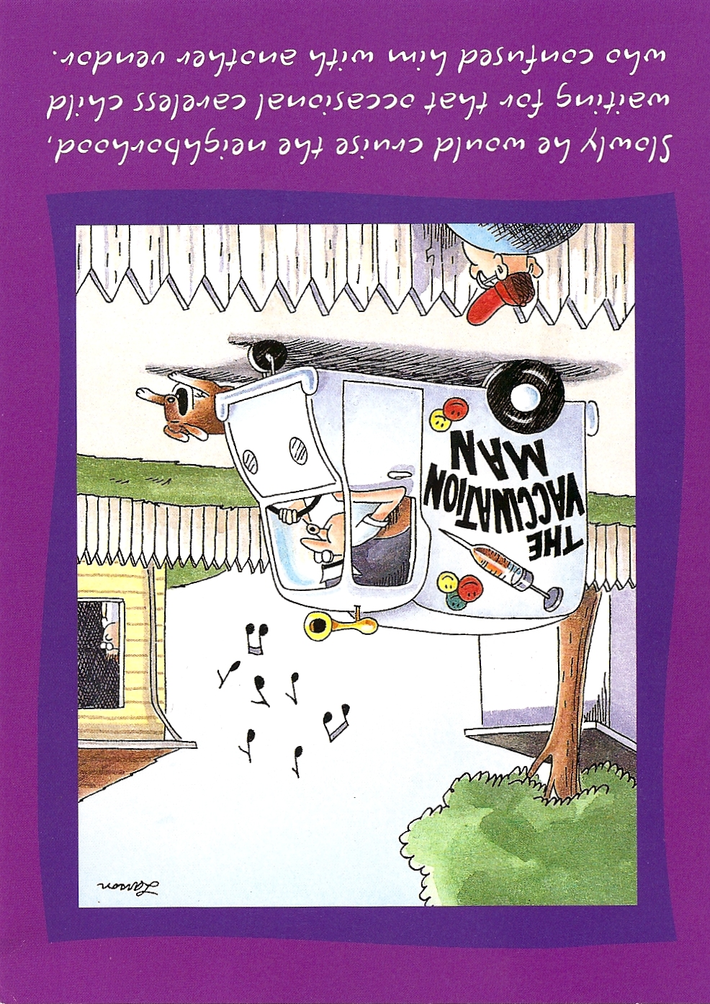
Slowly he would cruse the neighborhood waiting for the occasional careless child who confused him with another vendor

Slide 33
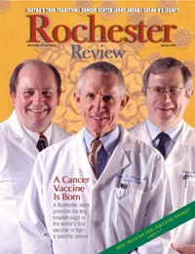

The First Effective Vaccine for Preventing Cancer

Slide 34
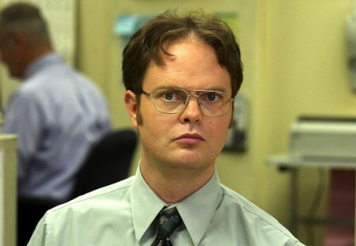
Jim: You work here, don't you want good insurance?
Dwight: Don't need it. Never been sick. Perfect immune system.
Jim: Ok, well if you've never been sick, then you don't have any antibodies.
Dwight: I don't need them. Superior genes. I'm a Schrute...and superior brain-power. Through concentration I can raise and lower my cholesterol at will.
Pam: Why would you want to raise your cholesterol?
Dwight: So I can lower it.

Slide 35
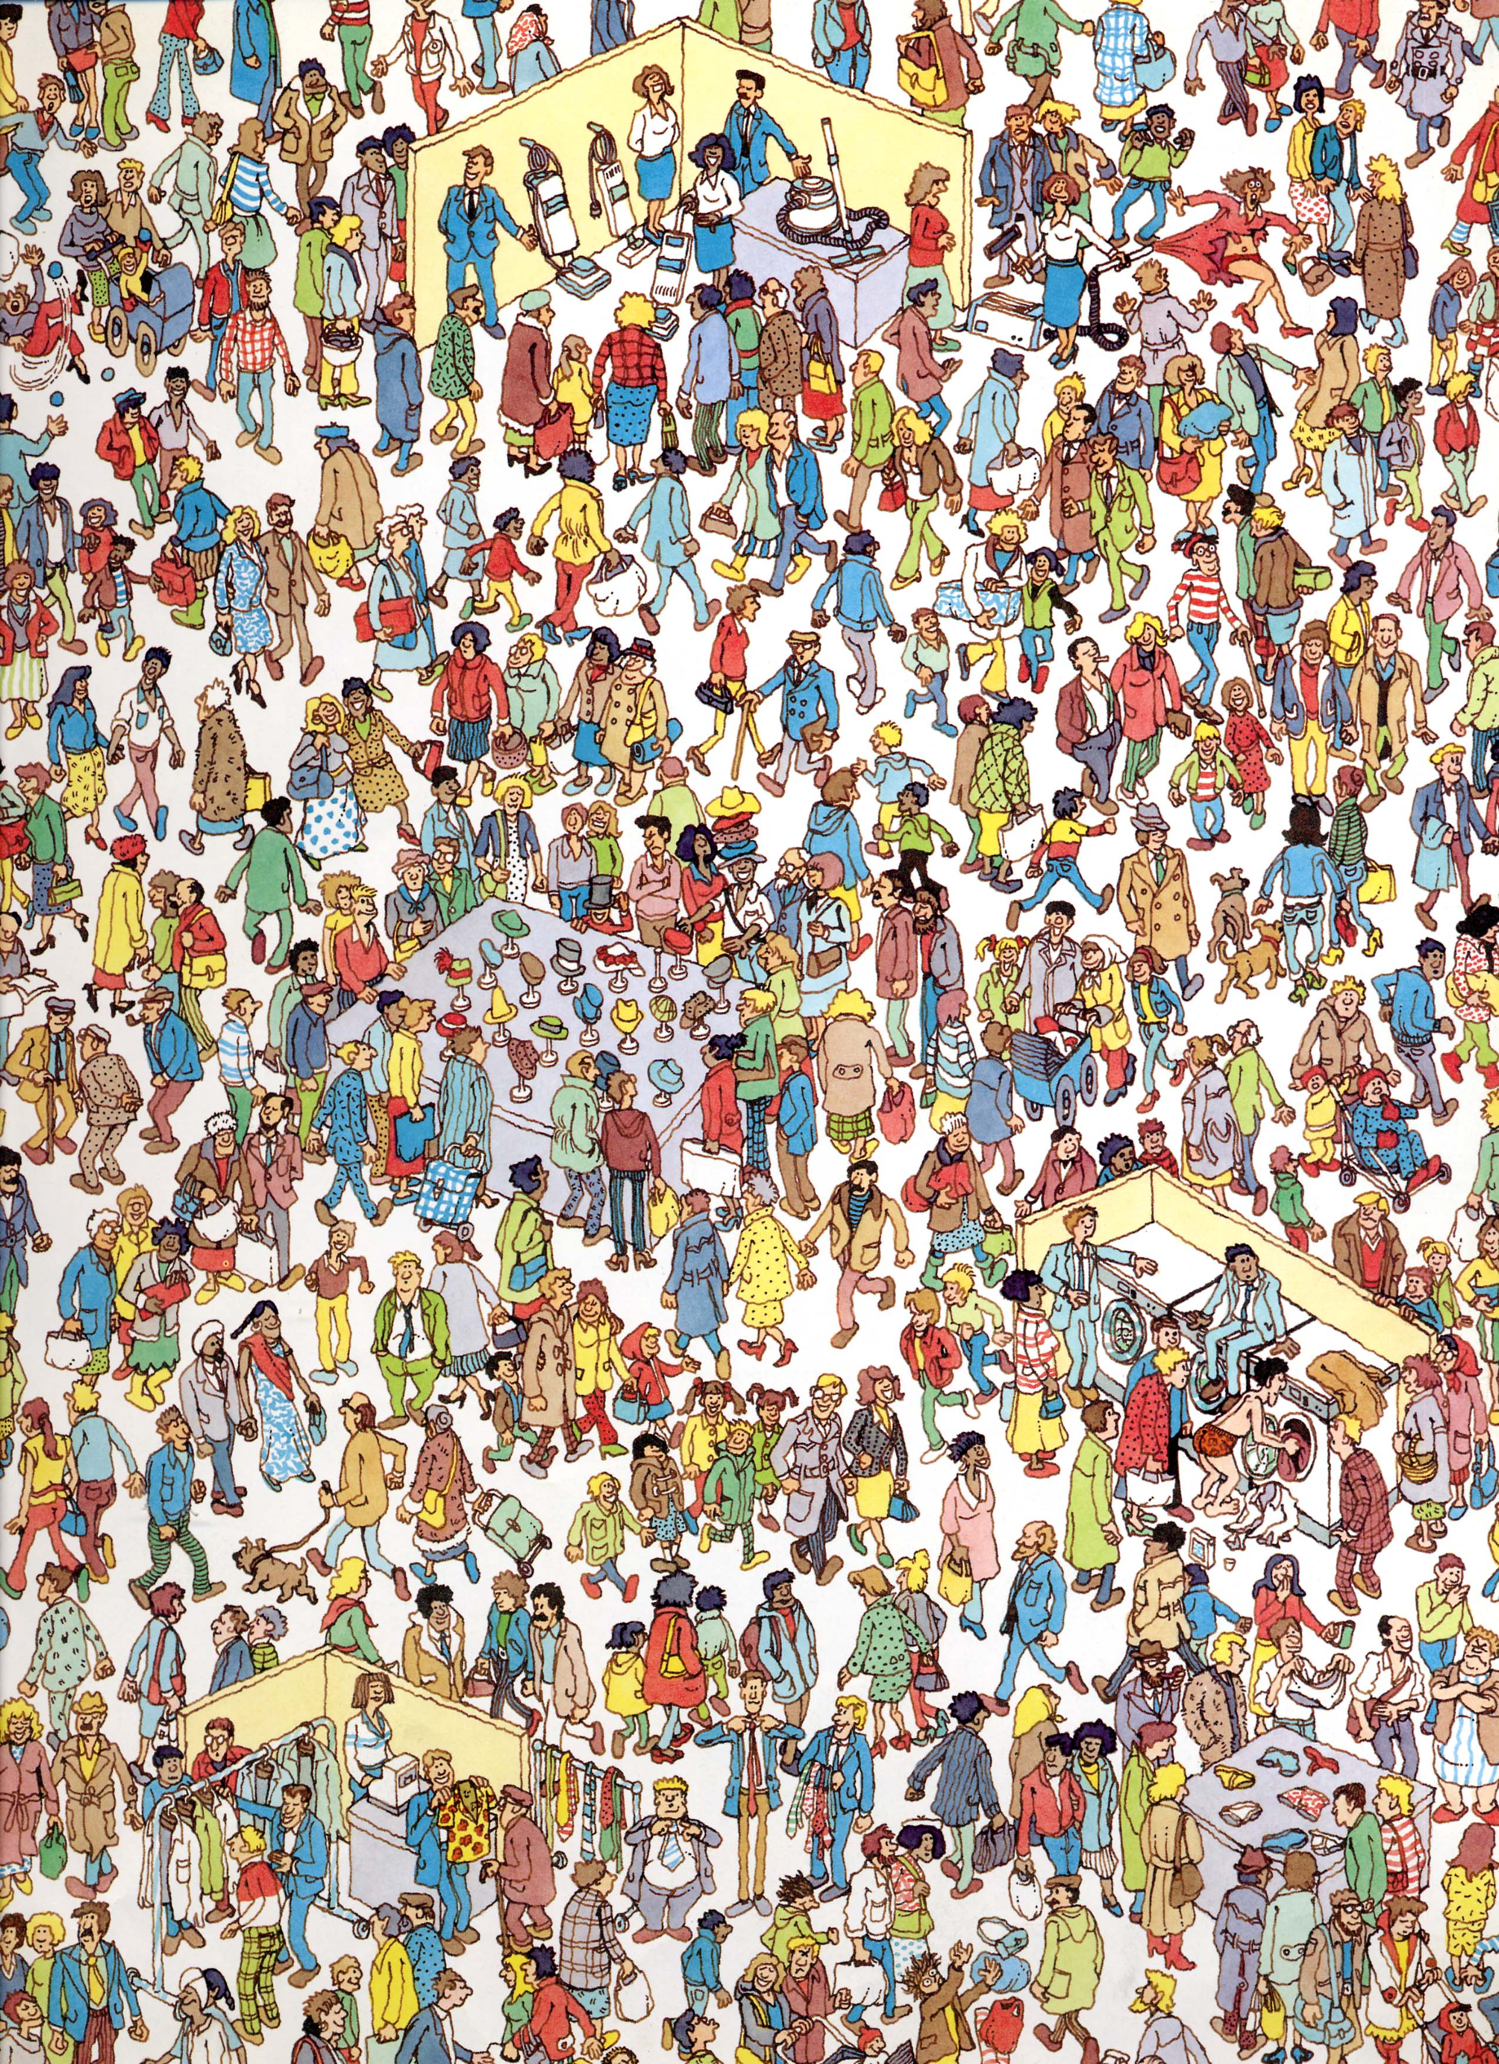
Where is Waldo ?

Slide 36
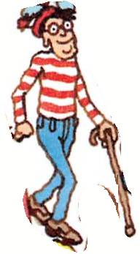
Clonal Expansion of Waldo clones

Slide 37
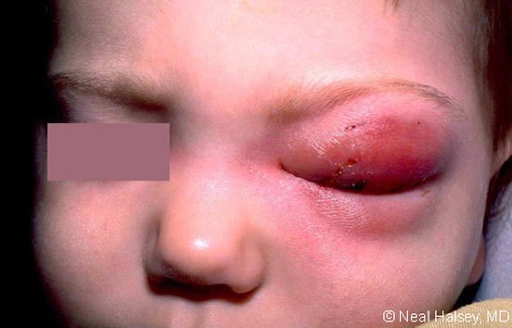

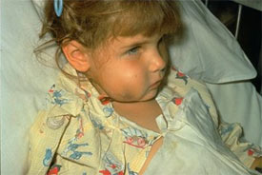
Hib Infections
Notes:
Clinical Features
Before the availability of the Haemophilus influenzae serotype b (Hib) conjugate vaccine in the United States and other industrialized countries, more than one-half of Hib cases presented as meningitis with fever, headache, and stiff neck. The remainder presented as cellulitis, arthritis, or sepsis. In developing countries, Hib is still a leading cause of bacterial pneumonia deaths in children.

Slide 38
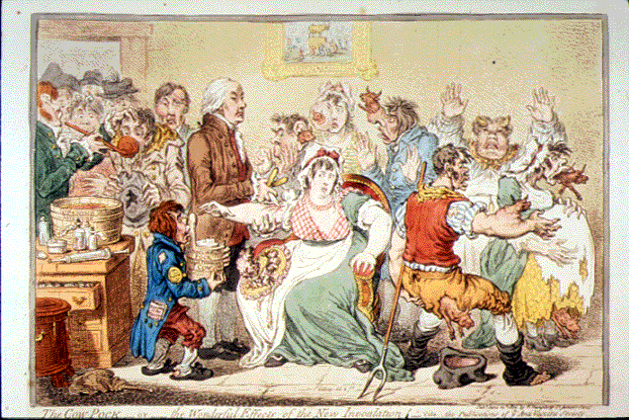

Slide 39
Antibody related slides and passive immunity

Slide 40
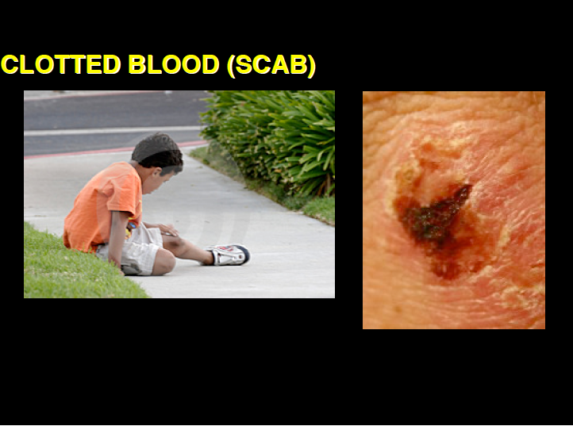


Slide 41
Passive Immunity
to Toxins
Inject mice multiple graduated low doses of toxin( or chemically treated toxin to create toxoid)
Transfer
Serum
(liquid after
blood clots)
Inject with live bacteria or high dose of toxin
live
Naïve second
mouse
Conclusion: Something in serum
protected animals (antibodies)

Slide 42
Immunity to Toxins
X
Inject mice with live bacteria or high dose of toxin
dead
Inject mice multiple graduated low doses of toxin (or chemically inactivated toxin)
Inject mice with live bacteria or high dose of toxin
live
Notes:
Feet up and feet down experiment

Slide 43
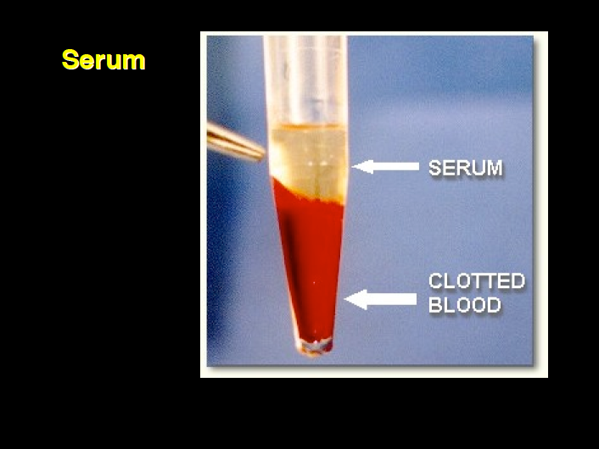

Slide 44
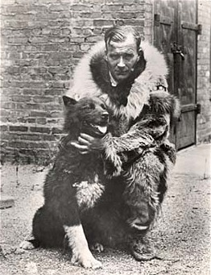
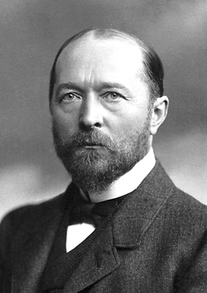
Famous Faces In Passive Immunity
Balto and Gunnar Kaasen.
EMIL VON BEHRING

Slide 45

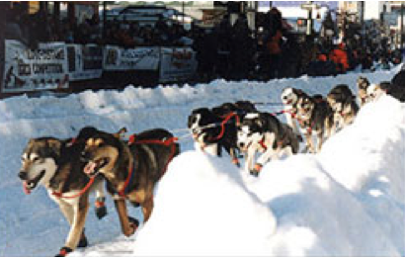
Anti-Toxins used for treatment of disease
Iditaroid Dog race
commemorates life saving
delivery
of anti-toxin for diphtheria
Notes:
Picture of Iditarod Dogs Balto was a Siberian husky born in Nome, Alaska in 1923. He spent much of his early life as part of a sled dog team that transported supplies to miners in the surrounding areas. But Balto is famous for his dog sled race from Nenana, Alaska to Nome, Alaska.
On January 21, 1925, several Inuit children in Nome, Alaska were diagnosed with diphtheria. Without the anti-toxin needed to stop the disease from spreading, almost all of the children in Nome would be attacked by this highly contagious disease. The only serum (antitoxin) for the disease was in a hospital in Anchorage, almost 1000 miles away. A train could only bring the serum part of the distance to Nenana, but after that transportation was hard to come by. Ice prevented transportation by ship, and frequent blizzards prevented transportation by flight. The final decision to transport the serum the remaining 674 miles between Nenana and Nome was by using a relay of dog sled teams. By doing this, it was estimated that it could take up to 13 days.
The package containing the serum left Anchorage by train on Monday, January 26, 1925 and arrived the next day in Nenana where it was turned over to the first dog sled team. More than 20 teams participated in this relay. The last team that would finish the relay was led by a musher named Gunnar Kassen, with Balto leading his sled team.
A blinding blizzard dropped temperatures to -50 degrees and winds gusted at 50 mph. Kassen was unable to navigate his way, and was about to give up all hope. But Balto remembered the trail well and followed his instincts leading Kassen and his team through the cold and snow. On February 2 at 5:30 AM, the team finally arrived in Nome, successfully delivering the serum, only seven days after leaving Anchorage.
Today, in memory of Balto�s hard work there is a statue of Balto in Central Park in New York City. Also the Iditarod Trial Sled Dog race has been run from Anchorage to Nome every year since 1973, and remembers the role of the dog teams in the settlement of Alaska and the heroic serum race that saved many children in 1925. On Balto�s statue there is a plague that reads: �Dedication to the indomitable spirit of the sled dogs that relayed anti toxin 600 miles over treacherous waters, through arctic blizzards, from Nenana to the relief of stricken Nome in the winter of 1925- Endurance, Fidelity, Intelligence.�

Slide 46
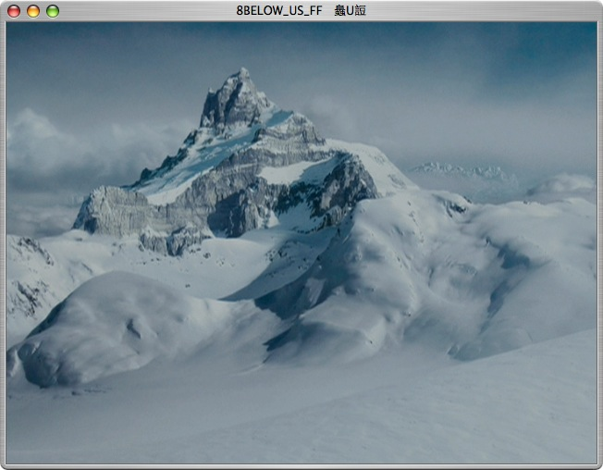

Slide 47
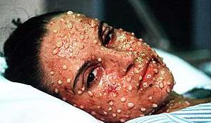
An important Issue for Bioterrorism is how long Does Immunity last?

Slide 48
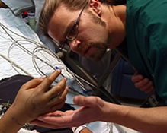
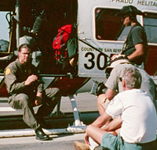
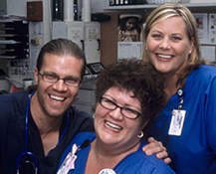
Animal Planet
CroFab
Anti-venin

Slide 49
Animal Planet Doc
Speed is essential
Passive Immunization
Need to act as quickly as possible before venoms can act
Venoms are complex mixtures of proteins
Notes:
NOTe-now using crofab-fab fragmennt reather than whiole antibody

Slide 50
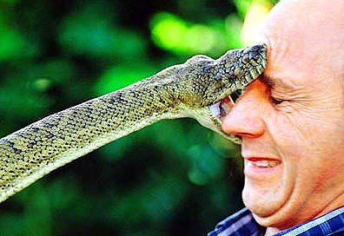

Slide 51
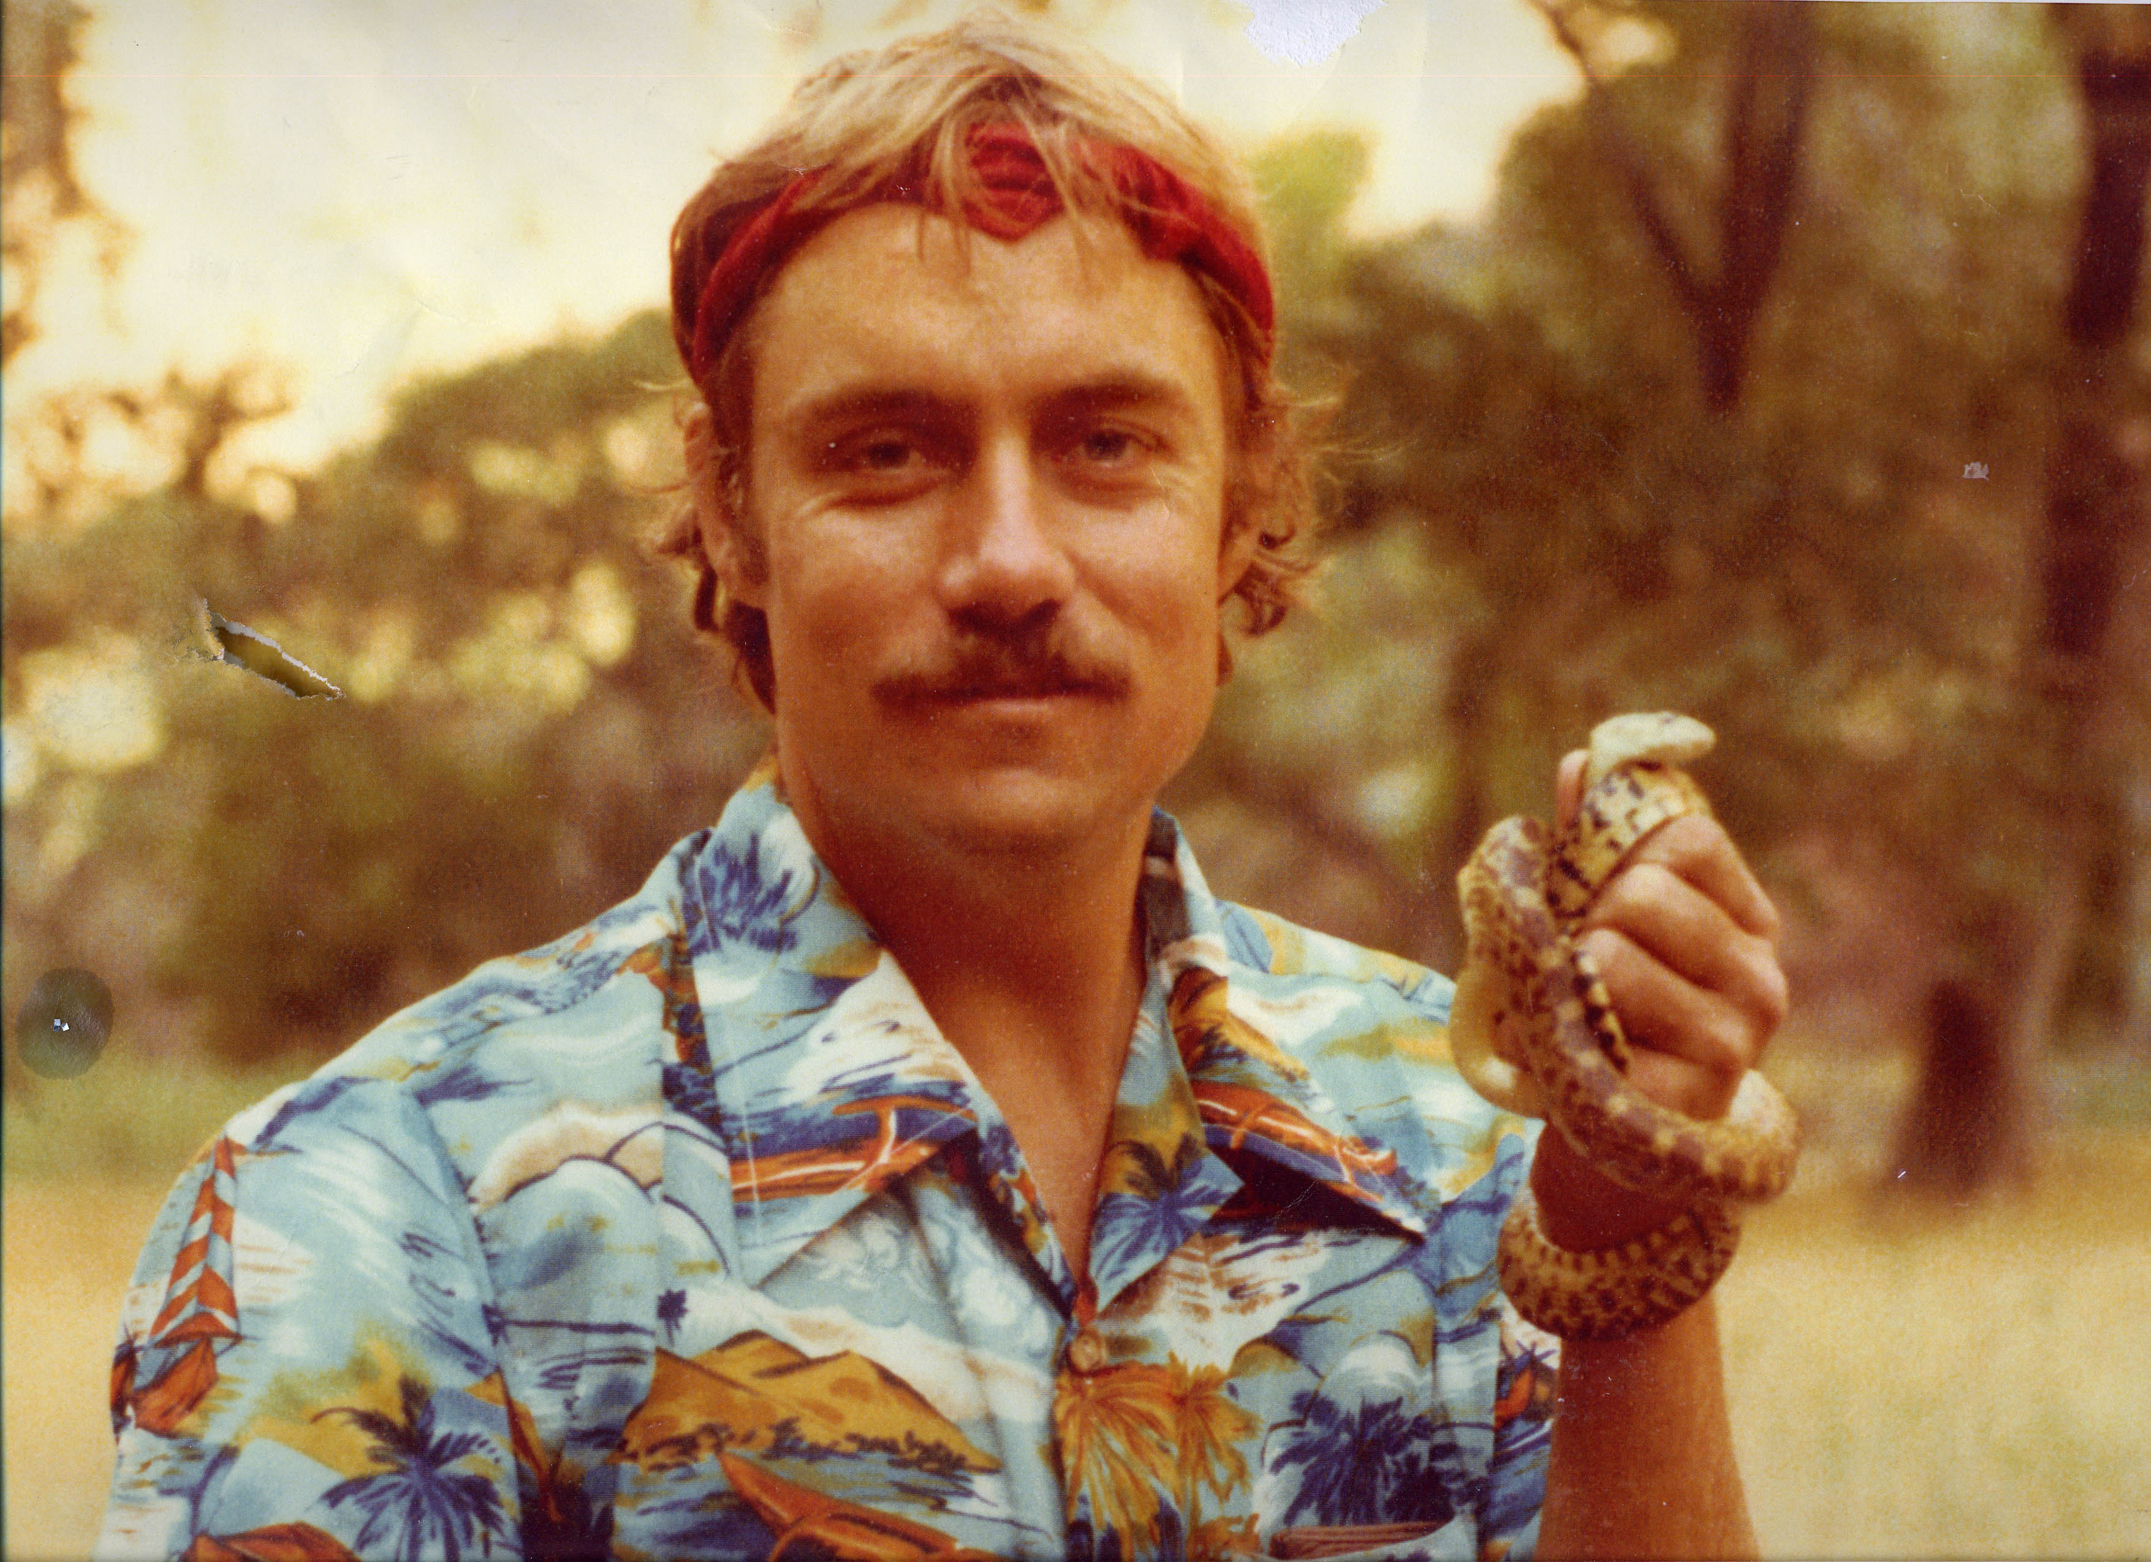

Slide 52

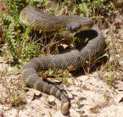
A treatment for rattlesnake Bites is a Passive immunization with Anti-venom typically a polyclonal serum made in horse
What problems might you anticipate?

