Slide 1
2014 Ebola Outbreak And The New York State Response
Host:
Christopher F. Davis PhD, MPH, CPH
Presenters:
Misha Robyn DVM, MPH
Shelley Zansky PhD
Andie Newman DVM, MPH, DACVPM
Monica Quinn RN, MS, CIC
January 8th 2015

Slide 2
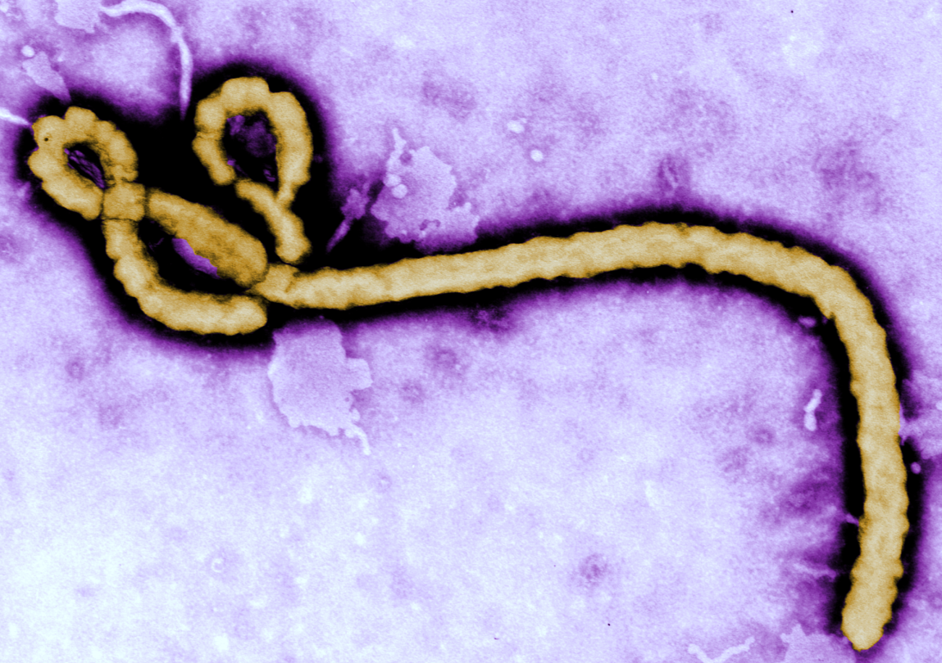
2014 Ebola Outbreak
Misha Robyn DVM, MPH
January 8, 2015
Centers for Disease Control and Prevention
Office of Public Health Preparedness and Response
Notes:
Present state of global outbreak

Slide 3
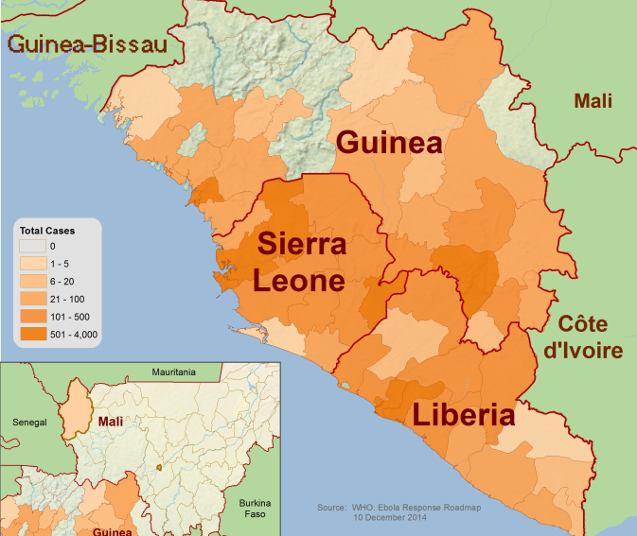
2014 Ebola Outbreak
Largest Ebola epidemic in history
CDC’s response to Ebola is largest international outbreak response in CDC’s history
http://www.cdc.gov/vhf/ebola/outbreaks/2014-west-africa/distribution-map.html

Slide 4
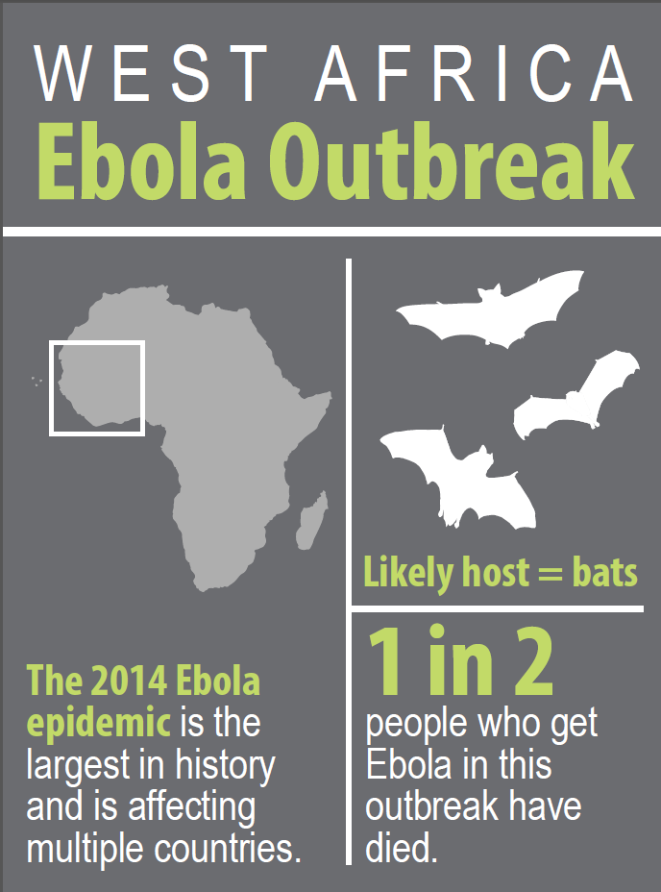
Ebola Outbreak, West Africa
On August 8, the World Health Organization (WHO) declared the current Ebola outbreak is a Public Health Emergency of International Concern (PHEIC)
  The PHEIC declaration underscores the need for a coordinated international response to contain the spread of Ebola
Notes:
Infographic: http://www.cdc.gov/vhf/ebola/pdf/west-africa-outbreak-infographic.pdf

Slide 5
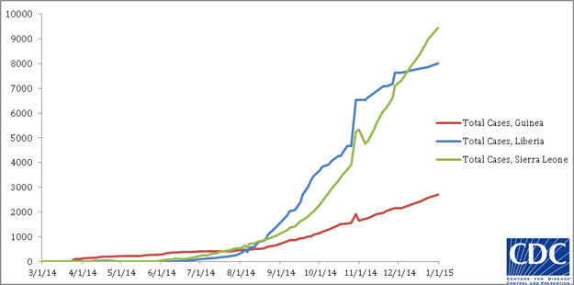
Cumulative reported cases of Ebola virus disease in Guinea, Liberia, and Sierra Leone

Slide 6

Ebola Cases and Deaths
As of January 5, 2015, a total of 20,691 cases of Ebola (13,184 laboratory-confirmed) and 8168 deaths have been reported.
Countries with Widespread Transmission
Country | Total Cases | Laboratory-Confirmed Cases | Total Deaths
Guinea | 2769 | 2465 | 1767
Liberia | 8115 | 3116 | 3471
Sierra Leone | 9772 | 7570 | 2915
Total | 20656 | 13151 | 8153
Countries with an Initial Case or Cases and/or Localized Transmission
Country | Total Cases | Laboratory-Confirmed Cases | Total Deaths
United States | 4 | 4 | 1
Mali | 8 | 7 | 6
Total | 13 | 12 | 7
Previously Affected Countries
Country | Total Cases | Laboratory-Confirmed Cases | Total Deaths
Nigeria | 20 | 19 | 8
Senegal | 1 | 1 | 0
Spain | 1 | 1 | 0
Total | 22 | 21 | 8
Source: http://www.cdc.gov/vhf/ebola/outbreaks/2014-west-africa/case-counts.html
Notes:
For latest case count numbers: http://www.cdc.gov/vhf/ebola/outbreaks/2014-west-africa/case-counts.html

Slide 7
Background on Ebola
Notes:
Let’s review background on Ebola virus.

Slide 8
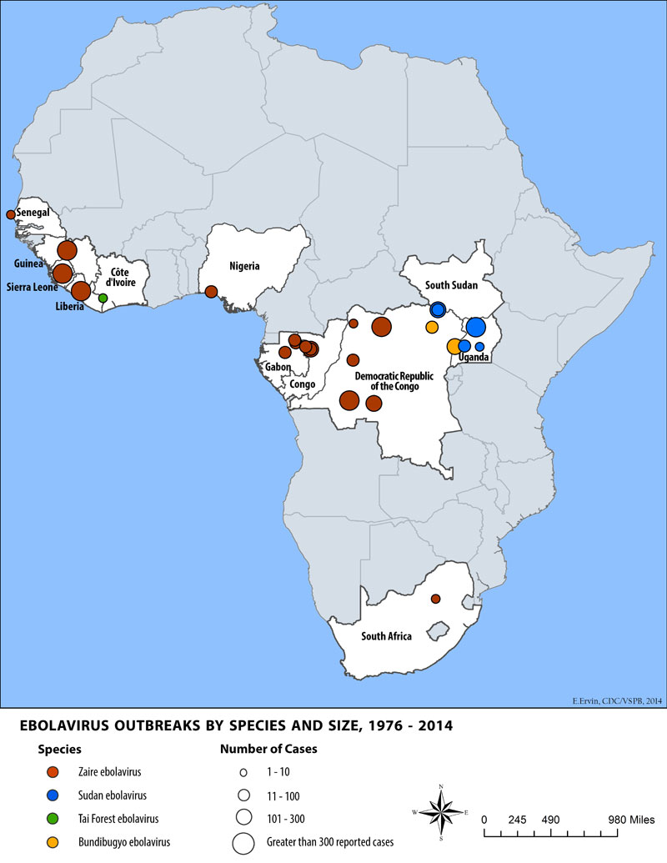
Ebola Background
Ebola is a rare and deadly disease
First discovered in 1976 near the
Ebola River in the Democratic Republic of the Congo
Outbreaks occur sporadically in Africa
Notes:
The first Ebola virus species was discovered in 1976 in Yambuku, Zaire, along the Ebola River (see map on the RIGHT). There were 318 cases, with a case fatality rate of 88%.
Ebola viruses are found in several African countries.
Source: Ebola Virus Disease Distribution Map: http://www.cdc.gov/vhf/ebola/resources/distribution-map.html.

Slide 9
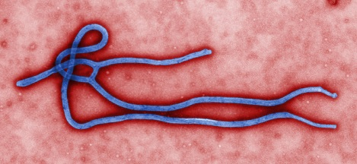
Ebola Virus Disease
Previously called Ebola
hemorrhagic fever
5 species of Ebolavirus
  Zaire ebolavirus
  Bundibugyo ebolavirus
  Reston ebolavirus
  Sudan ebolavirus
  Tai Forest ebolavirus
All but Reston ebolavirus known to cause disease in humans
Historically, death rates for Ebola range from 50%-90%
Notes:
Ebola virus belongs to a family of zoonotic RNA viruses, called Filoviridae, named after their long threadlike appearance, as shown in the colorful electron microscopy image.
Ebola, previously known as Ebola hemorrhagic fever, is caused by infection with one of the Ebola virus species, other than Reston, which is not known to cause disease in humans.
Historically, death rates have ranged from 50-90%

Slide 10
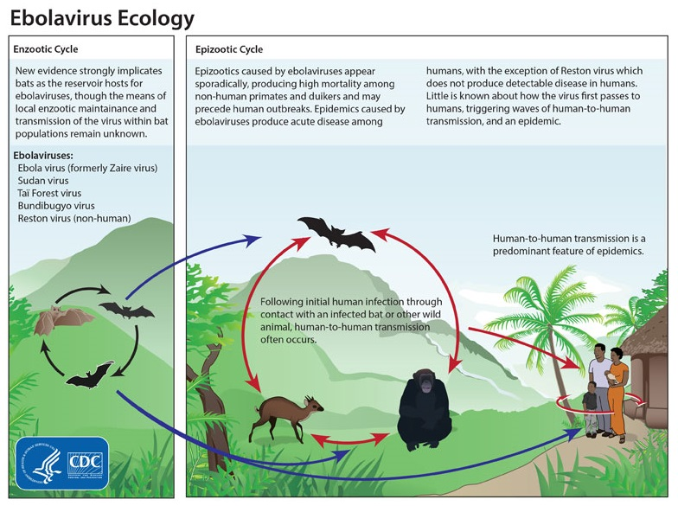
Notes:
Ebola virus ecology consists of an Enzootic cycle, in which the infection is maintained in an animal population, which new evidence strongly suggests bats as the reservoir hosts.
Epizootics occur sporadically, in which ebolavirus causes disease and high mortality in non-human primates and duikers (a type of antelope species). These epizootics may precede human outbreaks. Little is known about how the virus first passes to humans, triggering waves of human-to-human transmission.

Slide 11
Transmission
Ebola virus is spread through direct contact (through broken skin or unprotected mucous membranes) with
  A sick person’s blood or body fluids (urine, saliva, sweat, feces, vomit, semen)
  Contaminated objects (like needles, syringes)
  Infected fruit bats and primates (apes, monkeys)
Ebola virus has been found in breast milk, but it is not known if the virus can be transmitted from mothers to infants through breastfeeding
Ebola virus has been found in semen after recovery, but it is not known if the virus can be spread through sex (including oral sex)
  Men should abstain from sex (including oral sex) for three months
Mosquitoes or other insects cannot transmit Ebola virus
It is not believed that pets (like dogs and cats) are at significant risk for Ebola

Slide 12
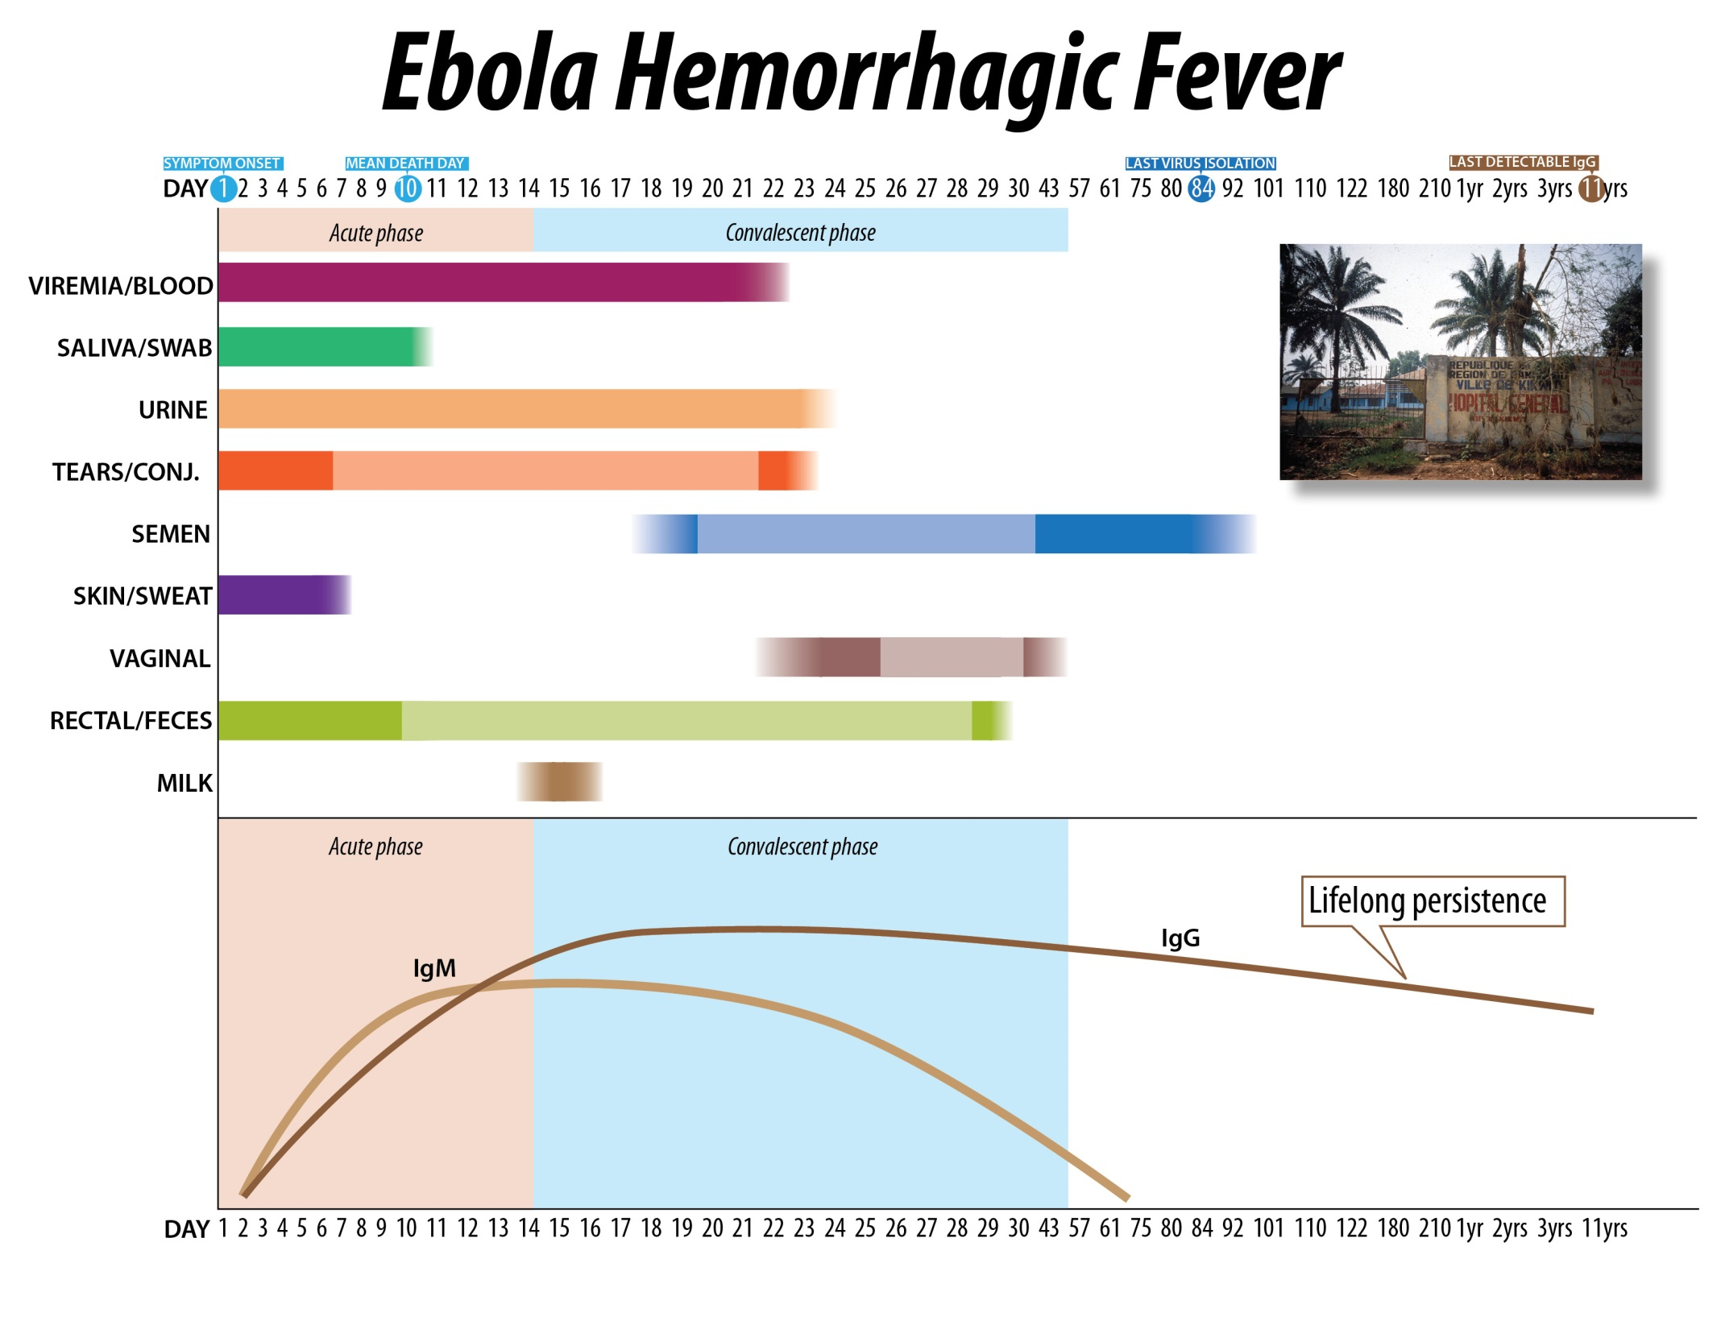
Human to Human Transmission
Notes:
This slide depicts the infectiousness of different body fluids over time.
On the top horizontal axis is time, starting at day 1 of symptom onset where the yellow arrow is.
Various body fluids are listed on the vertical axis. Dark colors indicate the fluid is infectious; lighter colors mean the fluid may be infectious.
During the acute phase, before the dashed yellow line, from 1 to 14 days after symptom onset, blood, saliva, urine, tears, skin, sweat, feces and breast milk are infectious.
Yes, semen and vaginal secretions can be infectious, which is why survivors are cautioned about sexual transmission and provided with condoms.
There are two main points here. First, a person is infectious WHEN they are symptomatic. Second, there are control measures which can prevent exposures to these body fluids.

Slide 13
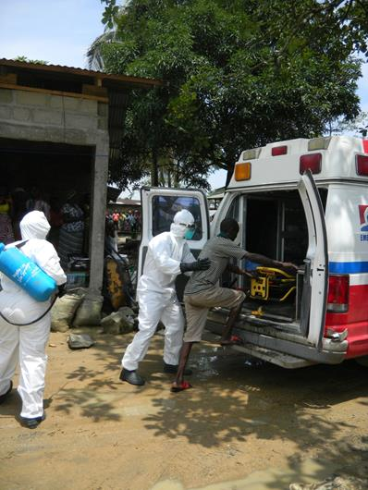
Signs and Symptoms
Signs and symptoms of Ebola
  Fever
  Severe headache
  Fatigue
  Muscle pain
  Vomiting
  Diarrhea
  Abdominal pain
  Unexplained hemorrhage
Incubation period, from exposure to when signs or symptoms appear, is 2 to 21 days, but average is 8 to 10 days
  A person infected with Ebola virus is not contagious until symptoms appear

Slide 14
Prevention
No FDA-approved vaccine for Ebola
  Experimental vaccines for Ebola are under development, but have not yet been fully tested for safety or effectiveness
  Several investigational vaccines for prevention of Ebola are in development and are currently being evaluated in Phase I trials. In addition, Phase II trials are currently being planned in West Africa.

Slide 15
Ebola Response in West Africa
Notes:
Let’s review background on Ebola virus.

Slide 16
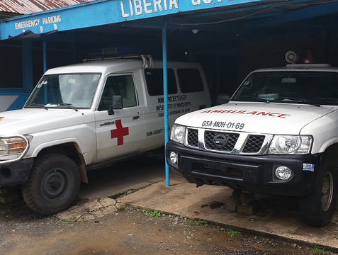
Outbreak Challenges in West Africa
Overburdened public health and healthcare systems
  Unpaid healthcare workers
  Insufficient treatment centers, beds, medical supplies, and personal protective equipment (PPE)
Notes:
Challenges to battling and stopping the Ebola outbreak in West Africa
Overburdened public health and healthcare systems
Unpaid healthcare workers, in some instances
Insufficient treatment centers/beds, medical supplies, personal protective equipment (PPE)
Photograph: Defunct ambulances at the Tubmanburg General Hospital in Bomi County, Liberia. With no functional ambulances, the county health officers cannot transfer patients to the Ebola Treatment Unit (ETU) in Monrovia.

Slide 17
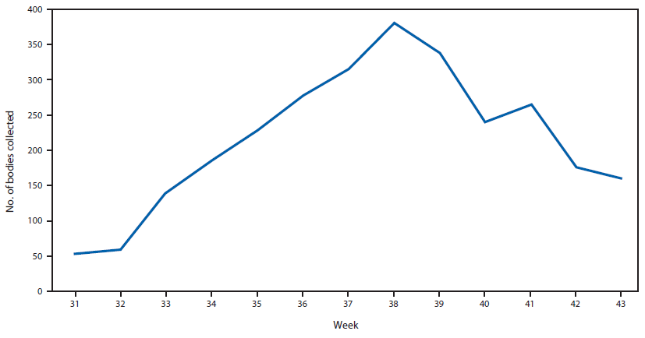
Number of bodies collected by week – Montserrado County, Liberia (July 28 – Oct 26)
MMWR. Evidence for Declining Numbers of Ebola Cases - Montserrado County, Liberia, June-October 2014. Nov 14, 2014.
Notes:
This is a graph showing the number of dead bodies collected by Epi Week in just Montserrado County from July 28 – Oct 26. Montserrado County is the county where Monrovia, the capital city, is, and also the place with the highest number of cases.
Since late July 2014, the International Federation of Red Cross and Red Crescent Societies (IFRC) has been responsible for the collection and cremation of all dead bodies from ETUs (except ELWA-3) and bodies from the community. For the period July 28–October 26, a total of 2,234 bodies were collected by the IFRC. The number of bodies believed to be the result of an Ebola-related death rose to a maximum in week 38 (September 15), with 380 bodies collected, and then declined to 160 by week 43 (October 20).
The majority (1,179 [53%]) were collected from homes or other community settings, 744 (33%) from ETUs, 194 (9%) from non-ETU health facilities, and 117 (5%) from unknown locations.
This may be due to both an overburdened healthcare system and community distrust of the government and outsiders.

Slide 18
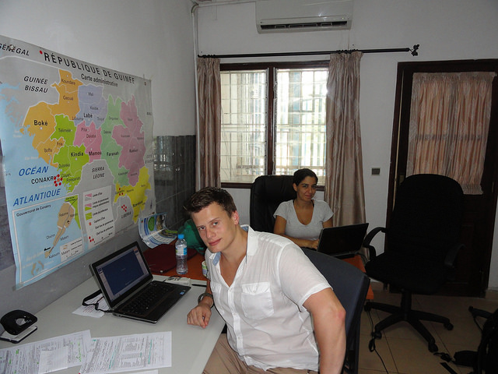
Outbreak Challenges in West Africa
    Inefficient use of stakeholders
      Backlog of data cleaning and entry
      Need for complete data
      Need to report suspected cases instead of waiting for lab confirmation
Notes:
Challenges to battling and stopping the Ebola outbreak in West Africa (continued)
Inefficient use of stakeholders
Backlog of data cleaning and entry that stakeholders could help to do
Need to complete critical missing data, such as contacts for confirmed cases
Need to report suspect cases instead of simply waiting for lab confirmation
Political pressure to underreport and intense media scrutiny
Photo: Negar Aliabadi and Max Nerlander, CDC EIS Officers, are working on their EpiInfo database at WHO office in Guinea

Slide 19
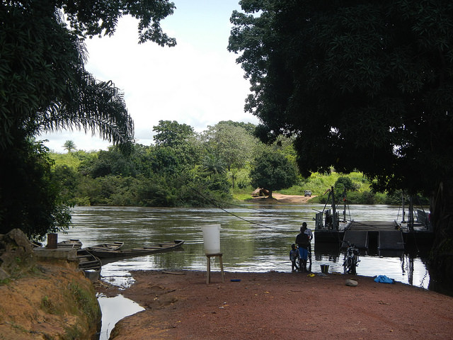
Outbreak Challenges in West Africa
Porous borders
High population mobility
Geographic breadth
Notes:
This is a picture of the borders of Guinea and Sierra Leone. Sierra Leoneans come across every week to sell items in the Gueckedou market. As you can see, border control is nonexistent. If someone is sick with Ebola in Guinea, but wants to be with their family in Sierra Leone, that person simply needs to take a boat across.
High population mobility by multiple means, such as motorbikes, boats, and cars, across these porous borders makes it hard to investigate new case leads since cases can migrate easily to another country. Contact tracing also is difficult in these circumstances.
The geographic breadth across which people move makes stopping human to human transmission very difficult.

Slide 20
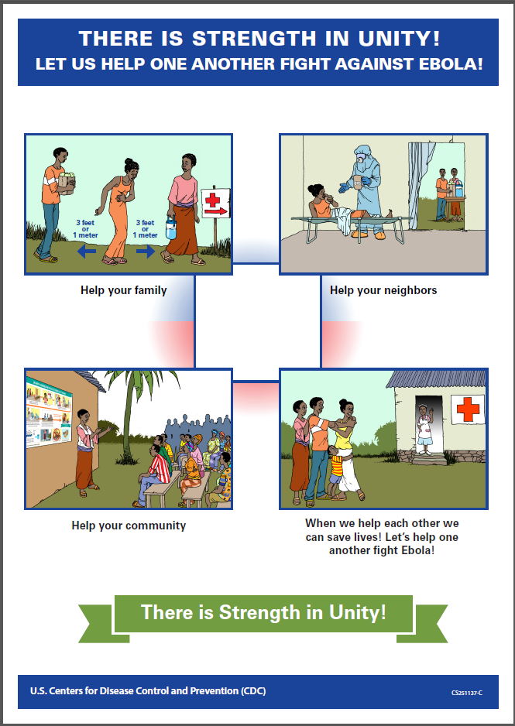
Outbreak Challenges in West Africa
Lack of acceptance of Ebola
Not overcome by education
Fear and superstition
  Health posters
Stigma
  Needing to share negative test results to return to work
Distrust of outsiders
  Brought Ebola to make money
Role of war exposure
Notes:
There are many challenges to this epidemic.
Lack of acceptance of EVD among the local population is a major one.
This has not been fully surmounted by education.
Fear and superstition are commonplace among the population. In one clinic which had health posters concerning a variety of topics on the walls, locals insisted that the Ebola-specific posters, such at this one on the RIGHT, be removed out of fear that such posters meant they would get Ebola in the clinic.
Stigma impacts the population negatively as well. Multiple people upon discharge from the ebola treatment center are not allowed to return to work despite having had two negative tests.
There is a strong distrust of outsiders. Some locals believe Ebola was brought to Guinea by outsiders to make money.
This area has had multiple civil wars in recent years, and there is a high level of distrust the not just outsides, but the local governments as well.
Poster: http://www.cdc.gov/vhf/ebola/pdf/preventings-stigma-low-literacy.pdf

Slide 21
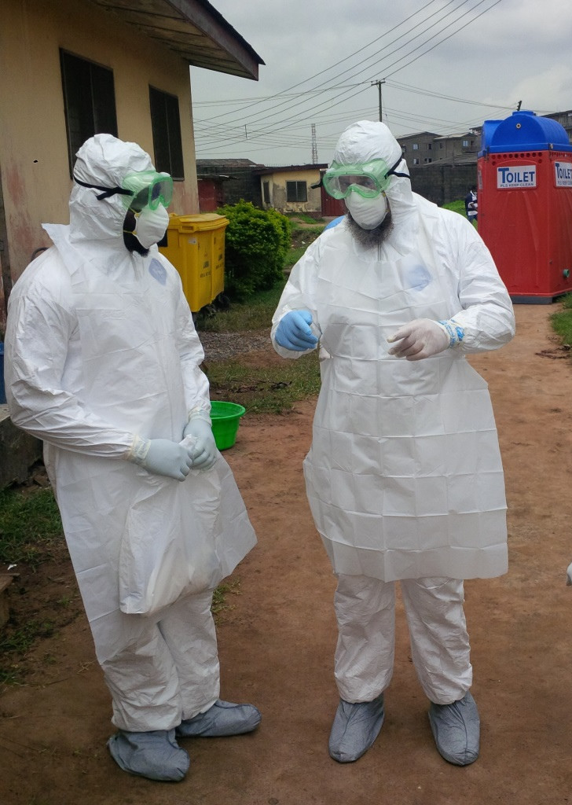
Overall Goals in Outbreak Response
Patient Care
  Experienced and/or trained staff
  Strict use of personal protective equipment (PPE)
Stop human to human transmission
  Case identification
  Contact tracing
  Infection control
Notes:
Overall goals in outbreak response
Patient Care
Experienced and/or trained staff
Strict use of personal protective equipment (PPE)
Stop human to human transmission
Case identification
Contact tracing
Infection control
Photograph: Nigerian physicians being trained by the World Health Organization (WHO) on how to put on and remove personal protective equipment (PPE) to treat Ebola patients.

Slide 22
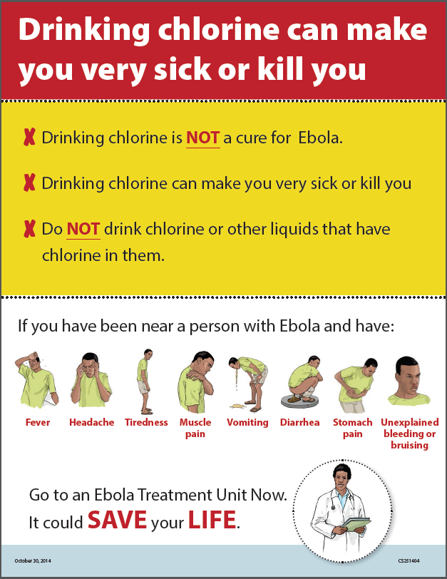
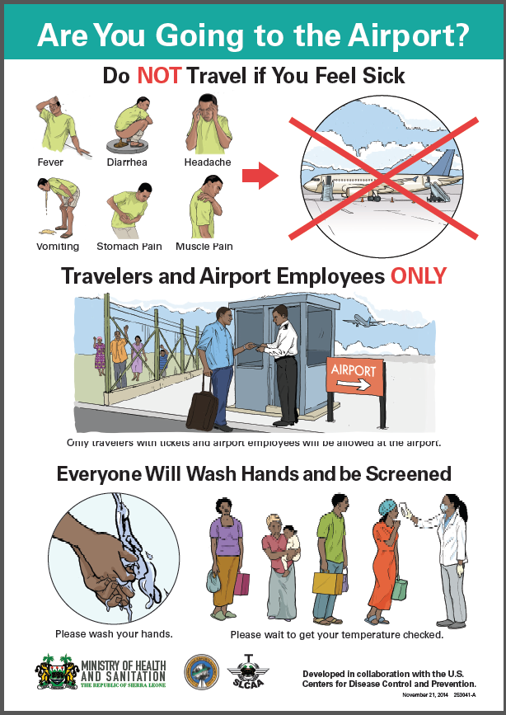
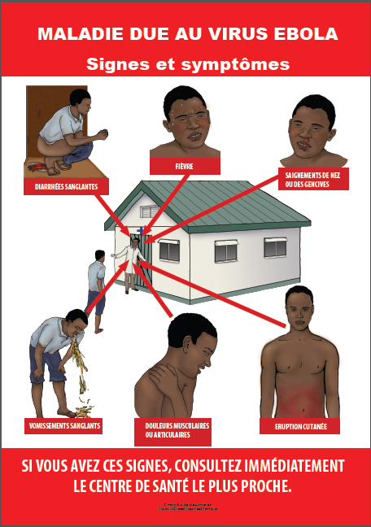
Overall Goals in Outbreak Response
Community education
  Text messages, radio and video messages in local languages, fact sheets, health posters, and pamphlets
Notes:
Overall goals in outbreak response (continued)
Community education
Fact sheets, health posters, pamphlets, radio spots, videos in local languages
http://www.cdc.gov/vhf/ebola/pdf/drinking-chlorine-can-make-you-sick-or-kill-you.pdf
http://www.cdc.gov/vhf/ebola/pdf/ebolaandmarburgpostersignssymptomsbrightredcolorfrench.pdf
http://www.cdc.gov/vhf/ebola/pdf/sierra-leone-airport.pdf
Listen or download Ebola radio health messages in local languages or see English transcript at http://www.cdc.gov/vhf/ebola/outbreaks/guinea/radio-spots.html.

Slide 23
Countering Stigma
West Africans, people who have traveled to West Africa, and healthcare workers may face stigma
  Stigma involves stereotyping and discriminating against an identifiable group of people, a place, or a nation
Communicators and public health officials can help counter stigma during the Ebola response by emphasizing that
  People born in West Africa are not more at risk for Ebola than anyone else. Viruses cannot target a particular population.
  If someone recently traveled to Guinea, Liberia, or Sierra Leone, they do not put others at risk if they don’t have symptoms
  Active monitoring does not mean a person is contagious. It means they are being watched for symptoms because they may have had some risk of exposure.
  Someone living with an individual who is being actively monitored is not at higher risk of getting or spreading Ebola

Slide 24
For the most current information, visit
http://www.cdc.gov/vhf/ebola/index.html

Slide 25
Airport Monitoring of Travelers Returning from Ebola Affected Countries
JFK Summary, October 2014 – January 2015
Shelley Zansky, PhD
Director, Emerging Infections Program
Bureau of Communicable Disease Control

Slide 26
NYSDOH JFK Screening Operation
Purpose:
Prevent and control the spread of Ebola in New York State (NYS)
Implement the Commissioner’s Order of October 27, 2014
Commissioner’s Order:
Identify and quarantine asymptomatic individuals who:
  Had “direct contact” to Ebola virus disease (EVD)
  AND
  Will be remaining in NYS for >12 hours

Slide 27
JFK Ebola-Related Screening Process
CBP Primary Passport Check
If itinerary originates from Ebola-affected country OR passport from an Ebola-affected country, person is sent to CBP Secondary Screening
CBP Secondary Screening
Anyone with signs of illness OR positive exposure is sent to CDC Tertiary Screening
CDC Tertiary Screening
If symptoms: conduct medical evaluation - persons with possible EVD immediately triaged to a medical facility
NYSDOH Screening
Determine if the person:
plans to remain in NYS (>12 hours or overnight) AND
meets the “direct contact” criteria
Additional screening for temperature, symptoms and exposures
If Ebola exposure history: determine if person meets CDC high risk, some risk or no known risk category.
May place someone on Do Not Board (DNB) status

Slide 28
Information Obtained During Airport Screening & Included in Epi-X Line List
Personal Information
  Name
  DOB
  Gender
  Permanent/Temporary Addresses, Phone Numbers, and Email
Arrival City/Airport and Date of Arrival
Ebola Affected Countries Visited
Health status – observed vomiting, diarrhea or bleeding; temperature; fever in past 48 hours; vomiting/diarrhea in past 48 hours
Health care worker in Ebola Affected Country; contact with a person sick with Ebola; touched body of someone who died in Ebola Affected Country

Slide 29
Travelers Returning from Ebola Affected Countries to JFK: 10/11/14 - 01/06/15

Slide 30
Proportion of Travelers Returning from Each Ebola Affected Country
Entire Monitoring Period: 10/11/14-01/06/15
Period Mali Included as an Ebola Affected Country: 11/18/14-01/05/15

Slide 31
Average Daily JFK Arrivals by Week: Proportion with NY as Final Destination, 10/26/14 - 01/03/15

Slide 32
Average Daily JFK Arrivals By Week: Final Destination NYC & NYS, 10/11/14 - /01/06/15

Slide 33
JFK Tertiary Screening Outcomes (N=21)
10/11/14 – 01/06/15

Slide 34
Health Care Workers Returning from Ebola Affected Countries: 10/11/14 – 01/06/15

Slide 35
Resident Counties of Returning Travelers (Excluding NYC), 10/11/14 - /01/06/15

Slide 36
The Ebola Outbreak and the New York State Response:
Contact Tracing and Management
Andie Newman DVM, MPH, DACVPM
January 8, 2015

Slide 37
Ebola Virus: Outbreak Control
Rapid identification and isolation of patients
Use of personal protective equipment (PPE) and strict adherence to infection control guidelines
Cleaning and disinfection of equipment
Appropriate handling/disposal of medical waste
Handling of corpses
Contact tracing and quarantine of exposed persons
Social mobilization
  Door-to-door education
  Radio
  Religious groups

Slide 38
Outbreak Control

Slide 39
Contract Tracing
Contact tracing: the identification and follow-up of persons who may have come into contact with an infected person
Goal: Rapid identification of persons infected with Ebola virus in New York State to interrupt disease transmission
Expected Outcome: Early isolation and treatment of persons symptomatic for Ebola virus disease
  Minimize the potential for secondary cases
  Protect public health
  Improve chances of patient survival
To be effective, it must be prompt and thorough

Slide 40
Contract Tracing and
Management: Who
Returning travelers from Guinea, Liberia, and Sierra Leone
  Airport screening
  Land-border crossings
    Erie, Niagara, Clinton and Jefferson Counties
Persons exposed to EVD patients in the US
  Household contacts, friends, co-workers
  Healthcare workers

Slide 41
Contact Tracing and
Management: How
Depends on level of risk
  High Risk Contacts of an EVD Patient
  Some Risk Contacts of EVD Cases
  Low (But Not Zero) Risk Contacts of an EVD Patient
  Persons with No Identifiable Risk
In New York State, being conducted by local health departments (LHDs) and DOH employees

Slide 42
CDC CARE Kit
Notes:
The Check and Report Ebola (CARE) kit

Slide 43
Airline Travelers from Countries with Widespread Ebola, 10/11/14-1/7/2015
county of destination

Slide 44
High Risk Exposures
Had percutaneous (e.g., needle stick) or mucous membrane exposure to blood or body fluids of the EVD patient while the person was symptomatic
Had exposure to the blood or body fluids (including but not limited to feces, saliva, sweat, urine, vomit, and semen) of the person with Ebola while the person was symptomatic without appropriate PPE
Processed blood or body fluids of the confirmed EVD patient while the patient was symptomatic without appropriate PPE or standard biosafety precautions
Lived in the immediate household with the person with Ebola while the person was symptomatic
Had direct contact with a dead body without appropriate PPE in a country with widespread EVD

Slide 45
Some Risk Exposures
Close contact in healthcare facilities, households or community settings with the person with Ebola while the person was symptomatic
  Close contact is defined as being for a prolonged period of time while not wearing appropriate PPE within approximately 3 feet (1 meter) of a person with Ebola while the person was symptomatic
Direct contact while using appropriate PPE with a person with Ebola while the person was symptomatic or with the person's body fluids, in a country with widespread transmission

Slide 46
Low (but not zero) Risk Exposures
Had brief direct contact (e.g., shaking hands) while not wearing appropriate PPE, with the person with Ebola while the person was in the early stage of disease
Were in brief proximity, such as being in the same room for a brief period of time, with the person with Ebola while the person was symptomatic
Had direct contact while using appropriate PPE with the person with Ebola while the person was symptomatic and in a country without widespread Ebola virus transmission (e.g., the U.S.);
  Includes healthcare workers who have cared for known EVD patients in U.S. facilities while wearing recommended PPE and with no known breaches in infection control
Notes:
Health care workers include (but are not limited to) physicians, nurses, nursing assistants, therapists, technicians, emergency medical service personnel, dental personnel, pharmacists, laboratory personnel, autopsy personnel, students and trainees, contractual staff not employed by the health-care facility, and persons (e.g., clerical, dietary, housekeeping, laundry, security, maintenance, administrative, billing, and volunteers) not directly involved in patient care but potentially exposed to infectious agents that can be transmitted to and from health care workers and patients.

Slide 47
Low (but not zero) Risk Exposures
Travelled on an aircraft with the person with Ebola while the person was symptomatic
Had been in a country with widespread Ebola virus transmission within the past 21 days and had no known exposures

Slide 48
No Identifiable Risk
Contact with an asymptomatic person who had contact with a person with Ebola
Contact with a person with Ebola before the person developed symptoms
In a country with widespread Ebola virus transmission more than 21 days previously
In a country with Ebola cases, but without widespread transmission or cases in urban settings with uncertain control measures, and did not have any other exposure defined above
Having remained on or in the immediate vicinity of an aircraft of ship during the entire time the conveyance was present in a country with widespread transmission and having no direct contact with anyone in the community

Slide 49
Airline Travelers to New York State (excluding NYC) from Countries with Widespread Ebola,
10/11/2014–1/7/2015
 | Frequency
Low Risk but not Zero | 86 (97%)
Some Risk | 3 (3%)
High Risk | 0

Slide 50
Post-arrival Monitoring: High or Some Risk Contacts
21-day voluntary quarantine from time of last high or some risk exposure
Direct active monitoring: 2x/daily visual visits to check temperature and health status
Possibility of a mandatory quarantine order for persons found not to be complying with voluntary quarantine
To date, has been done by DOH staff

Slide 51
Monitoring of High/Some Risk Contacts
Establish regular communication with exposed individuals
Twice daily check to assess for the presence of symptoms and fever, rather than relying solely on individuals to self-monitor and report symptoms if they develop
  Immediately prior to entering the home for each visit, call the individual to verify the lack of fever or symptoms
  Directly observe(e.g. in person) the individual at least once daily to review symptom status and monitor temperature; a second follow-up per day may be conducted remotely in lieu of a second direct observation
During each visit assess compliance with movement restrictions and general welfare
  Food, medications, other supplies, mental health, social services, etc.

Slide 52
Voluntary Quarantine – Considerations
Is the environment suitable for quarantine?
  Prior to quarantine, the home is assessed to be sure it is suitable to allow persons to remain there, including the need for de-contamination
  If de-contamination is needed or if the home is not suitable for other reasons, a safe place for contacts to live during the quarantine period or until their home is suitable must be identified
How will household pets be handled to avoid quarantine or euthanasia if they were exposed to Ebola?

Slide 53
General Considerations for Implementation of Quarantine and Monitoring
The contact should have a way to self-isolate from household members and pets as soon as possible if fever or other symptoms develop
  Ideally somewhere with a door that separates it from the rest of the living area and has its own bathroom
Given that an exposed person might become ill while sleeping, the contact should sleep in a separate bedroom from household members and pets

Slide 54
Voluntary Quarantine:
Other Planning Considerations
Where will the contact go in case of illness?
  EVD? Other (e.g., traumatic injury)?
  Who should transport?
  Who should be notified first? In an emergency, call 911. For a non-emergency, the first call should be to PH
Provision of needs not limited to
  Food, shelter, mental health, and social services
  Access to the internet, phone, books, games, TV
  Supplies for personal hygiene
  Financial resources as a result of not working
  Pet care

Slide 55
Other Considerations for Voluntary Quarantine
Individuals can walk outside their house on their own property, but they should not come within six feet of neighbors or others members of the public
  Does not apply to persons living in a rental unit unless it is a single family unit
  Likewise, these individuals should refrain from walking in their neighborhood
Guests may be allowed
  They must be able to make an informed choice
  They should remain >3’ away from the person being monitored
  A log book should be kept for all guests

Slide 56
What About Household Members of Persons under Quarantine?
There is no medical or public health reason why household members, including children, of asymptomatic persons under home quarantine cannot continue to attend school or work.
  They have not been exposed to Ebola virus and are not at risk of developing EVD as long as they remain unexposed.
However, given the concern that EVD may raise in the school and in the community, relocation of household members to a suitable environment outside of the quarantine location (e.g., a hotel or the home of another family member or friend) may be requested to avoid stigmatization and alleviate community concerns about household members continuously entering/exiting the quarantine location

Slide 57
Post-arrival Monitoring:
Low (But Not Zero) Risk Travelers
21-day monitoring recommended, with no movement restrictions, with active monitoring
Active monitoring: 2x/daily reports on temperature and symptoms
By LHD

Slide 58
Post-arrival Monitoring: Low (But Not Zero) Risk Contacts
Monitoring for 21 days after their last potential exposure.
LHD establishes regular, daily communication, to assess for the presence of symptoms and fever
  Phone
  E-mail

Slide 59
Low (But Not Zero) Risk Contacts
No restrictions on travel, work, public conveyances, or congregate gatherings, subject to the following considerations:
  Monitoring must continue without interruption
  All plans for travel outside of the LHD’s jurisdiction that might interfere with twice daily monitoring must be communicated in advance so that suitable arrangements for monitoring can be made with the jurisdiction of destination
  If the patient travels, arrangements may be made with the jurisdiction of destination for their monitoring during the time that the person is in the other jurisdiction

Slide 60
Monitoring Requirements:
Sometimes a Mixture
High and/or Some Risk
Low But Not Zero Risk
21 Days since last recognized exposure to EVD
21 Days of Active Monitoring
Last day of direct contact with Ebola patients
Last day in country with widespread Ebola
Quarantine with Direct Active Monitoring
Active Monitoring with No Movement Restrictions

Slide 61
No Identifiable Risk
No movement or monitoring restrictions are necessary unless there is a change in exposure category.

Slide 62
Ebola Virus Disease:
Preventing Infection in Healthcare Personnel
Monica Quinn RN, MS, CIC

Slide 63
Outline
EVD among Healthcare Personnel
Administrative and Work Practice Controls
Use of Personal Protective Equipment
Monitor Healthcare Workers for Illness

Slide 64
EVD Among HCP
As of Dec 28, 2014 | # HCP with EVD | # HCP Deaths
Liberia | 369 | 178
Sierra Leone | 148 | 110
Guinea | 143 | 87
Nigeria | 11 | 5
USA | 3 | 0
Mali | 2 | ~
Spain | 1 | 0
United Kingdom | 1 | 0
Total | 678 | 382
http://apps.who.int/iris/bitstream/10665/146763/1/roadmapsitrep_31Dec14_eng.pdf?ua=1
http://www.who.int/csr/disease/ebola/ebola-6-months/nigeria-senegal/en
Notes:
As of Dec 28 2014
EVD (Total Affected) (Total Deaths)
Guinea 2707 1709
Liberia 8018 3423
Nigeria 11 5
Sierra Leone 9446 2758
Total 20171 7890

Slide 65

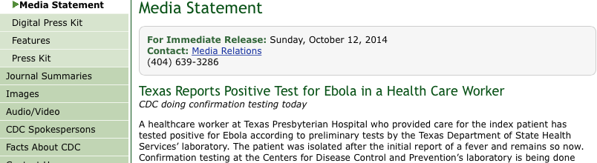
Exposure of Health-care Workers to EVD
Spain and Texas, USA
Notes:
Fall 2014: Transmission can happen in the US… These events resulted in a change in approach and recommendations for protecting HCP
Mention that the talk focuses on US Hospital inpatients.

Slide 66
CDC Enhanced Guidance:
EVD Personal Protective Equipment
Lessons learned from experience of US hospitals:
  Rigorous and repeated training
  No skin exposure when PPE is worn
  Trained monitor to observe and supervise
  Selection and use of PPE
    Use of PAPR with a full face shield, helmet or headpiece OR single use (disposable) N95 respirator in combination with single-use (disposable) surgical hood extending to shoulders and single-use (disposable) full face shield.
    Single-use (disposable), fluid-resistant or impermeable apron that covers the torso to the level of the mid-calf should be used if patients with EVD have vomiting or diarrhea. An apron provides additional protection against exposure of the front of the body to body fluids or excrement.

Slide 67
Administrative Controls
Designated site managers
Triage protocols
Identify critical patient care functions
Identify essential healthcare workers
TRAINING and PRACTICE for safe care of the Ebola patient
  Standard precautions and isolation procedures
  Use of personal protective equipment
  Healthcare personnel monitoring

Slide 68
Work Practice Controls
Isolate the Ebola patient in an appropriate private room
Limit the number of healthcare workers
Monitor patient care area at all times, use a HCP entry and exit log
Use a trained observers to watch HCP for possible exposures during patient care and during donning and doffing of PPE
Take sufficient time to put on and remove PPE
Ensure environmental cleaning and surface disinfection

Slide 69
Rationale for Monitoring HCP
Potential for unrecognized breaches in infection control and the high risk of coming into contact with blood or bodily fluids of sick patients
Allows for immediate exclusion, isolation, and early treatment of suspect cases among HCP
Goal is to assure daily monitoring, assure HCP and community safety, conduct monitoring without unduly burdening HCP

Slide 70
Commissioner’s Order
October 16, 2014
  Covered entities must maintain a log of all personnel coming into contact with a Patient or a Patient’s area or equipment, regardless of the level of PPE worn
  Covered entities shall measure the temperature twice daily of all personnel who come in contact with a Patient or a Patient’s area or equipment, including from off-duty personnel
  The log must describe each person’s measured temperatures and any symptoms
Notes:
Contact is defined as coming in physical contact, entering a Patient’s room, coming within three feet of a Patient, or performing laboratory testing on a specimen from a Patient with or without use of PPE’s.

Slide 71
Monitoring of Persons with Potential Ebola Virus Exposure
CDC recommends that healthcare personnel who provide care to Ebola patients in U.S. facilities, even while wearing appropriate PPE and with no known breaches in infection control, have direct active monitoring
Direct active monitoring for fever or other symptoms should continue until 21 days after the last exposure to the patient with EVD
http://www.cdc.gov/vhf/ebola/exposure/monitoring-and-movement-of-persons-with-exposure.html

Slide 72
Healthcare Personnel Exposure Risk
Low (but not zero) risk
  Healthcare workers who provide care in US facilities while wearing appropriate PPE
  Direct active monitoring, no travel or activity restrictions if direct active monitoring is conducted
  Some Risk/High Risk (HCP subject to activity and movement restrictions)
  Healthcare workers taking care of an Ebola patient in a US facility where another HCW is diagnosed with EVD without an identified infection control breach
  Close contact for prolonged period of time while not wearing appropriate PPE with a person with EVD while they were symptomatic
  Percutaneous injury, mucous membrane exposure, blood or body fluid exposure or processing specimens from a patient symptomatic with EVD without appropriate PPE
http://www.cdc.gov/vhf/ebola/exposure/monitoring-and-movement-of-persons-with-exposure.html
Notes:
Verbal: mention HCPs in Africa = Some risk

Slide 73
Direct Active Monitoring
Hospitals should monitor HCP twice a day for temperature and symptoms on work and non-workdays
Monitoring should continue until 21 days after
the last exposure
On work days monitoring must be done at the beginning and end of the work shift
On non-work days or leave of absence monitoring must be done twice a day
  One assessment must be observed
  NYSDOH will allow ‘tele-monitoring’ by smart phone or video hookup as an acceptable means of direct observation

Slide 74
Hospitals Must Share HCP Monitoring Data with Public Health
HCP monitoring data must be entered daily by the hospital into the Communicable Disease Epidemiologic Surveillance System (CDESS)
Use of CDESS allows HCP contact data to be accessible by those who need to see it:
  Hospital staff who are granted CDESS accounts for the purpose
  of HCP monitoring
  Local Health Department
    Where the hospital is located
    Where the patient with EVD resides
    Where the HCP reside
  NYSDOH

Slide 75
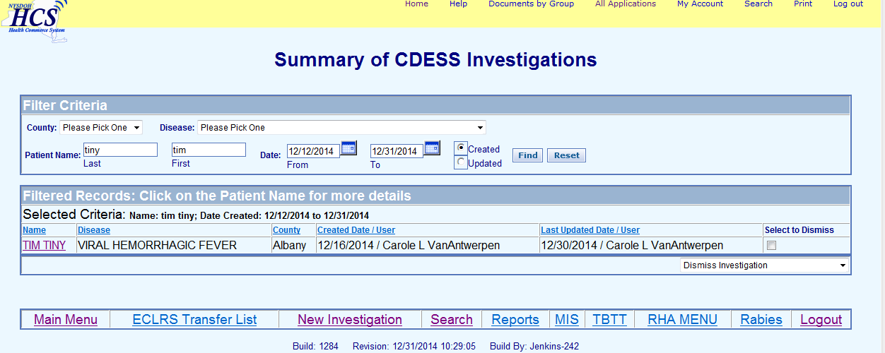
Viral Hemorrhagic Fever (VHF) Case
Notes:
CDESS has been modified to allow hcp monitoring data to be entered.

Slide 76
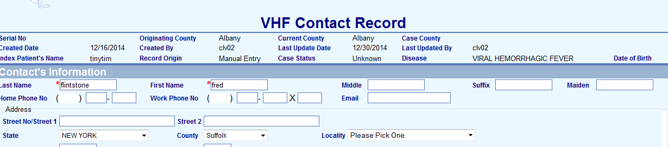
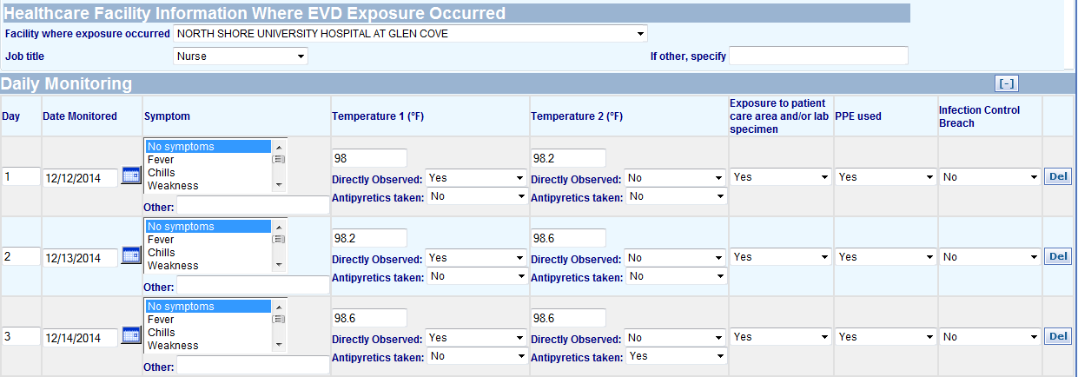

Slide 77
HCP Monitoring: Sick Plan
The healthcare facility must immediately contact the local or state health department and furlough the HCP if any of the following occurs:
  The HCP develops fever OR any EVD compatible symptoms during the 21 days from last exposure
  The HCP sustains a percutaneous exposure (needle stick), inadvertent contamination of skin or mucous membranes during care or doffing activities
  The healthcare worker reports improper or inadequate use of PPE or other low risk exposures

Slide 78
HCP Monitoring: Challenges
Who needs to be monitored?
How to collect the data so it can be shared between the facility, multiple local health departments and the NYSDOH
How to handle HCP lost to follow up?
Epidemic influenza and febrile HCP?

Slide 79
NYSDOH HCP Monitoring Preparations
HCP monitoring guidance has been developed for New York State hospitals
(Hospitals located within New York City will follow the protocol developed by the New York City Department of Health and Mental Hygiene.)
Conference calls with each designated hospital are in progress to review HCP monitoring protocols
CDESS application has been modified to allow data entry of HCP monitoring information
Ongoing support of NY State hospitals outside of New York City to train on use of the CDESS application for HCW monitoring

Slide 80
New York State
Designated Ebola Hospitals
New York State Outside of New York City
  Erie County Medical Center
  North Shore LIJ Health System in Nassau County Glen Cove Hospital
  Upstate University Hospital in Syracuse
  University of Rochester Medical Center in Rochester
  Stony Brook University Hospital on Long Island
  Women and Children’s Hospital of Buffalo
New York City
  Bellevue in Manhattan
  Montefiore in the Bronx
  Mt. Sinai in Manhattan
  New York Presbyterian/Allen Hospital in Manhattan

Slide 81
Acknowledgements
Dr. Debra Blog
Dr. Elizabeth Dufort
Dr. Emily Lutterloh
Dr. Daniel Kuhles
Dr. Misha Robyn
Dr. Hwagan Chang
Stan Kondracki
Carole VanAntwerpen
Jamie Sommer
Bridget Whitney

