Slide 1
Hello and Welcome to Today’s Webinar on the Homeland Security Exercise and Evaluation Program (HSEEP)!
If there are several folks together for this training, please put a list in Chat including name and email address

Slide 2
Homeland Security Exercise Evaluation Program (HSEEP)
Pat Anders
Manager, Health Emergency Preparedness Exercises
Office of Health Emergency Preparedness
January, 2017

Slide 3
Target Audience
The target audience for HSEEP training includes:
  Exercise Planning Team Members
  Controllers and Facilitators
  Exercise Evaluators
  State Administrative Agency (SAA) Exercise Program Managers
  Senior Officials

Slide 4
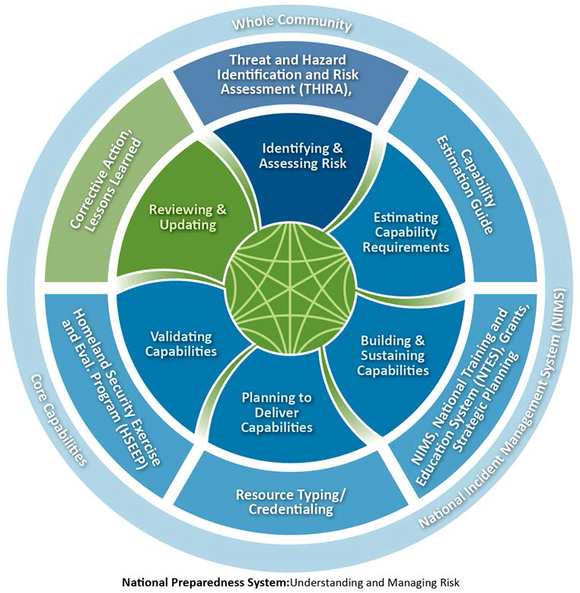
National Preparedness System
The National Preparedness System outlines an organized process for everyone in the whole community to move forward with their preparedness activities and achieve the National Preparedness Goal:
“A secure and resilient nation with the capabilities required across the whole community to prevent, protect against, mitigate, respond to, and recover from the threats and hazards that pose the greatest risk.”

Slide 5

National Preparedness System
Identify and Assess Risk and Severity
Estimate Capability Requirements
Build and Sustain Capabilities
Plan to Deliver Capabilities
Validate Capabilities
Review and Update Risks,
Tools and Resources

Slide 6
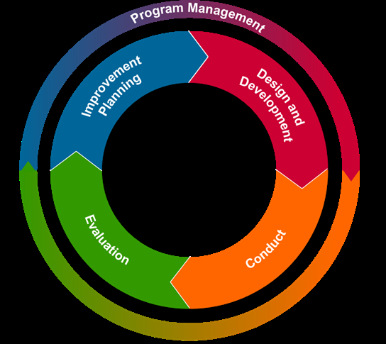
Common Methodology

Slide 7
Why Exercise?
Test and validate
  Plans
  Assess capabilities
Identify
  Resource requirements
  Assess capability gaps
  Areas for improvement

Slide 8
HSEEP Purpose
The Homeland Security Exercise and Evaluation Program (HSEEP) provides:
  a set of guiding principles for exercise programs;
  a common approach to exercise program management, design and development, conduct, evaluation, and improvement planning;
  a consistent approach to capabilities-based exercise program management; and
  a common methodology to measure progress toward building, sustaining, and delivering core capabilities.

Slide 9

HSEEP Guidance
HSEEP Fundamentals
  Program Management
  Design and Development
  Conduct
  Evaluation
  Improvement Planning

Slide 10

Replaced HSEEP Volumes I - V

Slide 11
HSEEP Applicability and Scope
Flexible, scalable, adaptable for use by
  Stakeholders across whole community, and
  Applicable to exercises for all mission areas
    Prevention
    Protection
    Mitigation
    Response
    Recovery

Slide 12
Revision Background
August 17, 2010, Secretary of Homeland Security directed revision of the National Exercise Program (NEP)
  FEMA Deputy Director Administrator for Protection and National Preparedness (NPD) directed revision of HSEEP
    accurately capture and reflect the Secretary’s vision for an overall updated and revised exercise program
  2013 iteration of HSEEP doctrine supersedes the 2007 HSEEP Volumes.
  More flexibility in implementing HSEEP

Slide 13
So what does “flexibility” mean?
We can develop, conduct and evaluate exercises however we like
  NOPE
We can toss HSEEP materials and make up our own
  NOPE

Slide 14
So what is the flexibility?
There is flexibility with the Exercise Evaluation Guides (EEGs)
There is flexibility in the number of planning meetings needed
  E.g., A full-scale exercise is going to need many more planning meetings than a two hour tabletop exercise

Slide 15
But still no flexibility
There is NO flexibility with the After-Action Report/Improvement Plan (AAR/IP) template
  Must use the April 2013 version as is

Slide 16
Let’s first look at how we got here in terms of capabilities

Slide 17
Target Capabilities and the Universal Task List
Target Capability List (TCL)
  37 capabilities
  Assigned under
    “Common”
    “Prevent”
    “Protect” Mission Areas
    “Response”
    “Recovery”
Notes:
Common = Planning, Communications, Risk Management, Community Preparedness and Participation, Intelligence and Information Sharing and Dissemination
Prevent = Information Gathering, Intelligence Analysis and Production, Counter-Terror Investigation and Law Enforcement, CBRNE Detection
Protect = Critical Infrastructure Protection, Food and Agriculture Safety and Defense, Epidemiological Surveillance and Investigation, Laboratory Testing
Response = On-site Incident Management, Emergency Operations Center Management, Critical Resource Logistics and Distribution, Volunteer Management and Donations, Responder Safety and Health, Emergency Public Safety and Security Response, Animal Disease Emergency Support, Environmental Health, Explosive Device Response Operations, Fire Incident Response Support, WMD and Hazardous Material Response and Decontamination, Citizen Evacuation and Shelter in Place, Isolation and Quarantine, Search and Rescue (Land-based), Emergency Public Information and Warning, Emergency Triage and Pre-Hospital Treatment, Medical Surge, Medical Supplies Management and Distribution, Mass Prophylaxis, Mass Care, Fatality Management
Recover = Structural Damage Assessment, Restoration of Lifelines, Economic and Community Recovery

Slide 18
Universal Task List (UTL)
Defined the tasks needed to be performed by Federal, State, local and tribal jurisdictions and the private sector to prevent, protect against, respond to, and recover from events defined in the 15 National Planning Scenarios
Approximately 1,600 unique tasks
Flexibility to determine “who” should perform them, and “how’

Slide 19
15 National Planning Scenarios
1. Improvised Nuclear Device
2. Aerosol Anthrax
3. Pandemic Influenza
4. Plague
5. Blister Agent
6. Toxic Industrial Chemical
7. Nerve Agent
8. Chlorine Tank Explosion
9. Major Earthquake
10. Major Hurricane
11. Radiological Dispersal Device
12. Improvised Explosive Device
13. Food Contamination
14. Foreign Animal Disease
15. Major Cyber Attack

Slide 20
Examples of Universal Tasks
Com.B 1 Develop resource management plans, protocols and procedures
Pre.B.1 3.1 Develop technologies for surveillance and detection for CBRNE
Pro.C.1 1.1.3.2 Plan and prepare for pandemic influenza, particularly for the stage when vaccine either is non-existent or in severely short supply
Res.B.1 16.1 Ensure coordination of assets assigned to perform worker safety and health risk assessment and risk management

Slide 21
TCL and UTLs morphed…
Into the “Crosswalk of Target Capabilities to FEMA Core Capabilities” in 2011

Slide 22


And from that emerged…..
PHP Capabilities in March 2011
HPP Capabilities in January 2012

Slide 23
Public Health Preparedness Capabilities Released March, 2011
Community Preparedness
Community Recovery
Emergency Operations Coordination
Emergency Public Information and Warning
Fatality Management
Information Sharing
Mass Care
Medical Countermeasure Dispensing
Medical Material Management and Distribution

Slide 24
Public Health Preparedness Capabilities Released March, 2011
Medical Surge
Non-pharmaceutical Interventions
Public Health Laboratory Testing
Public Health Surveillance and Epidemiological Investigation
Responder Safety and Health
Volunteer Management

Slide 25
Healthcare Preparedness Capabilities
Released January, 2012
Healthcare System Preparedness *
Healthcare Recovery *
Emergency Operations Coordination **
Fatality Management **
Information Sharing **
* Analogous to Community Preparedness and Community Recovery
Medical Surge **
Responder Safety and Health **
Volunteer Management **
** Shared with Public Health Preparedness Capabilities

Slide 26
Healthcare Preparedness and Response Capabilities - Released November, 2016
Foundation for Health Care and Medical Readiness
Health Care and Medical Response Coordination
Continuity of Health Care Service Delivery
Medical Surge
https://phe.gov/Preparedness/planning/hpp/reports/Documents/2017-2022-healthcare-pr-capablities.pdf
Notes:
Cap. 1: includes objectives to establish, operationalize a HCC; identify risk and needs; develop HCC Preparedness Plan; Train and Prepare the Health Care and Medical Workforce; ensure Preparedness is sustainable
Cap. 2: Dev. HCC and HC Org. Response Plans; Utilize Info-Sharing procedures and platforms; Coord. response strategy, resources and communication
Cap. 3: Identification of MEFs for h.c. delivery; plan for COOP; Develop a h.c. org. COOP and a HCC COOP; maintain access to non-personnel resources during an emergency; dev. Strat to protect h.c. information systems and networks; protect responders’ safety and health; plan for and coordinate h.c. evac and relocation; coord. h.c. system recovery
Cap. 4: plan for medical surge; respond to a medical surge (ED and Inpatient response; out-of-hospital surge; dev. Alternate care system; provide peds care; surge mgt. during chemical or rad event; provide burn care; provide trauma care; respond to behavioral health needs; enhance infectious disease and preparedness and surge response; distribute MCM; manage mass fatalities.

Slide 27
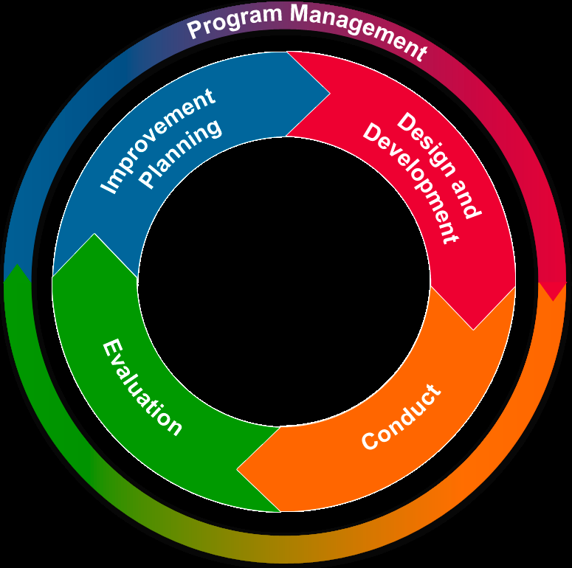
Overview of Exercise Program Management

Slide 28
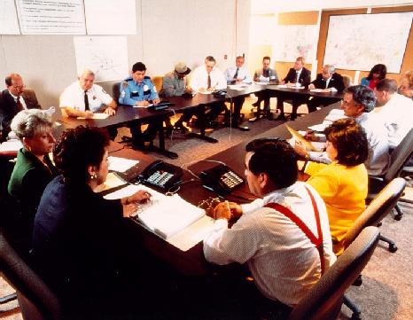
Exercise Foundation
Learn about your jurisdiction
  Threats, Hazards, and Vulnerabilities
  Policies, plans, and procedures
  Identified needs – Training,
  equipment, personnel, policy
  modifications

Slide 29
Elected and Appointed Officials
Engage early and often to identify exercise program priorities
  Review previous risk assessments and reports
  Provide:
    Overarching guidance and direction
    Planning and resource allocation
    Type and scope
    Roadmap to identify priorities
  Specific intent for individual exercises

Slide 30
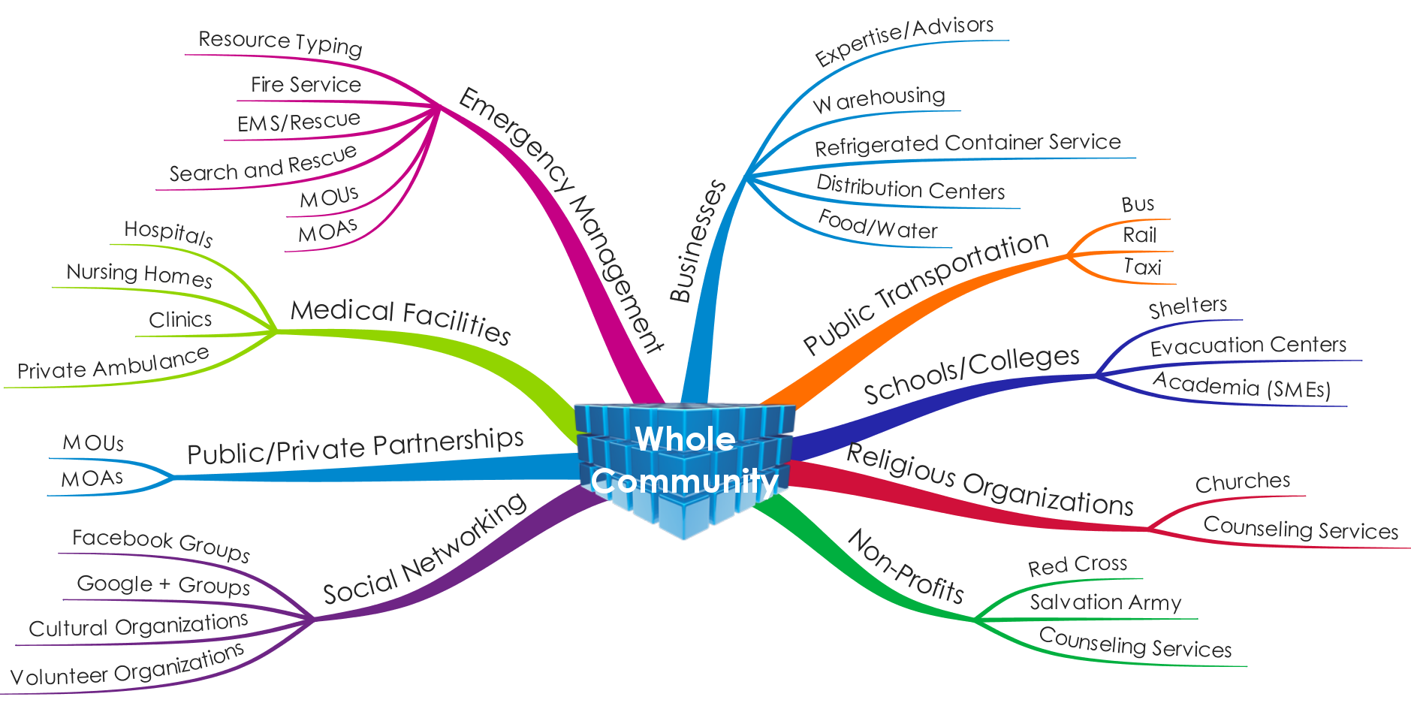
Who?

Slide 31
Types of Exercises

Slide 32
Discussion-Based Exercises
TYPES
  Seminars
    Plan Orientation/Review Assets
    Capabilities
  Workshops
    Analyze Requirements
    Develop Product
  Tabletop (TTX)
    Rehearsal
    Assess Plans
  Games
    Compete/Collaborate
    Validate Plans
    Explore Consequences
    FOCUS
      Jurisdiction:
        Plans
        Policies
        Procedures
      Inter-Jurisdictional
        Agreements
        Understandings
    PARTICIPANTS
      Facilitator
      Moderator(s)
      Evaluators
      Stakeholders/Sr. Leaders/Players

Slide 33
Operations-Based Exercises
TYPES
  Drills
    Single agency/organization
    Provide training/skills reinforcement
    Validate procedure
  Functional Exercises
    Validate/Evaluate Capability
    Command-and-Control and Coordination Function(s)
  Full-Scale Exercises
    Complex real-time response
    Multiagency cooperative – ICS
    Simulates reality – “as if” real
    Mobilize/deploy resources and personnel
    Requires close control and monitoring
    FOCUS
      Validate Implementation of:
        Plans
        Policies
        Procedures
      Inter-Jurisdictional
        Agreements
        Understandings
    PARTICIPANTS
      Controllers/Simulators
      Evaluators
      Actors
      Players
      Observers/VIPs

Slide 34

EXERCISE DESIGN AND DEVELOPMENT

Slide 35
Key Design and Development Steps
Review elected/appointed officials’ guidance, Training and Exercise Plan (TEP), and other factors;
Select exercise planning team and develop exercise planning timeline and milestones;
Develop exercise-specific objectives related to targeted capabilities;

Slide 36
Key Design and Development Steps
Identify evaluation requirements, identifying EEGs by mission area(s);
  Prevention - Response
  Protection - Recovery
  Mitigation
Develop the EEGs and exercise scenario;
Create documentation;
Coordinate logistics; and
Plan for exercise communication, control and evaluation

Slide 37
Exercise Foundation Key
Priority Factors
Multiyear Training and Exercise Plan (MYTEP)
Jurisdiction’s existing plans and procedures
THIRA or other risk, threat and hazard assessments
State or national preparedness reports
  http://www.tfah.org
Past exercise or real-event AARs/IPs
Identified or perceived areas for improvement
Accreditation standards or requirements (JC, DNV)
Grant or cooperative agreement requirements

Slide 38
Link Capabilities
Link each identified risk factor to the capabilities that mitigate the risk
Prioritize capabilities
Identify which stakeholders provide support toward mitigation of the risk

Slide 39
Exercise Planning Team Representation
Manageable size aligned with exercise type or scope/complexity
Represent full range of whole community stakeholders and participating stakeholder organizations

Slide 40
Subject Matter Experts
Add expertise to the Exercise Planning Team
Provide functional knowledge for player-specific tasks evaluated through objectives
Help make the scenario realistic and plausible
Ensure appropriate evaluation of capabilities

Slide 41

Trusted Agent
Individuals on Exercise Planning Team
DO NOT reveal scenario details to players prior to exercise conduct

Slide 42
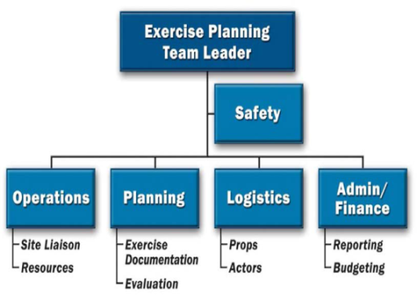
Successful Planning Teams
Have clearly defined roles, responsibilities, and functional requirements
Engage senior and appointed officials and whole community leadership in exercise planning
Utilize project management principles
Follows standardized process
EX: Can be organized using NIMS Incident
Command Structure (ICS) or other structure that defines support roles of each team member

Slide 43

Role and Function of the
Planning Team
Conducts planning meetings to:
  Determine exercise objectives, evaluation plan, and control and simulation systems
  Design, develop, conduct, and evaluate results of exercise
  Develop scenario, EEGs and other exercise documentation
  Plan logistics for exercise conduct
  Identify, create and distribute
pre-exercise materials

Slide 44
Planning Meetings
Meetings to discuss, review, or develop exercise content
Forum for coordination and collaboration among participating agencies and officials
Exercise planning teams should apply and adapt HSEEP doctrine to meet their specific needs

Slide 45
Concept and Objectives Meeting
FOCUS: IDENTIFY THE SCOPE AND OBJECTIVES OF THE EXERCISE
DISCUSSION POINTS
  Propose exercise objectives and their aligned capabilities
  Propose exercise location, date, and duration
  Participants and anticipated extent of play for exercise participants
  Who will comprise the Exercise Design Team
  Exercise control and evaluation
  Exercise planning timeline and milestones

Slide 46

Concept and Objectives Meeting
OUTCOMES:
  Exercise Concept
  Exercise timeframe
  Extent of participation
  Identification of planning team members
  Planning timeline, milestones, meeting dates

Slide 47
Initial Planning Meeting (IPM)
FOCUS
  Utilize elected and appointed official guidance
  Exercise design requirements identified
  Develop exercise documentation
  Assigns roles and responsibilities
DISCUSSION POINTS
  Exercise objectives and core capabilities;
  Evaluation requirements, including EEGs
  Relevant plans, policies, and procedures;
  Exercise scenario;
  Modeling and simulation planning;
  Extent of play (time, date and location)

Slide 48
Initial Planning Meeting (IPM)
OUTCOMES:
  Clearly defined exercise objectives and aligned capabilities
  Initial capability targets and critical tasks
  Exercise scenario variables
  List of participating exercise organizations and extent of play
  Identification of source documents
  Refined exercise planning timeline with milestones/lists of tasks

Slide 49
Midterm Planning Meeting (MPM)
PRIMARY FOCUS
  Re-engage Elected and Appointed Officials (prior)
  Exercise organization
  Scenario and timeline development,
  Logistics, and administrative requirements
  Review draft documentation
DISCUSSION POINTS
  Refinement and/or finalization of exercise documentation
  Logistical requirements
  Master Scenario Events List (MSEL) if no additional MSEL Planning Meeting will be held

Slide 50
Midterm Planning Meeting (MPM)
OUTCOMES
  Reviewed exercise documentation (as applicable)
  Well-developed scenario to include injects (if no MSEL held)
  Finalization of date, time, and location
  Identified logistics planning requirements
  Revised planning schedule, task assignments, meeting date and location for next meeting

Slide 51
Master Scenario Events List (MSEL) Meeting
PRIMARY FOCUS
  Develop chronological list that supplements exercise scenario
  Event synopses, expected participant responses, objectives and core capability targets
  Specific scenario events (or injects) that prompt players to implement the plans, policies, procedures, and protocols that require testing during the exercise
  Methods used to provide injects
DISCUSSION POINTS
  Tasks, conditions and standards required to meet exercise objectives
  Key events and critical tasks
  Event originator, target player, expected player actions and timeframe
  Contingency injects to prompt player action (if needed)

Slide 52

Master Scenario Events List (MSEL) Meeting
OUTCOMES
  Key event injects and timeline for delivery
  Assignment of responsibility for constructing remaining events
  Timeline for completion

Slide 53
Exercise Time | Inject # | From | To | Message | Expected Outcome/ Actions
0900 | 1 | SIMCELL | ALL PLAYERS | STARTEX | Exercise begins
0915 | 2 | SIMCELL | Hospitals | The NYSDOH is requesting that all hospitals complete a HERDS survey of current bed availability within one hour. | Hospitals receive IHANS notification Hospitals complete HERDS survey within one hour and submit to NYSDOH

Slide 54
Final Planning Meeting (FPM)
PRIMARY FOCUS
  Re-engage elected and appointed officials − ensure exercise aligned with intent, address questions, and receive last-minute guidance
  Ensure all elements of exercise are ready for conduct
DISCUSSION POINTS
  Final review of all exercise documentation
  Outstanding planning issues
  Review logistical activities (e.g., schedule, registration, attire, special needs)

Slide 55
Final Planning Meeting (FPM)
OUTCOMES
  Final approval of exercise documentation and presentation materials
  Identified issues resolved
  Attendees understand and approve exercise processes and procedures
  Logistical elements and task assignments , including equipment, facilities and schedule confirmed

Slide 56

Planning Meeting Follow-up Activities
Distribute meeting minutes
  Between meetings – Planning Team collaborates on assignments and prepares draft exercise documentation
  Distribute draft documentation prior to next meeting
  Repeat activities for each follow-on planning meeting
  Proflow = Procedural Flow – document with expected players actions and beginning of MSEL process

Slide 57

EXERCISE EVALUATION

Slide 58
Evaluation Planning Phase
Initial planning for evaluations includes:
  Engaging senior elected and appointed officials to identify specific evaluation requirements
  Identifying evaluation requirements early in planning and design phases
  Ensuring consistency in evaluation method

Slide 59
Evaluation Team Responsibilities
Be familiar with the mission areas, core capabilities, plans, policies and procedures to be examined during the exercise
Determine the structure of the evaluation team
Determine the tools and documentation needed to support the evaluation
Conduct a pre-exercise C/E Briefing
Recruit, train, and assign additional evaluators

Slide 60

Lead Evaluator
Oversees evaluation process and planning
Coordinates Evaluation Plan development using:
  Exercise-specific information
  Plans, policies, and procedures
  Determining Evaluator assignments
  Developing instructions and Exercise Evaluation Guides (EEGs)

Slide 61
Recruit, Assign and Train Evaluators
Recruit from nonparticipating organizations;
Identify early in planning process;
Assign based on knowledge of functional area(s) and plans, policies, procedures, and agreements;
Train on use of Exercise Documentation tools; and
Discuss what to look for and record during observation

Slide 62
Evaluation Documentation and Tools
Evaluation Plan
SitMan or EXPLAN
C/E Handbook
Evaluator Team Organization
Assignments
Locations
Evaluation Instructions
Instructions on use of tools, logs, forms
Evaluation Tools
Jurisdiction- or Organization-Specific SOPs, Plans, Policies
EEGs
MSEL

Slide 63
Exercise Evaluation Guides (EEGs)
Streamline and guide data collection
Enable thorough assessment
Support development of the AAR
Provide a consistent process for assessing preparedness through exercises
Help organizations map exercise results to exercise objectives, core capabilities, capability targets, and critical tasks for further analysis and assessment

Slide 64
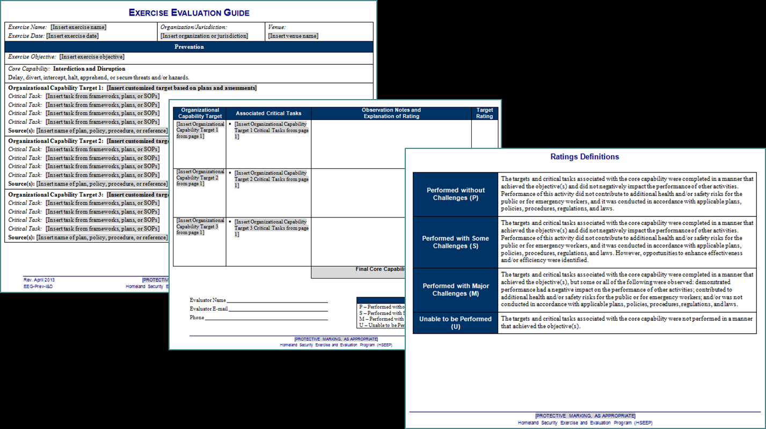
Exercise Evaluation Guides (EEG) Format

Slide 65

Evaluator Time Requirements
Evaluators should be available for:
  Pre-exercise briefing and/or site visit
  Exercise conduct
  Post-exercise Hot Wash
  Controller and Evaluator
  Debriefing
  After Action Contribution

Slide 66
Observation and Data Collection
Can differ between discussion-based exercises and operations-based exercises
Forms the basis for determining if:
  Critical tasks were successfully demonstrated and
  Capability targets were met

Slide 67
Observation
Conducted to examine
  Utilization of plans, policies, and procedures related to capabilities
  Implementation of legal authorities
  Understanding and assignment of roles and responsibilities of participating organizations and players
  Decision-making processes used
  Activation and implementation of processes and procedures
  How and what information is shared among participating agencies/organizations and the public

Slide 68
Data Collection
Supports AAR development by capturing
  Decisions and recommendations
  Roles and responsibilities
  Coordination and cooperation
  Supplemental data/written records
Evaluators should not be a distraction or
interfere with exercise play

Slide 69
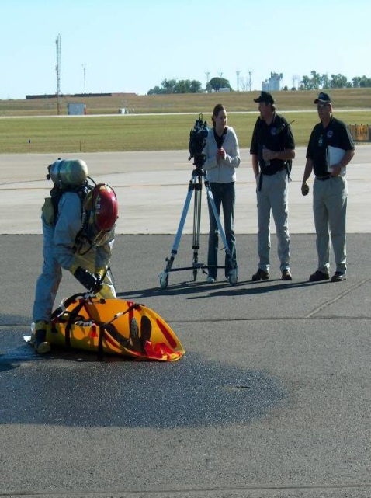
Exercise Observations
Observations come from a variety of sources, including
  Event logs (e.g., ICS 214)
  EEGs
  Evaluator notes
  Video or audio recordings
  Photographs
  Participant evaluation forms

Slide 70
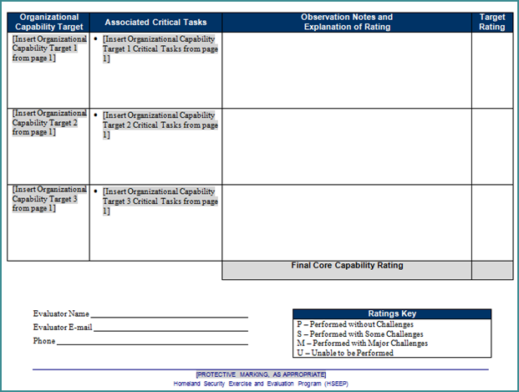
Recording Observations
Time Action Issues
If and how quantitative or qualitative targets were met
Actual time required for exercise players to complete the critical task(s)
How target was or was not met
Decisions made and information gathered
to make decision
Requests made and how they were handled
Resources utilized
Plans, policies, procedures,
or legislative authorities used or implemented
Any other factors contributed to the outcomes

Slide 71
Data Analysis Process
Consolidation of data
Examine/compare performance against targets
Identify strengths and areas for improvement
Conduct root-cause analysis

Slide 72

Root-Cause Analysis
“Rule of Five”
  Were the capability targets met?
  If not, WHY not?
  WHAT factors contributed?

Slide 73
Components of the EEGs
Capabilities: The distinct critical elements necessary to achieve a specific mission area (e.g., prevention).
  To assess both capacity and gaps, each capability includes capability targets.
    Example: Medical Surge

Slide 74
Components of the EEGs
Capability target(s): The performance threshold(s) for each capability
  they state the exact amount of capability that exercise players aim to achieve
  typically written as quantitative or qualitative statements
    Example: In response to a notification of a mass casualty event, activate the hospital’s Surge Plans.

Slide 75
Components of the EEGs
Critical tasks: The distinct elements required to perform a capability (how the capability target will be met). Critical tasks generally include:
  the activities, resources, and responsibilities required to fulfill capability targets; and are
  based on operational plans, policies, and procedures exercised.

Slide 76
Exercise Evaluation Guide (EEG)
Exercise Name: [Insert exercise name] Exercise Date: [Insert exercise date] | Organization/Jurisdiction: [Insert organization or jurisdiction] | Venue: [Insert venue name]
Response
Exercise Objective: [Insert exercise objective]
Core Capability: Public Health and Medical Services Provide lifesaving medical treatment via emergency medical services and related operations and avoid additional disease and injury by providing targeted public health and medical support and products to all people in need within the affected area.
Organizational Capability Target 1: [Insert customized target based on plans and assessments] Critical Task: [Insert task from frameworks, plans, or SOPs] Critical Task: [Insert task from frameworks, plans, or SOPs] Critical Task: [Insert task from frameworks, plans, or SOPs] Critical Task: [Insert task from frameworks, plans, or SOPs] Source(s): [Insert name of plan, policy, procedure, or reference]
Organizational Capability Target 2: [Insert customized target based on plans and assessments] Critical Task: [Insert task from frameworks, plans, or SOPs] Critical Task: [Insert task from frameworks, plans, or SOPs] Critical Task: [Insert task from frameworks, plans, or SOPs] Critical Task: [Insert task from frameworks, plans, or SOPs] Source(s): [Insert name of plan, policy, procedure, or reference]
Organizational Capability Target 3: [Insert customized target based on plans and assessments] Critical Task: [Insert task from frameworks, plans, or SOPs] Critical Task: [Insert task from frameworks, plans, or SOPs] Critical Task: [Insert task from frameworks, plans, or SOPs] Critical Task: [Insert task from frameworks, plans, or SOPs] Source(s): [Insert name of plan, policy, procedure, or reference]

Slide 77
SOOO…given the flexibility FEMA noted for EEGs….
Develop Organizational Capability Target(s): Develop capability target(s) specific to the organization. The core capability description may provide a starting point for developing capability targets; however, quantitative or qualitative measures are based on the organization’s plans, policies, and procedures.
Here is what we will do:
  Exercise Name: [Insert exercise name]
  Exercise Date: [Insert exercise date]
  Organization/Jurisdiction:
  [Insert organization or jurisdiction]
  Venue:
  [Insert venue name]

Slide 78
Objectives (sample)
Exercise Objective: In response to a notification of a mass casualty event, activate the hospital’s Surge Plans.
Capability: Medical Surge is the capability to rapidly expand the capacity of the existing healthcare system in order to provide triage and subsequent medical care. The goal is rapid and appropriate care for the injured or ill from the event and the maintenance of continuity of care for non-incident related illness or injury.

Slide 79
Critical Tasks
Identify the critical tasks needed to accomplish the capability target and demonstrate the core capability.
Tailor capability targets and critical tasks to reflect the exercise type.
  Discussion-based exercise: evaluators observe exercise players discussing or describing how critical tasks are performed.
  Operations-based exercise: evaluators observe exercise players performing critical tasks.

Slide 80

Toolkit for Critical Tasks
PHP/HPP Capabilities
Organizational plans, policies, or
procedures being tested
Target Capabilities List (TCL)
  http://www.fema.gov/pdf/government/training/tcl.pdf
Corrective actions from previous exercises or events
http://phasevtechnologies.com/studies/lamps/selectTask.php

Slide 81
Determine objective and critical tasks that will accomplish it
Objective #1: Identify additional staffed beds to accommodate an influx of 20% over the average daily ED census.
  Critical Task 1: Activate the facility’s HICS and HCC within 30 minutes.
  Critical Task 2: Add an additional 20% above capacity in the following area(s) of critical care (such as ICU, CCU, PICU, NICU)
  Critical Task 3: Decompress the current hospital census by 10%.
Source(s): Santa Margharita Hospital Medical Surge Plan

Slide 82
Sources
  List the source(s) of the capability targets and critical tasks
    Policies, plans, procedures, SOGs, SOPs
    Allows evaluators to reference plans or other documents as needed, as well as assist in the development of the AAR.

Slide 83
Organizational Capability Target | Associated Critical Tasks | Observation Notes and Explanation of Rating | Target Rating
[Insert Organizational Capability Target 1 from page 1] | [Insert Organizational Capability Target 1 Critical Tasks from page 1]
[Insert Organizational Capability Target 2 from page 1] | [Insert Organizational Capability Target 2 Critical Tasks from page 1]
[Insert Organizational Capability Target 3 from page 1] | [Insert Organizational Capability Target 3 Critical Tasks from page 1]
 |  | Final Core Capability Rating

Slide 84
Performed without Challenges (P) | The targets and critical tasks associated with the core capability were completed in a manner that achieved the objective(s) and did not negatively impact the performance of other activities. Performance of this activity did not contribute to additional health and/or safety risks for the public or for emergency workers, and it was conducted in accordance with applicable plans, policies, procedures, regulations, and laws.
Performed with Some Challenges (S) | The targets and critical tasks associated with the core capability were completed in a manner that achieved the objective(s) and did not negatively impact the performance of other activities. Performance of this activity did not contribute to additional health and/or safety risks for the public or for emergency workers, and it was conducted in accordance with applicable plans, policies, procedures, regulations, and laws. However, opportunities to enhance effectiveness and/or efficiency were identified.
Performed with Major Challenges (M) | The targets and critical tasks associated with the core capability were completed in a manner that achieved the objective(s), but some or all of the following were observed: demonstrated performance had a negative impact on the performance of other activities; contributed to additional health and/or safety risks for the public or for emergency workers; and/or was not conducted in accordance with applicable plans, policies, procedures, regulations, and laws.
Unable to be Performed (U) | The targets and critical tasks associated with the core capability were not performed in a manner that achieved the objective(s).
Ratings Definitions

Slide 85

After-Action Report/
Improvement Plan

Slide 86


Slide 87



Stages of Writing an AAR
Denial
  What is an AAR?
  Honestly - I have no idea what you are talking about.
Anger/Whining
  It’s someone else’s turn!
  Why do I always get stuck with this????
Bargaining/Begging
  If you tell John to write it, I will do every progress report
  for the next 5 years. Really. I promise.

Slide 88





Stages (cont).
Procrastination
  I need to organize my folders on the C: drive
  Isn’t it time for a staff meeting?
  Oh, wait – it’s my turn to clean out the coffee pot.
Depression/Gathering of sustenance
  Sad CDs, sleeping for hours
  Pick your “C” - Chocolate, chips, coffee, candy, cola, Cabernet
Acceptance
  Okkkkkk. I’ll write it. This time.
  But I am never doing it again…….

Slide 89
What Is an AAR?
Summary of key information related to evaluation
Overview of performance related to each exercise objective, critical task, and associated capabilities
Length, format, and development timeframe of the AAR depend on the exercise type and scope

Slide 90
Elements of an AAR
HSEEP 2013 Revision
  Exercise Overview
  Analysis of Capabilities
  Required Appendices
    Improvement Plan
    Participating Organizations

Slide 91
Break the rest of the After Action Report into pieces

Slide 92
Not required, but nice to include
Executive Summary
  Brief overview of exercise or event
  Capabilities tested
  3-5 top strengths
  3-5 top areas for improvement
Acronyms

Slide 93
Exercise Overview
Exercise Name
Dates
Scope
Mission Areas
Capabilities
Objectives
Threat or Hazard
Scenario
Sponsor
Participating Organizations
Point of Contact

Slide 94
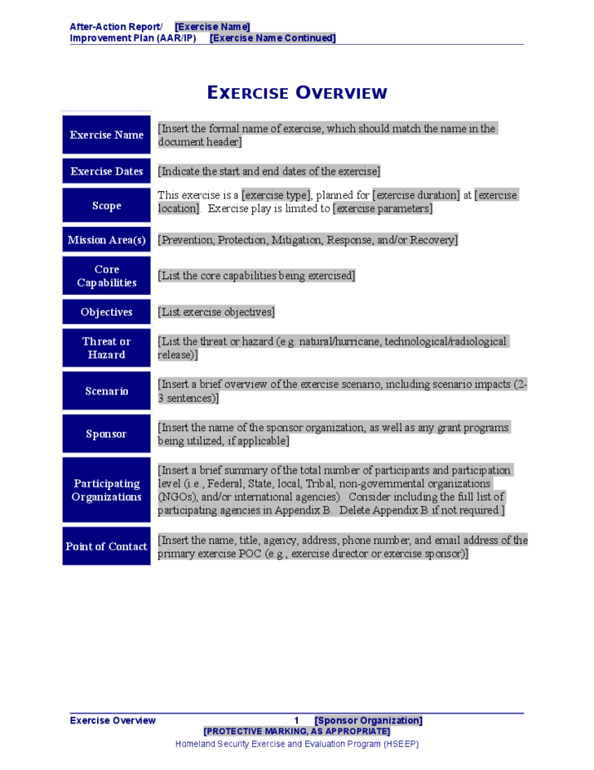

Slide 95
Analysis of Core Capabilities
Objective
Capability
Performed without Challenges (P)
Performed with Some Challenges (S)
Performed with Major Challenges (M)
Unable to Perform (U)
Only ONE rating per Objective !

Slide 96
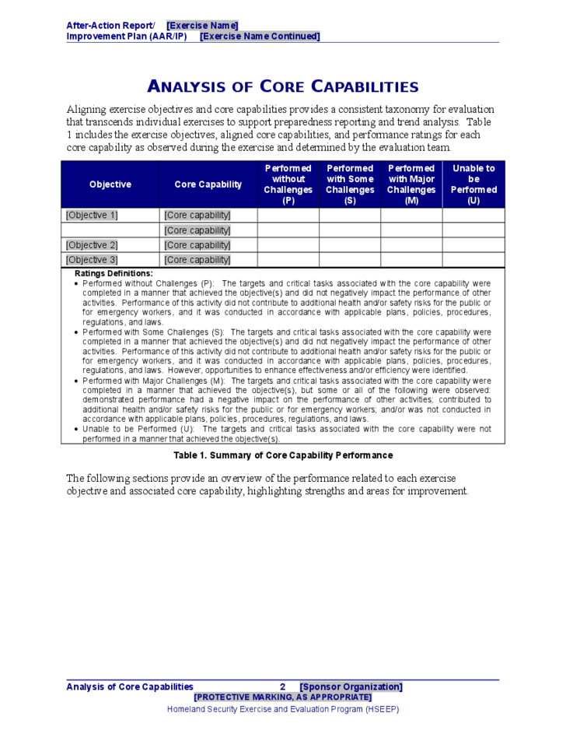

Slide 97
Analysis of Core Capabilities
Objective
  Copy from Exercise Overview
Capability
  Copy from Exercise Overview
Strengths
  Areas in which the evaluator observed that a necessary task was performed well

Slide 98
[Objective 1]
The strengths and areas for improvement for each core capability aligned to this objective are described in this section.
[Core Capability 1]
Strengths
The [full or partial] capability level can be attributed to the following strengths:
Strength 1: [Observation statement]
Strength 2: [Observation statement]
Strength 3: [Observation statement]
Areas for Improvement
The following areas require improvement to achieve the full capability level:
Area for Improvement 1: [Observation statement. This should clearly state the problem or gap; it should not include a recommendation or corrective action, as those will be documented in the Improvement Plan.]
Reference: [List any relevant plans, policies, procedures, regulations, or laws.]
Analysis: [Provide a root cause analysis or summary of why the full capability level was not achieved.]

Slide 99
Analysis of Core Capabilities
Areas for Improvement
  Areas in which the evaluator observed that a necessary task was not performed OR that a task was performed with notable problems
  Complete sentence that describes the general observation.
Reference
  Relevant plans, policies, procedures, laws, and/or regulations, or sections of these plans, policies, procedures, laws, and/or regulations or improvement actions from previous exercises.
  Occasionally there is no reference and N/A may be entered
Please note: DHS Target Capabilities/Capabilities and
Joint Commission critical areas are NOT references.

Slide 100
Analysis of Core Capabilities
Analysis
  More detail as to why the problem/gap occurred.
  Should be the most detailed section of the AAR/IP.
  Description of the behavior or actions at the core of the observation
  Brief description of what happened and the consequence(s) of the action or behavior.
Remember ROOT CAUSE!!!!

Slide 102


Appendix A:
Improvement Plan
Go back to AAR and pull the info
Core Capability | Issue/Area for Improvement | Corrective Action | Capability Element | Primary Responsible Agency | Organization POC | Start Date | Completion Date
 |  | Concrete? Actionable? | Listed on bottom of Appendix A | Is it the facility, agency, or someone over whom it has authority?

Slide 103
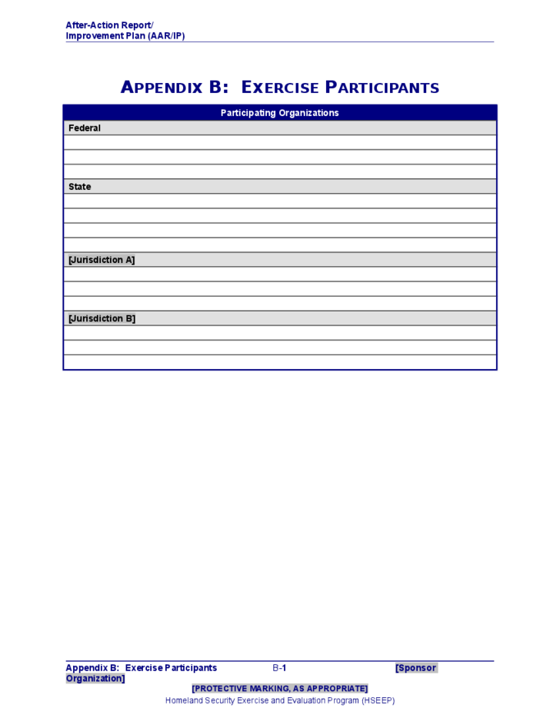
Appendix B: Exercise Participants

Slide 104
AAR Review
Exercise sponsor distributes AAR Draft to participating organizations and elected and appointed officials who
  Review and determine areas for improvement
  Determine organization with responsibility for corrective actions

Slide 105

IMPROVEMENT PLANNING

Slide 106
Corrective Actions
Concrete, actionable steps to resolve shortfalls.
Corrective actions may include:
  Changes to plans and procedures, organizational structures, and/or management policies
  Additional training, equipment or resources
After review and confirmation of areas for improvement, a Draft Improvement Plan is developed

Slide 107
After Action Meeting (AAM)
Forum to review the revised AAR and the Draft IP
Final consensus on draft corrective actions
Develop deadlines for implementation of corrective actions
Identify specific corrective action owners and assignees

Slide 108
Finalizing the AAR/IP – Corrective Action Tracking and Implementation
Distributed to exercise planners, participants, and other preparedness stakeholders as appropriate
Tracking corrective actions to completion
Ensure a system is in place to validate previous corrective actions have been successfully implemented

Slide 109
Using IPs to Support Continuous Improvement
Builds capabilities as part of a larger continuous improvement process
Proven method of issue resolution

Slide 110
Why Exercise?
Conducting exercises and documenting the strengths, areas for improvement, and associated corrective actions is
  An important part of the National Preparedness System
  Contributes to the strengthening of preparedness across the Whole Community and achievement of the National Preparedness Goal.
Over time, exercises should yield observable improvements in preparedness for future exercises and real-world events

Slide 111
For templates for all
materials discussed:
https://hseep.preptoolkit.org/

Slide 112

Pat Anders
patricia.anders@health.ny.gov

