Slide 1
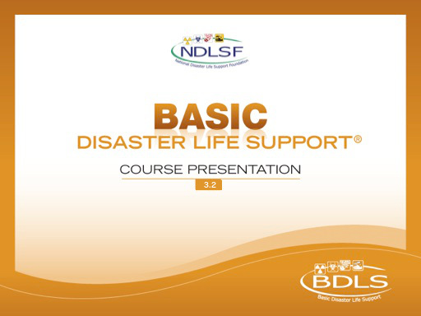

Slide 2


Session 3 – Lesson Five
Mass Casualty and Fatality Management

Slide 3
Learning Objectives
Describe rationale, elements, and actions for performing mass casualty triage
Discuss an all-hazards, scalable casualty management approach under potentially hazardous, stressful, and resource-constrained circumstances
Describe the concepts and principles of mass fatality management for health professionals in a disaster or public health emergency
Discuss the importance of professionalism and ethics in mass casualty care
Notes:
Describe rationale, elements, and actions for performing mass casualty triage, utilizing standardized triage categories and SALT methodologies and reinforcing the need for information reporting and sharing.
Discuss an all-hazards, scalable casualty management approach, including lifesaving interventions, clinical decision making, and casualty transport under potentially hazardous, stressful, and resource-constrained circumstances.
Describe the concepts and principles of mass fatality management for health professionals in a disaster or public health emergency.
Discuss the importance of professionalism and ethics in mass casualty care.

Slide 4
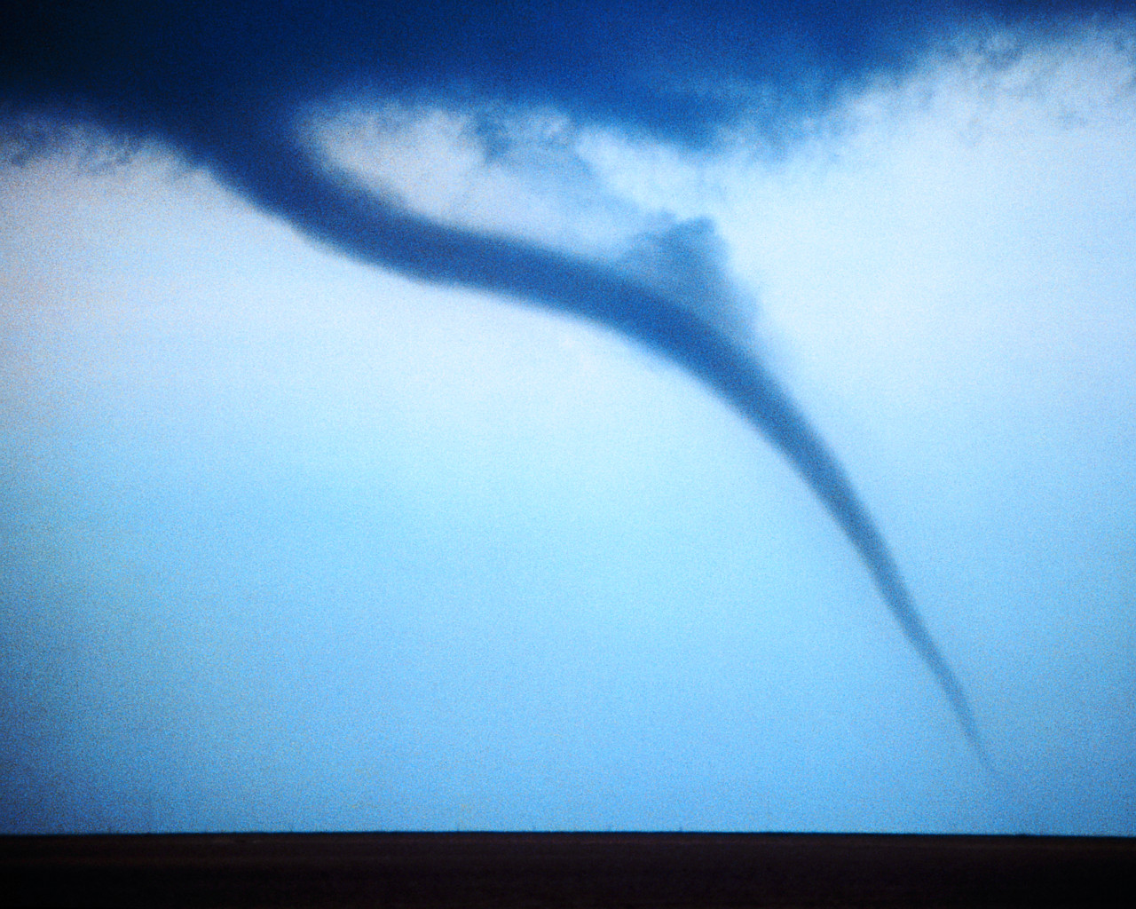
When disaster strikes… Save the most lives possible.
Notes:
When disaster strikes, emergency medical needs at the scene may quickly overwhelm local resources.
To save the most lives possible, quick decisions must be made for the efficient use of immediately available resources.

Slide 5
Background
Day-to-day emergencies
The greatest good for each individual patient
Large-scale disasters
The greatest good for the greatest number of potential survivors
Notes:
In day-to-day emergencies affecting limited numbers of patients, the objective is to do the greatest good for each individual patient.
In large-scale disasters or public health emergencies involving multiple casualties, the objective is to do the greatest good for the greatest number of possible survivors.

Slide 6
General Principles of Mass Casualty Triage
Treat first
The most seriously injured who have a reasonable possibility of survival
Treat last
Those who have the least severe illnesses or injuries or are very unlikely to survive
Separate
Those who require minimal or no treatment and get them to safety
Notes:
The goal of mass casualty triage is to create a formal, reproducible process for sorting casualties, so that: (1) those who are treated first will be those among the most seriously ill or injured who have a reasonable possibility of survival and (2) those who are treated last have the least severe illnesses or injuries or are very unlikely to survive, while (3) those who require minimal or no treatment can be separated from the others, so that scarce medical resources can first be directed to those with the greatest needs.

Slide 7
General Principles of Mass Casualty Triage
Mass casualty triage:
Systematic method
Organization of casualties
Mass casualty triage decision making encompasses:
Presence of a life-, limb-, or vision-threatening condition
Occurs at the scene
Available lifesaving interventions
Availability of transportation assets
Notes:
Mass casualty triage is a systematic method for organizing casualties at the scene of a mass casualty event. Mass casualty triage decision making encompasses three important considerations when determining an ordered prioritization:
The presence of a life-threatening, limb-threatening, or vision-threatening condition
The immediately available lifesaving and similarly emergent medical and surgical interventions that can be delivered
The availability of transportation assets, including their capabilities and capacities, and their timely access to arrival at health care facilities

Slide 8
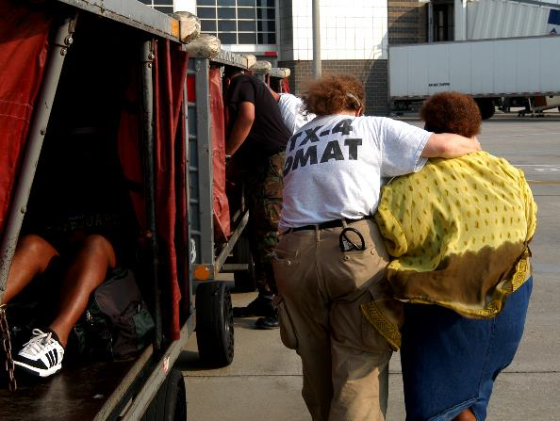
Mass Casualty Triage Systems
CareFlight
CESIRA
Homebush
JumpSTART
Military triage
Pediatric Triage Tape (PTT)
SALT Triage
Simple Triage and Rapid Treatment (START)
Triage SIEVE
Win Henderson/FEMA
Notes:
This slide lists in alphabetical order several of the most commonly used triage systems. The strengths and weaknesses of each are beyond the scope of this discussion, but highlights can be reviewed within the BDLS 3.0 Course Manual.
NDLS teaches the SALT triage system, which we will review today.
IMAGE -- New Orleans, LA, September 3, 2005: A member of Texas Disaster Medical Assistance Team 4, assigned to evacuee escort duty at the helicopter landing site, helps a rescued woman to a place on one of the many baggage wagons used to transport them from landing site to triage area inside the New Orleans Airport. Hurricane Katrina left hundreds of thousands of city residents homeless. New Orleans continues to be evacuated as the city works to remove the flood waters brought by hurricane Katrina. Win Henderson/FEMA.

Slide 9
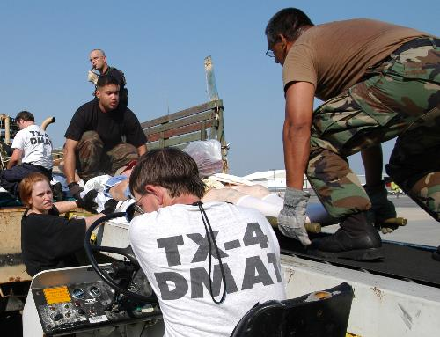
Mass Casualty Triage Systems
The US is moving toward national standardization in mass casualty triage
Federal Interagency Committee on EMS is implementing the Model Uniform Core Criteria (MUCC) as the national standard for Mass Casualty Triage
SALT triage meets the MUCC criteria
All agencies should use a MUCC compliant triage system which will be interoperable with SALT
Win Henderson/FEMA
Notes:
In the United States, there has been a lack of national standardization in mass casualty triage.
The Federal interagency Committee on EMS has recommend more standardization across agencies to improve interoperability. They are currently implementing the Model Uniform Core Criteria as the national standard for Mass Casulaty Triage. Salt Traige which we will review is compliant with the MUCC criteria. Your agency should use a MUCC compliant triage system which will be interoperable with SALT
IMAGE -- New Orleans, LA, September 2, 2005: Members of the Louisiana National Guard and the Dallas, TX, Disaster Medical Assistance Team ferry litter-borne evacuees from a truck for transport to a triage area inside the New Orleans Airport. Thousands of rescued residents stranded by Hurricane Katrina are being evacuated to cities around the nation. New Orleans is being evacuated due to flooding caused by hurricane Katrina. Win Henderson/FEMA.

Slide 10
SALT Triage
SALT Triage designed based on the best scientific evidence
S | ort
A | ssess
L | ifesaving interventions
T | reatment/transport
Notes:
The SALT triage methodology is a national consensus-based mass casualty triage model that was developed by using the best scientific evidence available. It is simple to use and easy to remember.
SALT instructs providers to globally:
Sort casualties into priority tiers by their ability to follow simple commands, then to individually
Assess casualties within each tier, while applying
Lifesaving interventions and assigning priority for
Treatment and/or transport
SALT is fully compliant with the Model Uniform Core Criteria for Mass Casualty Triage that recently were identified to ensure interoperability and standardization when responding to mass casualty events.

Slide 11
SALT
Mass Casualty Triage
Walk
Assess 3rd
Step 1 – Sort:
Global Sorting
Wave/Purposeful Movement
Assess 2nd
Still/Obvious Life Threat
Assess 1st
Step 2 – Assess:
Individual Assessment
LSI*
Control major hemorrhage
Open airway (if child, consider 2 rescue breaths)
Chest decompression
Autoinjector antidotes
Breathing
Obeys commands or makes purposeful movement?
Has peripheral pulse?
Not in respiratory distress?
Major hemorrhage in control?
Minor injuries only?
Yes
All Yes
Yes
Minimal
No
No
No
Dead
Delayed
Likely to survive
given current resources
Yes
Immediate
*LSI: Lifesaving Interventions
No
Expectant
Notes:
This is an overview of the SALT Mass Casualty Triage methodologies. For now the key is to recognize that there are two steps.
Step 1 is global sorting
Step 2 is individual assessment

Slide 12
SALT Triage
Step 1: Global Sorting
Walk
Assess 3rd
Wave/purposeful movement
Assess 2nd
Step 1 – Sort: global sorting
Still/obvious life threat
Assess 1st
Rapidly identify most at-risk by sorting into groups!
Limitations: Many… hearing, language, fear, injured family…
Notes:
Remember, step 1 is global sorting; a response to verbal commands will facilitate sorting victims into groups that will rapidly identify the most at-risk casualties quickly.
The goal of global sorting is to prioritize casualties for individual assessment. This is accomplished through simple voice commands. Evidence indicates that motor response carries reproducible prognostic validity. This identifies those casualties who are most likely to need immediate lifesaving interventions such as hemorrhage control.
Step 1 is global sorting; by using a response to verbal commands, this will facilitate sorting victims into groups that will rapidly identify the most at-risk casualties quickly.
The first action command of “If you can walk, get up and go to _____ “ also gets casualties out of harm’s way and can be lifesaving itself.
The second action “if you can hear my voice wave your hand and I will come to you”
Note that language barriers, disabilities, hearing loss, and many other things could or can be confounders in the global sorting process with voice commands.
Global sorting is accomplished through two actions
Please notice that it DOES NOT require any medical skill to perform; therefore, any and every person who is likely by duty or professional role to be in a disaster response role should know this simple sorting method; this information conveyed early to the 911 operator or arriving rescue personnel would be highly valuable.

Slide 13
SALT Triage
Step 2: Individual Assessment
L S I *
Control major hemorrhage
Open airway (if child, consider 2 rescue breaths)
Chest decompression
Autoinjector antidotes
Breathing?
Obeys commands or makes purposeful movement?
Has peripheral pulse?
Not in respiratory distress?
Major hemorrhage in control?
All
Yes
Minor injuries only?
Yes
Yes
Minimal
No
No
Dead
No
Delayed
Likely to survive
given current resources?
Yes
Immediate
No
Expectant
*LSI = lifesaving interventions
Notes:
Step two assesses individual casualties within prioritized groups and assigns each casualty a triage category. The first priority remains those casualties who do not move or have clear evidence of life-threatening, salvageable injuries. Focus is first on what can you do to save a life (lifesaving intervention completion if indicated) followed by then determining appropriate triage category assignment.

Slide 14
Individual Assessment
What can I do?
Lifesaving interventions
Control major hemorrhage
Open airway
Decompress chest
Autoinjector antidotes
Notes:
Assess for the need to intervene with simple lifesaving maneuvers. Lifesaving interventions include controlling major hemorrhage, opening the airway, decompressing the chest for tension pneumothorax, and autoinjecting antidotes in the setting of chemical contamination. If a child is not breathing, consider giving two rescue breaths. This assessment with lifesaving interventions should be done rapidly in order to progress to the next casualty.

Slide 15
SALT Triage
Step 2: Individual Assessment
L S I *
Control major hemorrhage
Open airway (if child, consider 2 rescue breaths)
Chest decompression
Autoinjector antidotes
Breathing?
Obeys commands or makes purposeful movement?
Has peripheral pulse?
Not in respiratory distress?
Major hemorrhage in control?
All
Yes
Minor injuries only?
Yes
Yes
Minimal
No
No
Dead
No
Delayed
Likely to survive
given current resources?
Yes
Immediate
No
Expectant
*LSI = lifesaving interventions
Notes:
After lifesaving interventions Individual casualty assessment moves rapidly in sequence through basic vital signs (breathing, hemorrhage, and pulse), to confirmation of response to verbal command. Nonpediatric casualties who are not breathing are dead. Pediatric casualties who do not breathe after two rescue breaths are dead. We will focus our attention now on the living (breathing) after LSI have been completed. We simply need to address these questions to determine the best option of triage category rapidly.

Slide 16
Individual Assessment
Triage Category Assignment
Response to interventions
Responds to commands?
Peripheral pulse?
Respiratory distress?
Bleeding stopped?
Notes:
Casualties who manifest circulatory collapse are assessed for likelihood of survival, given existing resources. Casualties with present breathing and circulation, yet with injuries, are assessed for the degree of injury severity.

Slide 17
Individual Assessment
Triage Category Assignment
Casualties overwhelm available resources
Goal of disaster triage:
Do the greatest good for the greatest number of potential survivors
I
D
M
E
IMMEDIATE
DELAYED
MINIMAL
EXPECTANT
DEAD
Notes:
By definition, a disaster overwhelms existing resources in an area. A mass casualty incident is having more casualties than available resources can take care of without additional support. This requires responders to triage patients to decide who needs the most immediate care and the allocation of available limited resources.
The goal of triage is to do the greatest good for the greatest number of people. We do that by appropriately utilizing our limited resources and staff.
The “ID-ME” acronym refers to the phrase “ID (identify) Me” and is used to both remind the triage personnel of the action (to identify the most serious casualties first) and to reinforce memory of the proper order assignment of all the categories for triage of live casualties.
It is always best to refer to the triage categories by name (immediate, delayed, etc), rather than by color or letter, as the latter can be confusing or even perceived as culturally insensitive if taken out of context by those not familiar with this process.
Animation: With sequential clicks the NDLS triage color bar, followed by the word description, and then followed by the first letter of the “IDME” acronym is presented. Note that the last category “dead” remains spelled out, as once a casualty is identified as dead, no further triage category or reassessment component is needed.

Slide 18
IMMEDIATE
Highest priority of casualties to receive care
Immediate, life-threatening conditions
Require immediate management in order to survive
Response to lifesaving interventions:
  Any NO answer + resources are available
Notes:
Immediate casualties are those classified as the highest priority to receive care. These are casualties with a life-threatening condition that requires immediate management in order to survive.
Examples of immediate casualties include the following:
A 30-year-old man with a large laceration to his left thigh that has uncontrolled, pulsatile bleeding
A 64-year-old woman who is breathing but has no palpable radial pulse
A 4-year-old girl with a fever and acute respiratory distress
A 34-year-old man who is found wandering around after an explosion and now can neither tell his name or where he is nor follow simple commands

Slide 19
DELAYED
Require prompt medical attention for survival
Condition can tolerate a short delay in treatment
Expected to survive despite that short delay
Response to lifesaving interventions:
  All YES answers + does need access to additional or definitive health care
Notes:
The delayed category is used for casualties requiring medical intervention for survival, but who have a condition that can wait for a short time without affecting their probability of survival.
Examples of delayed casualties include the following:
An 18-year-old woman who is having abdominal pain but is alert with normal vital signs
A 5-year-old boy with a laceration and deformity to his right forearm, but who is able to move his right hand while crying, “My arm hurts—I want my mommy!”

Slide 20
MINIMAL
Minor injuries or illnesses
Expected to survive even if medical treatment not received
Response to lifesaving interventions:
  All YES answers + does NOT need access to additional or definitive health care
Notes:
The minimal category is used for casualties who have minor injuries or illness and are expected to survive even if they do not receive medical attention. This casualty group should ideally be managed definitively in a manner that prevents them from overloading a nearby hospital that is vital to the management of more acute-severity casualties. For example, they may go to outlying facilities or treatment facilities stood-up for the incident

Slide 21
EXPECTANT
Casualties with low probability of survival
Not expected to survive given available medical resources
Response to lifesaving interventions:
  Any NO answer + resources are NOT available
Notes:
Casualties who are triaged to the expectant category are those who are considered to have a low probability of survival with the currently available medical resources.
Remember: Triage is dynamic!
It is entirely possible that a casualty initially triaged as expectant (gray) might actually be triaged as immediate (red) were there greater availability of resources.
Examples of expectant casualties include the following:
A 16-year-old boy with third-degree full-thickness burns over 80% of the body
A 25-year-old man exposed to a known source of ionizing radiation, who reports vomiting and headache starting approximately 15 minutes after the exposure
A 30-year-old woman with a through-and-through gunshot wound to the head with exposed brain matter

Slide 22
DEAD
Casualties with complete absence of life
Not breathing after basic airway-opening maneuvers, including two rescue breaths if a child
Attempt basic life-sustaining efforts only if sufficient personnel available
It is important to NOT move dead casualties, unless the remains are blocking access to live casualties
Notes:
A casualty triaged to this category manifests complete absence of the signs of life (ie, detectable life-sustaining cardiopulmonary function).
Casualties categorized as dead (black) are those who are not breathing after basic airway-opening maneuvers are attempted. In children, providers may also attempt to give two rescue breaths, ideally using a bag-valve-mask device. However, if there is still no respiratory effort, they too must be considered dead.
Attempts at basic life-sustaining interventions may be initiated, but only if sufficient personnel are available; such efforts are highly unlikely to be successful and should never detract from the care of other casualties with higher chances of survival.

Slide 23
Triage Categories
Immediate | Requires immediate care for a good probability of survival
Delayed | Requires care that can be safely delayed without affecting probability of survival
Minimal | Sick or injured but expected to survive with or without care
Expectant | Alive, but with little or no chance of survival given current available resources
Dead | A fatality with no intrinsic respiratory drive
Notes:
This summary slide introduces the logic based on survival likelihood of using triage categories.
We will apply this logic using the SALT algorithm of LSI response assessment and available resources to assign a triage category now during the individual assessment phase.
The Expectant category may be new to students it is important to emphasize that using it keeps those unlikely to survive from using resources as an immediate and allows rescuers to provide comfort care or resuscitation when resources allow.
Reminder that this could be considered the transport order but that assets will need to be used to their maximum benefit. For example, busing minimal patients, putting patients with different triage levels in a single ambulance (immediate on cot, delayed in jump seat, minimal in passenger seat)

Slide 24
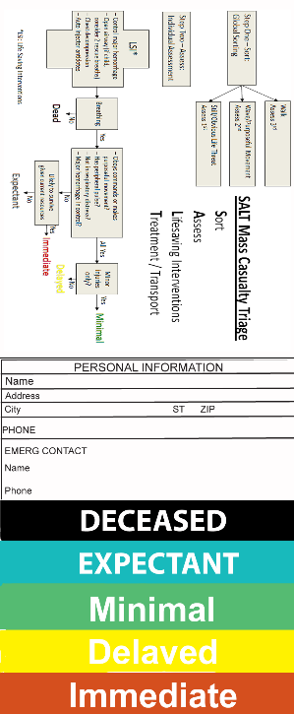
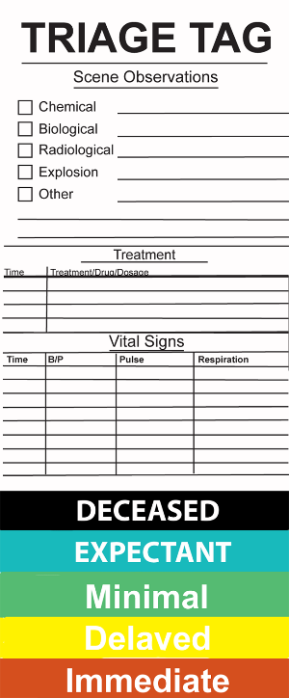
Triage Tags and
Casualty Care Documentation
Communicate findings
Triage tag
Category assignment
Category change
Patient tracking
Notes:
Once a casualty has been assessed, it is important for a rescuer to clearly and concisely communicate his or her findings to other rescue personnel.
This is typically done by attaching a triage tag to the casualty that identifies the category to which he or she has been assigned.
This will help avoid duplication of effort, since subsequent personnel who have contact with that casualty will immediately know the category to which he or she had previously been assigned.
Tags should account for the dynamic nature of triage and should allow for a casualty’s triage category to be changed if his or her condition changes.
It is important that triage tags provide a system for tracking patients, but they are not expected to provide the same level of recordkeeping that is generated during single-patient interactions.
IMAGE -- http://maxcdn.nexternal.com/medtech/images/triagetagNEW1.jpg.

Slide 25
MASS CASUALTY TRIAGE
Triage is both dynamic and continuous
Immediate
Delayed
Expectant
Minimal
Notes:
Triage is both dynamic and continuous.
Dynamic:
For example, a casualty triaged as immediate at one time might improve considerably or perhaps deteriorate further at a later time
As another example, a victim of a gunshot to a long bone is normally triaged to a trauma center; however, if demand (number of casualties) is high and/or supply (trauma center capacity) is low, that same patient may need to be managed at a local hospital, freeing the trauma center for more complex cases (eg, head, chest, abdomen)

Slide 26
MASS CASUALTY TRIAGE
Triage is both dynamic and continuous
Continuous:
Primary triage
Secondary triage
Tertiary triage
Primary triage
Secondary triage
Tertiary triage
Notes:
Triage is both dynamic and continuous.
Continuous:
Primary triage guides initial treatment and transport decisions
Secondary triage further prioritizes casualties within their triage groups based on clinical assessment of urgency of need. There is insufficient scientific evidence to support this process, will have to be clinician judgment based.
Tertiary triage, is the process of providing limited resources within the treatment setting (e.g., more patients need ventilators then are available or surgical suites)

Slide 27
Casualty Transport and Evacuation
Casualties must be prioritized for treatment as well as transport to definitive care.
Avoid overwhelming the closest hospitals:
  Transport priority patients to local hospitals
  Transport stable patients to more distant hospitals or treatment facilities stood-up for the incident
  Treat minor injuries and release from scene
Notes:
Casualties must be prioritized for treatment as well as transport to definitive care.
A top priority is to avoid overwhelming the closest hospitals
The disposition options for injured and ill people include:
Transportation of priority patients to local hospitals
Transportation of stable patients to more distance hospitals or other treatment facilities stood-up for the event
Treatment of minor injuries and release from the scene
Transport officials should have a good working knowledge of local and regional hospital and transport capabilities to distribute casualties throughout the area
Ideally, balanced casualty distribution will be achieved via a centrally controlled EMS system working with incident command in collaboration with a regional Emergency Operations Center

Slide 28
Casualty Reporting,
Identification, and Tracking
Efforts to identify and track casualties should begin at the scene
Tracking officer must ensure everyone accounted for
Systems can range from electronic system, to triage tag, to simply recording information on a piece of tape
Allow for more information to be added to system as it becomes available
Notes:
Efforts to identify and track casualties should begin at the scene even if these are just simple coding methods for patient tracking.
A tracking officer must ensure no one is transported without being accounted for.
Systems can range from a formal electronic system, to writing information on a triage tag, to simply recording information on a piece of tape attached to a casualty’s arm.
Robust systems will be flexible, allowing for more information to be added to the system as it becomes available and showing the relations between patients such as parents and children.

Slide 29
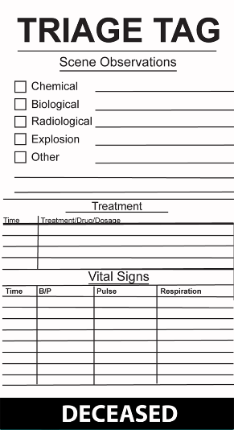
Mass Fatality Management
Generally performed by specialized teams (DMORT)
Identifying and examining remains
Moving deceased to the morgue(s)
Maintaining custody of bodies until released
Determining and reporting cause of death
Returning personal items to family members
Making final disposition decisions for bodies
Issuing death certificates
Notes:
Note most of these activities are not considered medical and should be done by special trained individuals (DMORT)
Once the scene has been cleared of live casualties, the focus can shift from casualty management to fatality management. This includes:
Identifying and examining remains
Moving the deceased to the morgue(s) (permanent or temporary)
Maintaining custody of the bodies until they are released
Determining cause of death
Returning personal items to family members
Making final disposition decisions for the bodies
Determining and recording cause of death and the circumstances surrounding the death
Issuing death certificates
Mass casualties are often crime scenes, and avoiding disrupting the remains of the deceased or displacing their personal belongings or other important nearby items is key.

Slide 30
Professionalism and Ethics in Mass Casualty Care
Adherence to established health practices
Clinical decision making
Professionalism
Difficult decision making
Challenging ethical dilemmas
Notes:
At a disaster scene, adherence to established health practices and professional conduct is paramount.
Clinical decision making must always be guided by defined—hence defensible—practices that are based both in science and in customary acts.
Professionalism:
Following incident command policies on:
Privacy and confidentiality
Maintaining safety and security
Cultural and ethical issues
Separation of sexes
Challenging ethical dilemmas will be encountered when authorities make decisions for the distribution of scarce resources and for access to limited health care services
Difficult decision making is best left to a group process through seeking peer consensus whenever feasible

Slide 31
Lesson Summary
Mass casualty event occurs when number of victims overwhelms resources
Change perspective to greatest good for greatest number
Initial goal of mass casualty triage to sort and assess casualties to identify those with life-threatening injuries and initiate lifesaving treatment and then evacuate all casualties
Mass fatalities will often complicate mass casualty events and may require specialized resources and handling
Notes:
A mass casualty or mass fatality event occurs when the number of victims overwhelms the resources available to care for them.
The initial goal of mass casualty triage is to sort and assess casualties to identify those with life-threatening injuries and initiate lifesaving treatment as soon as feasible.
Primary and secondary assessment, ideally performed once the casualty has been evacuated from the scene, following mass casualty triage.
Fatalities are an unfortunate reality of the mass casualty response. It is important that all potential responders understand the fundamentals of handling fatalities.

Slide 32
Questions?

