Slide 2
Session 2 – Lesson Three
Workforce Readiness and Disaster Deployment

Slide 3
Learning Objectives
Discuss pre-deployment considerations for participation in disaster response, including team activation and motivation, risk awareness and mitigation, education, training, and personal fitness for duty
Describe workforce protection measures in disaster, including purpose and types of personal protective equipment and decontamination
Notes:
Discuss predeployment considerations for participation in disaster response, including team activation and motivation, risk awareness and mitigation, education, training, and personal fitness for duty.
Describe workforce protection measures in a disaster, including the purpose and types of personal protective equipment and decontamination.

Slide 4
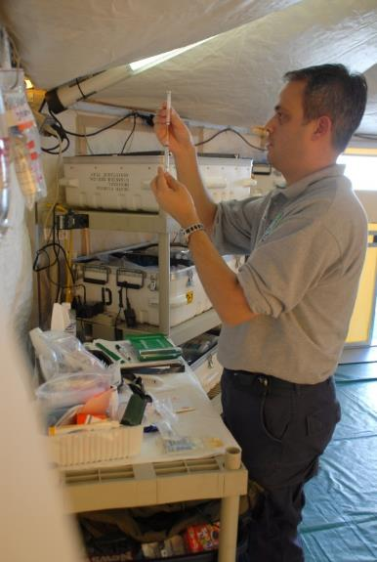
Background
Potential risks and disruptions must be recognized
Disaster operations physically and emotionally difficult
Coping strategies needed
Marvin Nauman/FEMA
Notes:
In every disaster there are risks (such as personal injury, exposure to disease, exposure to psychological trauma) that must be acknowledged and, if possible, prepared for. The health professional must anticipate that there will be disruptions in the modes in which things are normally accomplished. Patients may have to be moved from place to place using whatever resource is available. During disaster operations the work hours may be very long under difficult and possibly dangerous working conditions.
Responders need strategies to help them develop resilience, strength, and the skills needed to address the health challenges in a disaster. Strategies such as maintaining an exercise schedule, getting adequate rest (use of earplugs, sleep masks, personal music), and seeking support from peers can be used.
[BDLS 3.0 Course Manual 4-2]
IMAGE -- New Orleans, LA, February 27, 2006: Dr Michael Nash, pharmacist of the Disaster Medical Assistance Team (DMAT), prepares an injection for a patient in one of the DMAT pharmacies. This DMAT site on Canal Street is equipped to do resuscitation, minor surgery, intensive care, observation recovery, and acute care, and has 2 pharmacies; it is a part of FEMA's assistance to those injured by Hurricane Katrina. Marvin Nauman/FEMA.

Slide 5
Pre-deployment Preparation and Planning
Responders must be healthy enough to perform duties and be self sufficient
All aspects of well being not just medical
Notes:
All responders have the responsibility to ensure that they are physically and mentally capable of performing their job. The responders must ensure that they are both prepared and healthy before they respond to the disaster. Responders must discuss their acute and chronic medical issues with a physician or health care professional in advance of a deployment, such as during the pre-deployment medical screening examination. Consider the list of pre-deployment questions. [BDLS 3.0 Course Manual 4-3]

Slide 6
Maintaining Deployment Status
At-home personal matters need to be addressed while deployed
Financial/emotional support for responder’s family arranged
Arrangements for absence from work
Legal affairs in order
Notes:
Prolonged absence due to deployment may adversely affect financial obligations, educational goals, clinical workloads, and personal emotional connections. Volunteers should have an agreement with their place of employment to allow for their absence. Examples of workplace agreements include a 24- to 48-hour leave notification system, “backfill” personnel to manage workloads, and discussions regarding salary, such as using vacation time, regular pay, or no pay. Documents that need to addressed before deployment are health care power of attorney, living wills, and financial power of attorney. [BDLS 3.0 Course Manual 4-4 to 4-6]

Slide 7
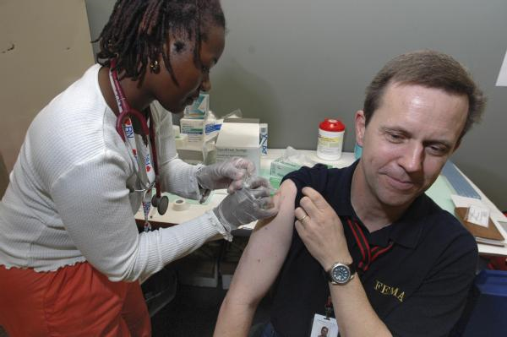
Personal Health and Wellness
Obtain physical exam prior to deployment
Identify and address acute and chronic health problems before deployment
Ensure immunizations are current
Acquire supply of personal medications
Expect long work shifts with decreased opportunities to sleep
Leif Skoogfors/FEMA
Notes:
Health assessment, to include current immunizations, and type and dose of any needed medications should be documented. Responders should have at least a 2-week supply of their personal medications. Expect limited access to nutritious food. Consider bringing nonperishable nutritious snacks such as protein bars and dried fruit and nuts. The average disaster responder works 12-hour shifts and sleeps 5.4 hours a night during deployment. [BDLS 3.0 Course Manual 4-7 to 4-8]
IMAGE -- Orlando, FL, August 31, 2005: Tim Butler, FEMA Disaster Employee from Boise, Idaho, receiving heath inoculation from nurse Reshanda Crayton. Butler, among thousands of FEMA workers, prepares for deployment in areas hit by Hurricane Katrina. Leif Skoogfors/FEMA.

Slide 8
Personal Equipment and Packing
Keep personal identification available at all times
Wear clothing appropriate for weather
Maintain a “go-kit”
Notes:
Identification during a deployment may be a driver’s license, passport, photo identification from a disaster response agency, or a professional license. Weather forecasts should be monitored and should dictate the appropriate personal clothing for the deployment. A “go-kit” is a prepackaged bag or suitcase that is ready to be used at any moment and should contain all essential items for a deployment. [BDLS 3.0 Course Manual 4-8 to 4-9]

Slide 9
Pre-deployment Education and Training
Complete training requirements prior to deployment
“Just-in-time” training may occur during deployment
Knowledge of NIMS, personal protective equipment, decontamination, scene security, and triage principles
Notes:
Consider as training resources the Federal Emergency Management Agency (FEMA) Emergency Management Institute (http://training.fema.gov/), and the National Disaster Life Support program (http://www.ndlsf.org). The ability to work with different individuals from multiple agencies is obtained through learning the National Incident Management System (NIMS) to ensure a common knowledge base. [BDLS 3.0 Course Manual 4-9 to 4-11]

Slide 10
Personal Risk Awareness and Mitigation
Mitigate Risk of Injury
Hygiene | Clean hands frequently
Shelters | Ensure situational awareness
Insects | Use repellent, wear appropriate clothing, use bed nets
Injuries | Consider hazards (power lines, unstable structures)
Notes:
Contamination of the eyes, nose, and mouth must also be avoided. Insect-borne diseases such as malaria may be endemic to the disaster operations area. Bed nets are nets placed around the bed to prevent the entrance of mosquitoes. Also consider the potential hazards posed by animals, which may be infected with rabies. Personal protective equipment (PPE) must be used at the level that is appropriate to the disaster. Responders must protect themselves first. [BDLS 3.0 Course Manual 4-13 to 4-15]

Slide 11
Workplace Activation and Mobilization
Notification of disaster via pre-established methods
Mobilization time frame after activation varies by role
Responders accountable for compliance with pre-deployment policies and check-in
Notes:
A disaster incident can be communicated through a phone call, a text message, an email, or a combination of these. For DMAT Volunteers may have less than 24 hours to indicate whether they are available for deployment. Mobilization time, which in some cases is less than 24 hours, is the time that it takes to relocate responders from the base to the area of need. Responders should anticipate reporting to a central location and then possibly being reassigned to a service site. [BDLS 3.0 Course Manual 4-15 to 4-16]

Slide 12
Workforce Protection
Protecting self first priority in order to save lives in safe manner
Evacuation of rescuers may become necessary
Safety and security dynamic
If rescuers are in immediate endangered -- casualty triage, treatment, and evacuation become secondary
Notes:
An injured or dead responder will not be able to continue his or her job and may require that resources be shifted from the at-need population to the responder. Response personnel may have to emergently evacuate if the working conditions change such as in a fluctuation in temperature extremes, change in wind direction, smoke or fire hazards, potential structure collapse, or release of hazardous materials. [BDLS 3.0 Course Manual 4-16 to 4-17]

Slide 13
Disaster Scene Operational Control Zones
Hot
(EXCLUSION Zone)
Site of release, most contaminated, needs HAZMAT
Warm
(Contamination Reduction Zone)
Location where workers enter and leave, decontamination occurs here
Cold
(Support Zone)
Area contamination-free: casualty collection, triage, treatment, transport
Notes:
In the hot (exclusion) zone, work is done exclusively by the hazardous materials (HAZMAT) response team. They are specially trained to identify the hazardous agent, stop the release of the agent, and rescue casualties. Hospitals and receiving centers must have procedures to minimize exposure to staff and patients. Hospitals and receiving facilities usually have trained decontamination teams and a designated decontamination zone. [BDLS 3.0 Course Manual 4-17 to 4-18]

Slide 14
Selection and Use of Personal Protective Equipment (PPE)
Safety officer determines level of PPE needed
PPE must be used properly during all phases
Two components of PPE:
Respiratory protection – purifiers, supplied air devices (SCBA), or air-line respirator
Protective garments – vapor-tight suits, partially resistant suit, or hooded coverall
Notes:
The safety officer will determine the level of PPE not only for people entering the hot zone but also for people staffing the decontamination area and security personnel. Personal protective equipment must be used to the level that is indicated and must be used consistently. Respiratory protection is the most useful component of any PPE and should be removed last. Air purifiers can be a gas mask type or a powered air-purifying respirator (PAPR). The air is purified through cartridges or a filter. Air purifiers must be used with a known contaminant that has a concentration lower than the level that is immediately dangerous to life or health (IDLH). Air purifiers cannot be used in an oxygen-deficient area. Supplied air can be given through a self-contained breathing apparatus (SCBA) or a respirator attached to an air line. Vapor-tight suits offer the most protection. Partially resistant suits offer less protection than vapor-proof suits. Hooded coveralls, made from a laminated plasticized Tyvek-type material, offer the least protection.
[BDLS 3.0 Course Manual 4-18 to 4-19]

Slide 15
Selection and Use of Personal Protective Equipment (PPE)
Level A
Highest level
SCBA with vapor-tight suit
Level B
High level respiratory
Level C
Less eye or skin protection needed
Chemical resistant clothing with full or half mask
Level D
Skin/eye exposure possible
Universal precautions
Typical work uniform
Notes:
Level B is the minimal level recommended on initial site examination of an unknown contaminant. Level B has an SCBA or supplied air and a chemical-resistant suit. Level C is used only with a known contaminant at a known concentration.
[BDLS 3.0 Course Manual 4-20 to 4-21]

Slide 16
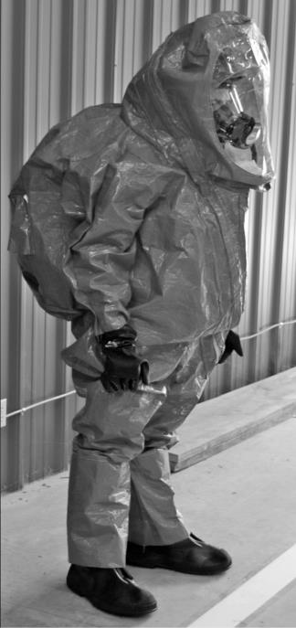
PPE – Level A
Highest level
SCBA with vapor-tight suit
Pros
Highest level of protection
Cons
Expensive
Requires extensive training
Certification required
Limited air supply
Fatigue/heat exhaustion
Dexterity
Communication
Notes:
Level A
Level A PPE should be worn when the highest level of respiratory, skin, eye, and mucous membrane protection is needed. It involves:
Positive-pressure, full-face-piece SCBA, or positive-pressure-supplied air respirator with escape SCBA (NIOSH approved)
Totally encapsulating chemical-protective suit
Gloves, outer, chemical-resistant
Gloves, inner, chemical-resistant
Boots, outer, chemical-resistant, steel toe and shank
Disposable protective suit, gloves, and boots (depending on suit construction, may be worn over totally encapsulating suit)
IMAGE -- Courtesy of Georgia Health Sciences University Department of Emergency Medicine.

Slide 17
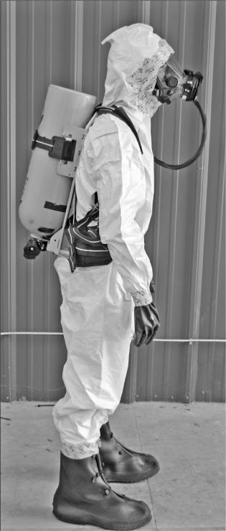
PPE – Level B
High-level respiratory
Less eye or skin protection needed
Pros
High level of respiratory protection
Cons
Less protection from liquid or vapor
Expensive
Requires extensive training and fit testing
Certification required
Limited air supply (SCBA)
Can use supplied air (limited range)
Fatigue/heat exhaustion
Dexterity limited
Communication issues
Notes:
Level B PPE should be selected when the highest level of respiratory protection is needed, but a lesser level of skin and eye protection is sufficient. Level B is the minimum level recommended on initial site entries until the hazards have been identified and defined by monitoring, sampling, and other reliable methods of analysis, and equipment corresponding with those findings has been provided. Level B requires either supplied air or SCBA but lacks the full encapsulation. Level B protection involves:
Positive-pressure, full-face SCBA, or positive-pressure-supplied air respirator with escape SCBA (NIOSH approved)
Hooded chemical-resistant clothing (overalls and long-sleeved jacket; coveralls; one- or two-piece chemical-splash suit; disposable chemical-resistant overalls)
Gloves, outer, chemical-resistant
Gloves, inner, chemical-resistant
Boots, outer, chemical-resistant, steel toe and shank
IMAGE -- Courtesy of Georgia Health Sciences University Department of Emergency Medicine.

Slide 18
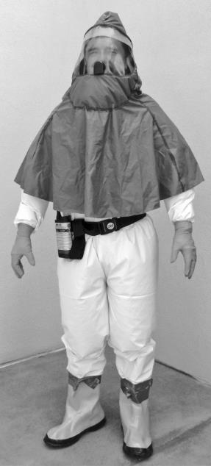
PPE – Level C
Skin/eye exposure possible
Chemical resistant clothing with APR mask or hood
Pros
Comparatively inexpensive
Good respiratory protection
Cons
Less protection from liquid or vapor
Still requires training
Required fit-testing program
Certification required
Will not work in oxygen-deficient environments
Protection against chemicals limited
Fatigue/heat exhaustion
Dexterity limited
Communication issues
Usually adequate for hospital DECON operations
Notes:
Level C protection should be selected when the type of airborne substance is known, the concentration has been measured, criteria for using air-purifying respirators are met, and skin and eye exposure are unlikely. Periodic monitoring of the air must be performed. Level C protection involves:
Full-face or half-mask APRs (NIOSH approved)
Hooded chemical-resistant clothing (overalls; two-piece chemical-splash suit; disposable chemical-resistant overalls)
Gloves, outer, chemical-resistant
Gloves, inner, chemical-resistant
IMAGE -- Courtesy of Georgia Health Sciences University Department of Emergency Medicine.

Slide 19
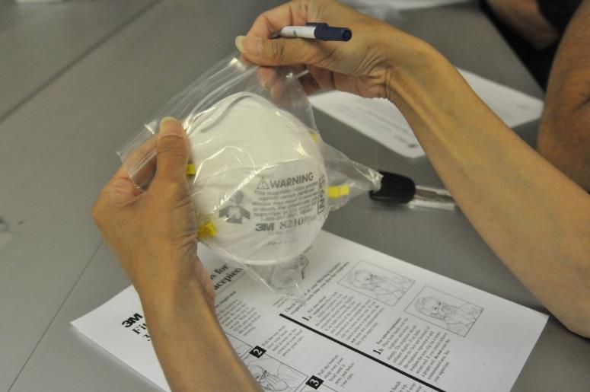
PPE - Level D
Universal Precautions
Typical work uniform
Pros
Inexpensive
Cons
Provides no, or limited, protection against liquids, particulates, or vapors
May require fitting and fit testing (N-95, etc)
Varies widely by job description
Notes:
Level D PPE is universal precautions as practiced in any health care facility. It should not be used on any site where respiratory or skin hazards exist. It involves:
Coveralls
Boots/shoes, chemical-resistant
IMAGE -- Bismarck, N.D., July 27, 2011: A FEMA Community Relations specialist takes a class on the proper use of protective masks in the JFO in Bismarck, ND. FEMA is providing protective mask for employees who are working in area where debris is present. Patsy Lynch/FEMA.

Slide 20
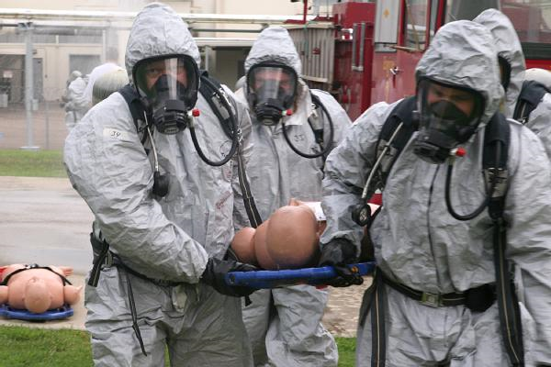
PPE Challenges
Clinical procedures and casualty assessment challenges
Senses are impeded
Decreased touch
Hearing and sight limited
Smell intentionally reduced
Performing lifesaving interventions remains high priority
Shannon Arledge/CDP
Notes:
It is very difficult to perform technical skills such as placing an intravenous line, performing a pleural decompression, or applying a tourniquet. If PPE prevents lifesaving procedures from being performed, then whatever supportive procedures that can be performed while maintaining the same level of PPE should be done. The patient can then be rapidly transported to a decontamination area for decon, then transported to a clean treatment area. Responders must practice evaluating patients and performing medical procedures while wearing higher levels of PPE.
[BDLS 3.0 Course Manual 4-21 to 4-22]
IMAGE -- Anniston, AL, August 4, 2011: Center for Domestic Preparedness (CDP) Superintendent Todd Jones (pictured front left), along with other members of his team, carry a simulated victim through the decontamination process during an exercise at the CDP. The CDP, in Anniston, AL, instructs responders to determine their response tactics, select required equipment, personal protective levels, and decontamination procedures. Responding to all-hazards mass casualty events is a highlight and core principle behind CDP training. Shannon Arledge/CDP.

Slide 21
Casualty Decontamination
Trained and appropriately equipped personnel should perform decontamination
Remove or deactivate contaminants to prevent secondary contamination
Consider decontamination in all explosive, hazardous material, or radiation exposure events
No potentially contaminated patients to or in health care facilities without decontamination
Notes:
Decontamination is generally performed by trained and appropriately equipped personnel to reduce a person’s exposure to hazardous materials and minimize the chance of secondary contamination of responders, health care providers, and others.
It involves the process of removing or deactivating harmful contaminants such as chemical agents and radioactive materials from external body surfaces.
If contaminated casualties, or casualties whose status regarding contamination is unknown, arrive at a health care facility, they should not be allowed to enter the facility until they have been properly decontaminated.
[BDLS 3.0 Course Manual 4-22]

Slide 22
Casualty Decontamination
WET decontamination
Consists of washing in shower or wiping casualties with moist cloth/sponge
DRY decontamination
Removal of clothing and debris
Can eliminate up to 90% of contaminants
Preferred method tepid shower with liquid soap; avoid bleach on humans
Notes:
Decontamination is a primary objective for initial casualty care. It consists of two types, dry and wet:
Dry decontamination essentially consists of removal of clothing and/or debris. In many instances, the removal of clothing may eliminate up to 90% of contamination.
Wet decontamination consists of washing in a shower or wiping down the casualties with a soap-and-water solution or some form of moistened cloth. Showering with tepid water and a liquid soap with good surfactant properties is the preferred method for removing hazardous substances from skin and hair. Water alone is good, soap and water are better.
Bleach solutions should not be used on humans. Bleach solutions can be used for equipment decontaminations.
[BDLS 3.0 Course Manual 4-22 to 4-23]

Slide 23
Mass Decontamination Considerations
Only lifesaving interventions performed before decontamination
Each agency should have protocol for what can be done prior to decontamination
After decontamination, move for further medical and mental health evaluation
WET ➔ STRIP ➔ FLUSH ➔COVER
Notes:
Mass decontamination can be summarized into the action items outlined in the box.
Timely decontamination of many presenting casualties is challenging. Initial wetting of the casualties with water [wet] followed by removal of all clothing in an appropriate setting [strip] should occur. Then copious rinsing, flushing with water [flush] in a temperature-controlled environment where possible, concludes with providing each casualty appropriate garments [cover].

Slide 24
Special Decontamination Considerations
Nonambulatory: require special procedures and additional personnel to move
Children: increased risk of hypothermia, fear, and psychological trauma
Cognitively or physically impaired (e.g., deaf, dementia): will need additional resources
Assistive devices (e.g., walkers or prosthetics): need to be removed and decontaminated
Notes:
Nonambulatory patients may have to be evaluated in a separate dedicated area with access to additional equipment such as a conveyor system of wheelchairs. Additional people will be needed to transfer the patient from place to place. Pediatric decontamination can be very resource intensive as it may take up to three people to decontaminate one child. Ensure that there is appropriate clothing, for example, diapers for children. Beware of hypothermia in infants and young children owing to their thinner skin and their higher body surface area to body mass ratios. Children may not understand the necessity of decontamination and the need to have their clothes removed and have their bodies washed by strangers. Children may also not be willing to be separated from their family members, so will need to be decontaminated together with family members when possible. People with assistive devices such as walkers, canes, hearing aids, and prosthetics must have the device removed and placed in a plastic bag. These individuals will then become less mobile and will require additional resources.
[BDLS 3.0 Course Manual 4-23 to 4-25]

Slide 25
Workforce Demobilization
Demobilization planned process:
Not emergency evacuation
Organized transition
Operations shift from response to recovery
May participate in debriefing – “hot wash”
Notes:
Demobilization is the formal notification from incident command that a team of responders’ mission or tasking is completed.
Demobilization is the process of “standing down” and disbanding resources when emergency response needs have been met. Demobilization is a planned process involving the organized transition of functions or cessation of services and
a dismantling of equipment and site-based resources.
A “hot wash “ is a debriefing where the strengths, weaknesses, and areas for improvement are reviewed for the consideration of corrective measures for future disaster responses.
[BDLS 3.0 Course Manual 4-25]

Slide 26
Workforce Deployment-Related Stress
Disaster response can be stressful but rewarding
Emotional stressors include:
Loss of life/serious injuries
Emotional distress of victims
Sleep deprivation/lacking basic comforts
Separation from family
Symptoms of stress are normal and generally temporary
Seek professional help if persists
Notes:
Exceptionally empathic disaster responders may internally absorb the traumatic stress of the disaster survivors and feel overwhelmed in meeting the needs of the survivors. Stress buildup may lead to a state of exhaustion with difficulty functioning, leading to compassion fatigue. Compassion fatigue may progress to posttraumatic fatigue syndrome.
[BDLS 3.0 Course Manual 4-25 to 4-26]

Slide 27
Workforce Demobilization and Deployment-Related Stress
Everyone experiencing disaster affected by situation
Healthy to reach out for help and accept when needed
Everyone has different methods of coping
Elissa Jun/FEMA
Notes:
Deployment-Related Stress: It is normal to feel sadness, grief, and anger about what happened and what was seen during a disaster. It is natural to feel anxious about personal safety and the safety of one’s family. Acknowledging personal feelings will help an individual move forward more quickly. Focusing on one’s contributions, strengths, and abilities can help in healing if an individual is troubled by the experience. Everyone has different needs and different ways of coping. This is normal. It is healthy to reach out for and accept help if needed.
[BDLS 3.0 Course Manual 4-25 to 4-26]
IMAGE -- Joplin, MO, August 10, 2011: Jay Tarter (left), his wife, Luci, and their daughter Emily share an emotional moment at the "I AM JOPLIN" event, a back-to-school gathering attended by thousands of school-aged children and their parents at Missouri Southern State University. Elissa Jun/FEMA.

Slide 28
Question 1 What is the highest level of PPE?
Level A
Level B
Level C
Level D
Notes:
Question:
What is the highest level of PPE?

Slide 29
Question 1 What is the highest level of PPE?
Level A
Level B
Level C
Level D
Notes:
Question:
What is the highest level of PPE? A

Slide 30
Question 2 What should be performed prior to decontamination?
Routine medical treatments
Lifesaving interventions
Triage category assignment
All of the above
Notes:
Question:
What should be performed prior to decontamination?

Slide 31
Question 2 What should be performed prior to decontamination?
Routine medical treatments
Lifesaving interventions
Triage category assignment
All of the above
Notes:
Question:
What should be performed prior to decontamination? b

Slide 32
Question 3 Which of the following statements is true about demobilization stress?
Responders should not experience stress
Symptoms of stress are never normal
All responders should seek mental health treatment
Everyone copes with stress differently
Notes:
Question:
Which of the following statements is true about demobilization stress?

Slide 33
Question 3 Which of the following statements is true about demobilization stress?
Responders should not experience stress
Symptoms of stress are never normal
All responders should seek mental health treatment
Everyone copes with stress differently
Notes:
Question:
Which of the following statements is true about demobilization stress?

Slide 34
Lesson Summary
Responders must possess knowledge, demonstrate skills, maintain fitness, and be able and prepared to perform duties
Risks, disruptions, and hazards part of every disaster response operation
Responder must be aware of and use personal protective equipment to protect self
Perform lifesaving interventions when necessary prior to decontamination
Notes:
Responders must have specific knowledge, demonstrate certain skills, possess and maintain a fitness to respond, and be able and prepared to perform their duties.
Risks, disruptions, and hazards are part of every disaster response operation. The responder must be aware of and use personal protective equipment to protect themselves.
Perform lifesaving interventions when necessary prior to decontamination.

Slide 35
Questions?

