Slide 1
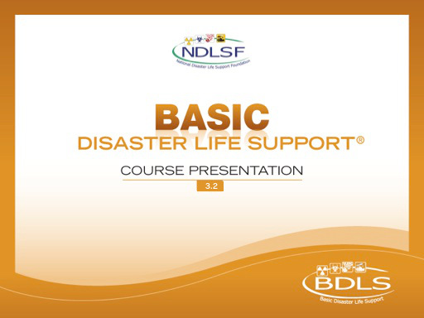

Slide 2


Basic Disaster Life Support™
Introduction

Slide 3
Course Learning Objectives
Describe an all-hazards, standardized, scalable casualty management approach for use in disasters and public health emergencies, including lifesaving interventions and medical decision making in an altered care environment
Describe information sharing, resource access, communication, and reporting methods useful for health professionals during disasters and public health emergencies
Describe the purpose and importance of incident management system for providing health and medical support services in a disaster or public health emergency
Notes:
These BDLS 3.0 Course Objectives can be found in the BDLS 3.0 Course Manual, pages xxvii and xxviii.
The BDLS® course and course objectives support a consensus-based competency framework,* which was endorsed by the National Disaster Life Support Education Consortium in 2009. A chart depicting the specific competencies and subcompetencies that are relevant to each chapter in this manual is presented as Appendix B.
Describe an all-hazards, standardized, scalable casualty management approach for use in disasters and public health emergencies, including lifesaving interventions and medical decision making in an altered care environment
Describe information sharing, resource access, communication, and reporting methods useful for health professionals during disasters and public health emergencies
Describe the purpose and importance of the incident management system for providing health and medical support services in a disaster or public health emergency
*Source document: Subbarao I, Lyznicki J, Hsu E, et al. A consensus-based educational framework and competency set for the discipline of disaster medicine and public health preparedness. Disaster Med Public Health Preparedness. 2008;2:57-68.

Slide 4
Course Learning Objectives
Describe field, facility, community, and regional surge capacity assets for the management and support of mass casualties in a disaster or public health emergency
Describe considerations and solutions to ensure continuity of and access to health-related information and services to meet the medical and mental health needs of all ages, populations, and communities affected by a disaster or public health emergency
Describe public health interventions appropriate for all ages, populations, and communities affected by a disaster or public health emergency
Notes:
Describe field, facility, community, and regional surge capacity assets for the management and support of mass casualties in a disaster or public health emergency.
Describe considerations and solutions to ensure continuity of and access to health-related information and services to meet the medical and mental health needs of all ages, populations, and communities affected by a disaster or public health emergency.
Describe public health interventions appropriate for all ages, populations, and communities affected by a disaster or public health emergency.

Slide 5
Course Learning Objectives
Identify potential casualty populations in a disaster, including persons with acute injuries or illnesses; those with pre-existing disease, injuries, or disabilities; those with age-related vulnerabilities or other access needs; and family/caregiver support network
Describe the deployment readiness components for health professionals in a disaster or public health emergency
Describe an all-hazards standardized, scalable workforce protection approach for use in disasters, including detection, safety, security, hazard assessment, support, and evacuation or sheltering in place
Notes:
Identify potential casualty populations in a disaster, including persons with acute injuries or illnesses; those with pre-existing disease, injuries, or disabilities; those with age-related vulnerabilities or other access needs; and family/caregiver support network.
Describe the deployment readiness components for health professionals in a disaster or public health emergency.
Describe an all-hazards standardized, scalable workforce protection approach for use in disasters, including detection, safety, security, hazard assessment, support, and evacuation or sheltering in place.

Slide 6
Course Learning Objectives
Describe actions that facilitate mass casualty field triage utilizing a standardized stepwise approach and uniform triage categories
Describe the concepts and principles of mass fatality management for health professionals in a disaster or public health emergency.
Describe the clinical assessment and management of injuries, illnesses, and mental health conditions manifested in a disaster.
Describe moral, ethical, legal, and regulatory issues relevant to the health-related management of individuals of all ages, populations, and communities affected by a disaster or public health emergency.
Notes:
Describe actions that facilitate mass casualty field triage utilizing a standardized stepwise approach and uniform triage categories.
Describe the concepts and principles of mass fatality management for health professionals in a disaster or public health emergency.
Describe the clinical assessment and management of injuries, illnesses, and mental health conditions manifested in a disaster.
Describe moral, ethical, legal, and regulatory issues relevant to the health-related management of individuals of all ages, populations, and communities affected by a disaster or public health emergency.

Slide 7
Course Faculty
Patrick Byrne, BSN, RN, MEP, CHEC III
Anne D’Angelo, MS, RN
Ralph Estep, PhD, RN, CIH, CSP
Brooke Lerner, PhD
Donna Sowles, RN
Chris Tarantino, MEP, CHEC III, MPIO-C
Kathee Tyo, MS, RN
Diana Volkman, RN
Notes:
The faculty slide is designated for NDLS Training Centers to list and introduce all faculty members involved in the BDLS course.

Slide 8
Course Disclosures
All instructors are NDLS certified
There are no disclosures commercial or personal for any instructors today.
Notes:
The disclosure slide is designated for NDLS Training Centers to list any faculty conflict of interests for the BDLS course. Any perceived conflicts of interest should be reported on the course evaluation and/or to the course director.

Slide 9
Course Requirements
Recommended CDLS® v3.0 course knowledge base
Recommended IS100 and IS700
Registered for class at http://register.NDLSF.org
Review BDLS® v3.0 Course Manual
Complete pre-course assessment
Participate in all BDLS course components
Complete post-course assessment
Complete participant evaluation
Notes:
The requirements for the BDLS course include recommended CDLS course knowledge base, review of the BDLS 3.0 Course Manual, participation in all BDLS course components, completion of the pre- and post-course assessments, and completion of the participant evaluation.

Slide 10
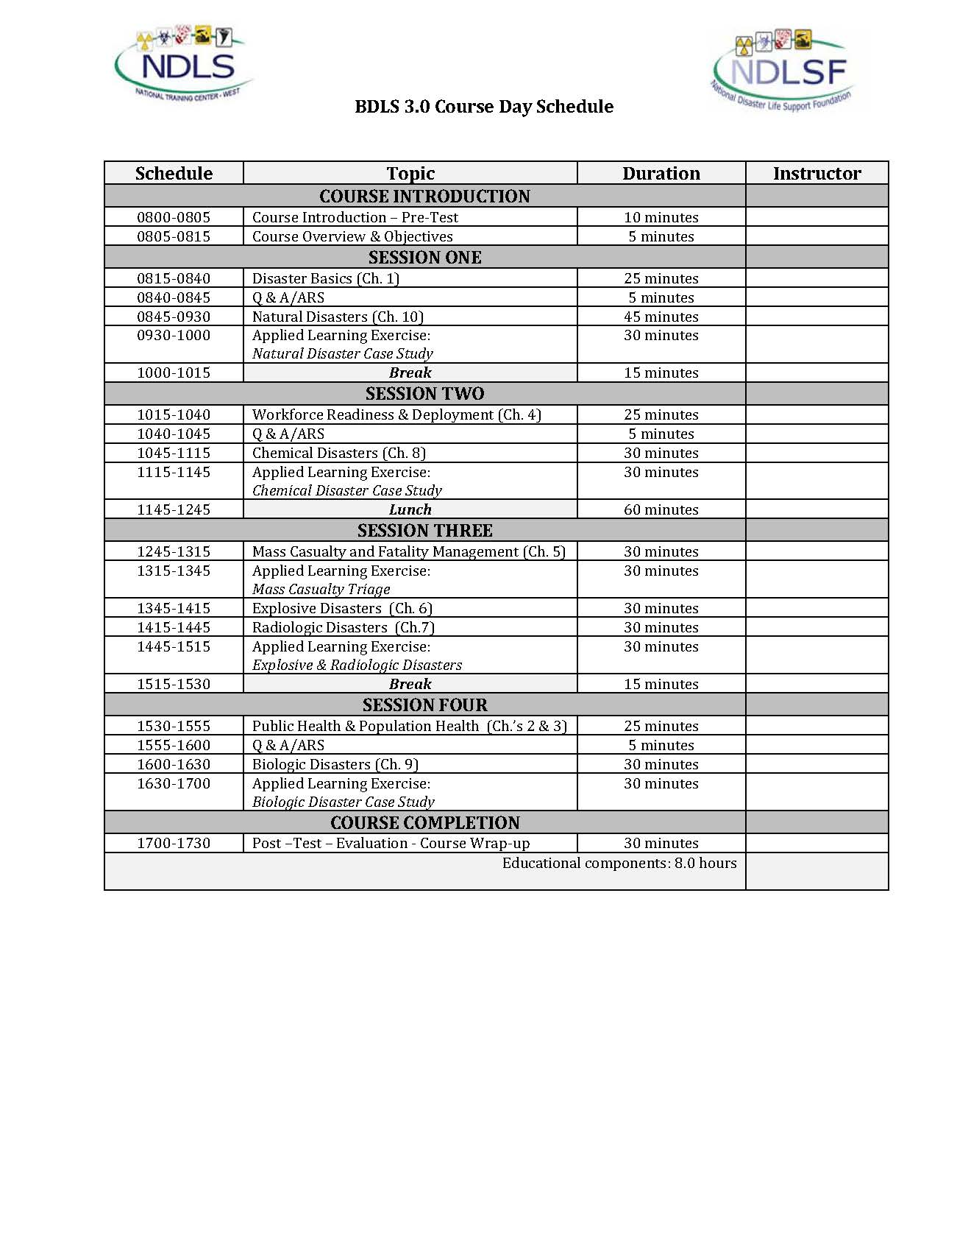
Course Design
Composed of four sessions, with following themes:
Disaster basics
Workforce preparedness
Casualty management
Public-population health
Notes:
The BDLS course is composed of four sessions, with the following themes:
1. Disaster basics
2. Workforce preparedness
3. Casualty management
4. Public-population health

Slide 11
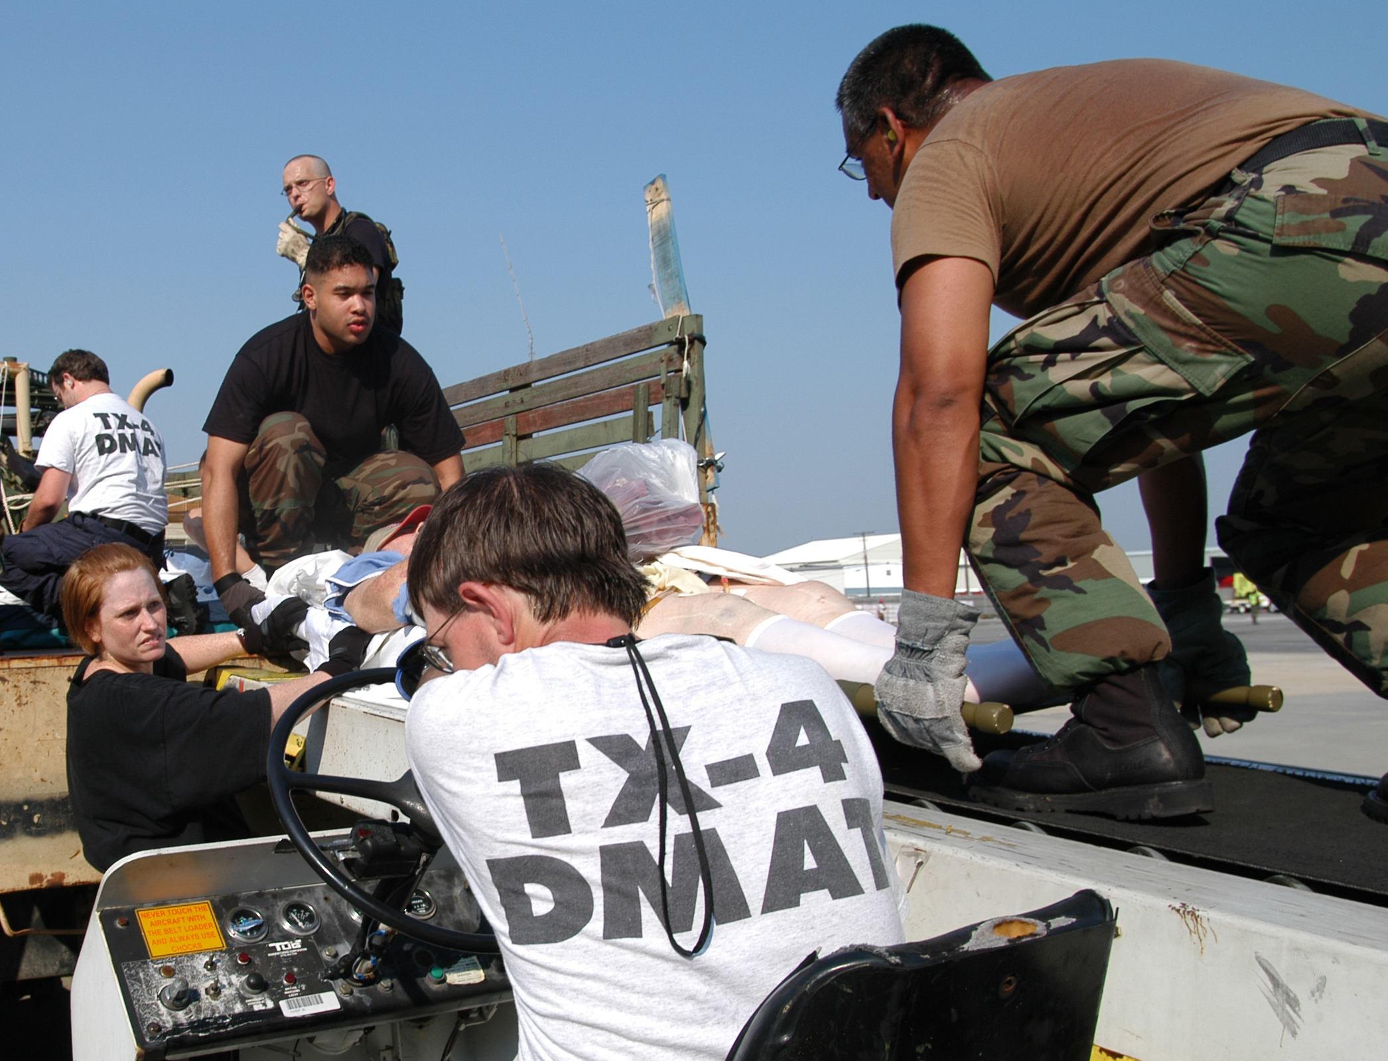
Course Design
Each session is composed of the following:
Basic concepts (25 min)
ARS Q and A (5 min)
Relevant typology (30 min)
Exercise (30 min)
Total: 1 hour, 30 minutes
Win Henderson/FEMA
Notes:
Each session is comprised of the following elements: basic concepts, audience question and answer, relevant typology, and the applied learning exercise.
IMAGE -- New Orleans, LA, September 2, 2005: Members of the Louisiana National Guard and the Dallas, TX, Disaster Medical Assistance Team ferry litter-borne evacuees from a truck for transport to a triage area inside the New Orleans Airport. Thousands of rescued residents stranded by Hurricane Katrina are being evacuated to cities around the nation. New Orleans is being evacuated due to flooding caused by hurricane Katrina. Win Henderson/FEMA.

Slide 12
Course Overview
Session 1 – Disaster Basics
Disaster Basics | 25 minutes
Question and Answer With ARS | 5 minutes
Natural Disasters | 30 minutes
Applied Learning Exercise: Natural Disaster | 30 minutes
Break | 15 minutes
Notes:
Here is the overview of session 1.

Slide 13
Course Overview
Session 2 – Workforce Preparedness
Workforce Readiness and Deployment | 25 minutes
Question and Answer With ARS | 5 minutes
Chemical Disasters | 30 minutes
Applied Learning Exercise: Chemical Disaster | 30 minutes
Lunch | 60 minutes
Notes:
Here is the overview of session 2.

Slide 14
Course Overview
Session 3 – Casualty Management
Mass Casualty and Fatality Management | 30 minutes
Applied Learning Exercise: SALT Triage Methodologies | 15 minutes
Explosive, Traumatic, Nuclear, and Radiologic Disasters | 60 minutes
Applied Learning Exercise: Explosive, Traumatic, Nuclear, and Radiologic Disasters | 30 minutes
Break | 15 minutes
Notes:
Here is the overview of session 3.

Slide 15
Course Overview
Session 4 – Public-Population Health
Public Health and Population Heath | 25 minutes
Questions and Answer With ARS | 5 minutes
Biologic Disasters | 30 minutes
Applied Learning Exercise: Biologic Disaster | 30 minutes
Notes:
Here is the overview of session 4.

Slide 16
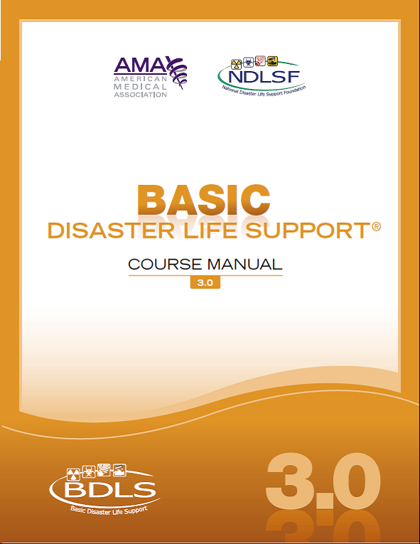
Course Manual
Reference tool
10 chapters
Well-referenced
Peer-reviewed
Detailed explanations
Additional resources
Notes:
The BDLS 3.0 Course Manual, consisting of ten chapters, is a reference tool for you to use in conjunction with the course. The manual is a well-referenced, peer-reviewed resource that contains additional resources.

Slide 17
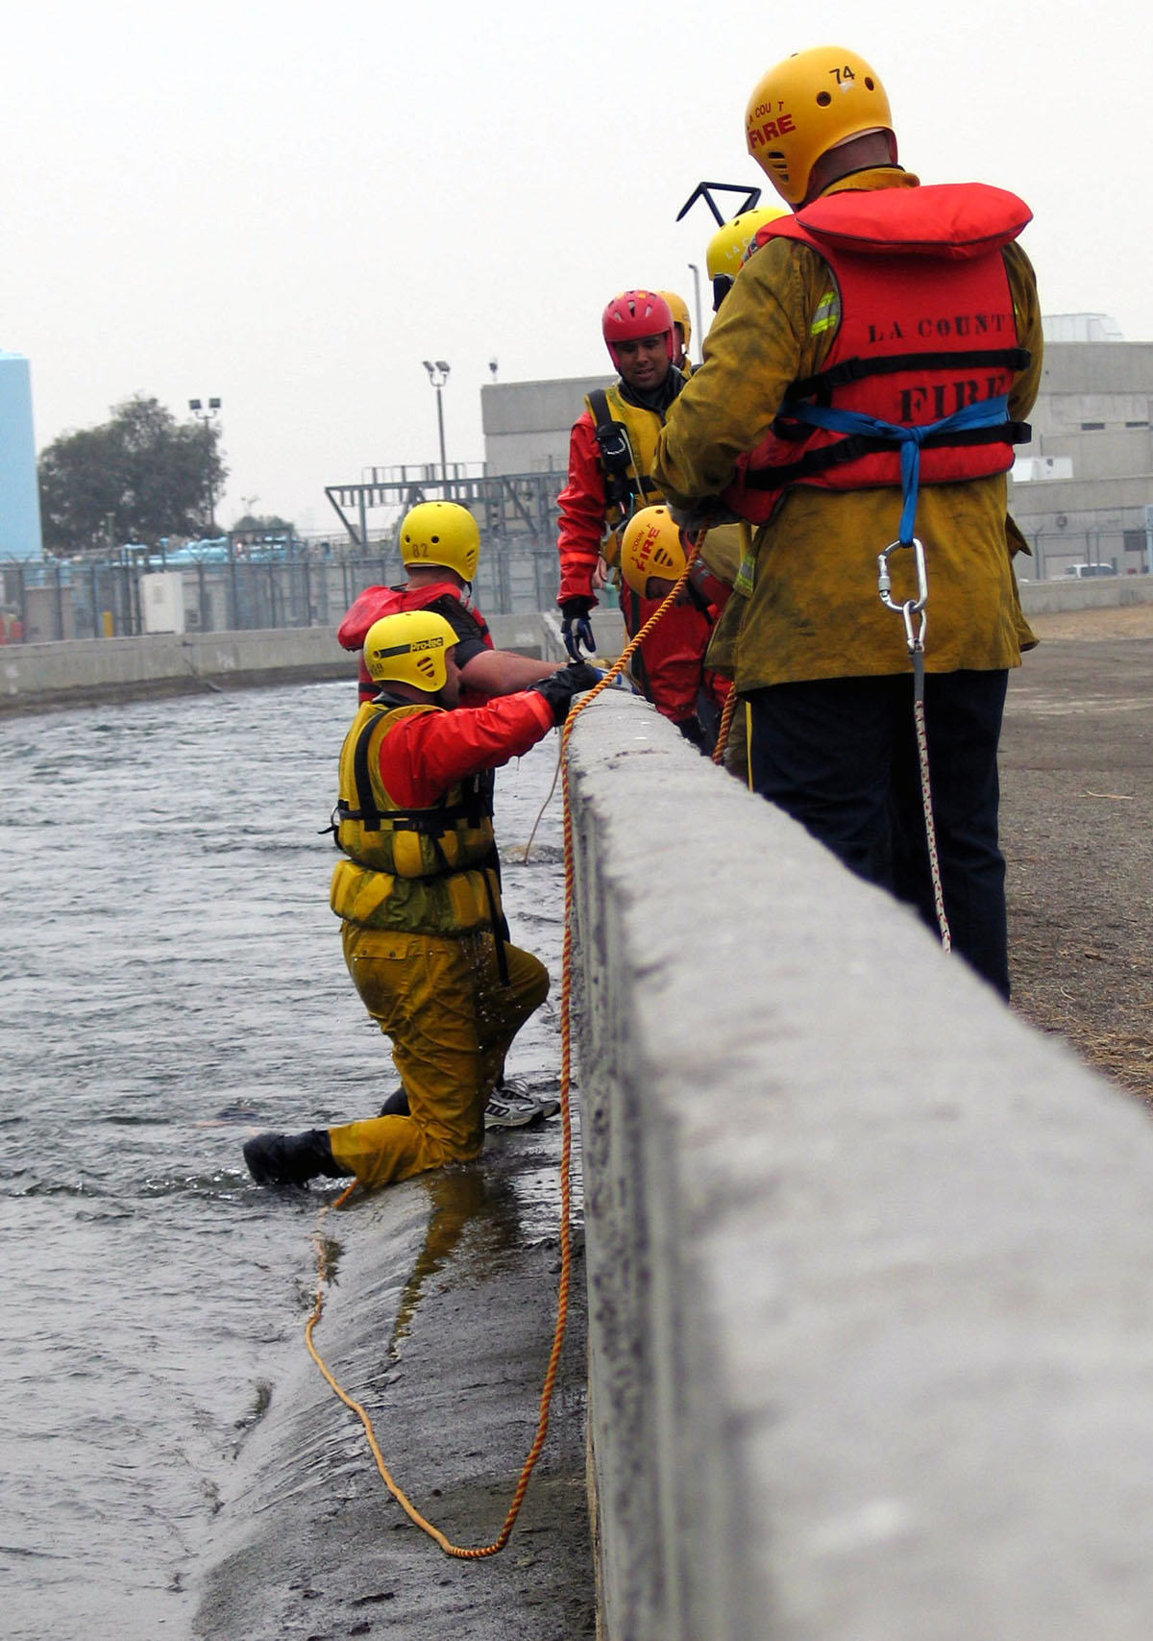
Post-Course Assessment and Evaluation
Complete both the Post-Course Assessment and the Evaluation at the NDLS website http://Register.NDLSF.org after completion of the class
Once the you have passed the Post-Course Assessment (80% or better) PRINT YOUR CERTIFICATE OF COMPLETION
Jason Pack/FEMA News Photo
Notes:
Please complete the pre-course assessment. This is to measure your own learning achievement. Do not use any resources to assist in the completion.
IMAGE -- Los Angeles County, CA: firefighters with LA County Battalion 11 practice retrieval techniques during company drills. Jason Pack/FEMA News Photo.

Slide 18
BDLS v.3.2 Program
  Meets competencies through defined objectives
  Applies NDLS™ program principles
  Prepares you for disaster casualty management
  Fulfills prerequisites for ADLS® Course entry
Notes:
The BDLS course meets competencies through defined objectives to prepare you for disaster casualty management. The course applies the NDLS program principles and will fulfill the prerequisites for entry into the ADLS course.

Slide 19
QUESTIONS?

