Slide 1
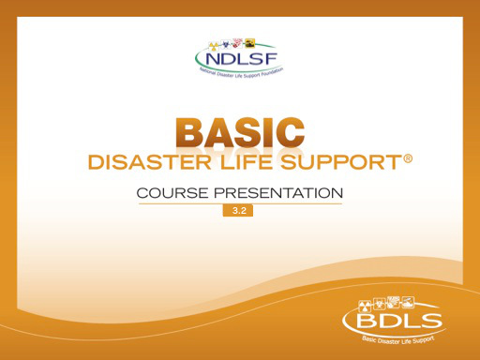
Interactive Webinar Component
Applied Learning Exercise
Chemical Disasters

Slide 2
GROUP ASSIGNMENTS
GROUP 1
GROUP 2
Gregory Millwater
Candy Anderson
Anna Gardner
Kelly Smith
Vasilios Lianos
Tammy Healy
Lynn Gordner
Mark Vitale
Susan Burke
Tanja Peters
Daniel Neaverth
Heather Loftus
GROUP 3
GROUP 4
Kimberly Maguda
Keith W Collins-Allen
Shawna Rizzi
Amy Romanik
Rachael Nees
Emily Warfle
Deb Weaver
Andrew Dunnick
Dan Hedgecock
Winnie Romeril
William McGill
Andrew Parker

Slide 3
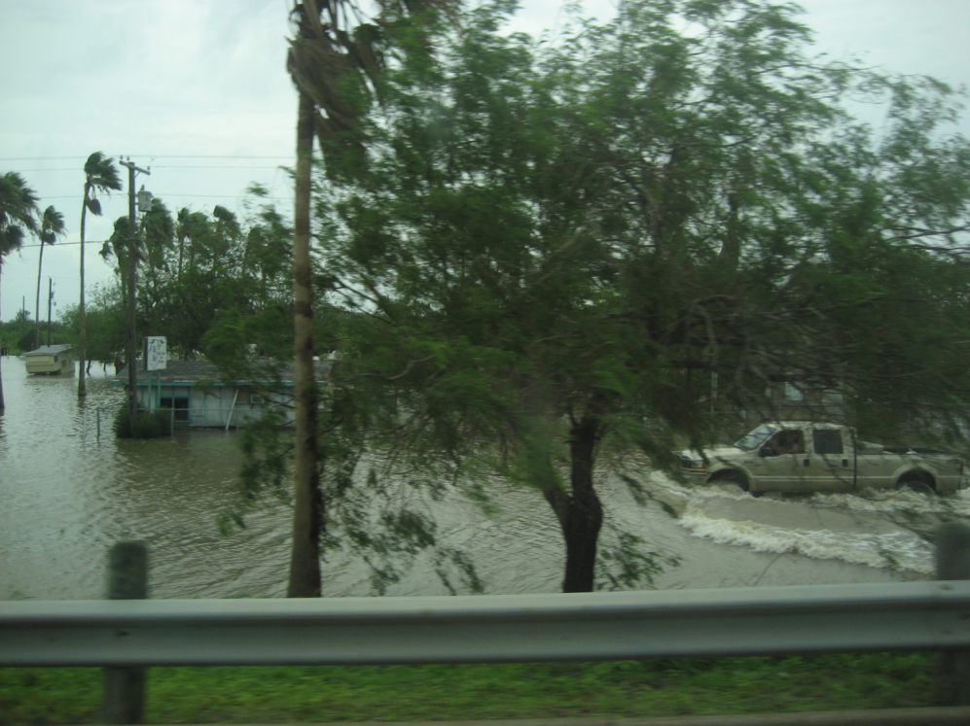
P | lanning and preparation
R | esilience
E | ducation and Training
D | etection
I | ncident Management
S | afety and Security
A | ssess Hazards
S | upport
T | riage and Treatment
E | vacuation
R | ecovery
Are my needs > resources?
Putting the PRE-DISASTER Paradigm™ into practice!
Notes:
We are about to begin a series of Applied learning exercises – to provide an example of how to apply the PRE-DISASTER Paradigm into practice.
As was explained in the first online module, lesson 1: “Disaster Basics,” the PRE-DISASTER Paradigm™ is a useful tool to both learn and organize your approach to many of the key areas and topics relevant to being prepared disaster health and medical personnel.
Clearly, having excellent health and medical skills is essential to helping meet the needs of the casualties and impacted communities after a disaster; however, it is equally important that each health and medical provider be properly skilled in the basic tenets and practices of a disaster in order to be an effective asset to the situation.
CLICK
Always be asking yourself with each step or area considered, am I in a needs > resources situation? If so, prioritize the action items and information sharing required to solve and address it.

Slide 4

Chemical Disasters
Scenario
Graniteville, SC
911 calls and radio calls to emergency communication center concerning patients
Notes:
The train derailment transportation incident that occurred in Graniteville, SC, demonstrated many of the important issues relevant to a chemical disaster. It began with someone calling 911 for help!

Slide 5
Lesson Scenario
2:40 am 911 calls, reporting train accident.
2:46 am Responding fire chief reports driving into a cloud of fumes and almost being overcome by fumes. Orders responding units to stage at marshaling point.
2:53 am Fire chief and responding units arrive to an upwind marshaling point. 911 calls report trouble breathing and fumes. Instructions to shelter in place given.
3:18 am EMS contacts local hospitals and advises of potential for multiple incoming patients from a chemical spill.
Notes:
At roughly 2:40 am, two Norfolk Southern trains collided near an Avondale Mills plant in Graniteville, SC. Norfolk Southern train No. P22 was parked on a siding near the Avondale Mills plant. Train No. 192, which was transporting chlorine gas, sodium hydroxide, and cresol, was diverted by an improperly lined railroad switch onto the siding, where it collided with P22. The collision derailed both locomotives and 16 of train No. 192's 42 freight cars, as well as the locomotive and one of P22's two freight cars. One of 192's tank cars loaded with 90 tons of chlorine ruptured, releasing about 60 tons of the gas.
The location of the incident was immediately adjacent to a residential area and a textile plant where the night shift was on duty. In total more than 250 patients were treated at local hospitals. Although decontamination was performed on scene, many patients arrived at local hospitals incompletely decontaminated or not decontaminated at all. Patients were maldistributed, with two facilities becoming completely overwhelmed and with pediatric patients passing a children's hospital to go to a nonpediatric center. Most patients had minor respiratory symptoms; a few required intubation due to the severity of their symptoms. Nine people died from the incident and 5400 residents were evacuated from their homes for 2 weeks during the cleanup.

Slide 6
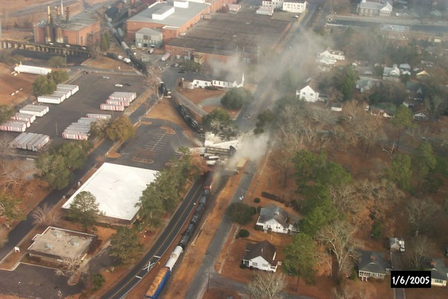
Notes:
The images show both the train derailment and the spilled contents from the train cars responsible for the chemical disaster associated with the Graniteville incident. Please note the proximity to residential housing as well as businesses nearby. Note also the cloud plume visible, showing the importance of wind direction as well as the overall importance of early situational awareness.

Slide 7
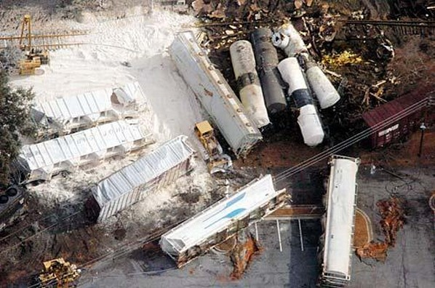
Notes:
A closeup of the accident scene

Slide 8
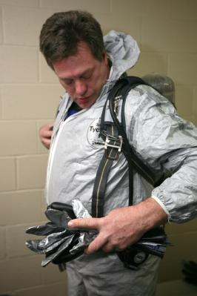
P | lanning and preparation
R | esilience
E | ducation and training
D | etection
I | ncident management
S | afety and Security
A | ssess hazards
S | upport
T | riage and Treatment
E | vacuation
R | ecovery
Shannon Arledge/FEMA
Are my needs > resources?
Putting the PRE-DISASTER Paradigm™ into practice!

Slide 9
PRE-DISASTER Paradigm™
Planning and Practice
GROUP 2
What chemical disaster plans are in place?
What are the key components to an effective disaster plan?
Notes:
Have there been any previous chemical fire disaster plans? Have all the appropriate personnel and agencies participated in a drill before this event occurred? Disaster response plans should undergo revision as needed. In particular, after each drill or actual response, the performance of individuals enacting the disaster plan and the efficacy of the disaster plan itself must be reviewed to improve the quality of future responses. Are the drills frequent and do they consider all hazards?
After an actual incident, drill, or exercise, chemical disaster response plans should be reviewed to determine whether the procedures in the written plan were adequate and met the actual needs of the occurrence. Typically, areas for improvement are noted in an after-action report, and revisions to the plan would be made and promulgated by the chief executive.
People in the immediately affected zone can be instructed to keep windows closed, to remain indoors, and to remove (if possible) or not use the in-the-window type of air conditioners. People should be instructed to remain calm. Those people in areas that might potentially be affected should have an evacuation plan and should listen for and obey responder instructions regarding possible evacuation. The resilience of the community will be dependent on whether the hazardous effects of the incident have been mitigated.
When hazards are identified that may produce a potential chemical disaster, any possible mitigation actions that can isolate the hazard from a vulnerable population or critical infrastructure should be considered when feasible. These steps will increase the resilience of a community or health care facility after any type of disaster.

Slide 10
PRE-DISASTER Paradigm™
Resilience
GROUP 2
What prior actions could have been taken to mitigate the effects of the event?
Notes:
Resilience involves behaviors, thoughts, and actions that can be learned and developed in anyone.
Resilience also refers to plans that return the infrastructure of a community to normal as soon as possible after an event.
Resilience can be enhanced through mitigation efforts to eliminate or reduce the probability of disaster occurrence or reduce the effects of unavoidable events.

Slide 11
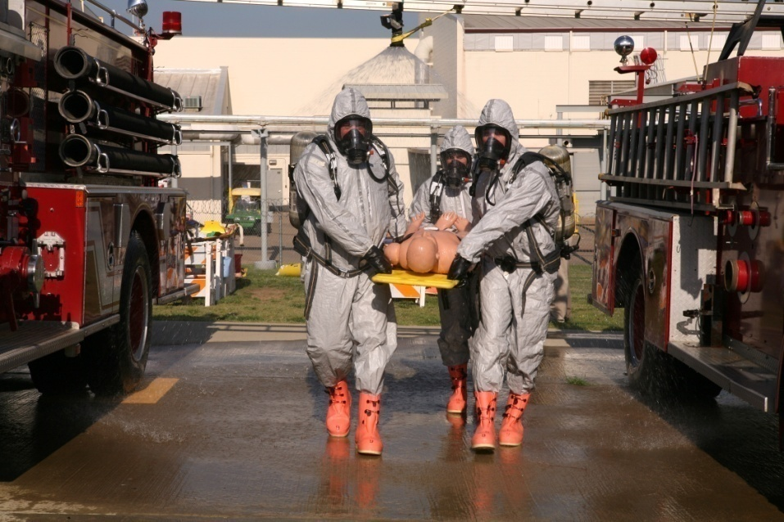
PRE-DISASTER Paradigm™
Education and Training
GROUP 2
What type of training should responders have?
What about just-in-time training?
Shannon Arledge/FEMA
Notes:
Responders should have had previous training in which they practiced putting on various types of PPE and working in them. Responders should also have had full-scale drills in which they treated multiple patients in a contaminated environment. The training should be based on the jurisdiction’s Emergency Operations Plan, which is unique to each jurisdiction and should reflect the potential hazards of that jurisdiction.
Training should be based on the current, updated version of the jurisdiction’s emergency operations plan, and the training evaluated by conducting a discussion or operations-based exercise. Particular emphasis on recognizing the signs and symptoms of chemical exposure, how to take initial personal protective actions, and performing decontamination should be considered for chemical disasters.

Slide 12

The DISASTER Paradigm™
Detection
GROUP 3
Based on information from callers, what type of incident is this likely to be?
Jason Pack/FEMA
Notes:
As reliable information may not be available, health care providers can presume on the basis of the reported signs and symptoms of choking and eye irritation that there was a chemical gas release. Health care personnel can gather more information from multiple sources, including first responders, 911 dispatch, incident commander, and chemical plant manager.
Reliable information regarding the exact nature of the chemical and extent of a person’s exposure is unlikely early on in the event. As such, health care providers should be able to identify the type of agent and principles of care on the basis of signs and symptoms of illness, as well as how to determine that a possible chemical event has occurred in the community by using additional resources.

Slide 13
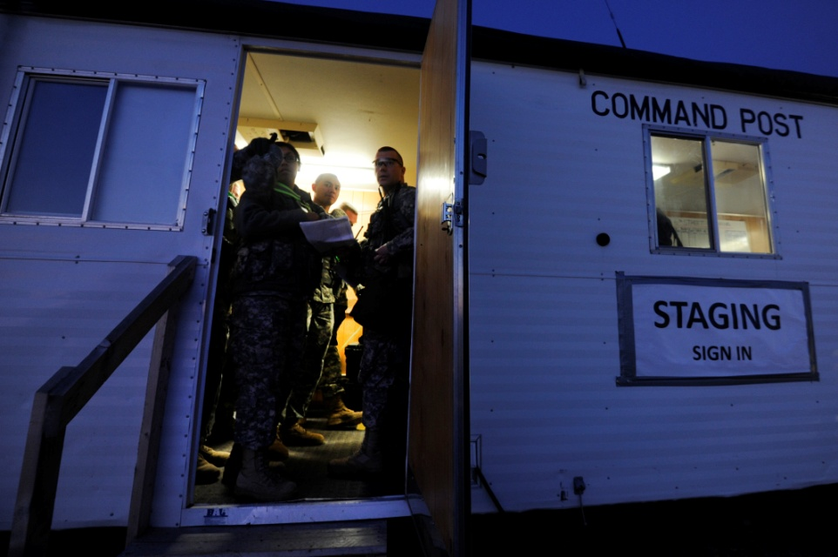
The DISASTER Paradigm™
Incident Management
GROUP 3
What NIMS areas the impact health and medical role?
  What is your role within the ICS structure?
  Where could command posts be set up?
Staff Sgt. Vernon Young/US Air Force
Notes:
One way for the incident command structure to be established is on scene. The arriving responders, in this case firefighters, will set up a command post and establish an incident commander. The incident commander is often the highest-ranking responder who is currently on site. The commander will establish a safe perimeter, designate a command area, and assign roles to the responders. The commander will then disseminate information, either personally or through a public information officer.
In addition to on-scene incident management, there can be a second incident management structure in place at the receiving health care facility. In large-scale chemical incidents where there is a large number of actual or expected casualties, the receiving hospital will establish its own incident commander. The hospital incident commander may be positioned in the hospital’s emergency operations center. The hospital’s incident commander will coordinate the proper use of hospital resources.
Like all disasters, chemical disasters will be managed by using the incident command system (ICS). It is likely, on the basis of the scope of the event, that the jurisdiction’s emergency operations center or hospital command center will be activated for a large-scale incident. Adhering to ICS principles and following the chain of command are essential to ensure that all critical functional roles are performed during a chemical disaster.

Slide 14
The DISASTER Paradigm™
Safety and Security
GROUP 3
What steps must be taken immediately on scene?
What level of PPE?
What must the receiving hospital do in order to ensure the safety of its patients and workers?
Notes:
Personal protective equipment must be used by responders to the incident. Initially responders should be in level A or, at a minimum, level B PPE until all hazards are identified. On scene a safety perimeter must be established immediately. It is critical to try and limit the number of people exposed to the chemicals and to prevent further exposure to patients who were previously exposed.
Hospitals should activate a lock-down procedure. Ingress and egress to the health care facility must be strictly controlled to ensure that there is no secondary contamination, of hospital personnel or hospital patients, by contaminated patients.
Preventing personnel and critical facilities from secondary contamination is paramount in responding to a chemical disaster. Rapid site security measures and perimeter control should be put into place as soon as possible, and hospitals should be placed on lockdown. This will ensure better control of how contaminated individuals are handled, and the spread of contamination and potential for secondary contamination of critical infrastructure will be avoided.
Additionally, appropriate PPE should be utilized by first responders and first receivers when performing rescue, triage, or decontamination operations during a chemical disaster.

Slide 15
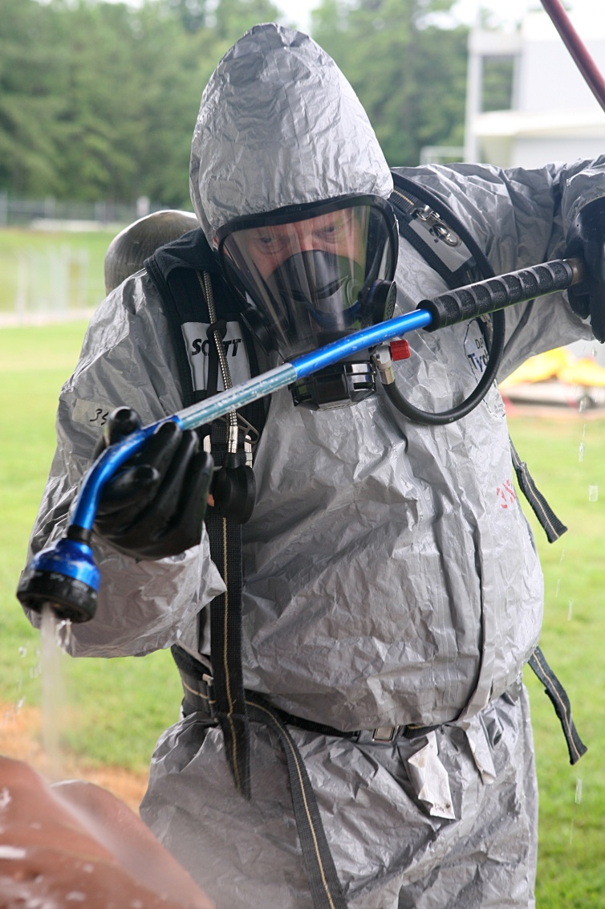
The DISASTER Paradigm™
Assess Hazards
GROUP 4
What type of hazards are expected from this incident?
How will you assess the dangers or threat levels?
Shannon Arledge/FEMA
Notes:
After gaining initial situational awareness and getting safety and security measures under way, it is important to now consider what specific hazards are present or imminent.
Chemical exposure, injury from downed power lines, falling debris and other effects of the train crash , explosions or fires from other chemicals on the train or fuel or in the crash area (e.g. gas lines)
Move to safe area and use appropriately skilled teams to assess – some ideas are to determine train cargo, visually inspect the area,

Slide 16
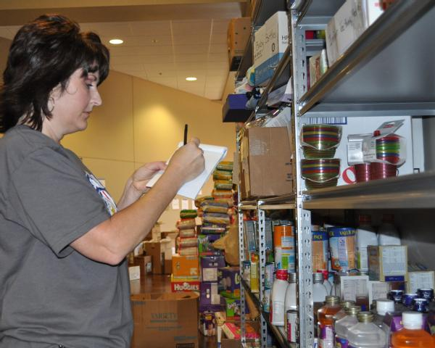
The DISASTER Paradigm™
Support
GROUP 4
How should support be provided during this event?
Who is needed?
Marilee Caliendo/FEMA
Notes:
Support should be provided by using the incident command system. Information and support should flow through the incident commander and be distributed through designated people. The methods and means of support must be coordinated by a central person to ensure that resources are not duplicated or wasted. A centralized system allows for the proper application of needed resources to the area of greatest need
Receiving facilities should set up patient decontamination areas with designated decontamination teams in place.
Who – Hazmat, law enforcement, public health, EMS, decon teams (at scene and hospitals), utility companies, train company
Support to manage the incident should be requested through the ICS structure in place either on scene or at the facility. Individuals in positions to identify and procure resources for incident operations should have procedures in place for rapid execution and deployment of resources as soon as possible. Additionally, individuals in logistics or planning positions who are in charge of resource procurement and allocation should have proper training on their roles and participate in frequent drills and exercises.

Slide 17
The DISASTER Paradigm™
Triage and Treatment
GROUP 4
How should triage occur?
What triage principles might apply?
When should decontamination occur? How?
What is the treatment for casualties?
Notes:
Triage should occur on scene and at the receiving hospitals. The on-scene patients must be considered contaminated and will require decontamination before treatment at the receiving facility. Given the large number of potential victims, a mass casualty situation may be declared requiring additional resources to be mobilized.
Decontamination should occur as soon as possible, definitely before the patients enter the health care facility for definitive treatment. On-scene decontamination may consist of removal of the patient from the toxic environment, removal of clothes, irrigation of eyes, and administration of oxygen. At the receiving hospital's decontamination area, the patients may undergo a more thorough decontamination, including being washed with soap and water and given uncontaminated clothing.
Triage will be performed twice, both at the scene and at the hospital, particularly when decontamination is being performed. Individuals should be triaged initially to prioritize who goes through decontamination first and then triaged medically after the removal of contamination. The fundamental principle of triage during a chemical disaster is to treat the most people with the best chance of survival using the resources available. In the setting of a mass casualty event, treatment will be symptom-based on clinical diagnoses and should not rely on diagnostic testing. Neurologic, pulmonary, and cardiovascular effects will be the most likely to cause mortality in a chemical disaster. Both cyanide and nerve agents have specific antidotes that can be administered to reverse the effects of the agent.

Slide 18

The DISASTER Paradigm™
Evacuation
GROUP 1
How is the decision for people to shelter in place or to evacuate the area made?
Shannon Arledge/FEMA
Notes:
The decision of whether people who are in the affected zone or potentially in contact with the affected zone should evacuate is made within the ICS system. There are many factors, such as weather, time of day, season of year, nature of chemical agents involved, and restrictions in populations (ie, very young, very old, multiple comorbid conditions, bed-bound). The incident commander will receive input from the HAZMAT teams, public agencies, and emergency management personnel.
Decisions on evacuation or sheltering in place will depend on several factors, including the weather, the time of day, the ability of the facility or building to be prepared for sheltering in place, and the distribution and vulnerabilities of the population affected. The decision for evacuation or sheltering in place will be made within the ICS and include input from HAZMAT teams, public health agencies, and emergency management personnel.

Slide 19
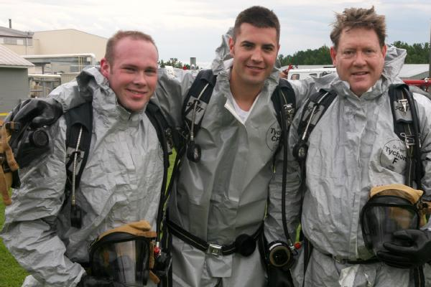
The DISASTER Paradigm™
Recovery
GROUP 1
What are the priorities for recovery from a chemical incident?
Shannon Arledge/FEMA
Notes:
The priorities that must be address for the recovery phase of a chemical incident response to begin are as follows: removal of the chemical agent, removal of all traces of contamination, restoration of essential services, and securing of critical infrastructure.
Recovery from the event will be based on the level of preparedness that existed before the event. If facilities and jurisdictions have comprehensive plans, sound training, and frequent drills, they will generally be more resilient after an event than a facility or jurisdiction that is less prepared. Removal of all traces of contamination, restoration of essential services, and securing critical infrastructure are priorities in recovery from a chemical disaster.

Slide 20
Chemical Disasters
After-Action Review
During chemical incident, proper level of personal protective equipment must be used
Contaminated or those at risk must be decontaminated thoroughly and in a timely manner
Through incident command system, resources are utilized efficiently and information gathered to make critical decisions such as when to evacuate area
Notes:
During chemical incident, proper level of personal protective equipment must be used.
Contaminated or those at risk must be decontaminated thoroughly and in a timely manner.
Through incident command system, resources are utilized efficiently and information gathered to make critical decisions such as when to evacuate area.

Slide 21

Questions?

