Slide 1
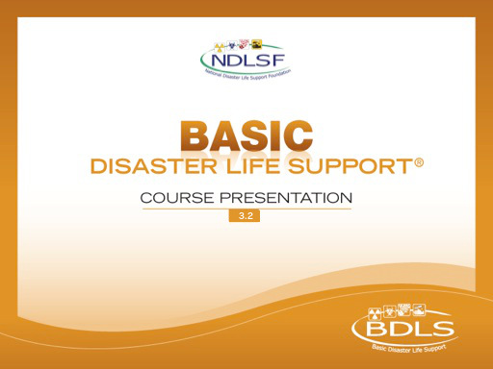
Interactive Webinar Component
Applied Learning Exercise
Natural Disasters

Slide 2
GROUP ASSIGNMENTS
GROUP 1
GROUP 2
Gregory Millwater
Candy Anderson
Anna Gardner
Kelly Smith
Vasilios Lianos
Tammy Healy
Lynn Gordner
Mark Vitale
Susan Burke
Tanja Peters
Daniel Neaverth
Heather Loftus
GROUP 3
GROUP 4
Kimberly Maguda
Keith W Collins-Allen
Shawna Rizzi
Amy Romanik
Rachael Nees
Emily Warfle
Deb Weaver
Andrew Dunnick
Dan Hedgecock
Winnie Romeril
William McGill
Andrew Parker

Slide 3
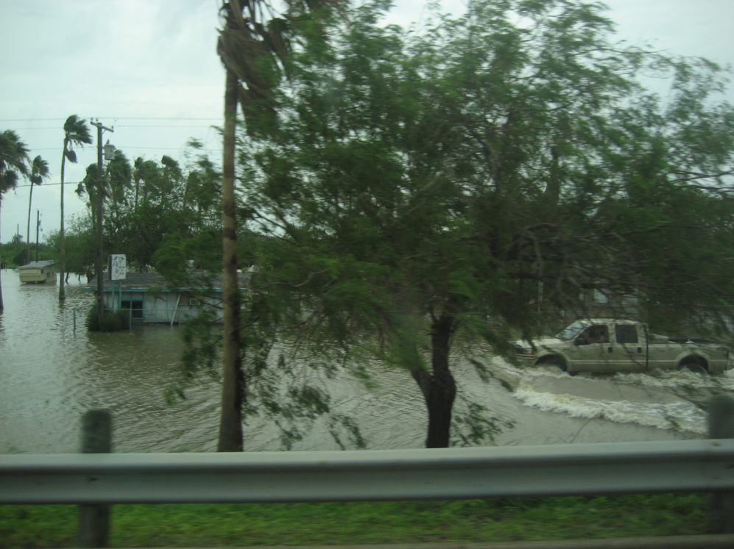
P | lanning and preparation
R | esilience
E | ducation and Training
D | etection
I | ncident Management
S | afety and Security
A | ssess Hazards
S | upport
T | riage and Treatment
E | vacuation
R | ecovery
Are my needs > resources?
Putting the PRE-DISASTER Paradigm™ into practice!
Notes:
We are about to begin a series of Applied learning exercises – to provide an example of how to apply the PRE-DISASTER Paradigm into practice.
As was explained in the first online module, lesson 1: “Disaster Basics,” the PRE-DISASTER Paradigm™ is a useful tool to both learn and organize your approach to many of the key areas and topics relevant to being prepared disaster health and medical personnel.
Clearly, having excellent health and medical skills is essential to helping meet the needs of the casualties and impacted communities after a disaster; however, it is equally important that each health and medical provider be properly skilled in the basic tenets and practices of a disaster in order to be an effective asset to the situation.
CLICK
Always be asking yourself with each step or area considered, am I in a needs > resources situation? If so, prioritize the action items and information sharing required to solve and address it.

Slide 4
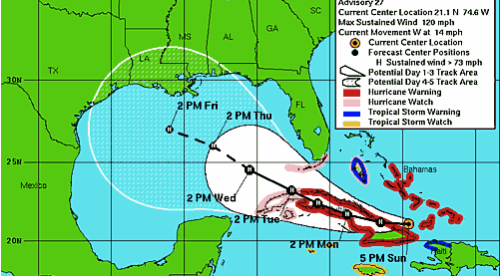
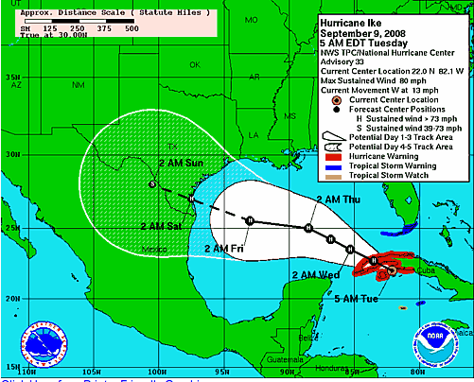
Natural Disasters Scenario
NWS (NOAA) update on approaching hurricane over the last 48 hours
Notes:
SCENARIO (modeled after Hurricane Ike – 2008)
You live in Galveston Island, Texas. The Date is September 9.
For the past 48 hours, the National Hurricane Center, a division of the National Weather Service (NWS), has been reporting on an approaching hurricane
The Hurricane was noted early to be an unusually large storm, with early forecast of a category 4 hurricane on the Saffir-Simpson hurricane scale. The left image is showing the early path. The right image shows the update 2 days later
Landfall is anticipated for September 12-13. The September 9 image would have predicted landfall to occur along the lower third of the Texas coast in the area near Corpus Christi, Texas.

Slide 5
PRE-DISASTER Paradigm™
Planning and Practice
GROUP 1
Would your current plan provide you with clear instructions and action steps?
Have you practiced drills and exercises implementing such instructions and action steps?
What about your personal and family plan?
Notes:
Do your community and workplace have disaster plans?
Do you have a personal and family plan?
Are these plans practiced and evaluated regularly?
Various methods exist for planning and conducting useful disaster training exercises. To be useful, they do not have to be full-scale, field-based exercises. Useful exercises require that the “right” people be invited to participate, that clear objectives be established and tied to local threats and concerns, and that a practical approach be used to enable the group to learn and improve disaster plans and skills.
Not all natural disasters can be predicted, but certain measures can be addressed now to mitigate the ill effects of most events. Participation in drills and exercises and understanding local and professional response plans will help maintain order in potentially chaotic situations. Medical facilities, public health departments, civic organizations, and humanitarian agencies can also organize memoranda of understanding for personnel and resource sharing.

Slide 6
PRE-DISASTER Paradigm™
Resilience
GROUP 1
What could have been done to foster resilience prior to this storm?
Ability of individuals and communities to adapt and overcome adversity due to disaster
Notes:
Resilience involves behaviors, thoughts, and actions that can be learned and developed in anyone.
Resilience also refers to plans that return the infrastructure of a community back to normal as soon as possible after an event.
Resilience can be enhanced through mitigation efforts to eliminate or reduce the probability of disaster occurrence or reduce the effects of unavoidable events.
Cohesive, healthy communities will likely be more resilient in times of disaster. Increasing situational awareness and general all-hazards preparedness is paramount to increasing community resilience. At the legislative level, policies and procedures can be put in place to expedite political decision making in times of disaster or public health emergency. Considerations for improved infrastructure and land use planning can also be addressed.

Slide 7
PRE-DISASTER Paradigm™
Education and Training
GROUP 1
Are health and medical providers in your area ready to manage such an approaching disaster?
What “just-in-time” educational and training actions could be considered?
Notes:
Health professionals, regardless of specialty or area of expertise, should have a basic understanding of all-hazards disaster casualty management and how their various roles are integrated with other segments of the disaster response system. This includes the ability to recognize general features of disasters and public health emergencies; how to report a potential emergency; and where to get more information should the need arise. Health professionals also should know the ethical and legal structures that govern response to serious mass casualty incidents, while maintaining the highest possible standards of care under extreme conditions. This encompasses their rights and responsibilities to protect themselves and treat others.
Education and training can be acquired at all levels to improve outcomes. The general population can be trained in all-hazards preparedness and disaster-specific techniques. They can additionally be trained in first response and cardiopulmonary resuscitation. Responders can be further trained, and a volunteer base can be established.

Slide 8
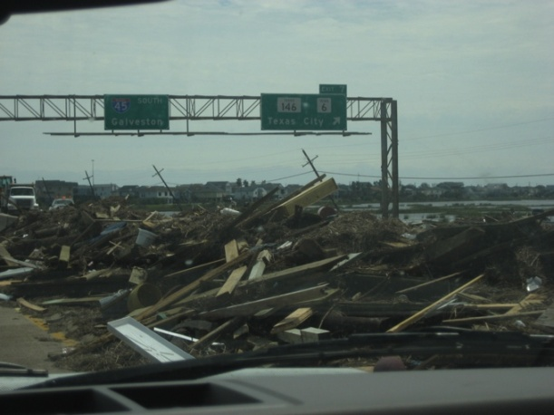
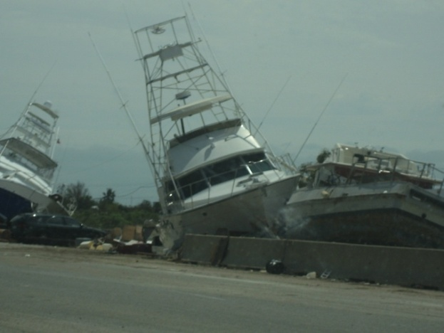
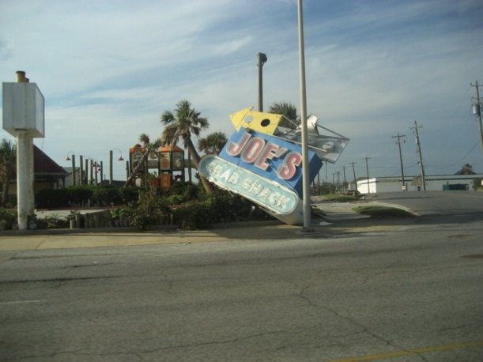
Natural Disaster Scenario
UPDATE
SITREP, 0208 Hours, September 13, 2008:
Landfall Hurricane Ike, Galveston Island, Texas
Category 2 with winds of 110 mph
Hurricane-force winds exceeding 120 miles wide
Tropical-force winds exceeding 275 miles wide
Ray E. Swienton, MD
Notes:
Scenario update:
SITREP, 0208 Hours, September 13, 2008:
Landfall Hurricane Ike, Galveston Island, Texas
Category 2 with winds of 110 mph
Hurricane-force winds exceeding 120 miles wide
Tropical-force winds exceeding 275 miles wide
You note coastal devastation of marine vessels, businesses, and debris-filled roadways

Slide 9
The DISASTER Paradigm™
Detection
GROUP 2
How would you gain early situational awareness immediately following landfall?
  Is a disaster present?
  What has happened?
  What is needed now?
  Who should I call?
Notes:
Detection:
How would you gain early situational awareness immediately following landfall? The questions listed are those that we identified in the first lesson presentation today. These will focus your attention on early situational awareness:
Is a disaster present?
What has happened?
What is needed now?
Who should I call?
Maintaining situational awareness via timely, credible, and reliable information is essential before, during, and after a disaster strikes. This includes up-to-date guidelines, recommendations, health alerts, and modern, standards-based information systems that monitor data on injuries and diseases and enable efficient communication among public and private health organizations, the media, and the public.
Close monitoring of weather and seismologic activity can help to provide extra warning time before a major disaster—time that is potentially lifesaving. However, not all localities are equipped with early warning systems; efforts should be made to provide disaster-vulnerable areas with the appropriate means of surveillance and warning. The citizenry should also have a base-level awareness of indicators of disaster and the knowledge of where to report such information.

Slide 10
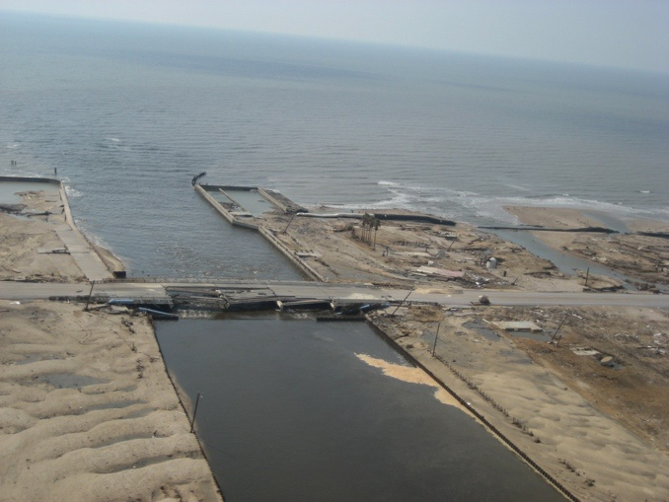
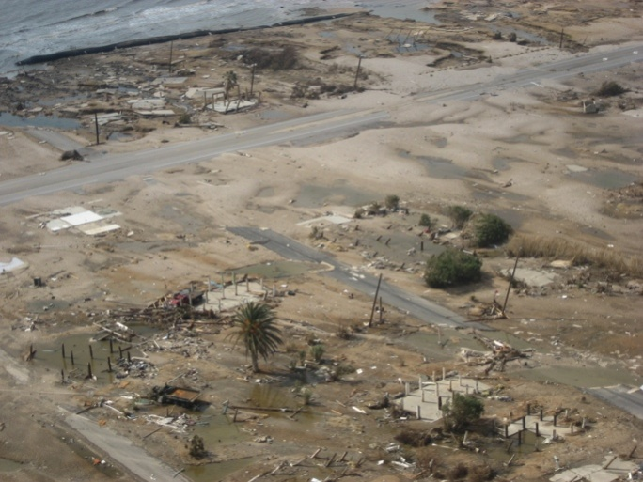
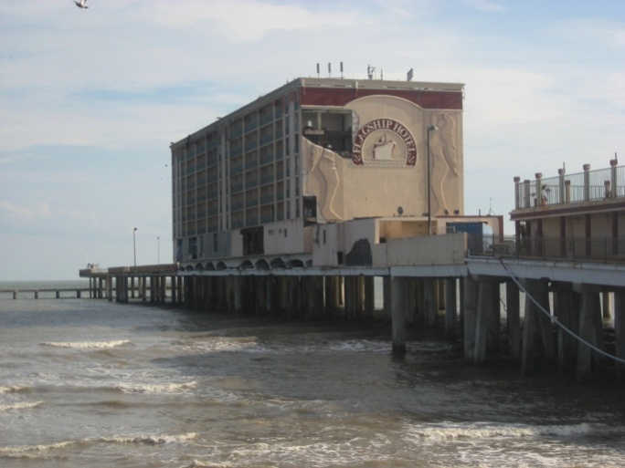
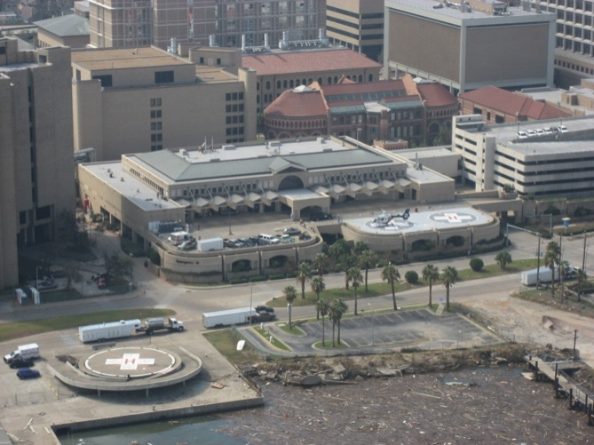
Natural Disasters Scenario
UPDATE
Ray E. Swienton, MD
Early Situational Awareness
Notes:
Focus on early situational awareness now reveals impact on Galveston Island
Roadways and bridges were severely damaged, causing access delays
Coastal areas were completely devastated and leveled to the ground
Remaining buildings (such as this hotel located on a pier) were heavily damaged
The University of Texas Medical Branch (UTMB) was heavily flooded and severely damaged

Slide 11
The DISASTER Paradigm™
Incident Management
GROUP 2
Do you understand NIMS areas that impact health and medical role?
  What is your role within the ICS structure?
What are emergency support functions (ESFs) and which involve health/medical and population sheltering?
Notes:
Incident management:
All roles will impact health in different ways, key medical provider roles are in operations under incident command. The students should be able to discuss their role at their home institution even if it is simply a responder who follows commands.
What are emergency support functions (ESFs) and which involve health/medical and population sheltering?
Emergency support function (ESF) annexes are the organizational structure for coordinating federal interagency support. ESFs provide a means for the incident command system (ICS) to align resources and stakeholders and coordinate them across federal, state, and related agencies. There are 15 ESF annexes, and the following is a summary of those more commonly impacting casualty care management:
ESF-5 – Emergency Management: Coordination of incident management and response efforts; issuance of mission assignments; resource and human capital; incident action planning; and financial management
ESF-6 – Mass Care, Emergency Assistance, Housing, and Human Services: Mass care, emergency assistance, disaster housing, and human services
ESF-7 – Logistics Management and Resource Support: Comprehensive, national incident logistics planning, management, and sustainment capability; resource support (facility space, office equipment and supplies, contracting services, etc)
ESF-8 – Public Health and Medical Services: Public health; medical and mental health services; and mass fatality management

Slide 12
Natural Disaster Scenario
UPDATE
ESF-6: Mass Care, Emergency Assistance, Temporary Housing and Human Services
  Recognizes a lack of medical provider coverage to comply with FNSS guidelines at temporary housing shelter operations, ICS-213 generated
ESF-8: Public Health and Medical Services
  MACC liaison briefs ESF-8 “desk” on the ICS-213 stated needs and asks the LMOC to “fill” this request
Notes:
ESF-6: Recognizes a lack of medical provider coverage to comply with FNSS guidelines at temporary housing shelter operations, ICS-213 generated
ESF-8: MACC liaison briefs ESF-8 “desk” on 213 stated needs and requests LMOC to “fill”
A mass care (ESF-6) chief was notified by the American Red Cross that a shelter had been established and was seeking medical providers to assist in managing patient-casualties that had been amassed in a facility of opportunity distant from the directly impacted area. The mass care chief issued an official message (ICS form 213). The ICS 213 General Message Form is a written communication document commonly used by all areas of emergency response. The value is that it is used to communicate real-time, ongoing events and resource needs. This form can be obtained at the FEMA ICS Resource Center website: http://training.fema.gov/EMIWeb/IS/ICSResource/ICSResCntr_Forms.htm. The ICS-213 for this issue was then transmitted to the Multi-Agency Coordination Center (MACC), which, on reviewing the issue, sent a liaison to “brief’ (discuss) this issue with the ESF-8 “desk” (section) as they are responsible for medical, public health, and related resource management. The ESF-8 decision is to have the Local Medical Operations Center (LMOC) fulfill this resource need to provide proper medical providers and services to meet the medical needs of the casualties at this identified location.

Slide 13
The DISASTER Paradigm™
Safety and Security
GROUP 2
What likely human systems failures should you be concerned about after landfall?
What safety and security concerns do you have regarding request for shelter medical support?
Notes:
Safety and security:
What likely human systems failures should you be concerned about after landfall?
What safety and security concerns do you have regarding the request for shelter medical support?
The BDLS 3.0 Course Manual contains a table of additional “discussion points” in each chapter, which are provided here for ease of use:
Chapter 1. All-Hazards Disaster Casualty Management, 1.9: Discussion Points on pp 1-30 and 1-31:
Is the scene secure?
Is it safe to enter?
Safety is always the top priority—personal safety followed by that of the response team. Report any recognized or suspected hazard to appropriate authorities. Do not enter any disaster scene or take any action until authorities determine it is safe. Protecting yourself from becoming a casualty is the number 1 priority.
Chapter 10. Natural Disasters, 10.15: Discussion Points on pp 10-42 to 10-43 of BDLS 3.0 Course Manual:
Natural disasters often cause extensive damage to both human-made and natural landscape. It is important to protect oneself from both the primary effects of the hazard (ie, flying debris, flowing floodwater, or very strong winds) and the secondary effects (ie, building collapse, downed power lines, water source contamination). Responders should mark potentially dangerous sites, wear appropriate personal protective equipment (PPE), and proceed with caution into disaster sites. Securing the scene will help to prevent injury and/or illness of responders and citizens alike.

Slide 14
The DISASTER Paradigm™
Assess Hazards
GROUP 3
While providing medical support in temporary housing shelter, what hazards should you consider or may develop?
Notes:
Assess hazards
While providing medical support in a temporary housing shelter, what hazards should you be considering or may develop?
Actual and potential hazards related to a disaster must be assessed continually. Hazards will vary according to the situation encountered and the assignment given to the health responder. All disasters, regardless of the primary cause, create the possibility of secondary hazards capable of injuring anyone present at the scene, including responders.
In addition to securing the scene, it is important to do a thorough assessment of potential health and safety hazards after a disaster. Because no disaster is the same, there is no cut-and-dried hazard assessment checklist. Attention should be paid to readily apparent hazards as well as less obvious possibilities.

Slide 15
The DISASTER Paradigm™
Support
GROUP 3
When providing medical services to sheltering population, remember…
  What do I have?
  What is needed?
  Where is it?
  When will it arrive?
  What if it is unavailable?
Notes:
Support
Regarding providing medical services to a sheltering population, remember:
What do I have?
What is needed?
Where is it?
When will it arrive?
What if it is unavailable?
What outside assistance is needed (eg, police, fire, emergency medical services, government, other)?
Can adequate surge capability and capacity be established to meet local public safety and health needs and priorities?
Effective disaster management hinges on the timely delivery of resources to where they are needed most. Estimate when resources at hand will be depleted, and contact outside resources in advance giving them notice as to what your needs will be and when. Health responders should be knowledgeable about surge capacity assets in the public and private health response sectors and the extent of their potential assistance in an emergency.
Both responders and citizens should be aware of the local, regional, and national support services that may be offered in an emergency or disaster setting. Trained responders and medical personnel should also be prepared to help nearby localities, ideally through a predetermined affiliation with a humanitarian group or through a mutual aid agreement.

Slide 16
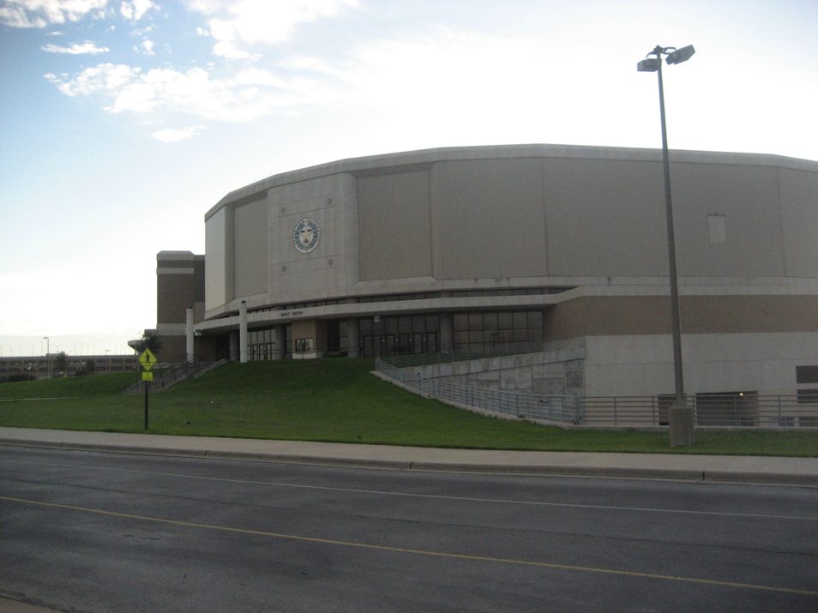
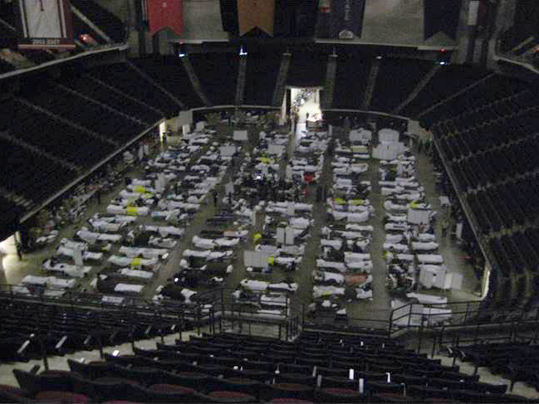
Natural Disaster Scenario
UPDATE
Arrive at shelter and medical services requested
Ray E. Swienton, MD
Notes:
Scenario update:
You arrive at the shelter where medical services have been requested. What can you tell me about this picture?
Daylight coming through distant doorways, yet all appear to be in beds, no one appears to be walking around, surrounding chair areas are empty, etc.

Slide 17
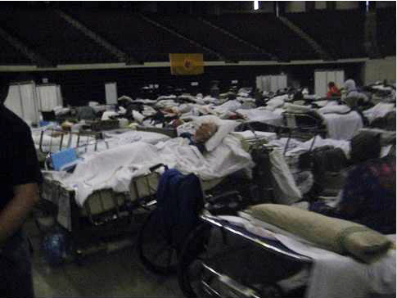
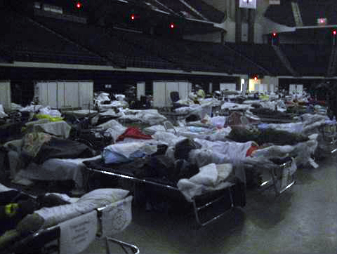
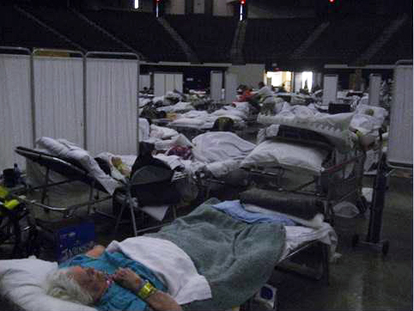
The DISASTER Paradigm™
Triage and Treatment
GROUP 3
Does this appear to be a general population of casualties?
Are you prepared and ready to provide this level of medical care?
Ray E. Swienton, MD
Notes:
Triage and treatment
Does this appear to be a general population of casualties?
This was the site of a large-scale medical sheltering operation after Hurricane Ike. More than 250 bedridden, mostly nursing home evacuees and severely functionally limited casualties amassed.
Are you prepared and readied to provide this level of medical care?
Are protocols, procedures, and resources in place for the rapid triage and immediate treatment of casualties?
What public health interventions are needed?
In a disaster, clinical responders should be prepared to apply and adapt their usual skill set and expertise to the triage and treatment of seriously injured or ill persons under crisis conditions, with limited situational awareness and resources. Triage systems will be used to guide casualty assessment and treatment at a disaster scene. Various public health actions and interventions also must be considered. The basics of risk communication and health messaging will be essential for communicating with affected individuals, their families, and the media regarding exposure risks and potential preventive measures, without contributing to public alarm, fear, and anxiety. Health responders should be familiar with clinical and mental health implications of natural and human-caused disasters and recognize that persons may have been exposed to nonconventional agents as the source of unusual presentations.
Appropriate clinical casualty management will include assessment and response to both medical and psychological casualties. Personnel should be trained with an all-hazards approach and understand appropriate use of medical and mental health assessments, applicable emergent and ongoing intervention opportunities, and the local protocols for information sharing and reporting of all casualties triaged and treated. Legal and ethical considerations for triage and treatment should also be considered.
These pictures readily show the large number and near-total care-dependent population that was residing at this medical shelter operation. Of note was that this population began to pose a significant risk of overwhelming the local emergency departments and hospitals; the local health care infrastructure was spared this surge in large part because of the placement of a DMAT Strike Team on site that was able to provide a care level beyond that of the providers assigned to this shelter.

Slide 18
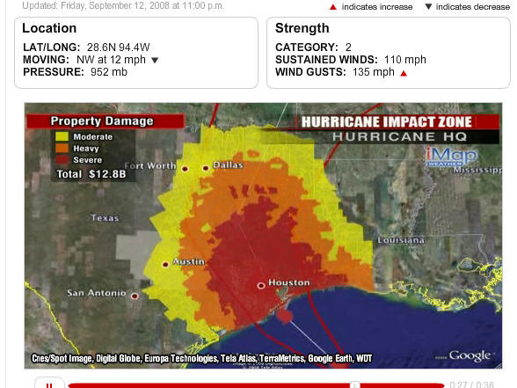
The DISASTER Paradigm™
Evacuation
GROUP 4
When would you mobilize evacuation resources and issue orders?
High risk of causing human systems failure disasters
Notes:
Evacuation:
When would you mobilize evacuation resources and issue orders?
The evacuation process is often a dangerous undertaking. The risk of causing a human systems failure disaster is high. Moving casualties, transportation accidents, changing health status during prolonged evacuations, etc. are possible during evacuations.
Are enough transport units en route to the scene?
Should affected persons evacuate or shelter in place?
Getting all potential survivors out of the scene as soon as possible during a disaster is usually the short-term goal. This may be challenging if the scene is deemed unsafe because of the presence of immediately life-threatening conditions.
Some natural disasters will necessitate evacuation, while others will require specific shelter-in-place methods. It will also be important to consider the impact of the natural disaster on existing health care infrastructure, as migration of the affected population will influence surge capacity management and continuity of operations in local and neighboring health care facilities.
The images demonstrate the challenges in predicting accurate Hurricane path and landfall timing/location. The image from September 9 (top image) predicted a path with landfall on the lower third of the Texas coast, while the September 12 modeling image (bottom image) predicted the now impending Houston/Galveston, Texas landfall to occur on September 13, 2008, making timely and accurate evacuation of affected persons a challenge

Slide 19
The DISASTER Paradigm™
Recovery
GROUP 4
What can you do to assist with recovery?
  Relief
  Rehabilitation
  Restoration
Priority to restore health and medical infrastructure of impacted community
Notes:
Recovery:
What can you do to assist in the recovery?
Relief
Rehabilitation
Restoration
A priority is to restore the health and medical infrastructure of the impacted community
The BDLS 3.0 Course Manual contains a table of additional “discussion points” in each chapter, which are provided here for ease of use:
Chapter 1. All-Hazards Disaster Casualty Management, 1.9: Discussion Points on pp 1-30 and 1-31:
What are the long-term mental and physical challenges facing the community?
What are the financial and economic repercussions of the disaster?
Recovery is the longest phase of disasters. Recovery includes monitoring communities and first responder health weeks, months, and years after a disaster. Physical, psychological, social, and economic stress can prevent individuals and communities from recovering in a timely way. Effective preparation and planning can help build the resilience necessary for individuals and communities to withstand and recover from disasters and other tragic events.
Chapter 10. Natural Disasters, 10.15: Discussion Points on pp 10-42 to 10-43 of BDLS 3.0 Course Manual:
Physical, psychological, social, and familial effects can last long after the disaster has passed and homes, buildings, and other infrastructure have been restored. Knowing what resources are available, understanding evacuation routes and response plans, and creating professional and personal plans will help expedite the recovery process.

Slide 20
Natural Disasters
After-Action Review
OUTCOMES
US Deaths > 100; more than 20 still missing
Damage $29.6 B (3rd most expensive in US history)
Largest search and rescue operation in US history
Storm surge 10-20 ft in and around Galveston, Texas
Hurricane Ike caused 29 tornadoes across the US
3900 buildings destroyed on just the Bolivar Peninsula
Impact on local health and medical providers (UTMB)
Notes:
Immediately after Hurricane Ike, significant flooding occurred at the University of Texas Medical Branch (UTMB), leading to water damage and subsequent mold damage. An initial 2400 employees were laid off work, all of the medical students were transferred to other Texas medical schools, residencies were disrupted, and some were closed (UTMB Emergency Medicine residency was closed after Hurricane Ike). An estimated 3800 UTMB employees were terminated around November 2008 after an estimated 30% reduction in overall work force. It was not until August 2009 that the UTMB emergency department reopened for patient access.

Slide 21


Questions?

