Slide 1
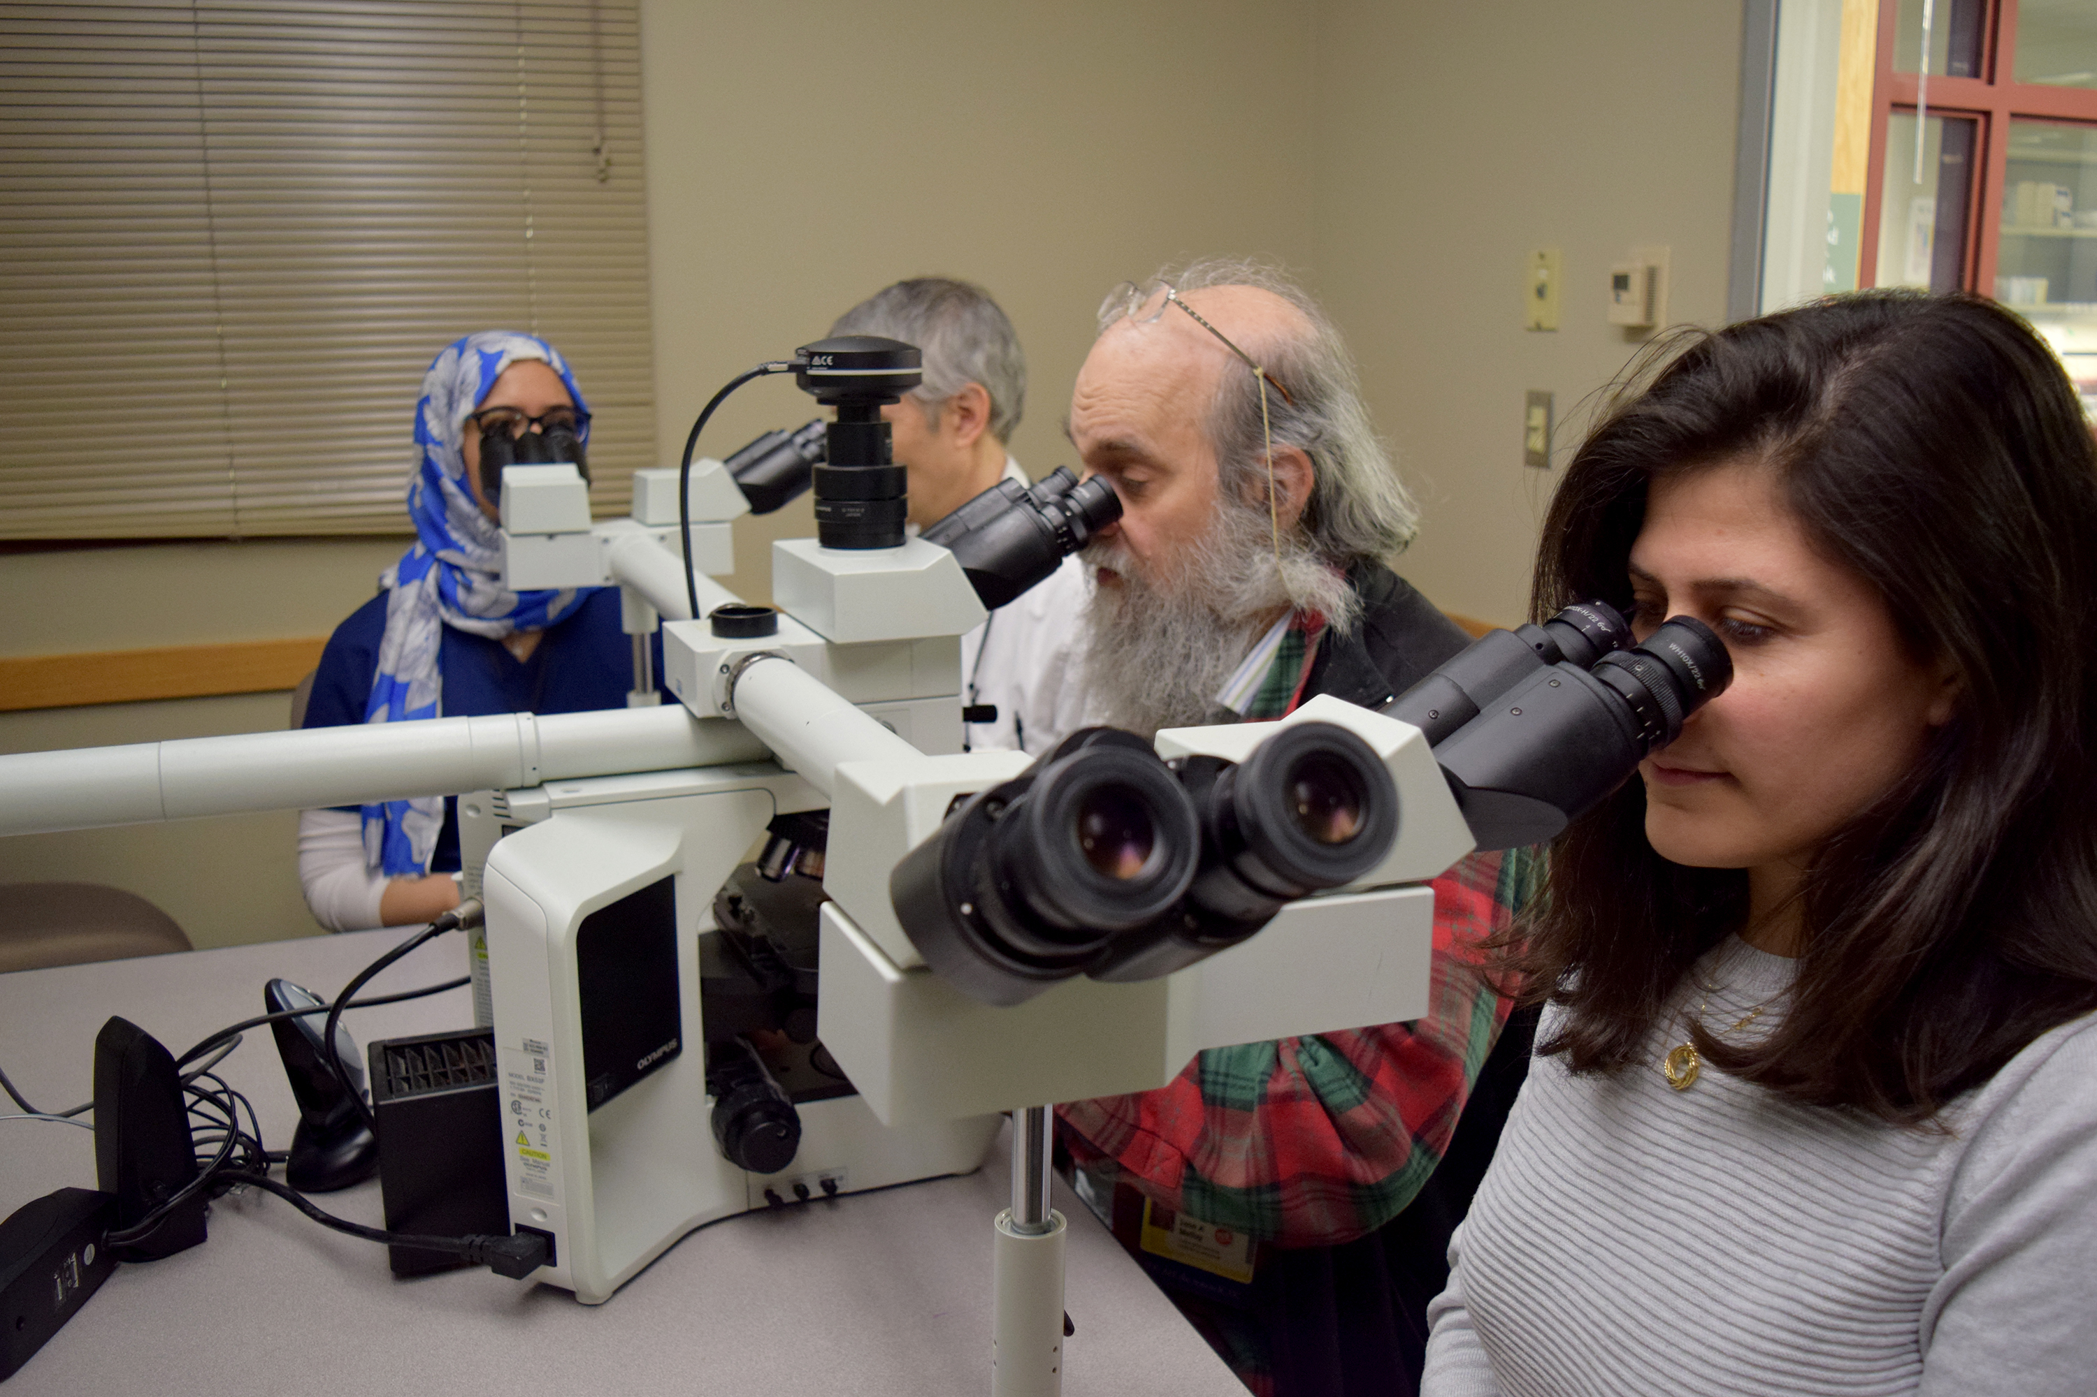
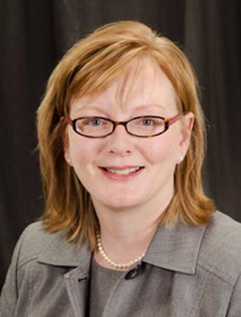
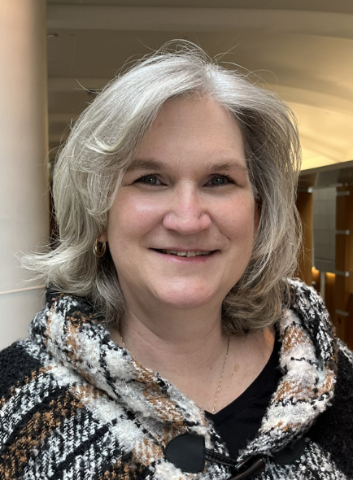
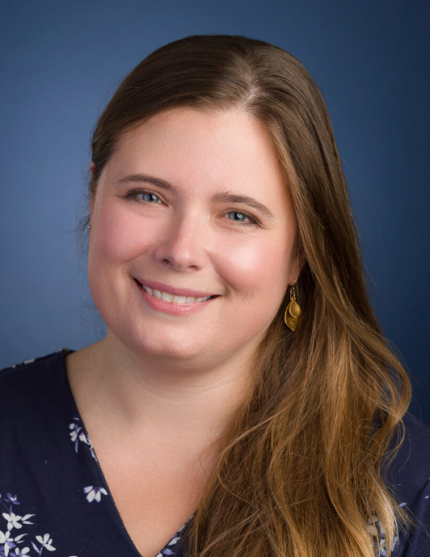
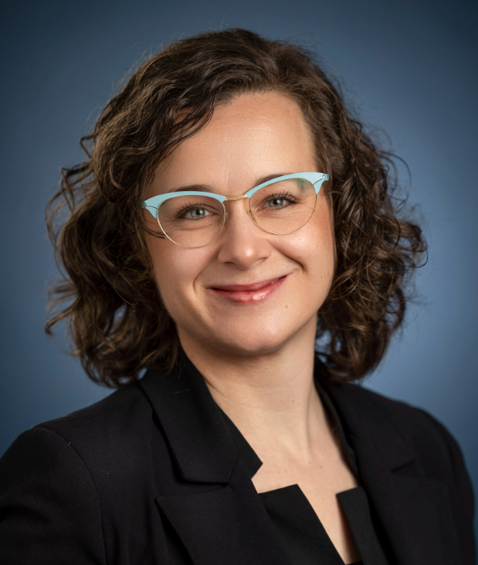
OPEN HOUSE Pathology Residency Program
Two dates to choose from:
September 16, 2024 6:00 p.m. ET
REGISTER HERE
October 7, 2024 6:00 p.m. ET
What would
YOU
Like to know?
Get the chance to ask
questions during session
REGISTER HERE
CONTENT:
Program Highlights
Meet our Program
Leadership
Meet a few of our
Residents
LEARN ABOUT:
Curriculum
Research Opportunities
Living in Rochester
Wellness Programs
Resident Life
Christa Whitney-Miller, MD
Endowed Chair, Pathology
Frieda Robscheit-Robbins Professor
Pathology & Laboratory Medicine
Linda Schiffhauer, MD
Program Director
Residency Program
Jennifer Findeis-Hosey, MD
Vice Chair of Education
Interim, Surgical Pathology Director
Pathology & Laboratory Medicine
Helena McMurray, PhD
PhD Program Director
Pathology & Laboratory Medicine
Anna-Karoline Israel, MD
Assistant Professor
Notes:
This slide has the Slide Design template “content” applied.
The first level bullet has been set up with a “null” character to make it appear unbulleted and still allow automatic bullets for subsequent levels. The second through fifth levels have bullets: from the left margin, tab once (or click the “increase indent” button) and the second level bullet will appear; further tabbing increases the indent and produces the corresponding bullet.

