Slide 1
Healthy Communities Reducing Health Disparities for People with Intellectual Disability
October 2, 2013

Slide 2
Special Olympics
Eunice Kennedy Shriver
First Special Olympics Games - July 20, 1968 – Chicago
More than 4 Million Athletes in over 170 countries
http://www.youtube.com/watch?v=fjwaV0awGTI

Slide 3
Health Programs at SONY
Special Olympics New York is working to strengthen the training and competitive experience of each Special Olympics athlete by promoting inclusive and healthy communities that create an environment of dignity and support the athlete’s health, fitness and quality of life.

Slide 4
Healthy Athletes
Fit Feet
FUNfitness
Health Promotion
Healthy Hearing
MedFest
Opening Eyes
Special Smiles

Slide 5
Profound Health Disparities Findings from SONY Healthy Athletes Screenings 2007-2012
HEALTH PROBLEM | PERCENT (%)
Need Urgent Dental Care | 7%
Untreated Tooth Decay | 22%
Failed Hearing Tests | 34%
Needed New Rx for Eye Glasses | 44%
Overweight or Obese (Adult) | 82%
5

Slide 6
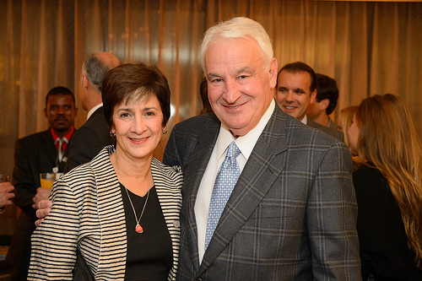
Partnership
Golisano Foundation
one of the largest private foundations in the nation devoted exclusively to supporting programs for people with intellectual disabilities
Partner with SO
$12 Million

Slide 7
Healthy Communities Vision
http://www.youtube.com/watch?v=qfcKPpalUKM

Slide 8
Healthy Communities Vision
Communities where Special Olympics athletes and others with ID:
Have the same access to health and wellness resources
Can attain the same level of good health as all community members
Where there is no “wrong door” for someone with ID to walk through.

Slide 9
Healthy Communities Approach
Through partnership, provide more health services for athletes, including care.
Weave expanded health services throughout all Special Olympics programming.
Leverage technology to enhance impact.
Build awareness.

Slide 10
New York’s
Healthy Communities Initiative

Slide 11
NY Healthy Communities
Oral Health
Physical Activity & Nutrition
Technology
Sustainability

Slide 12
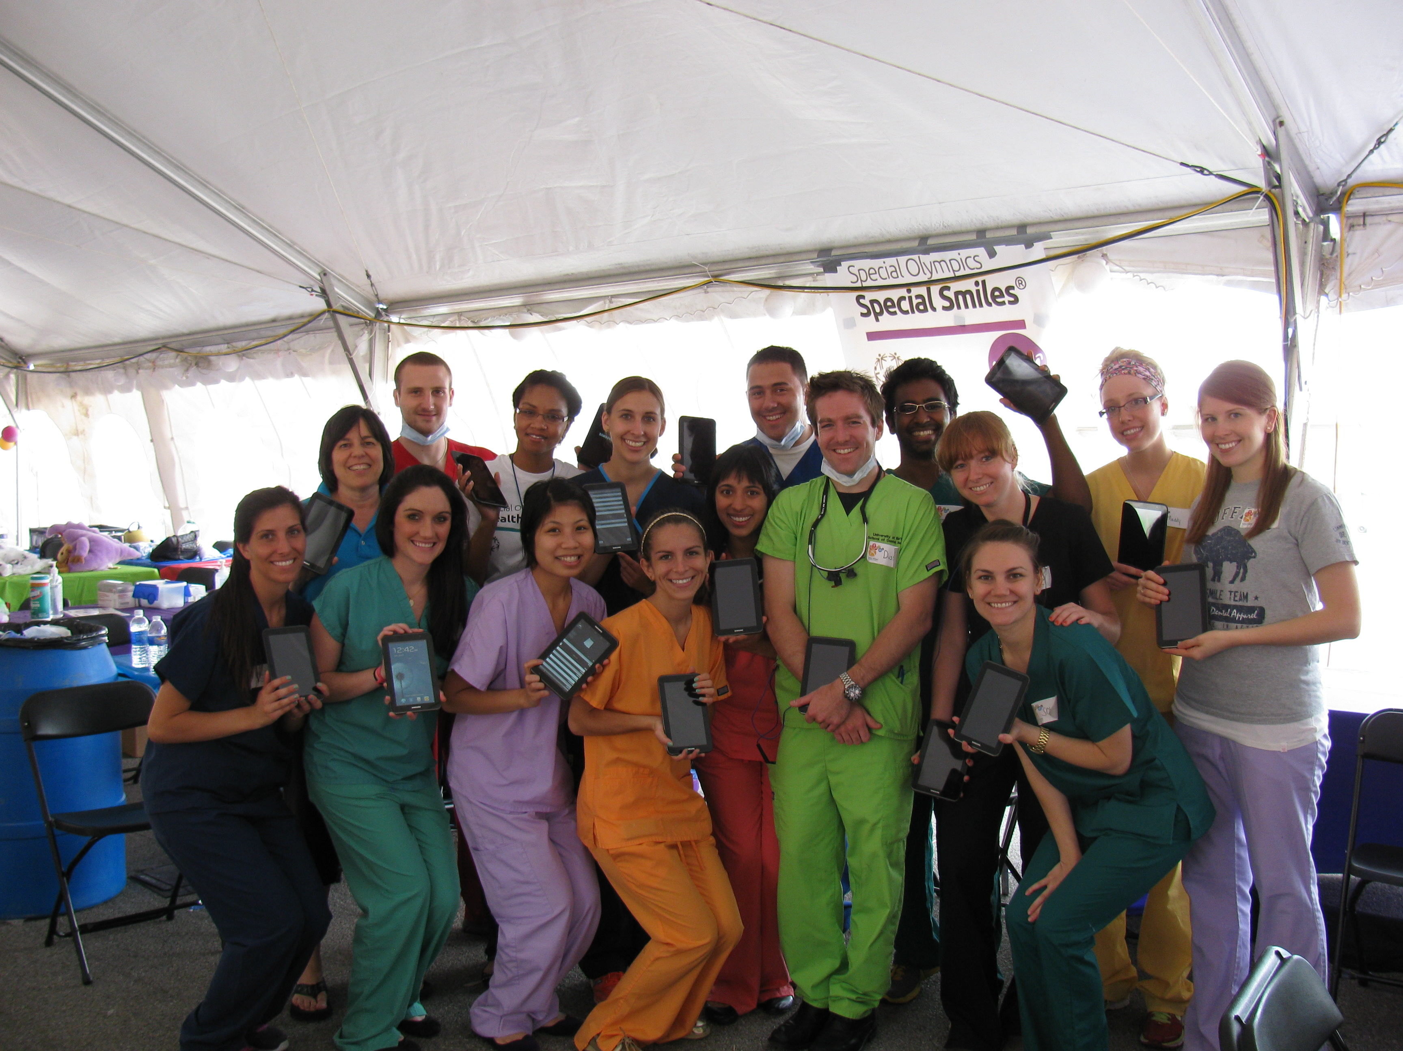
NY Healthy Communities
Oral Health
Increased referral sites – RochesterHealth.com
Electronic Records
SMS Text Messaging
Follow Up
Oral Hygiene

Slide 13
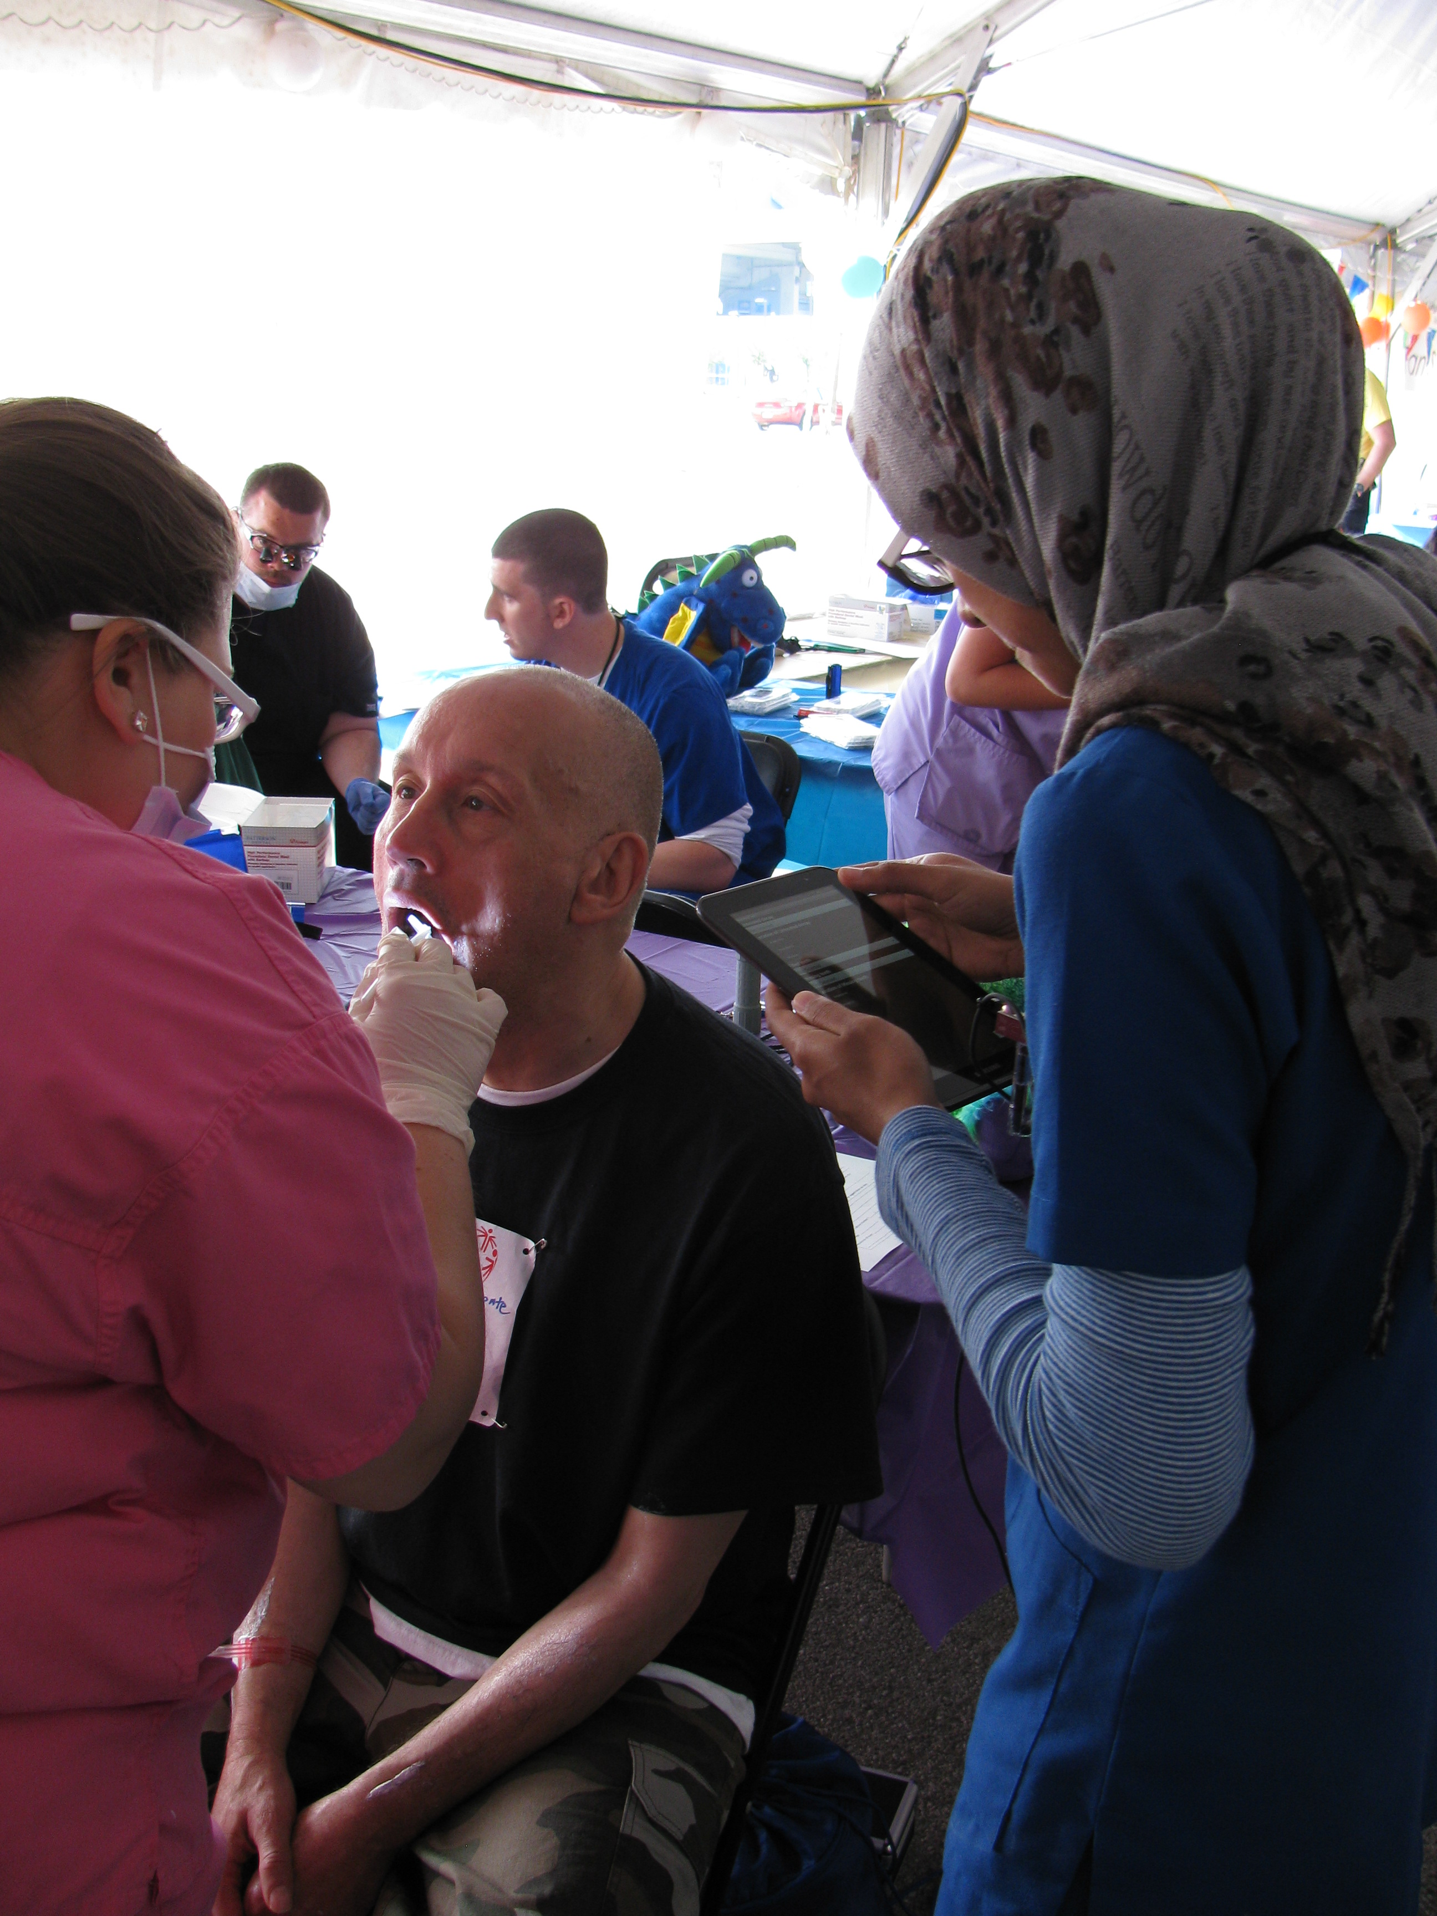
NY Healthy Communities
Oral Health
New curricula in dental professionals’ training programs
Eastman Institute for Oral Health
Monroe Community College
University at Buffalo
School of Dental Medicine
Training for practicing dental
providers

Slide 14
Special Olympics and Monroe Community College
Strengthen Curriculum
Dental Hygiene Program
Dental Assisting Program
Continuing Education
A focus on treating patients with IDD
Special Smiles
Volunteer Opportunities for Students
Leadership Opportunities for Professors

Slide 15
Oral Health Pilot Program
Based on recommendations from Eastman Oral Health Taskforce:
Dental Hygienists in Group Home Settings
Deliver preventative Care
Screen for Oral Cancer
Provide Oral Hygiene Instruction (Residents, Staff & Family Members)
Dental Care Coordinator
Make Appointments for Treatment
Schedule general anesthesia services
Ensure group home residents have a Dental Home

Slide 16
Questions? Thank You!
Onolee Stephan, MPH
585-586-7400 x 104
Ostephan@specialolympics.org

