Slide 1

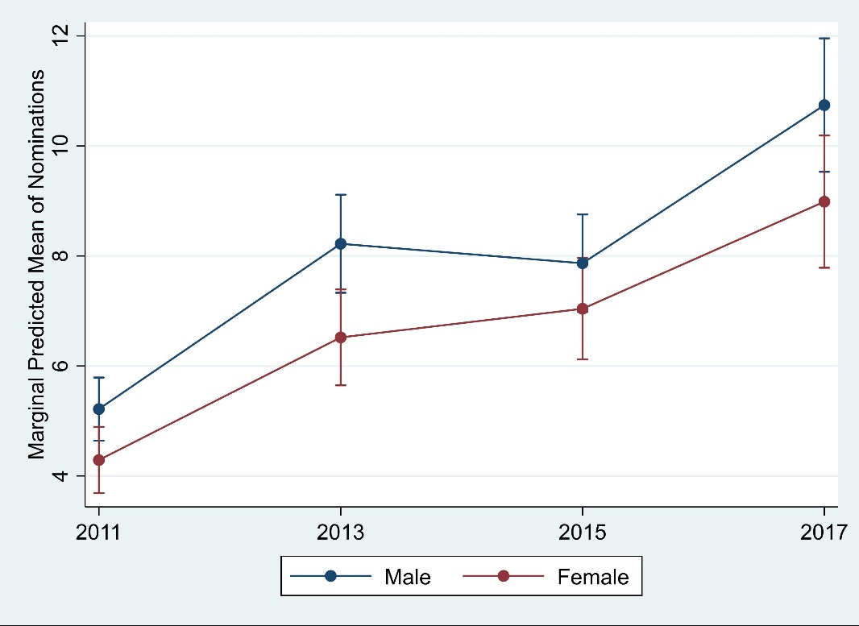
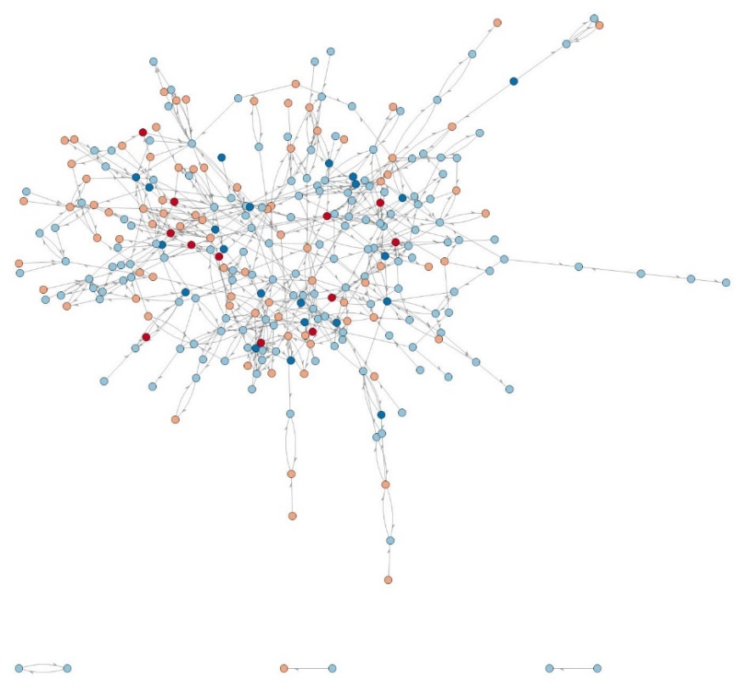
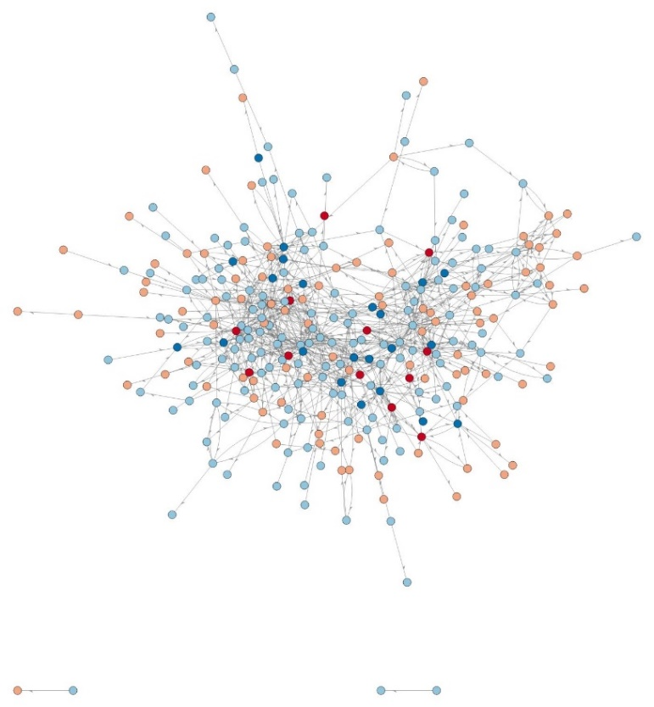
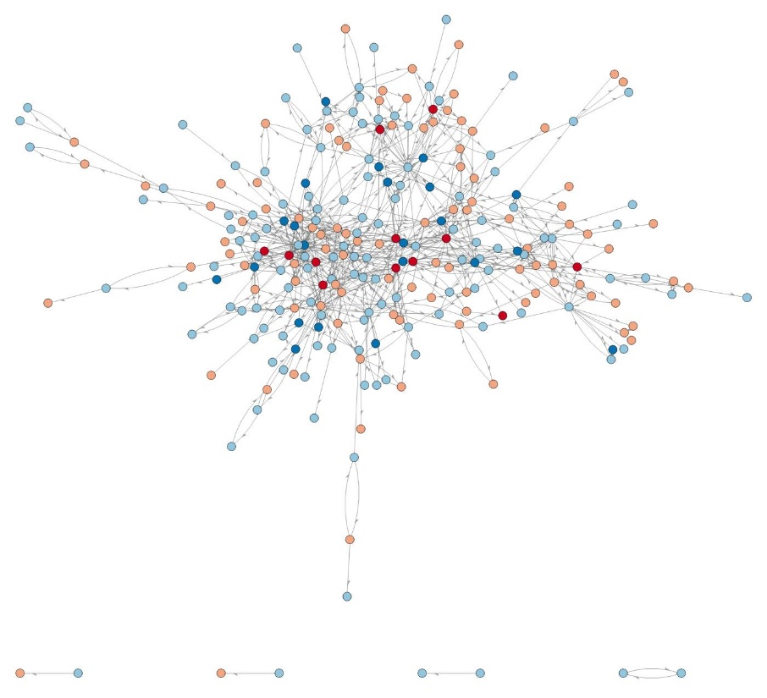
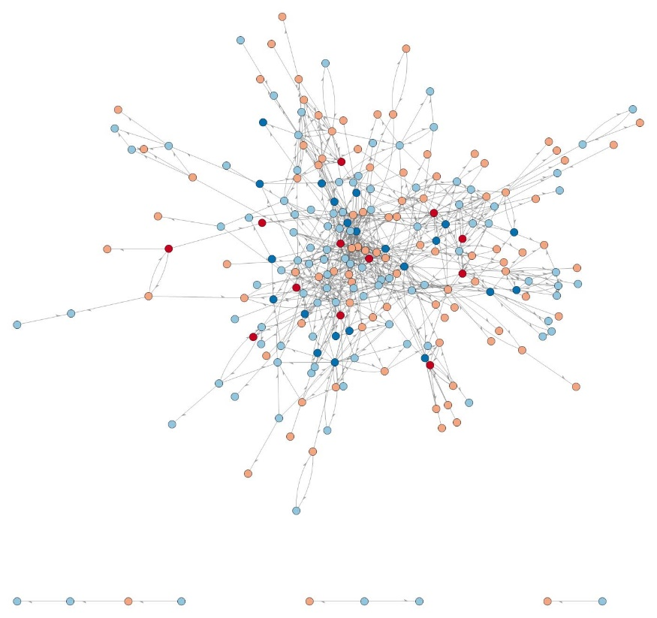
Longitudinal Analysis of Research Collaborations and Emerging Networks
Ann M. Dozier, RN, PhD, FAAN¹, Elizabeth Wayman MS¹, Camille Anne Martina, MS, PhD¹, Nicole O’Dell, MS², Eric P. Rubinstein, JD, MPH, MBA¹, Thomas T Fogg³
¹Clinical and Translational Sciences Institute, University of Rochester Medical Center
²Yale University ³Yale School of Medicine
Objectives
Marginal Means of Nominations per Year by Gender
Ratio of nominations doubled (2011 to 2017. Respondents named more collaborators in 2017.
Networks of Respondents for Each Year
2011
2013
2015
2017
To longitudinally track emerging research collaborations and assess their development and productivity.
Background
Collaborations essential for successful research across the translational continuum; supporting networks is a priority for translational science and aligns with the emerging science of Team Science.
Unlike bibliometric analyses, this approach prospectively identifies emerging research networks that may not have yet produced (e.g. grant, publication). This information can inform initiatives to support/strengthen these new networks (e.g. resources, mentorship).
Network development over time provides information about how research networks evolve or not. Linking with their associated products network data can assess key characteristics for success and impact of institutional initiatives.
Analyzing these networks by investigator characteristics (e.g. gender) also provides information on patterns that may uncover institutional weaknesses or biases.
Females and males had similar trends over the time period.
Females nominated fewer collaborators compared to males.
Density: 0.0078
Reciprocity: 0.356
Global Clustering Coefficient: 0.092
Density: 0.0112
Reciprocity: 0.415
Global Clustering Coefficient: 0.119
Density: 0.0107
Reciprocity: 0.413
Global Clustering Coefficient: 0.116
Density: 0.0136
Reciprocity: 0.424
Global Clustering Coefficient: 0.158
Females who responded all 4 years n=12
Males who responded all 4 years n=22
Females who responded in given year
Males who responded in given year
Method
Results
Discussion and Limitations
Four survey administrations (2011, 2013, 2015, 2017)
All full- and part-time University of Rochester Medical Center faculty invited by email to complete survey.
Respondents indicated:
  whether they were involved in research,
  if involved in research, identified collaborators from a drop-down list of investigators in the institution. Space was provided for write-ins.
Also associated with each investigator: Full- and part-time status, faculty rank, and departmental affiliation.
Grant data were the institution’s Office of Research and Project Administration. Grant data included all submissions (funded and not funded), award number, award effective data, award final expiration date, funding amounts, principal investigator and co-investigators.
Multilevel generalized linear model to predict incidence of nominations based on gender and year, with respondent IDs as random effects variable, and Poisson as the link function.
1800 (range 1730-2034) full- and part-time faculty received email invitations on average.
NOTE: Survey distribution included a large number of individuals whose role is exclusively clinical
403 respondents (range 385-441) each administration on average.
257 (range 233 to 280) respondents named research collaborators on average.
1988 (range 1594 to 2265) collaborations named each year on average.
This methodology captured a consistent number of collaborations over an 8-year period.
Analyses reveal increasing network density over time.
Analyzing research networks over time provides an important metric to assess how research networks evolve and devolve and the characteristics of those that grow or stagnate.
Analyses can demonstrate the impact of support provided to networks or teams by the CTSI, department or other institutional mechanism.
Limitations
Only included collaborations from within the Medical Center.
Not all networks may have been identified.
Who was eligible to respond (resigned, new appointees) and who responded each year varied
Unclear the proportion of individuals involved in research who responded.
Did not require that both collaborators endorsed the collaboration
Definitions
Multilevel generalized linear model: addresses the dependence of several responses from the same person over the years.
Global Clustering Coefficient: proportion of all connected triplets in the network. Measures the tendency to form tightly knit groups. 1 indicates high clustering.
Reciprocity, for a directed graph: proportion of bidirectional relations, (double lines with arrows in both directions).
Density: proportion of relations out of all possible relations. 1 indicates a fully connected network.
Next Steps
Analyze network productivity using linked grant data.
Identify dissolved networks to determine contributing factors
Contact: Ann M. Dozier, RN, PhD, FAAN
ann_dozier​@​urmc.rochester.edu, 585​-​276​-​3998
The authors gratefully acknowledge the assistance of Reza Yousefi-Nooraie, M.Sc., Ph.D. for data analysis.
The project described in this publication was supported by the University of Rochester CTSA awards number UL1 TR002001 and TR000042 from the National Center for Advancing Translational Sciences of the National Institutes of Health.

